Slide 1
Smart Grid Technology:
Safe Practices & Security Analysis
Presented by: Jack Rogerson
Clark University

Slide 2
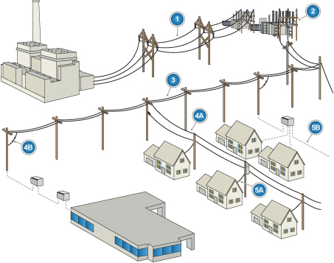

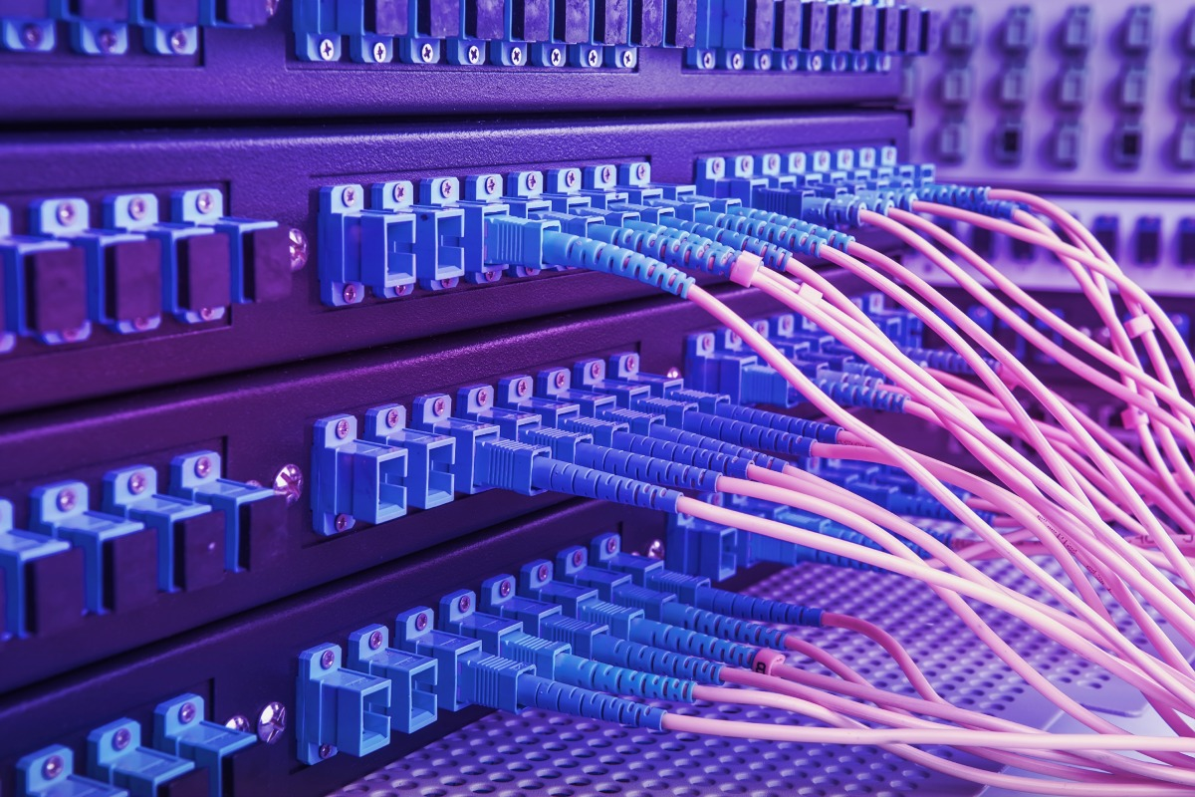
What is A Smart Gird?
“
A Smart Grid is an electrical grid which includes a variety of operation and energy measures including advanced metering infrastructure, smart distribution boards and circuit breakers, renewable energy resources, energy efficient resources, and sufficient utility grade broadband to connection and monitor the system.
”

Slide 3
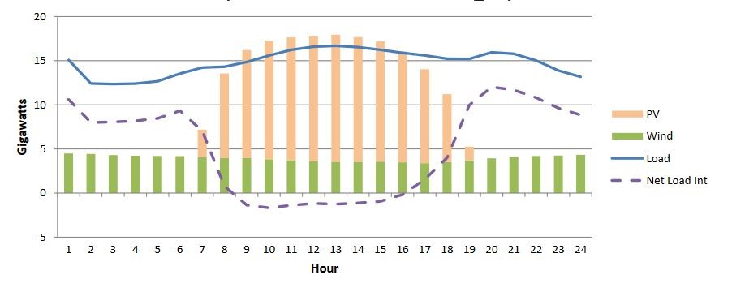
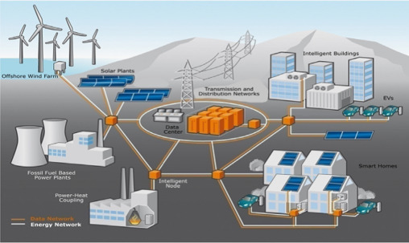
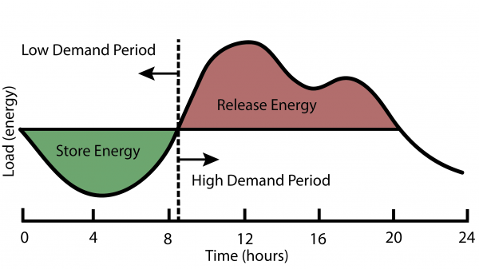
How is the Gird Evolving?

Slide 4
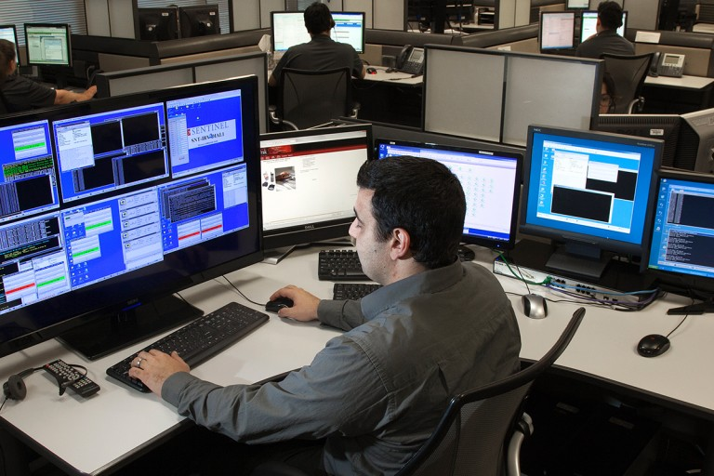
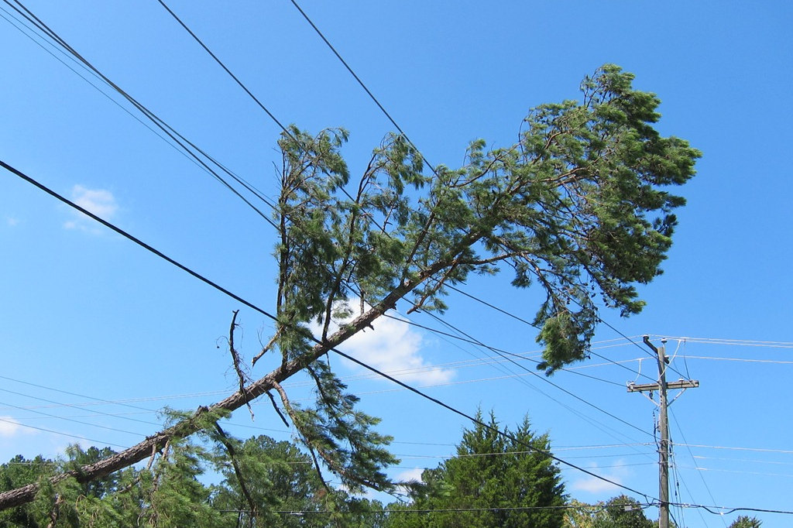
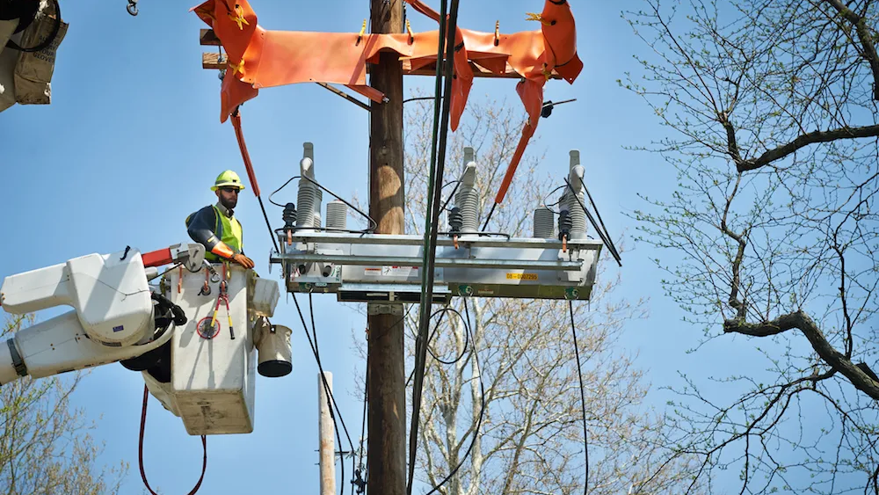
How does the Smart Grid Help?
Physical Faults:
Optimizations:
Increased Uptime
Dynamic Rerouting Around faults
Remote Access/Control
More Granular
AI/Machine Learning
System Wide Decisions
More Prediction Data
Distributed Generation
Data:
Many New Metrics
Real Time Data
Common Failure Points
Distributed Energy Consumption, Renewable Energy

Slide 5
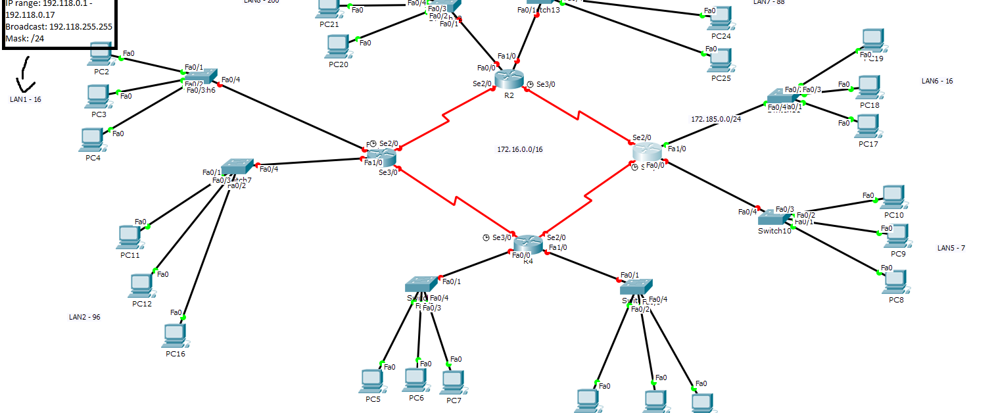
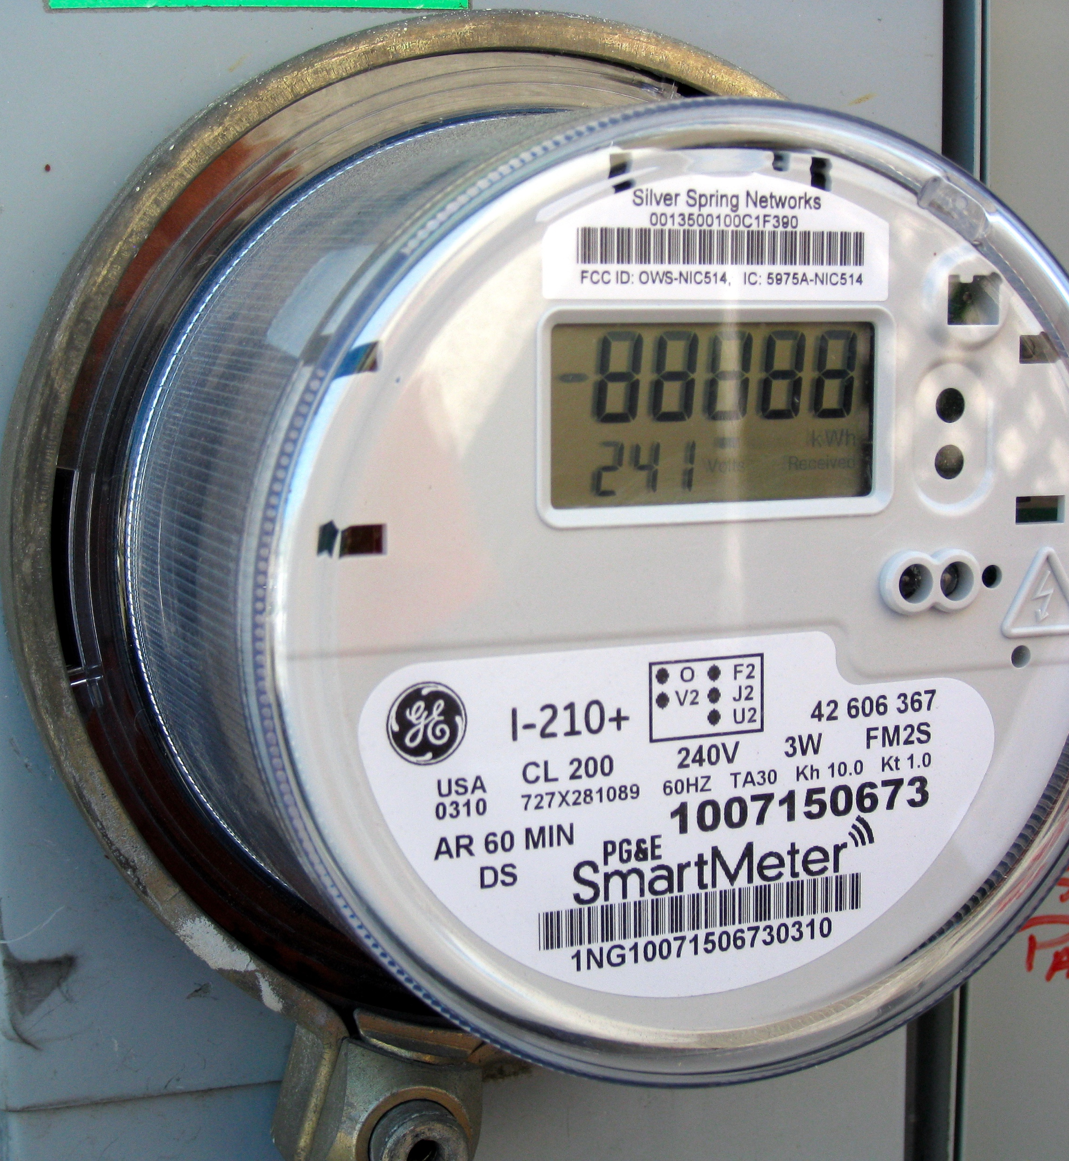

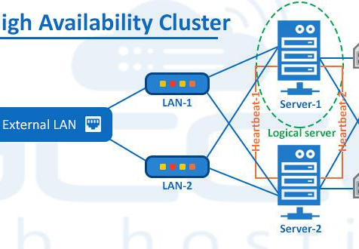

Smart Gird IoT Vulnerabilities?
Unauthorized Control Access
Physical Access
Network Interdependence
Server-Side Uptime & High Availability
Traffic Analysis and Snooping
And More…

Slide 6
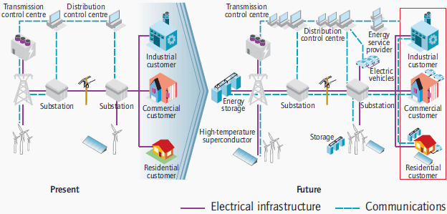
Grid Interconnectedness and Codependence?
How does telecommunications equipment get power?
How does the Smart Grid build redundancy over the Internet?

Slide 7
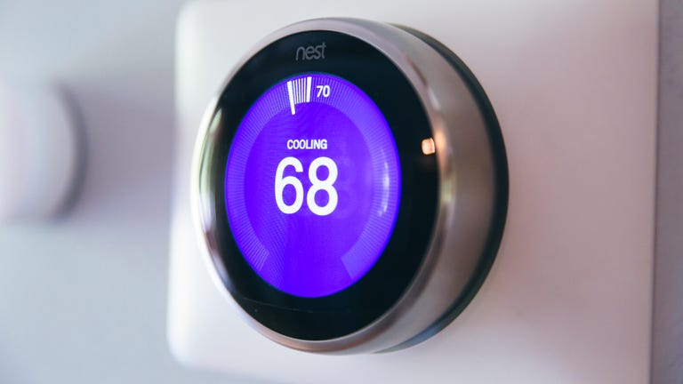
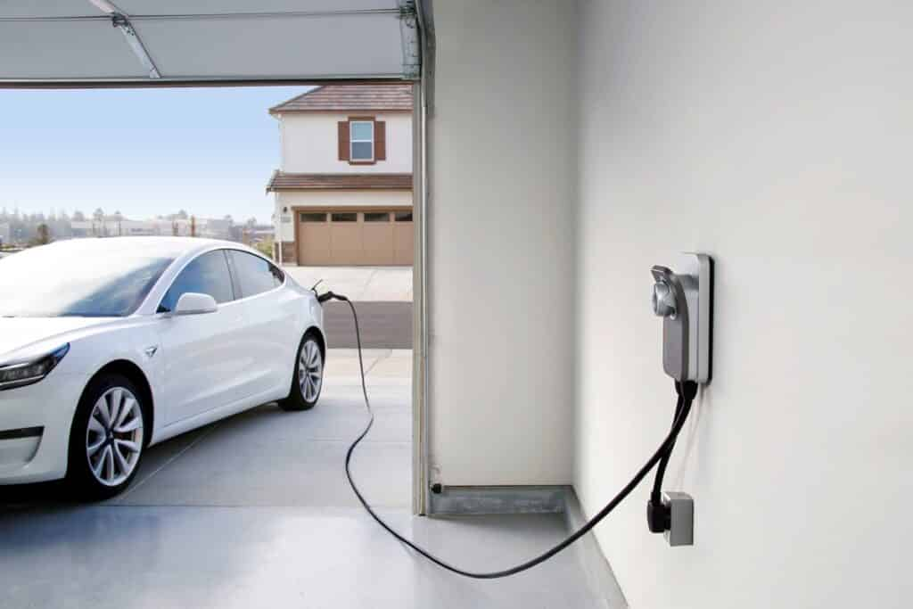
Home Consumption and IoT?
How does an electric world control energy use?
Customer Premise Equipment and Security?

Slide 8
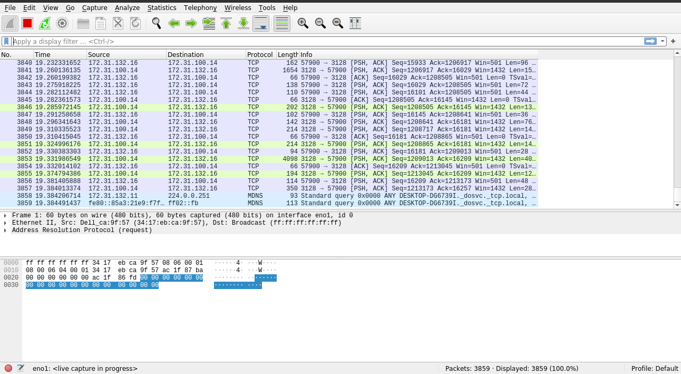
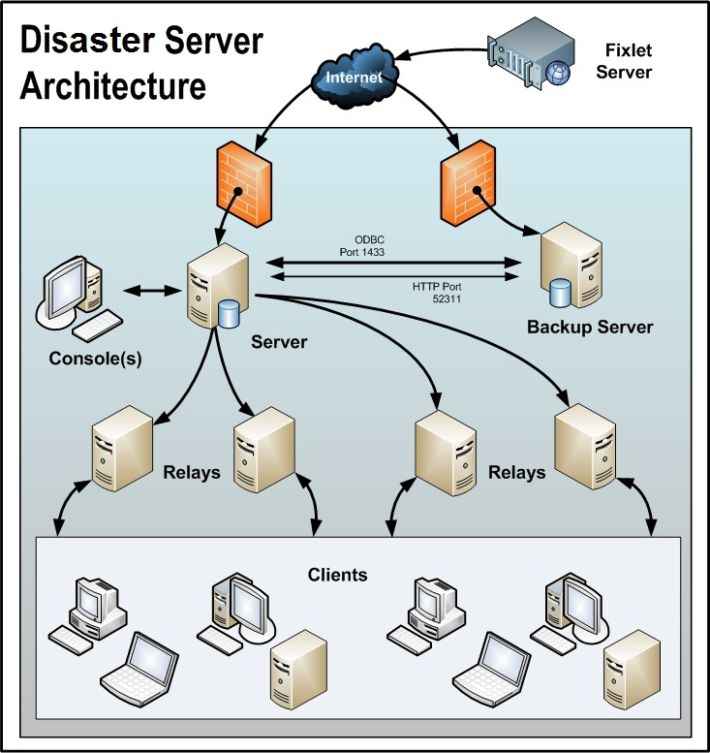
Protocol Security and Availably?
How does we prevent outsides from analyzing packet data?
Control center security and availability?

Slide 9
Overall Recommendations:
Redundant & High-Quality Equipment
Redundant Pathways for Communication
High Access Security and Integrity
Protocol Encryption and Traffic Padding
Regular Security Auditing and Terrorism Analysis

Slide 10
Smart Grid Technology:
Safe Practices & Security Analysis
Questions?
Presented by: Jack Rogerson
Clark University

Slide 11
Citations & Resources:
[1] Carlos Lopez, et al. “Smart Grid Cyber Security: An Overview of Threats and Countermeasures.” Journal of Energy and Power Engineering, vol. 9, no. 7, 2015, https://doi.org/10.17265/1934-8975/2015.07.005.
[2] Cintuglu, Mehmet Hazar, et al. “A Survey on Smart Grid Cyber-Physical System Testbeds.” IEEE Communications Surveys & Tutorials, vol. 19, no. 1, 2017, pp. 446–464., https://doi.org/10.1109/comst.2016.2627399.
[3] Digital Energy Utilities Communications - GE. https://www.ge.com/digital/sites/default/files/download_assets/utilities-communications-from-ge-digital.pdf.
[4] Gunduz, Muhammed Zekeriya, and Resul Das. “Cyber-Security on Smart Grid: Threats and Potential Solutions.” Computer Networks, vol. 169, 2020, p. 107094., https://doi.org/10.1016/j.comnet.2019.107094.
[5] Kabalci, Yasin. “A Survey on Smart Metering and Smart Grid Communication.” Renewable and Sustainable Energy Reviews, vol. 57, 2016, pp. 302–318., https://doi.org/10.1016/j.rser.2015.12.114.
[6] Mahmud, Rasel, et al. “A Survey on Smart Grid Metering Infrastructures: Threats and Solutions.” 2015 IEEE International Conference on Electro/Information Technology (EIT), 2015, https://doi.org/10.1109/eit.2015.7293374.

