Slide 1
CSR & McDonald’s
QBUS 250:
Rachel Quinn & Jack Rogerson
Notes:
Both

Slide 2
Background:
Introduction of the Business Organization
Notes:
Rachel

Slide 3

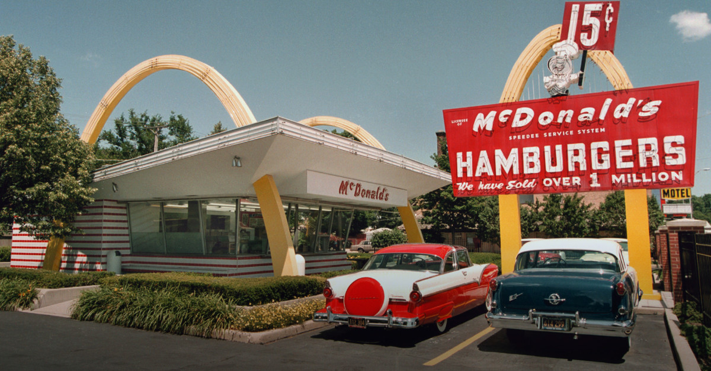

McDonald’s: Background
1940 - Maurice and Richard McDonald opened a burger restaurant
Focused on a limited menu consisting of beverages, burgers, and fries to create quality food with fast services
1954 - Ray Kroc visited the restaurant and was amazed by their efficiency.
McDonald brothers had established an assembly line to increase their productivity rate, resulting in an efficient and enjoyable customer experience.
Notes:
Rachel

Slide 4

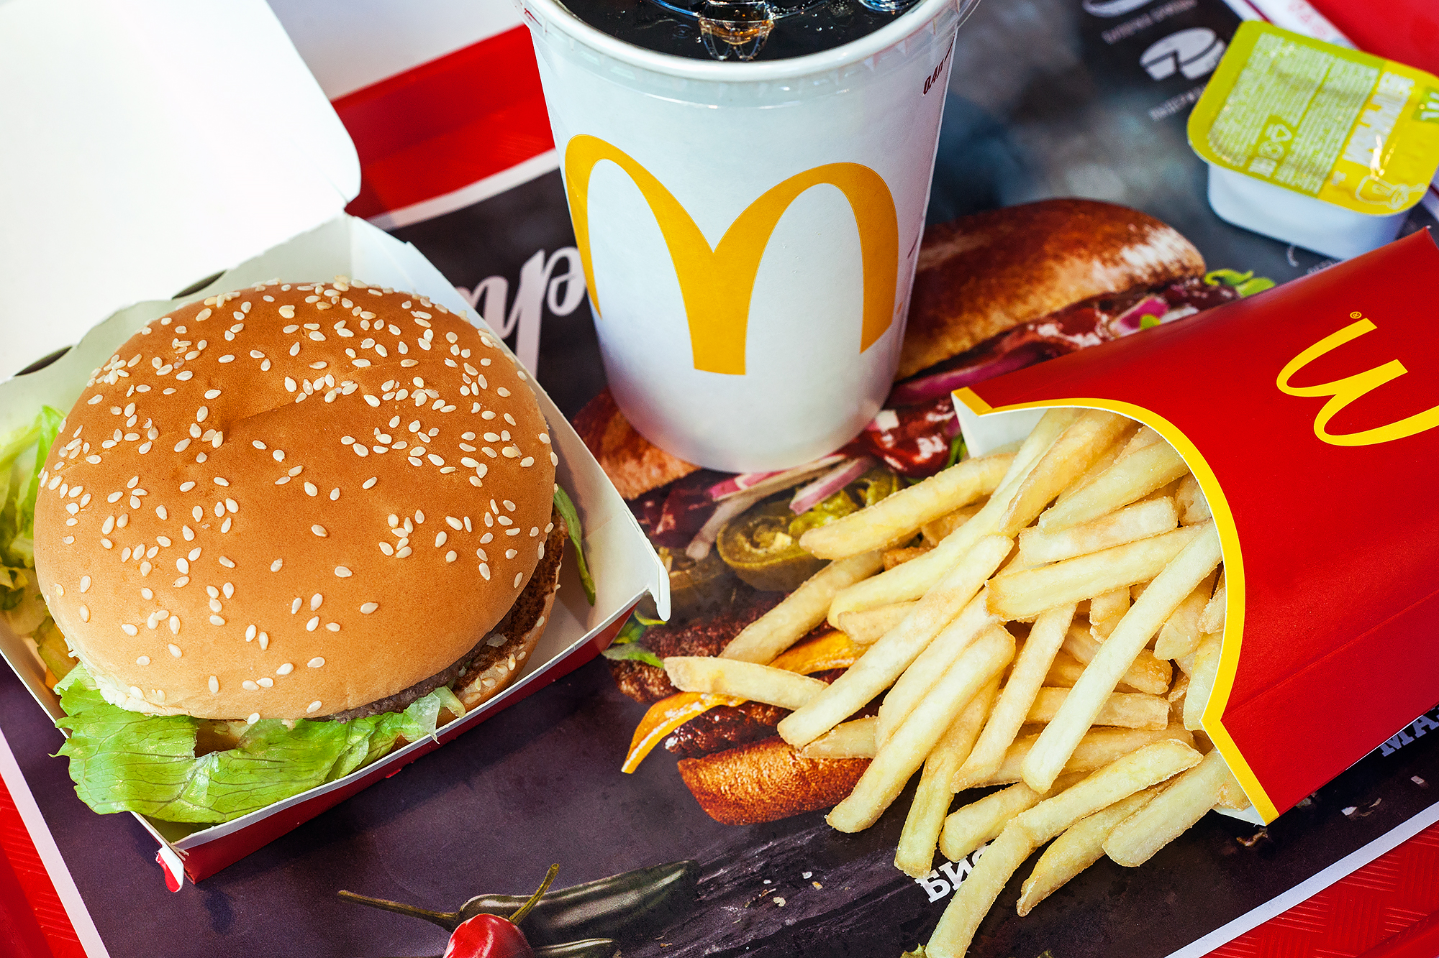
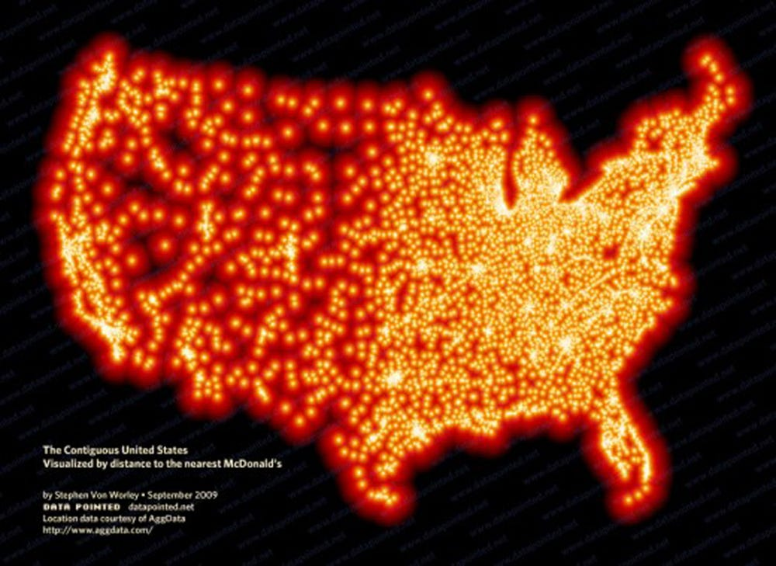
McDonald’s: Background
Kroc founded the McDonald’s Corporation, formerly known as the McDonald’s System, Inc. in 1955.
Opened 3 McDonald’s restaurants, where he generated net sales of $235,000.
In 1961, Maurice and Richard McDonald sold the rights to McDonald’s to Ray Kroc for $2.7 million.
Notes:
Rachel

Slide 5
Ethics Program Overview:
Notes:
Jack:

Slide 6

Notes:
Jack:

Slide 7
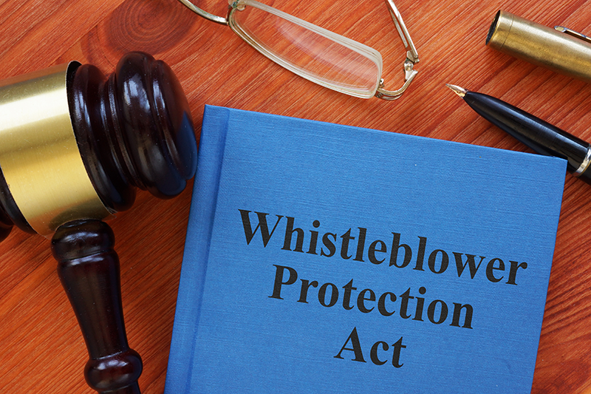
McDonald’s Ethics Programs: Practices and Policies
Hundreds of policies, but most are legal protection, and for the bottom of the leadership hierarchy.
Policy is to follow the law, with some relevant additions.
Standout Policies:
  Product Safety
  Whistleblower Protection
  Employment Practices
  Acting in Best Interests
  Conflicts of Interest
  Corporate and Social Responsibility
  Fair Competition and Antitrust
Notes:
Jack:

Slide 8
Aimed at producing effective leaders from top-down within the organization’s structure.
  Typically start with regional personnel not senior leadership.
Training courses for prospective branch managers offered abundantly.
Training the managers
  Points of emphasis:
    Effective Task Delegation
    Maintaining Effective Hierarchical Communication
    Establish Protections for Confidential Information
    Data Privacy (External to Organization) for Employees & Trade Secrets
McDonald’s Ethics Programs: Practices and Policies
Notes:
Jack:

Slide 9
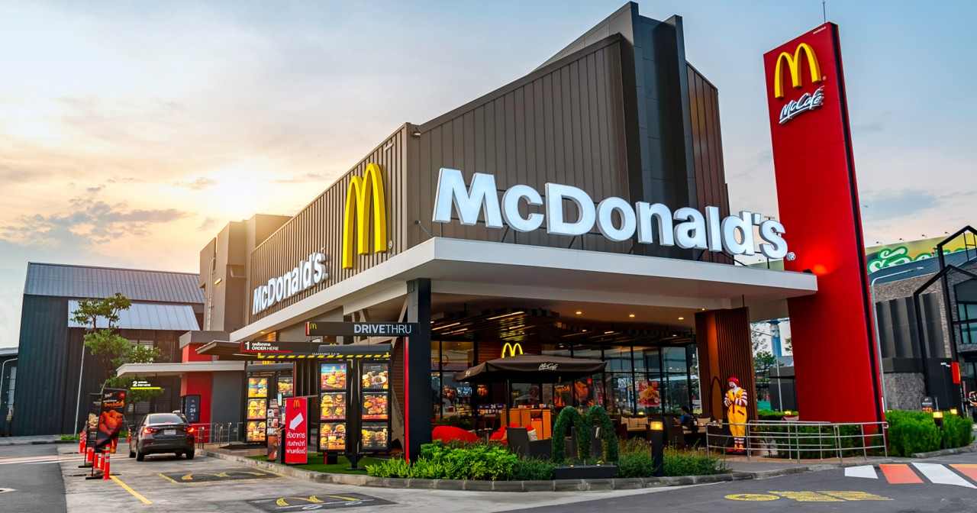
McDonald’s Ethics Programs: Practices and Policies
Rules and regulations aimed to sponsor moral operation of employees:
  Uphold the principles of the McDonald's Corporation.
  Maintain high standards for work and business conduct.
  Know/utilize the Business Integrity phone line.
  Fulfill the rigorous expectations for safety and quality.
  Fulfill the protection of trade secrets.
  Know reporting retaliation protections.
  Comprehend human right provisions.
Notes:
Jack:

Slide 10
Successes:
  Consistency
  Brand Saturation and Penetration
  Automation of Process/Technologies
  Approach of Modernizing Tradition: Breakfast Menu
Challenges/Failures:
  Wasteful Practices
  Environmental Considerations
  General Consideration of Health Impact
McDonald’s Ethics Programs: Successes and Failures
Notes:
Jack

Slide 11
Selected CSR Issues:
Analysis, and Recommendations
Notes:
Jack

Slide 12
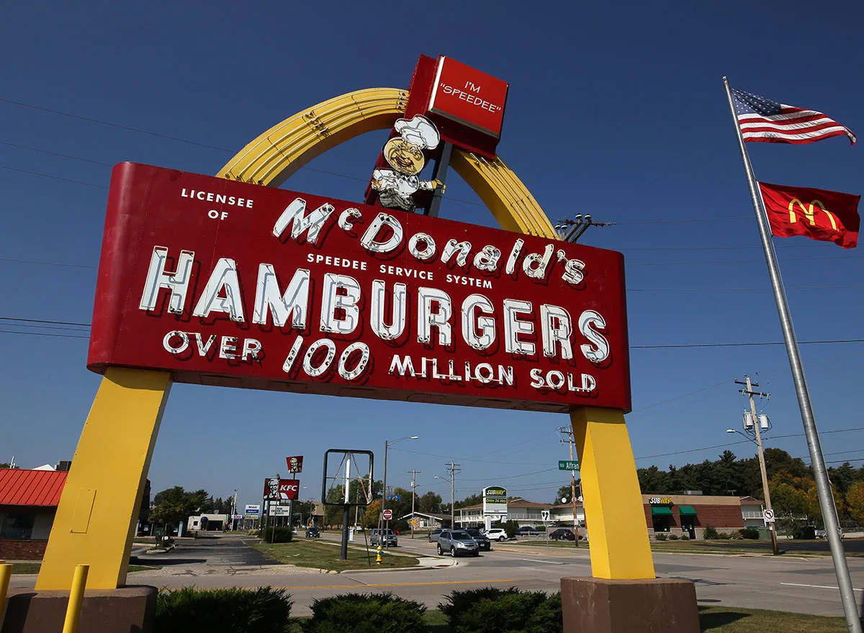
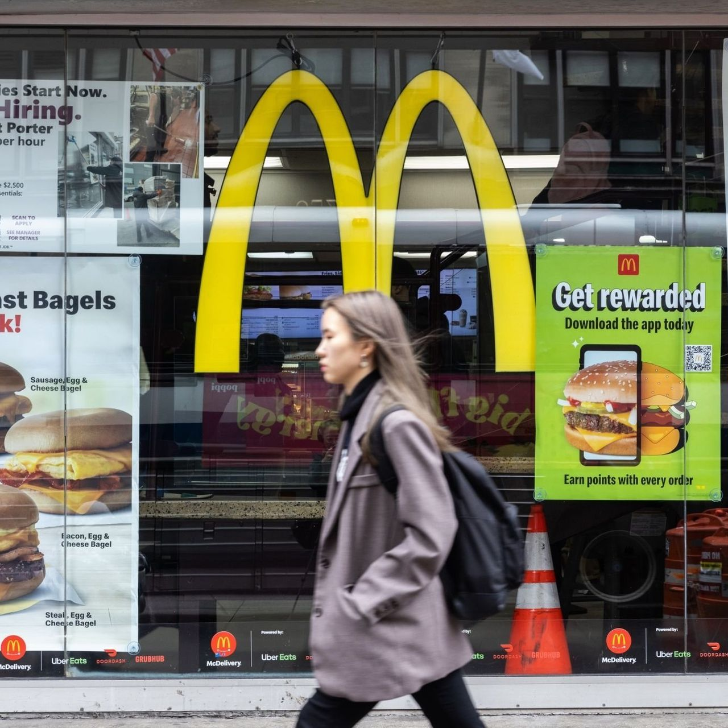
Unethical Working Conditions:
Discrimination, sexual harassment, and low wages
2021 - Lawsuit filed against a McDonald’s
  14-year-old girl was sexual assaulted by the restaurant manager
  Walter A. Garner, a 42-year-old man convicted of previous sexual assaults and sexual harassment.
Rice Enterprises - aware of the sexual harassment and sexual assault
Had previous surveillance footage of Garner groping the victim in the workplace.
April 2021 - Walter Garner was finally arrested for “...showing a minor pornography”, three months after he sexually assaulted the 14-year-old girl.
Walter Garner finally fired
Owner offered her support for the victims as well as increased security and added a second training in hopes of creating a safer and more respectful workplace.
Notes:
Rachel

Slide 13
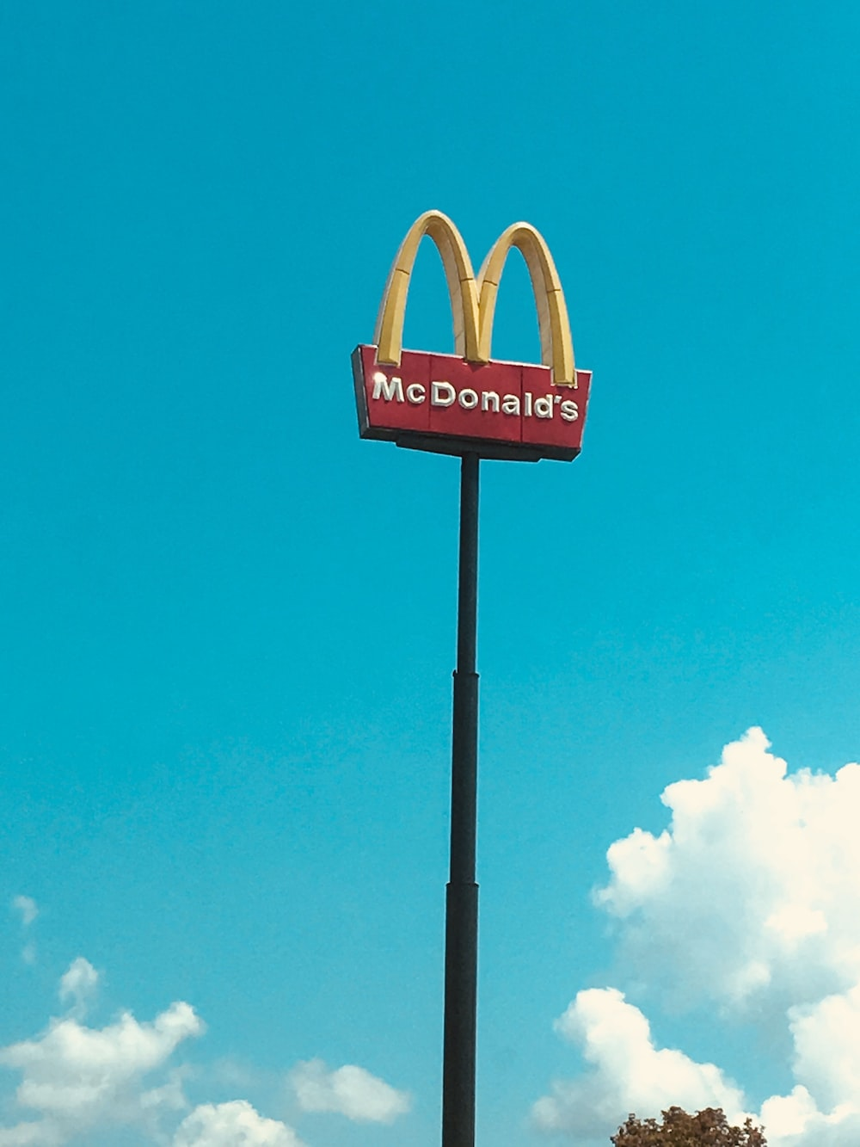
Unethical Working Conditions:
Known for ignoring sexual assault allegations
May of 2019 - 25 employees filed lawsuits against McDonald’s
2019 - McDonald’s incorporated an anonymous hotline for employees to report unethical practices and actions within their restaurants
There have been cases where those who did report were essentially reprimanded for disturbing the workplace.
The McDonald’s Corporation has promised to “...include training in retaliation harassment, and anti-violence policies, annual crew and manager surveys, and a new process for reporting complaints” (Meisenzahl, 2021).
Notes:
Rachel

Slide 14
CSR Issue: Unethical Working Conditions
Stakeholders Impacted: Board of Directors, investors, management, governing bodies, and employees
Societal Consequence: Negatively influences other organizations to tolerating unethical behavior and creates an unsafe work environment as the norm.
Recommendations: Background checks, zero-tolerance policy, and increasing security cameras
Notes:
Rachel

Slide 15
Corporate Bullying
The McDonald’s Corporation Franchises it’s restaurants
Franchisees must follow a strict contract
That contract requires them to use outdated machinery
Franchisees are still responsible for maintenance costs!
McDonalds pays less for new restaurants
Franchisees are cheated out of potential profits
Notes:
Jack

Slide 16
— JEREMY O’SULLIVAN
“
“It’s a huge money maker to have a customer that’s unable to make fundamental changes to their own equipment.”
Notes:
Jack

Slide 17
CSR Issue: Corporate Bullying and Supplier Regulations
Stakeholders Impacted: Franchisees, Employees, Consumers
Societal Consequence: Higher Maintenance Costs, Damaged Reputation, Increased stress, Lack of Safety, Lack of Variety, Lack of Reliability
Recommendations: Open supplier contracts for bid! The resulting competition could return even more than the money saved on the outdated machinery.
Notes:
Jack

Slide 18
Data and Technology Practices
Deceptive data collection strategies and policies.
  Buying habits and identifying information.
  Geolocation data.
Use of targeted advertising and AI to market to consumer populations.
  While not the implementer, use of services is still questionable.
Overall questionable processes regarding customer wellbeing.
  Putting bottom line profit over consumer stakeholders.
Notes:
Jack:
Don’t ask don't tell policy with respect to data.
Difference between ease of use data collection, and extrapolating extreme meaning and analysis from data.

Slide 19
CSR Issue: Data and Technology Practices
Stakeholders Impacted: Board of Directors, investors, management, employees, and customer populations.
Societal Consequence: Advertising: Primarily long-term in scope and is most dangerous to influential population groups such as children or teenagers.
Recommendations: Establish more appropriate policies regarding data transparency to customers. Lead by example and allow granular data control. Possible rewards systems for forthcoming data access.
Notes:
Jack:

Slide 20
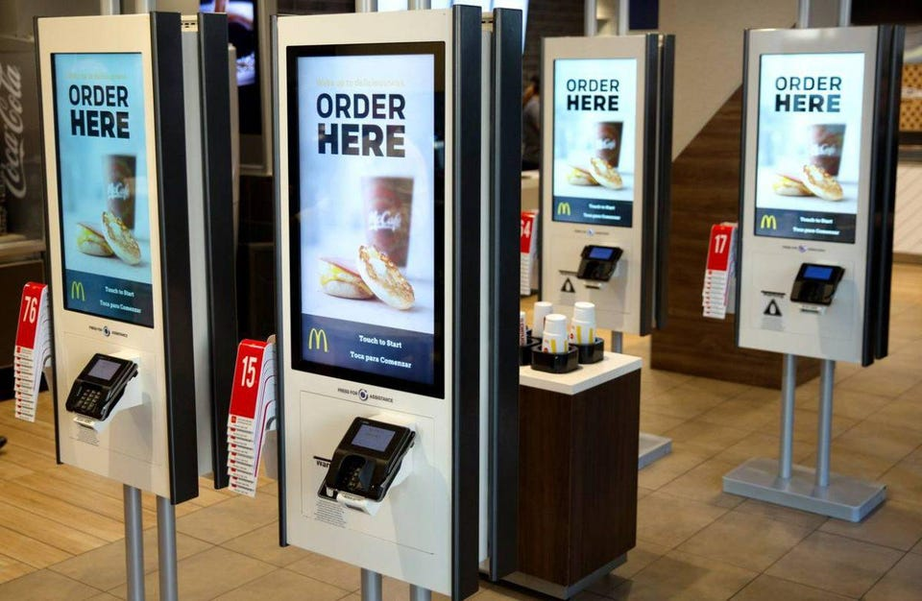

Overall McDonald’s Success
Innovation
  Ordering kiosks, order ahead
Automation
Efficiency
General standards/policies are
as expected but need to be more strict
Notes:
Rachel

Slide 21
Overall Conclusions
What are your overall recommendations?
Prioritize the well-being of their employees as critical stakeholders.
Establish a zero-tolerance policy.
Decrease room for ambiguity in the code of conduct.
Notes:
Rachel

Slide 22
Thank you
Any Questions?
Notes:
Rachel

