Slide 1
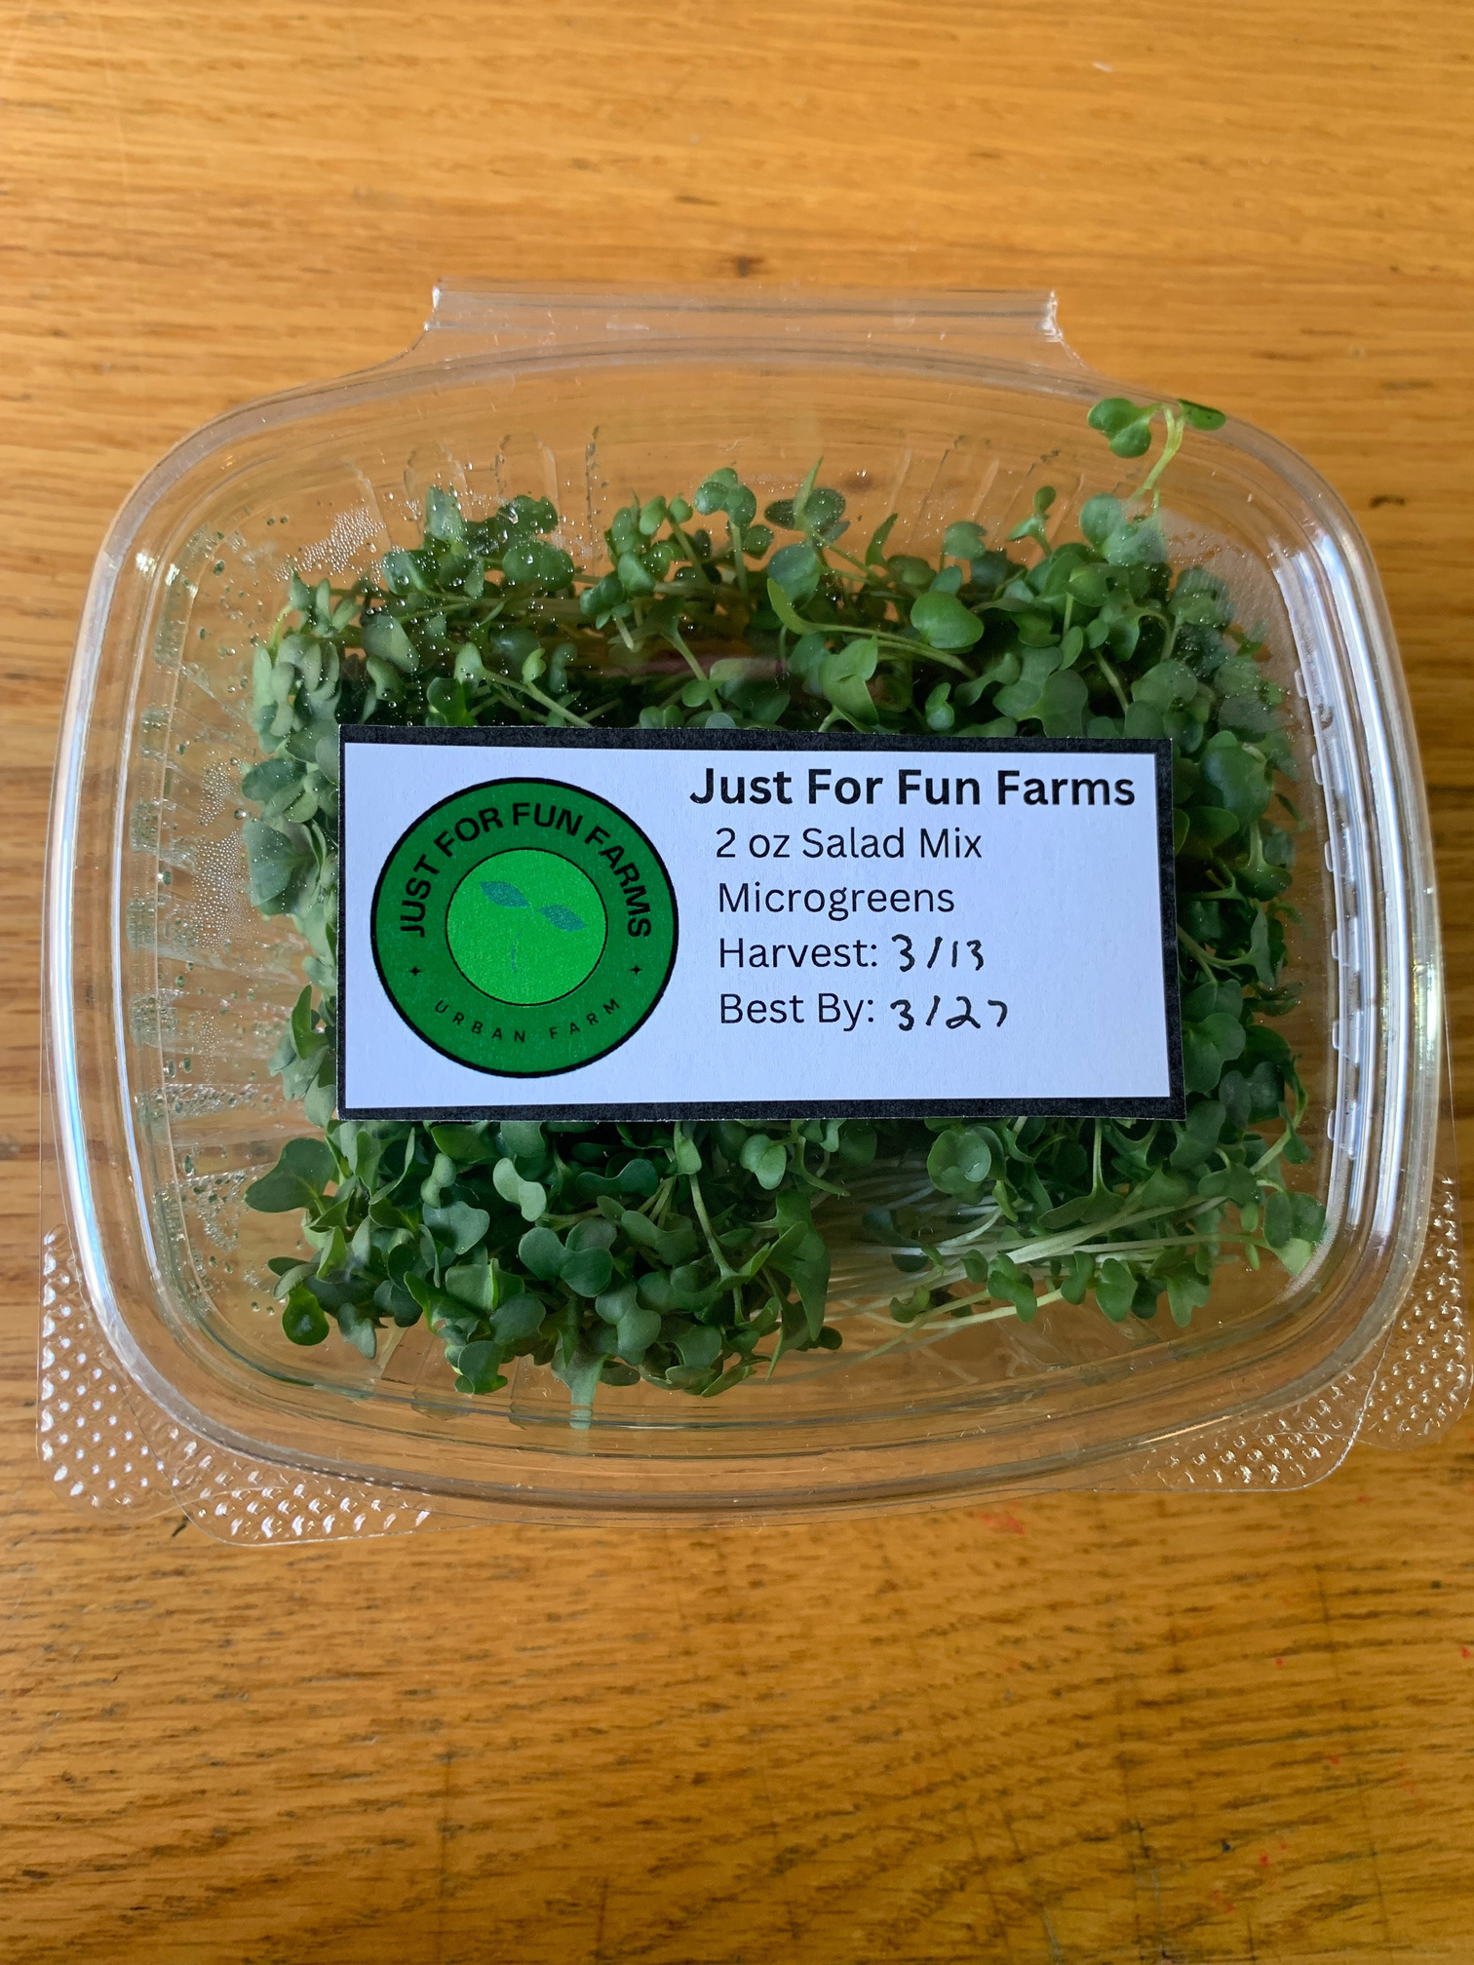

JUST FOR FUN FARMS
MICROGREENS FARM
BY: OWEN CHASE
Notes:
Hello everyone - my name is owen chase and I am the founder and operator of just for fun farms where I grow microgreens from sweet to spicy meeting your nutritional needs
I hope you enjoyed my microgreens salad at lunch!

Slide 2
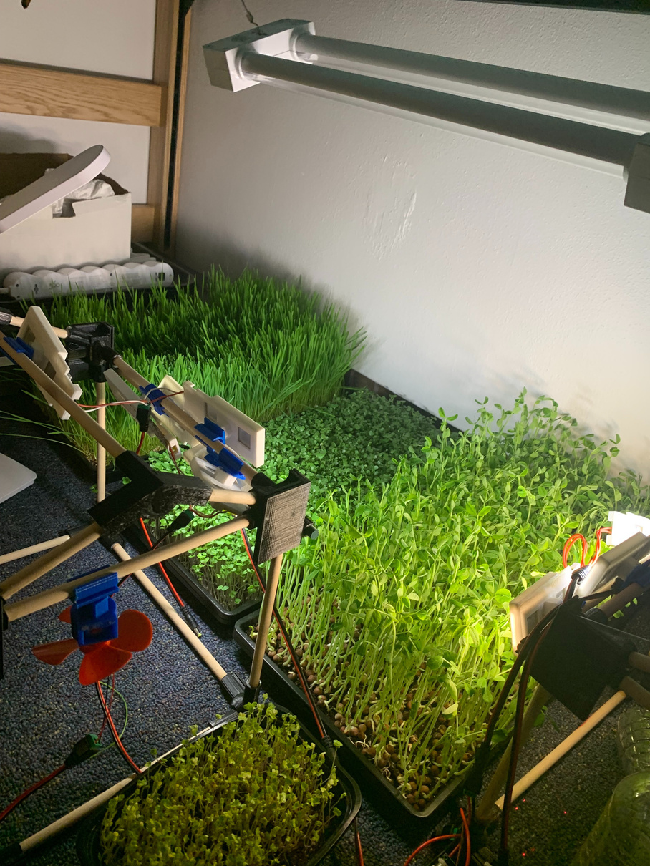
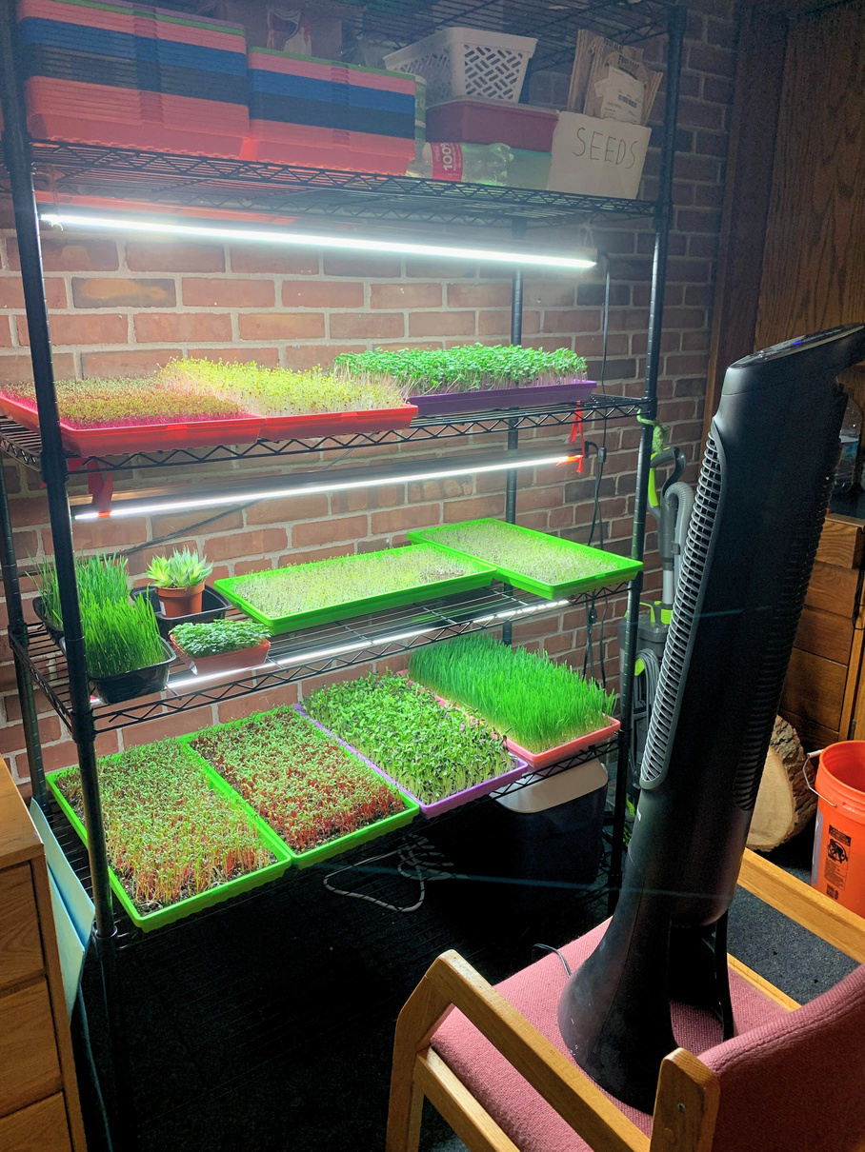
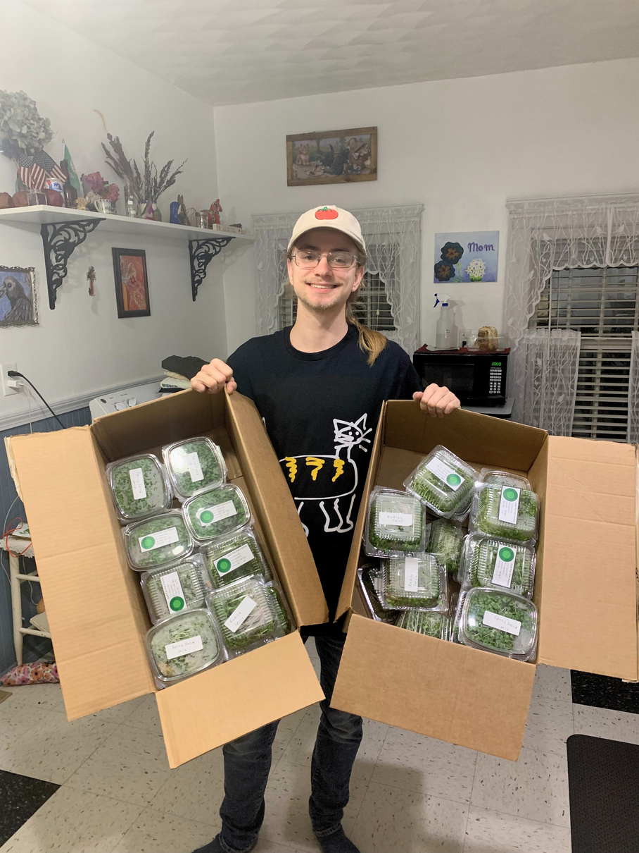
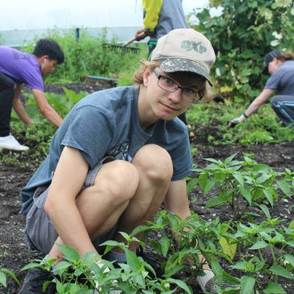
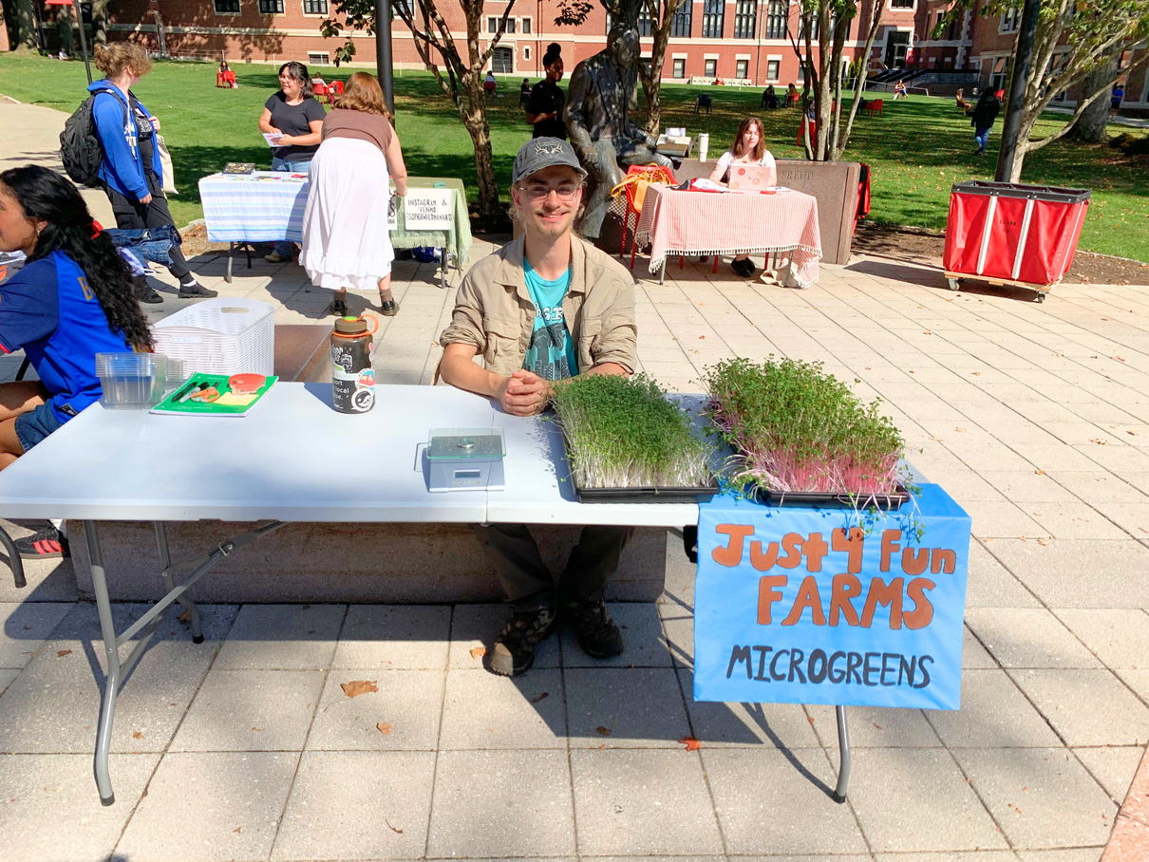
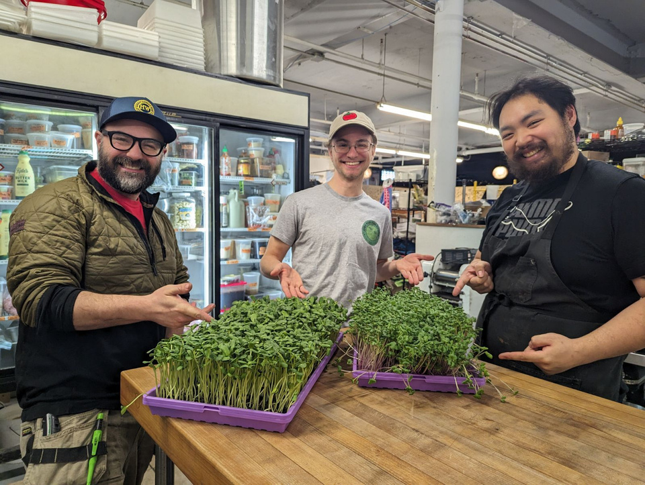
MY
STORY
JANUARY ‘23
FIRST
MICROGREENS
DECEMBER ‘23
FIRST GROW
RACK
MARCH ‘24
SUBSCRIPTION
PROGRAM
AUGUST ’19
FIRST TIME
FARMING
OCTOBER ‘23
FIRST POP UP
FEBRUARY ‘24
FIRST RESTAURANTS
Notes:
Updated story
when I was a kid my mom was always nagging me to me get outside and to help her in the garden
- its a chore and i just wanted to play videogames
- all changed in 2019 first job with urban agriculture
- sparked a passion in me for growing food and feeding the community
- in college take this passion with me - in 2023 I discovered MICROGREENS a young nutrient dense vegetable that can be grown in doors, year round.
At this time I was growing for friends, family and for the woo fridges, but by the end of the year I had started selling at the clark pop up and I got my first grow rack.
So far this year I made my first sales to other businesses such as WooJuice and Wooden Bar
- and I started my subscription program where people can sign up for reoccuring orders to be delivered to their home every week

Slide 3

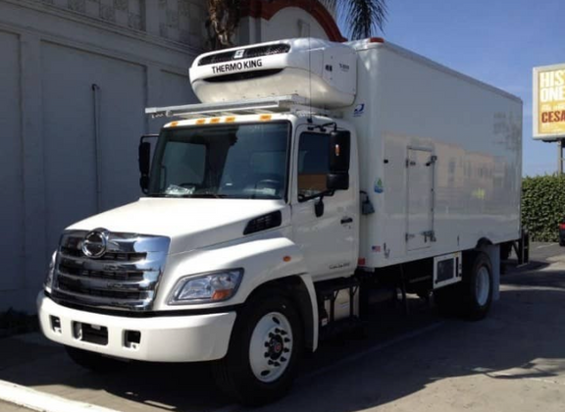
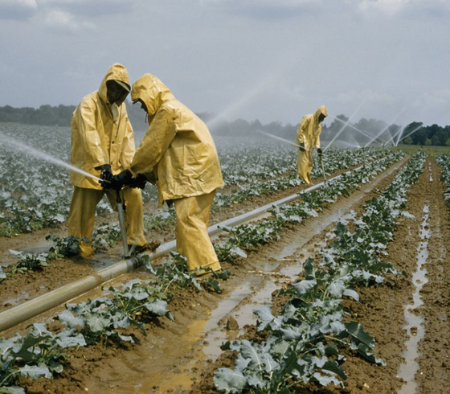
WHAT’S WRONG?
Food access
19.5% MA households
food insecure
~Project Bread
Limited local
options
Environmental
impact
Notes:
I started growing microgreens because I realized that our current food system has some flaws
Its hard to access fresh fruits and vegetables.
almost 20% of households in MA are food insecure. If you dont have these foods in your diet
- it can lead to a higher chance of heart disease, diabetes, or nutritional deficiencies
- there are not enough programs serving these populations
another issue is that there are limited local food options when both families and chefs want local food!
-Imported foods are more likely to get damaged in transit
- and they have a higher co2 emission from traveling longer distances.
speaking of co2 emissions
big agriculture - has another environmental impact - soil degredation - due to the heavy use of pesticides - this practice IS NOT SUSTAINABLE

Slide 4

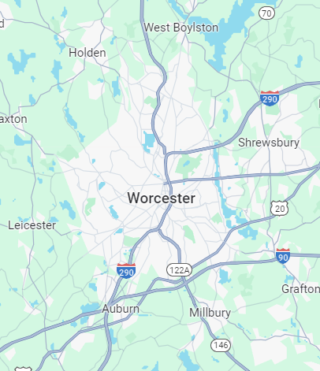
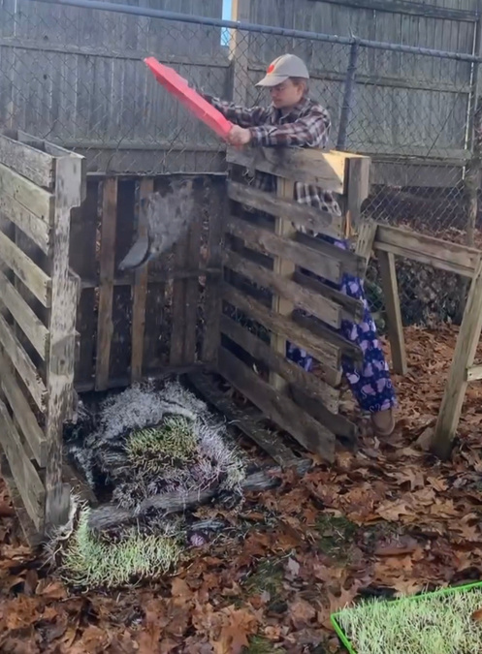
ONE FARM DOES IT ALL
Food assistance
48% Main South households have SNAP
~WRRB
Hyper-local
Sustainable
Worcester
Notes:
At Just For Fun Farms I address all of these problems
A unique solution to increase food accessibility is to partner with the REC farmers market where all vendors are able to accept food assistance programs such as SNAP and HIP.
- HIP is 40-80 dollars a month specifically for farmers market produce
- this is an amazing opportunity because the market is IN MAIN SOUTH where almost 50% of households have snap and hip benefits that they want to spend
also donate extra produce to FIRM PANTRY ------ 22.8% Worcester households have snap - the worcester regional research bureau
my hyper local business model ensures all produce is consumed within 15 miles of my farm
- this helps me cut own transportation emissions.
- and it allows customers to have fresh produce delivered within a day of harvest.
- Great because microgreens are weather independent - can provide people with local food year round
-people want to support environmentally friendly practices
- I'm cautious of my farm's environmental impact because of this I use sustainable practices - i have 0 water waste and 100% of my spent soil is composted and reused

Slide 5





Competitor Analysis
Accepts HIP
Accepts SNAP
Restaurants
Subscriptions
Hyper-local
Community impact
Notes:
While some other farms address these problems no one does it like me!
When I partner with REC I will be the one to serve the HIP community
I also have a great social media presence showing my growing practices and what I am doing within the community

Slide 6
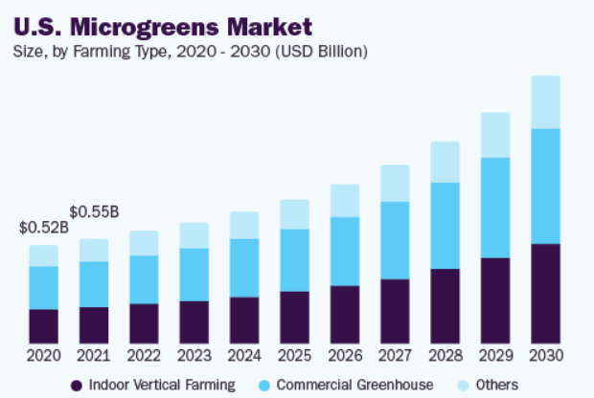
MICROGREENS INDUSTRY
  73% want local food
~Gallup News
  20% increase local food sales in the last 5 years
~USDA
~Grand View Research
Notes:
The microgreens industry as a whole is growing at a rate of 12% per year.
in 2021 the total available market was 550 million dollars
Do people even want local food?
YES! 73% want local food options
this desire for local foods is show by a 20% increase in local food sales in the past 5 years.
local sales 1.5% of USA's total agricultural production
68% of ppl globally prefer local food - statistica
microgreens market and cagr grand view research
20% local food sales increase usda
93% americans want to eat healthy bbq lab
73% of americans want to include local produce in their meals - gallup news
95% of single family urban households will pay more for local food
1.5 of usa agricultural production is sold locally

Slide 7
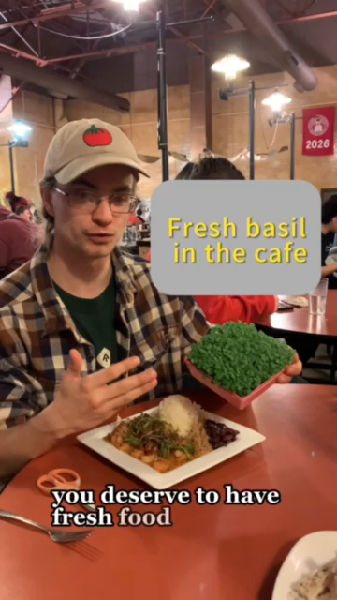
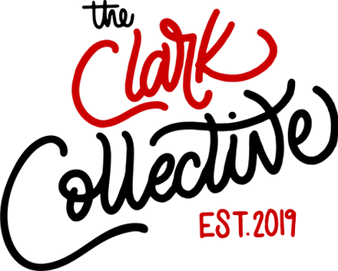


MARKETING
Networking
Clark U Media - student spotlight
Clark E & I - podcast, blog, pop ups
REC - vendor spotlight
Jeremiah’s Inn - produce donations
Restaurants - free samples
Notes:
For my business my marketing strategy is NETWORKING - using a grassroots approach i am building my relationships with the local community. this is important because people want to know who their farmer is, know what they do, and how and why they do it.
I do this by collaborating with existing organizations example clark u media team is doing a story on me - and selling at uni park and why i do it
- clark e and i im on the podcast episode this week - go watch it
and to network with restaurants i bring them free samples - 50% of these groups are now purchasing microgrens from me
- clark e and i podcast episode out this week watch it on spotify
- restaurant relationships - i bring them free samples - so far 50% of the restaurants ive given samples to are now buying product
networking with existing organizations and creating community based relationships
KNOW WHAT COMES FROM MY MARKETING
my marketing is networking and creating relationships
Marketing plan - My current marketing is to direct people to the clark collective pop up and my website for community / restaurant orders
Instagram and facebook posts - people pre order ____% of pre ordering increasing each month ---- and 68% of of my monthly sales are repeat customers who follow me on social media - this social media keeps people updated on what I am selling
Instagram ads - talk about this and what I get from it??
Other marketing
- clark wonderfulspaces
- clark FIRM and woo fridges donate and then people get to try my produce???
- out reach to restaurants offering free samples and menu / flier for chefs and restaurants so far i've done 4 of these and 2 ended up buying produce after.
- marketing through danny frederick photography - 25$ interview posted to his page alot of entrepreneurship and clarkies follow his page over 300 followers and his interviews get the highets engagement rates out of all his photos. this gives people a chance to learn about my story and my business
- marketing opportuinty through clark media team - student spotlight on me and my business
- clark e and I program meet the vendors program
- reached out to danny
- reached out to worcester telegram
- reached out to clark university radio station
- My marketing now is shifting from targeting the clark community to the greater worcester community and restaurants in preparation for the REC farmers market where I can accept food assistance programs
talk about what im doing beyone social media - greater community - ads - what my marketing gets me --- ex ppl follow my instagram 20% are now pre orders --- and 60% are repeat customers - i have to think my instagram constant posts are part of that
Organic growth - transparent social media know your farmer
IN PAARTNER SHIP WITH REC - collaborative post!!!!! - woo fridge - restaurants collab posts - firm
my marketing shows transparancy in how i produce - it allows people to know me as their grower - grass roots relationships
further along local newspaper
- clark internal spotlight clark now
-- the scarlet newspaper
- my highschool
- the person zack that wrote the thing for jack
POTENTIALLY talk about 73% of people in my feedback survey want to purchase again
- check excel sheets to see what % of people are reoccurring customers

Slide 8
COST OF GOODS SOLD
One Container | Broccoli
Seeds | $0.25
Soil | $0.20
Packaging | $0.29
Utilities | $0.10
TOTAL | $0.84
PRICE | $4.00
PROFIT | $3.16
Currently price $4
Farmers market price $5
Monthly sales - 80 containers
375% profit
Notes:
every container i produce costs me .84 cents rn i sell $4 each at a 375% profit margin
- at my target market i will increase my price to 5 because there will be a greater demand for my produce
and people will be more willing to spend money on local food

Slide 9
Year To Date Revenue | Containers | Live Trays | Subscriptions | Grow Kits
# Sold | 86 | 2 | 4 | 4
Revenue | $344 | $45 | $320 | $36
COGS | $72.24 | $5.97 | $35.20 | $15
Profit | $271.76 | $39.03 | $284.80 | $21
% Profit | 376% | 653% | 809% | 140%
Notes:
I currently have 4 channels of revenue
- containers at pop ups
- live trays to restaurants
- home delivery subscriptions
- grow kits
!!!!!
with your investment I will BUILD upon my channels with the highest percent profit margins going from 200 to over 3000 dollars a month in revenue
and increase direct to consumer sales and also restaurants and subscriptions by meeting clients and customers

Slide 10
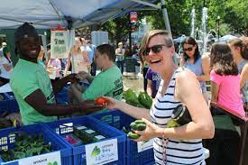
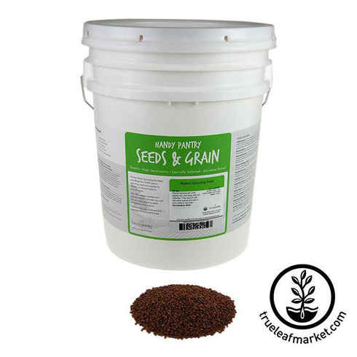
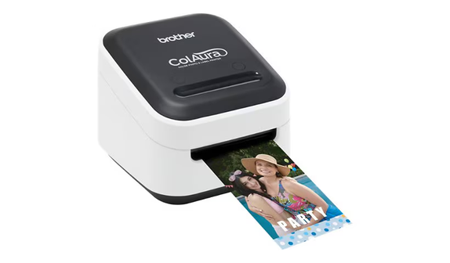
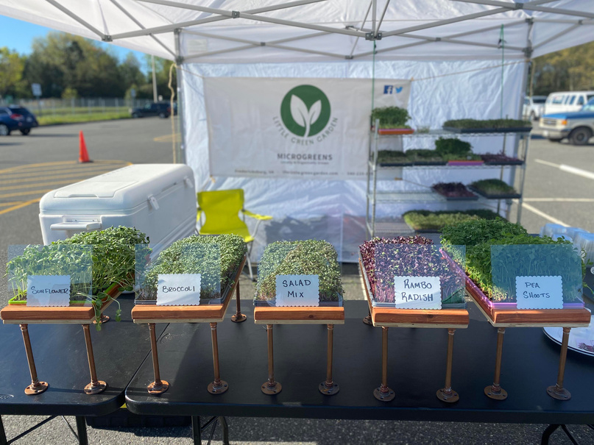
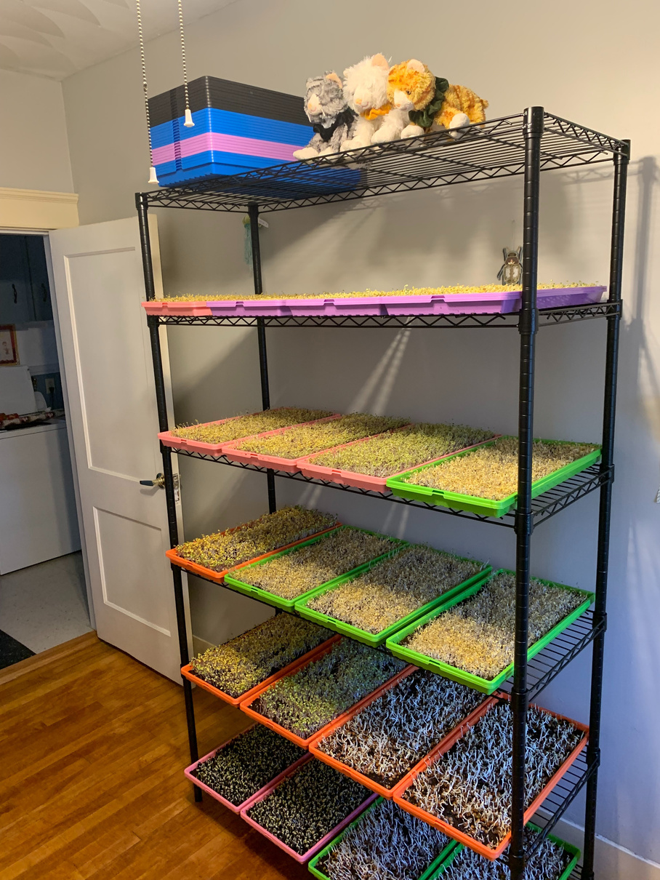
ASK - $3,500
Vendors Fee - $ 940
52 markets
Bulk Materials - $1080
  Seeds
  Containers
Branding Kit - $430
  Label maker
  Stickers, pins
  Banner
Tent Display - $375
  Tent
  Tables
  Coolers
Grow Racks - $675
  Racks
  Trays
  Lights
Notes:
To make this happen I am asking for 35 hundred dollars.
I need money for the REC vendors fee which helps cover their marketing and liability insurance
- this is at university and beaver brook park from june to october
I need a tent display in order for my stand to look professional and attractive! It is important for my produce and stand to have a neat look
I am asking for over a thousand dollars in bulk materials - I recognize this is a lot but buying seeds and containers in bulk will decrease my COGS by 33% saving me 1,300 dollars by the end of the year
I need two more grow racks to accomadate the higher demand I will have at the market - this will increase my weekly revenue by 900 dollars
And finally I need a branding kit which includes a logo maker because whats all of this useful for if Im not able to label my microgreens!
I want people to talk about me when they buy my product!
This ask covers everything I need for my business sell at the REC's farmers market during the peak selling season where i can accept snap and hip benefits
ASK TOTAL - 3,368 - plus 105 for rack or 309 for 2k more containers
1) VENDORS FEE & product liability insurance - I need this to be able to sell at the market
- University and Beaver Brook Park package - $940 dollars for market duration June - October 52 market days 18$ per day
2) TENT DISPLAY - These are the things I need to have an attractive and professional stand - ALSO required to be at the market.
- tent - 160
- tables 8 + 6 fold - 94
- coolers 4 pack - 30
- crates 3 - 45
- weights - 40
3) BULK MATERIALS - For the selling season - 1000 trays - 4500 containers - revenue 22.5k - Buying bulk seeds, soil, and containers will allow me to get a large discount - decrease my average COGS by 33.5% - saving me $1267 based on selling 4500 containers throughout the season
SEEDS
broccoli - $180
radish - $250
sunflower - $150
peas - $200
- Seeds broccoli 1 lb 14 25 lb 178 - 49% discount - 375 trays
- Seeds triton purple radish 1 lb 12.4 25 lb 143 - 54% discount - 320 trays
- Seeds red arrow 1 lb 12.58 25 lb 131 - 58% discount - 320 trays
- Seeds expensive radish 1 lb 19.00 25 lb 248 - 48% discount - 320 trays
- Seeds sunflower 1 lb 9.25 lb 72 - 68% discount - 100 trays
- Seeds speckled pea 5 lb 13.4 25 lb 43 - 36% discount
- 45 trays
- Seeds organic green pea 5 lb 16.3 25 lb 55.3 - 32% discount - 45 trays
CONTAINERS
- restaurant super store 200/57 webstaurant online bulk 2000/309 = 46% discount
- i need 2x this order idk to ask for it or not? if i do get it it saves me 50 $ on shipping cuz only have free trial one month for 4400 containers add 360$
4) GROW RACK - To accommodate the greater demand at the market I need another grow rack - my current set up allows for 20 trays - 90 containers a week - with another rack it doubles - bringing in extra $450 in revenue a week
to reach my 1k trays goal during the summer I will need 2 more rack set ups
which will bring max weekly sales 270 containers - $23,400 similar to 1000 trays 4,500 containers x 5 = 22,500
Equipment needed!
- Rack - 110 220
- 30 trays - 298
- 12 lights - 130
- 3 timers - 26
If I buy a second rack I already have full set up from the extras of other items - so then 2 racks for 900 weekly revenue +$105
5) BRANDING KIT -429
This will help my stand and produce have a professional and attractive look
- logo printer - 180
- logo paper roll 2,400 - 40
- business cards 100 - 45
- stickers 500 - 90
- pins 200 - 64
- banner - 45
1,400 vendors fee and insurance
1k vendors fee up to 400$ can be reimbursed from REC but i need down payment
1300 Bulk Supplies
seeds 500 - 60% off when bulk
labels 200 - 30% off when bulk
soil 600 - saves me 6 hrs work
know the break downs on these percentages ----
saving me 900 dollars
To accommodate the market's demand I need to another grow rack which will allow me to grow 20 more trays per week for max profit of 400 more $ per week
and finally I need 800 dollars to build an attractive display - main items are a tent, tables, signage and a label maker which will create a professional look for my products
marketing / business development - line each the name and the price
800 Table display
This money will go towards equipment I need to sell at the market and have an attractive stand - key items include tents, label maker, tables and other items
attractive stands attract more customers - make my brand look professional
tent 150
tables 120
weights 80
label maker 200
banner and signs 80
cooler - 20
bread holder 5x10 50
RUGRUGRUG
600 microgreens rack set up
I will need more another rack to meet the demand for this market
- rack - trays - lights
this will not only be helpful for the market but also year round when i am serving more restaurants and have more CSA members
rack 100
lights / cables 150
trays 300

Slide 11
Projected Revenue | Containers | Live Trays | Subscriptions | Grow Kits
# Sold | 1,580 | 432 | 54 | 56
Revenue | $7,900 | $9,720 | $4,320 | $504
COGS | $885 | $1,042 | $370 | $189
Profit | $7,015 | $8,678 | $3,950 | $315
% Profit | 792% | 833% | 1,068% | 167%
Notes:
with your investment my projected revenue for 2024 is 22k
getting into the farmers market will not only increase my direct so consumer sales but It will introduce me to chefs and home delivery subscribers who will buy my produce year round.
WHY I EXPECECT THIS
Containers sold starting market
15 per pop up each month I expect to increase my daily sales by 5
got to 15 cuz based on current sales at clark im doing 5/hour at clark pop
REC has more people and they have HIP benefits they want to spend! --- ashley says 75-200 visitors per day at markets ---- leads to total unique customers 3k per month 2.4k use hip 96k available per month HIP ONLY ---- and this is what I will get if i grab 3% of total sales i get 2.9k hip a month will translate to 48 containers a day
LIVE TRAYS
Expect to sell 8 trays a month to each restaurant - expect to grow 1 restaurant per month
subscriptions
expect to grow 1 subscription person added per month - 80$ revenue 16 containers a month

Slide 12
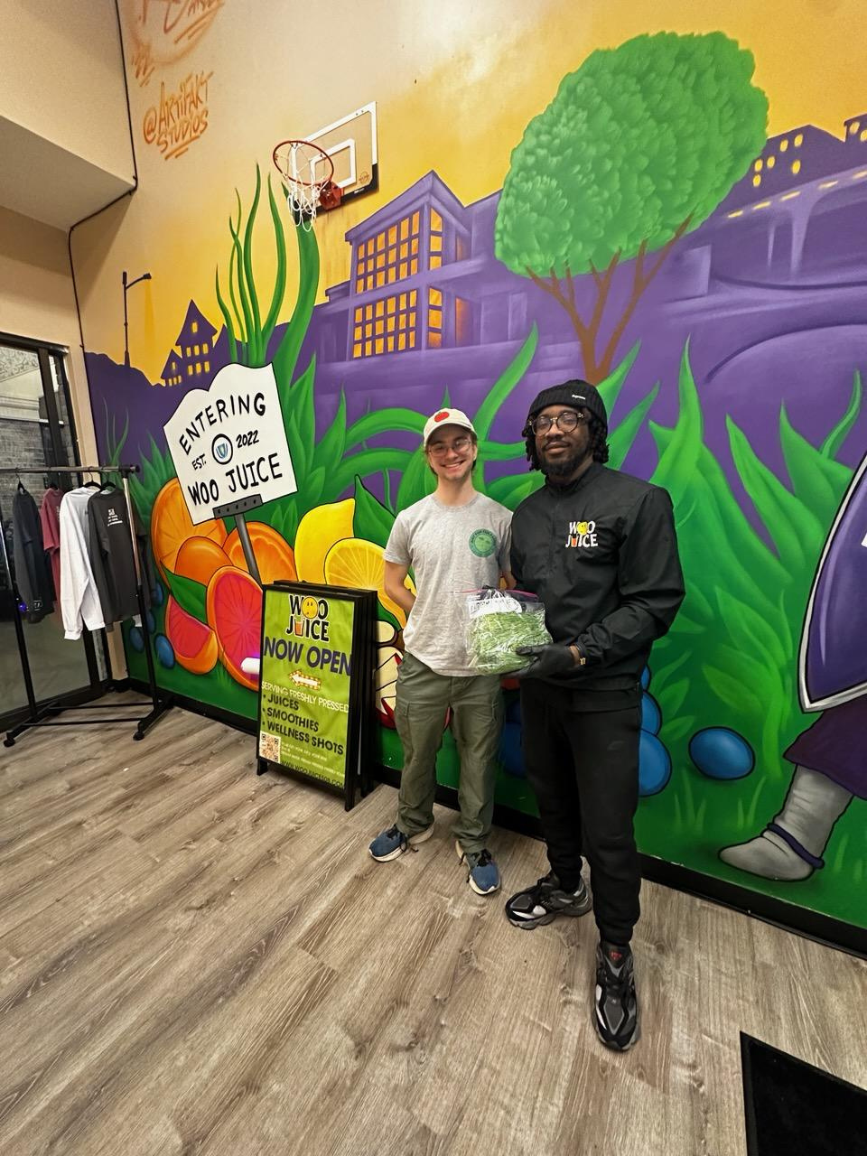
After the Market
I am a year-round business!
Jan. | Feb. | Mar. | Apr.
May | June | July | Aug.
Sept. | Oct. | Nov. | Dec.
Farmer’s Markets
Restaurants & Subscriptions
Notes:
After the market I hop right into my peak selling season for restaurants and subscriptions.
During the winter the quality of grocery store produce tanks. Because of this people are desperate for fresh local food!
I am a year round business!
- market season into subscription and restaurant season into market season into subscr....
funding will allow me to sell at the market where I can meet restautanrs and subscribers AND ALSO give me the equiptment and supplies needed to in the winter season
- microgreens weather independent and unlike super market produce during the winter the quality remains the saim
- this is why I will get an increase in restaurants and subscribers during the winter
- I AM A YEAR ROUND BUSINESS
being at the farmers market wont only increase my direct to consumer sales it will introduce me to chefs and potential csa subscribers

Slide 13
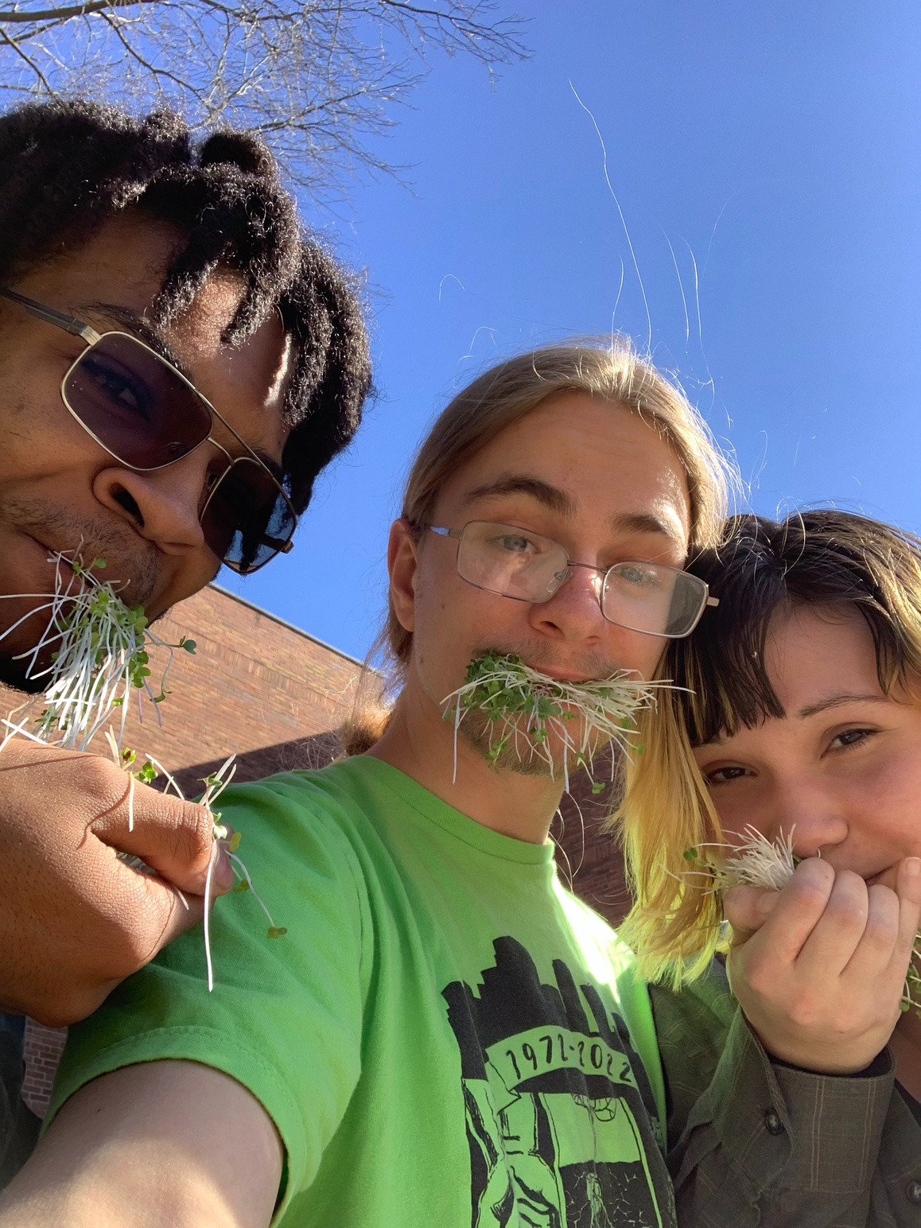

THANK YOU
FOLLOW THE FARM!
  SCAN ME!
Notes:
Thank you for listening to my presentation and a huge shout out to jack levine my mentor
dont forget to follow the farm on social media and order some microgreens!

