Slide 1
Masala King

Slide 2
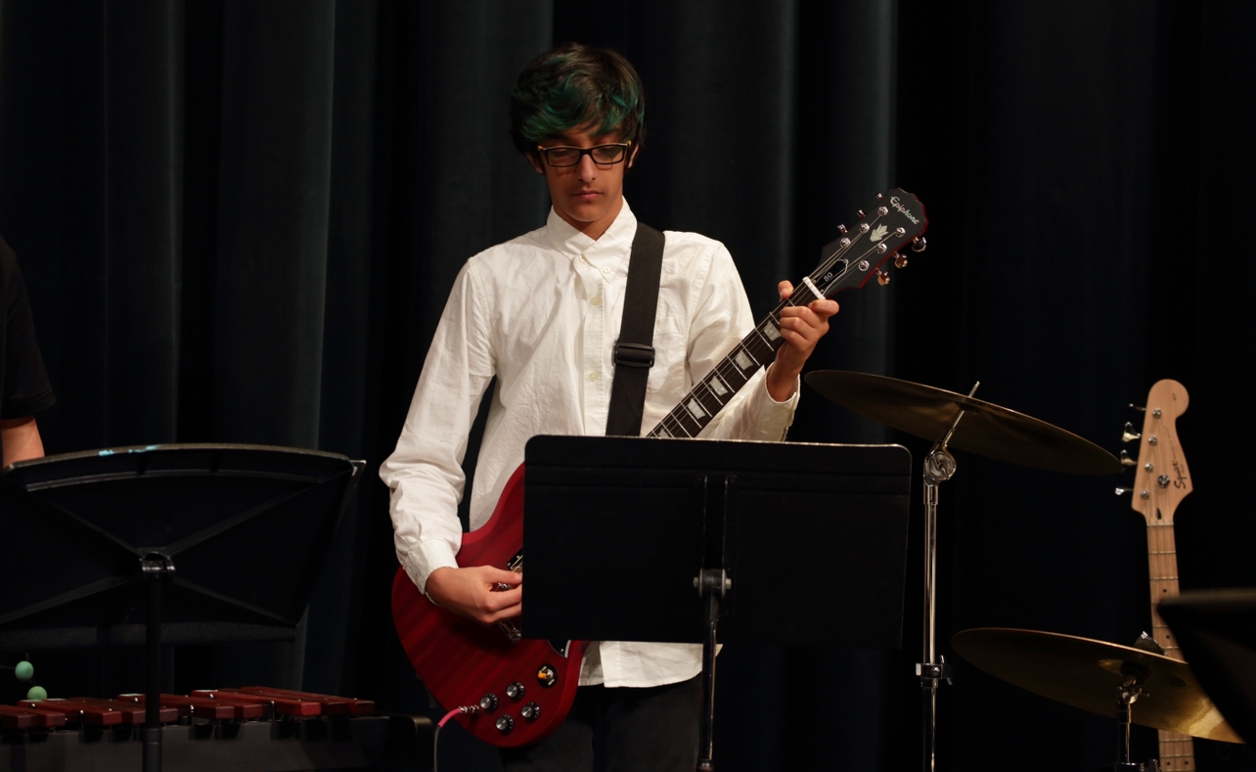
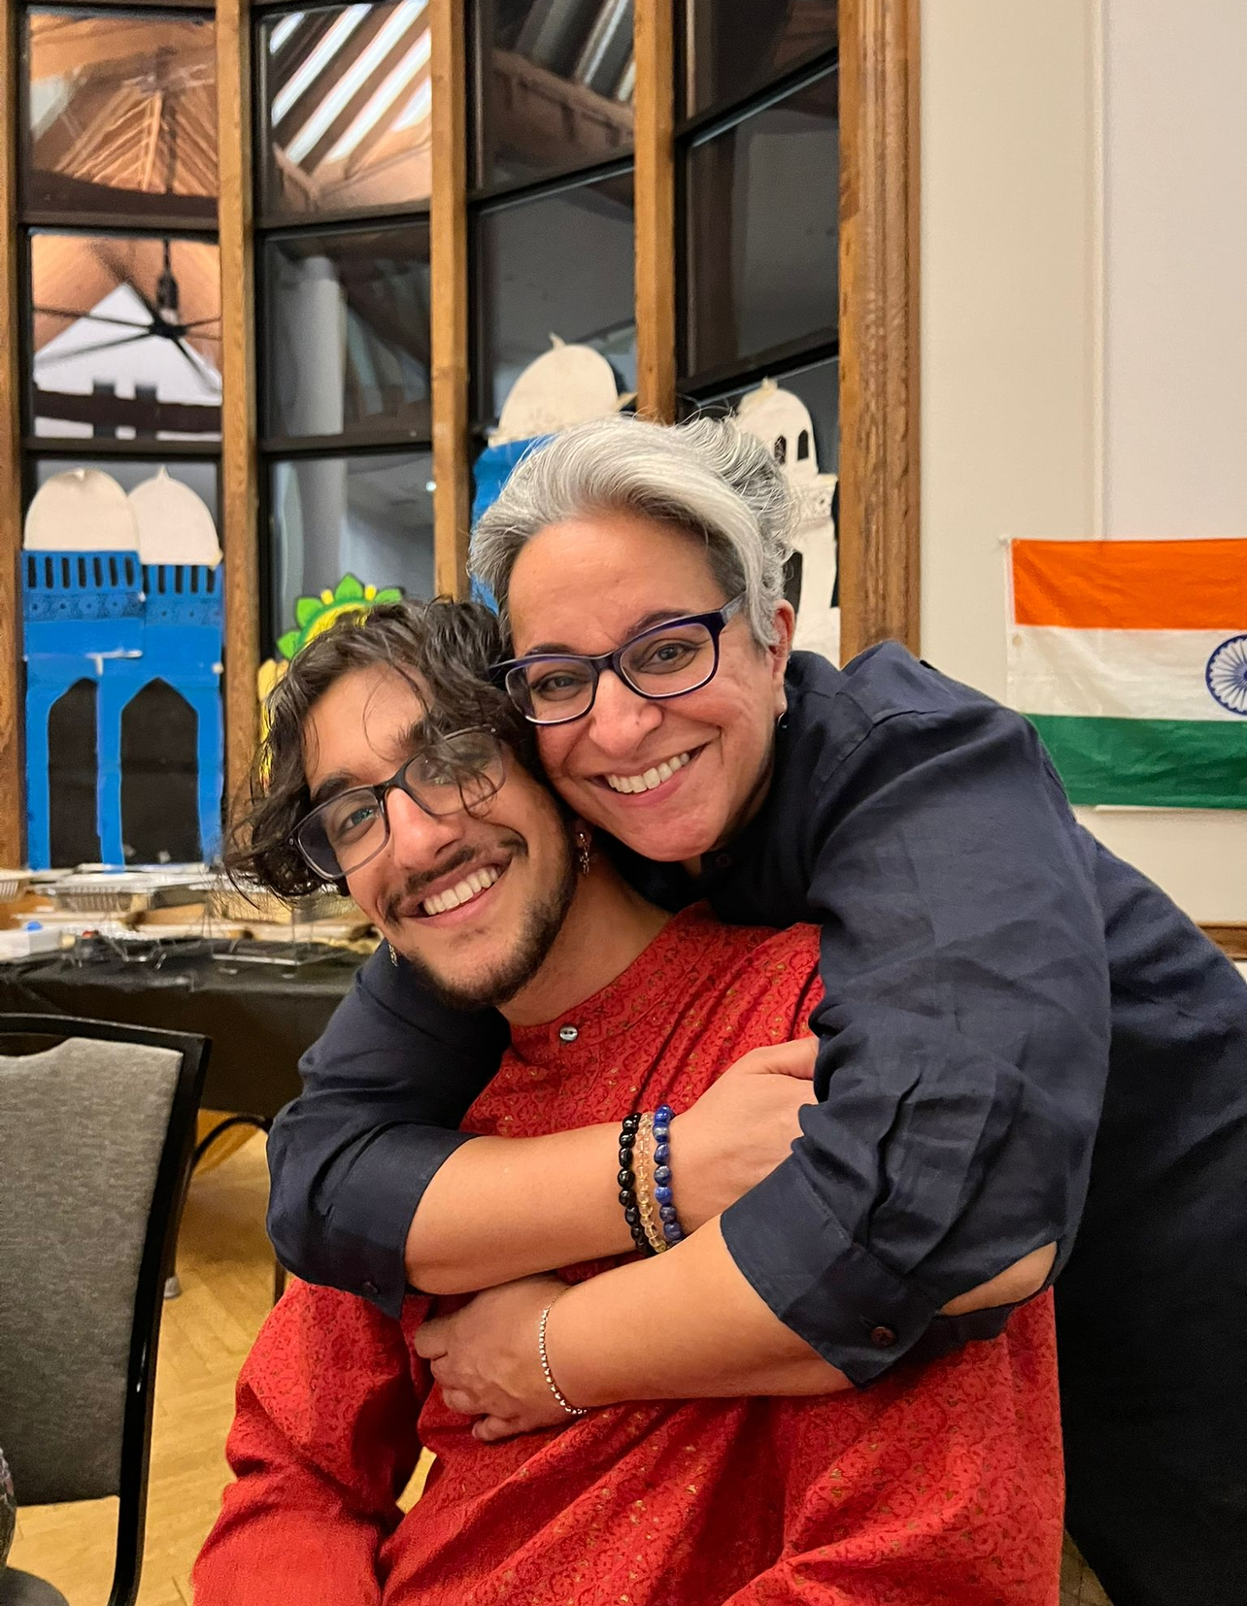
How Masala King started
2008

Slide 3
How Masala King started
Got my first computer and used garageband for the first time
2008
2018

Slide 4
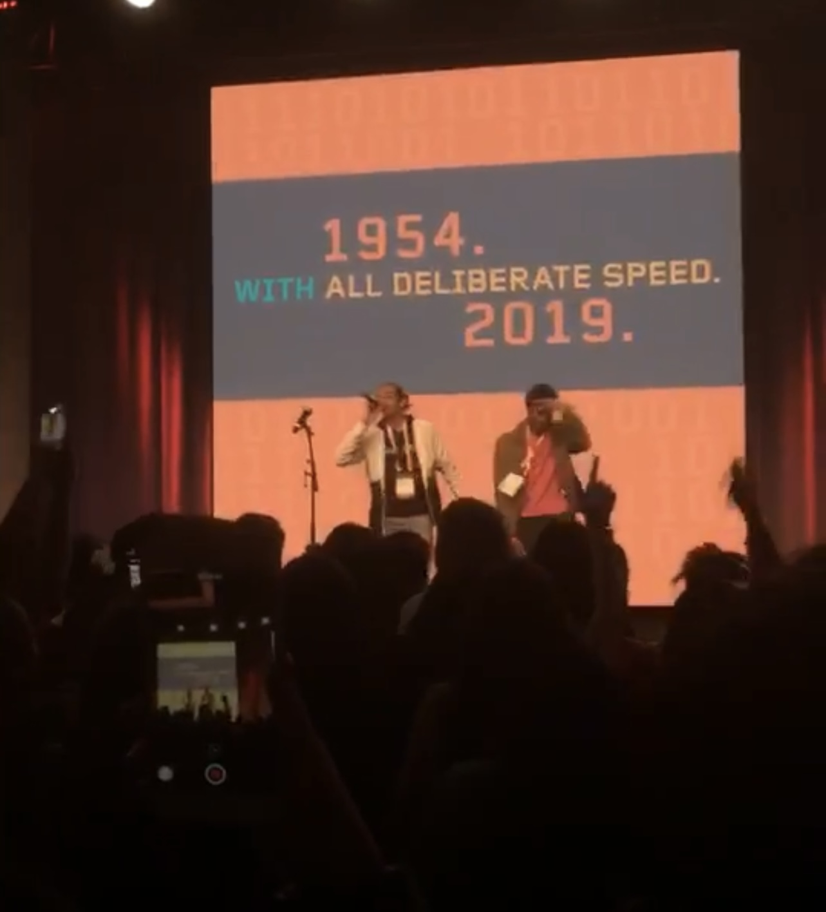
Made my first beat on ableton after taking a class
2008
2018
2019

Slide 5
Learned how to use fl studios and started getting serious with my music
2018
2019
2021

Slide 6
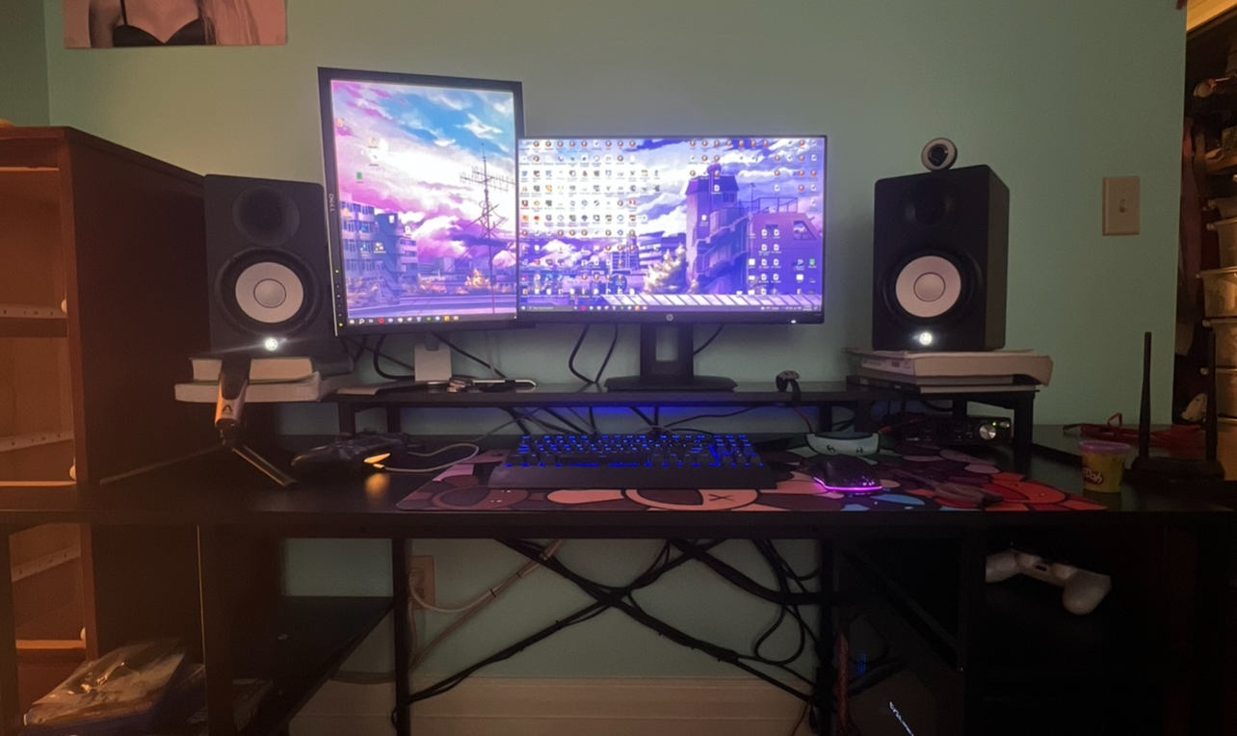
Started streaming on twitch and Got my first sale
2019
2021
2023

Slide 7
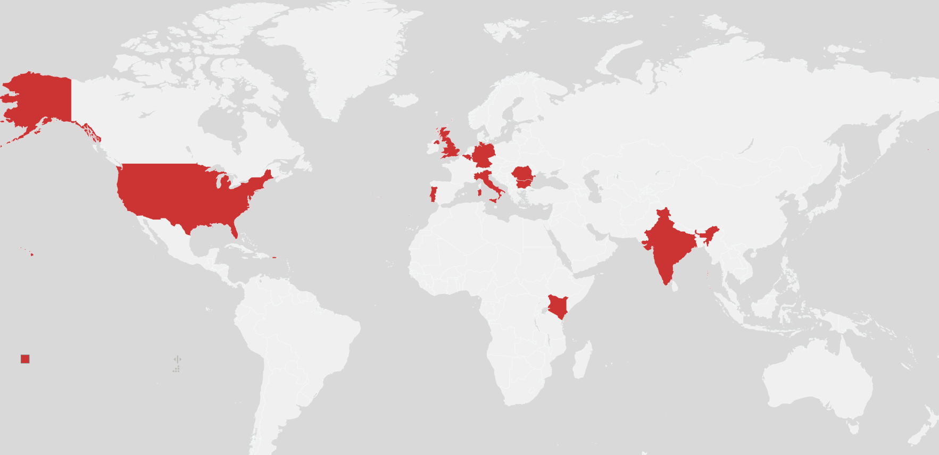
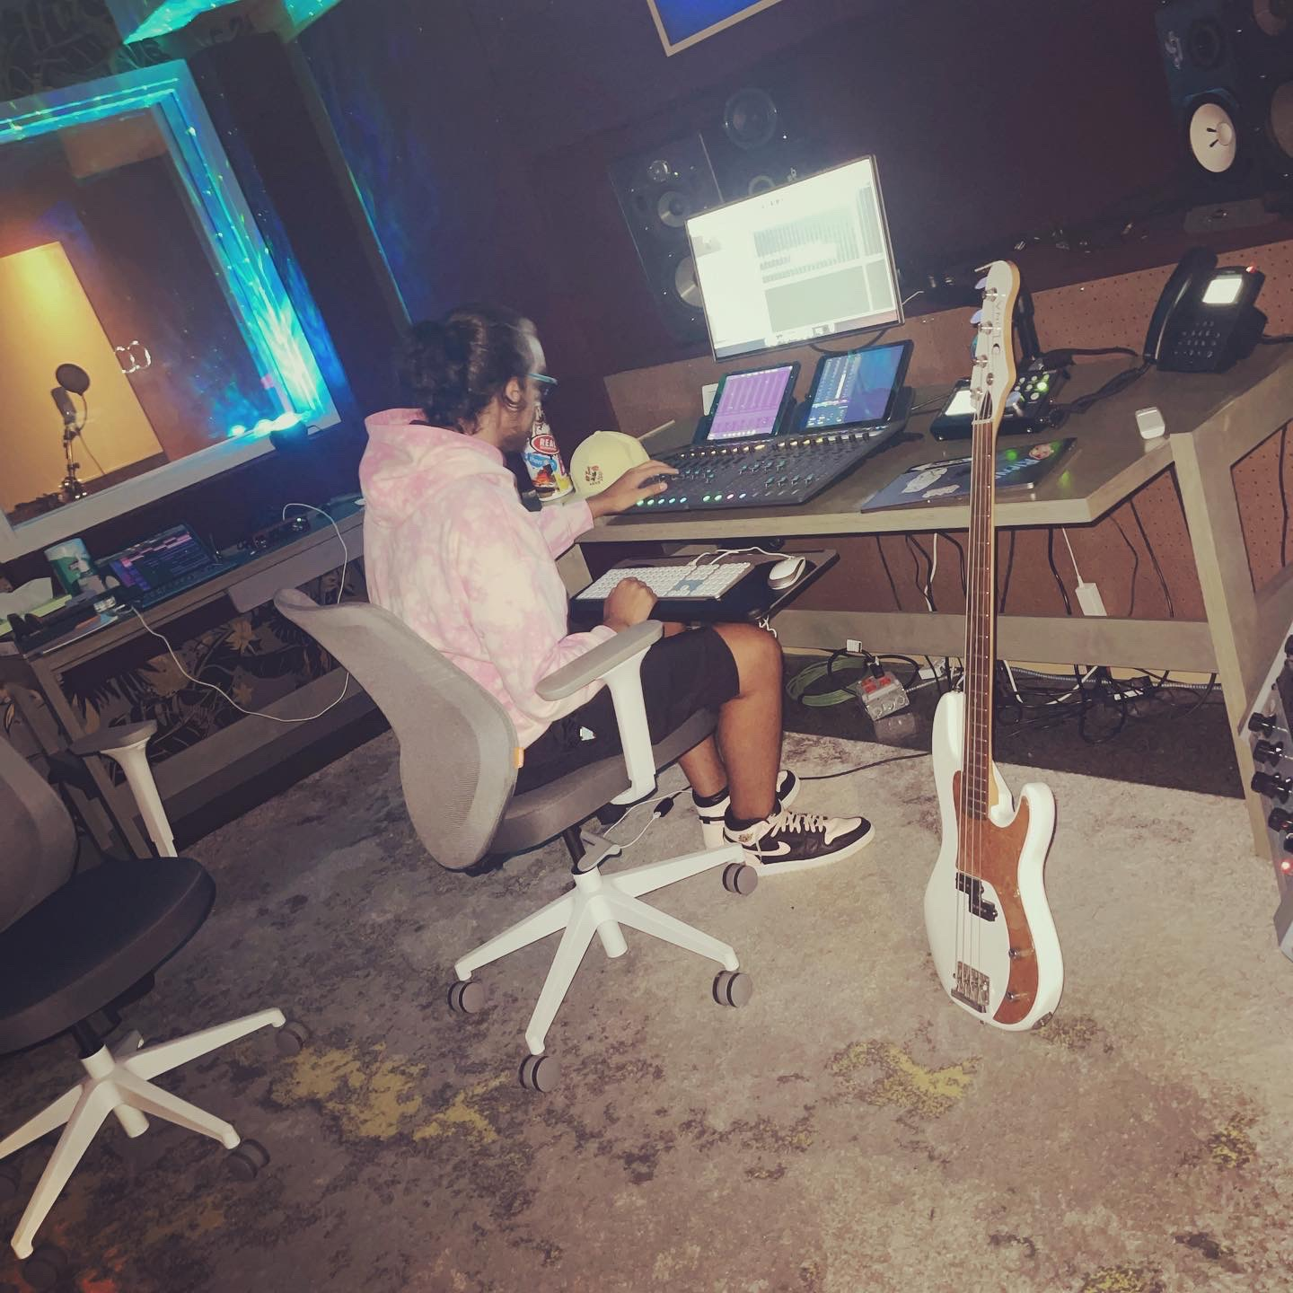
Decided to go all in on music production
2021
2023
2024

Slide 8
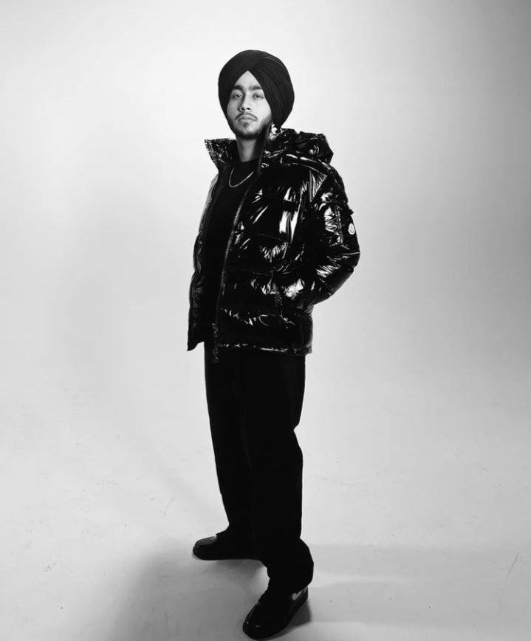


Problem
Lack of South Asian Artists popular in Western Music
How do Producers get to where they are today?
Traction in a saturated industry esp being a part of underrepresented community
Growing industry and the future of music is in global music
Not enough people sharing their stories
A lot of gatekeeping

Slide 9
industry
82.2M AMERICANS STREAM MUSIC
$4.5 BILLION Indie Artists (50% of Spotify payouts)
U.S. Music Revenue $26.2 BILLION
Global music $31.2b 2022
RnB + HipHop 30.7%

Slide 10
industry
According to IFPI
U.S. Music Revenue $26.2 BILLION
RnB + HipHop 30.7%
$4.5 BILLION Indie Artists (50% of Spotify payouts)

Slide 11
industry
According to IFPI
U.S. Music Revenue $26.2 BILLION
Global music $31.2b 2022
$4.5 BILLION Indie Artists (50% of Spotify payouts)
82.2M AMERICANS STREAM MUSIC
RnB + HipHop 30.7%

Slide 12
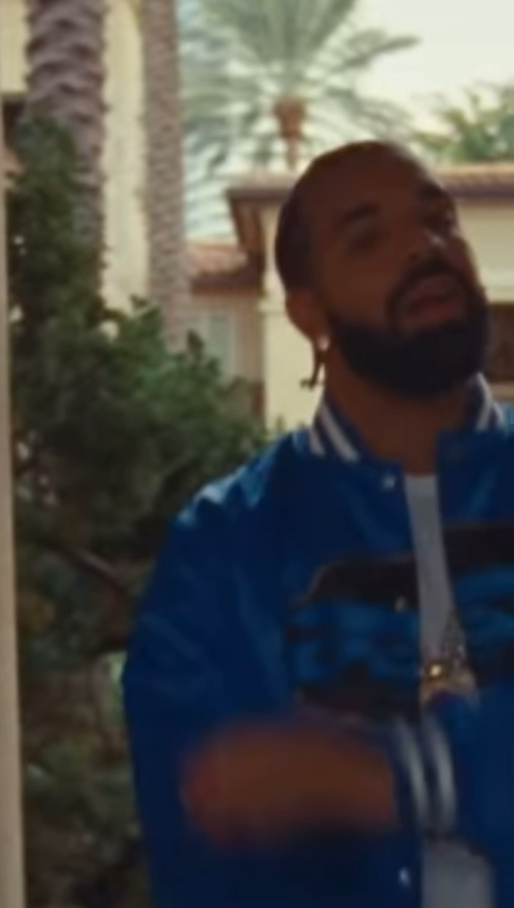
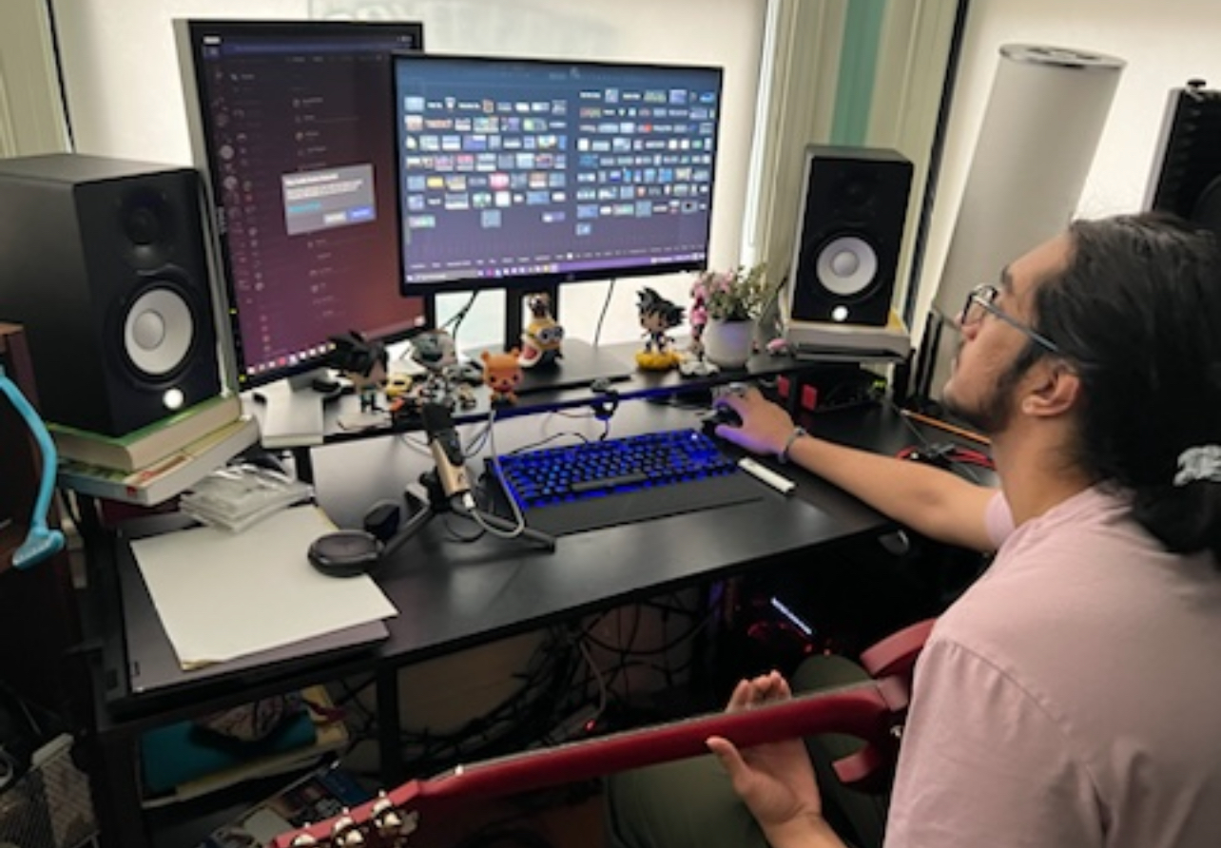
Solution
What I do now
11 Countries

Slide 13
Solution
MASALA KING
Make beats, sell services to artists, brands, influencers around the world
Focusing on South Asian artists
Make music that tie cultures together
TWITCH AND CONTENT CREATION
Twitch and Content Creation
Create content
Show what it takes to be a producer from the ground up
Create content
Show what it takes to be a producer from the ground up

Slide 14
Solution
MASALA KING
Make beats, sell services to artists, brands, influencers around the world
Focusing on South Asian artists
Twitch and Content Creation
Create content
Show what it takes to be a producer from the ground up

Slide 15
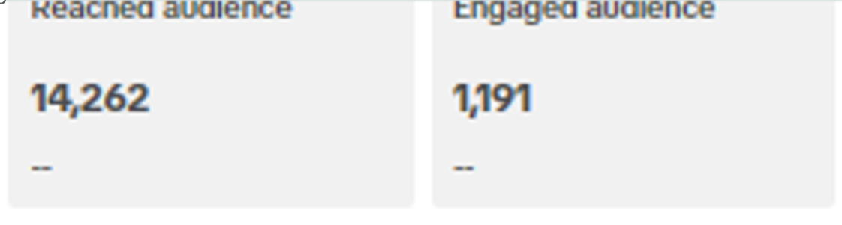
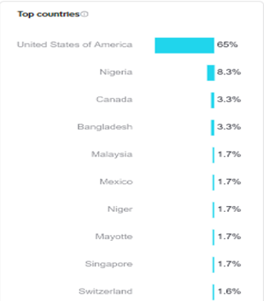
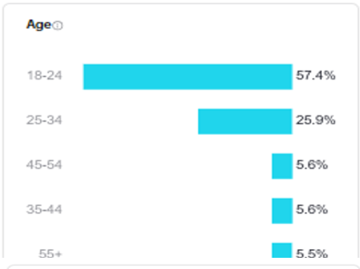
mARKET
40,000 views on TikTok
70,000 views on Instagram

Slide 16
industry
RnB + HipHop 30.7%
82.2M AMERICANS PAY FOR STREAMING SERVICES
Global music made $31.2 Billion in 2022 (US made $10 billion)
Music Revenue $26.2 BILLION
BeatStars negotiated a $50,000 non-exclusive license with a $40,000 sale to sell exclusively
$4.5 BILLION generated by Independent Artists (50% of Spotify payouts)

Slide 17
industry
Music Revenue $26.2 BILLION
Global music made $31.2 Billion in 2022 (US made $10 billion)
$4.5 BILLION generated by Independent Artists (50% of Spotify payouts)
82.2M AMERICANS PAY FOR STREAMING SERVICES
RnB + HipHop 30.7%

Slide 18
audience

Slide 19
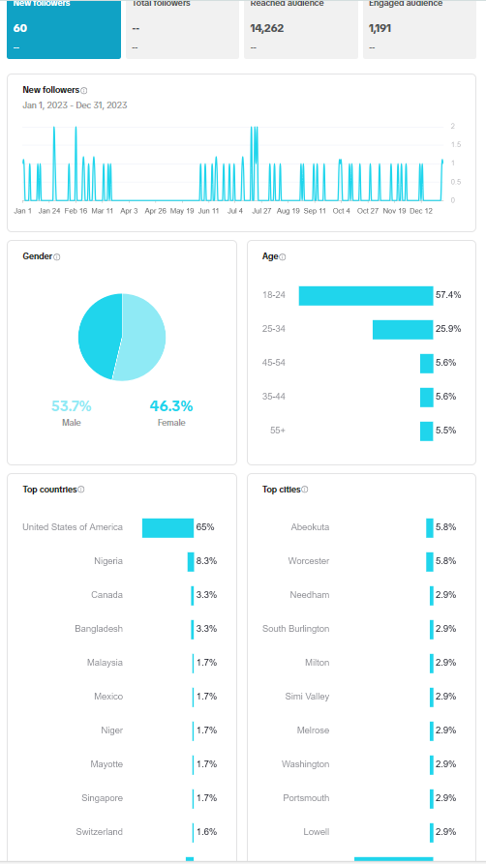
audience

Slide 20
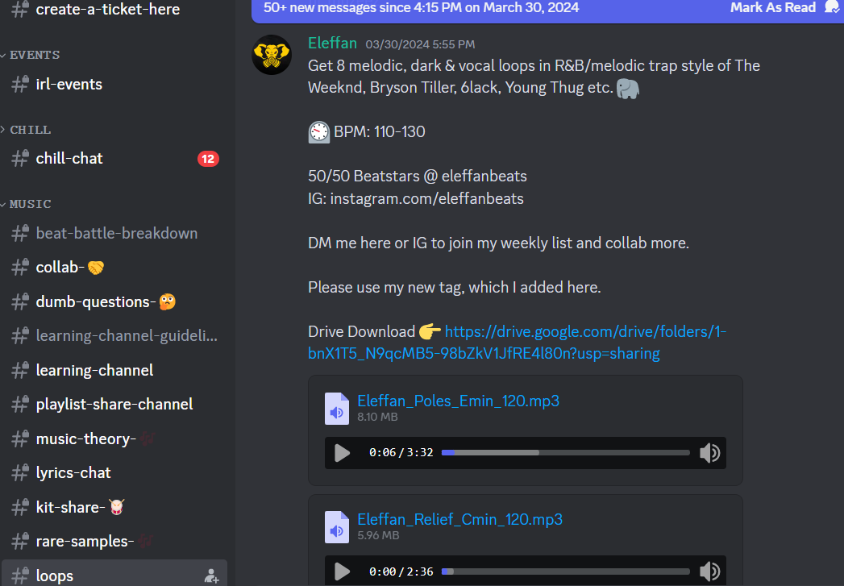
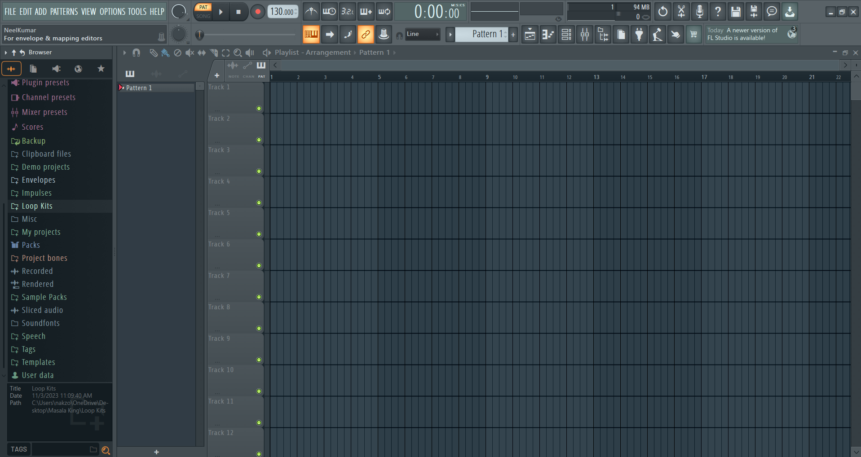
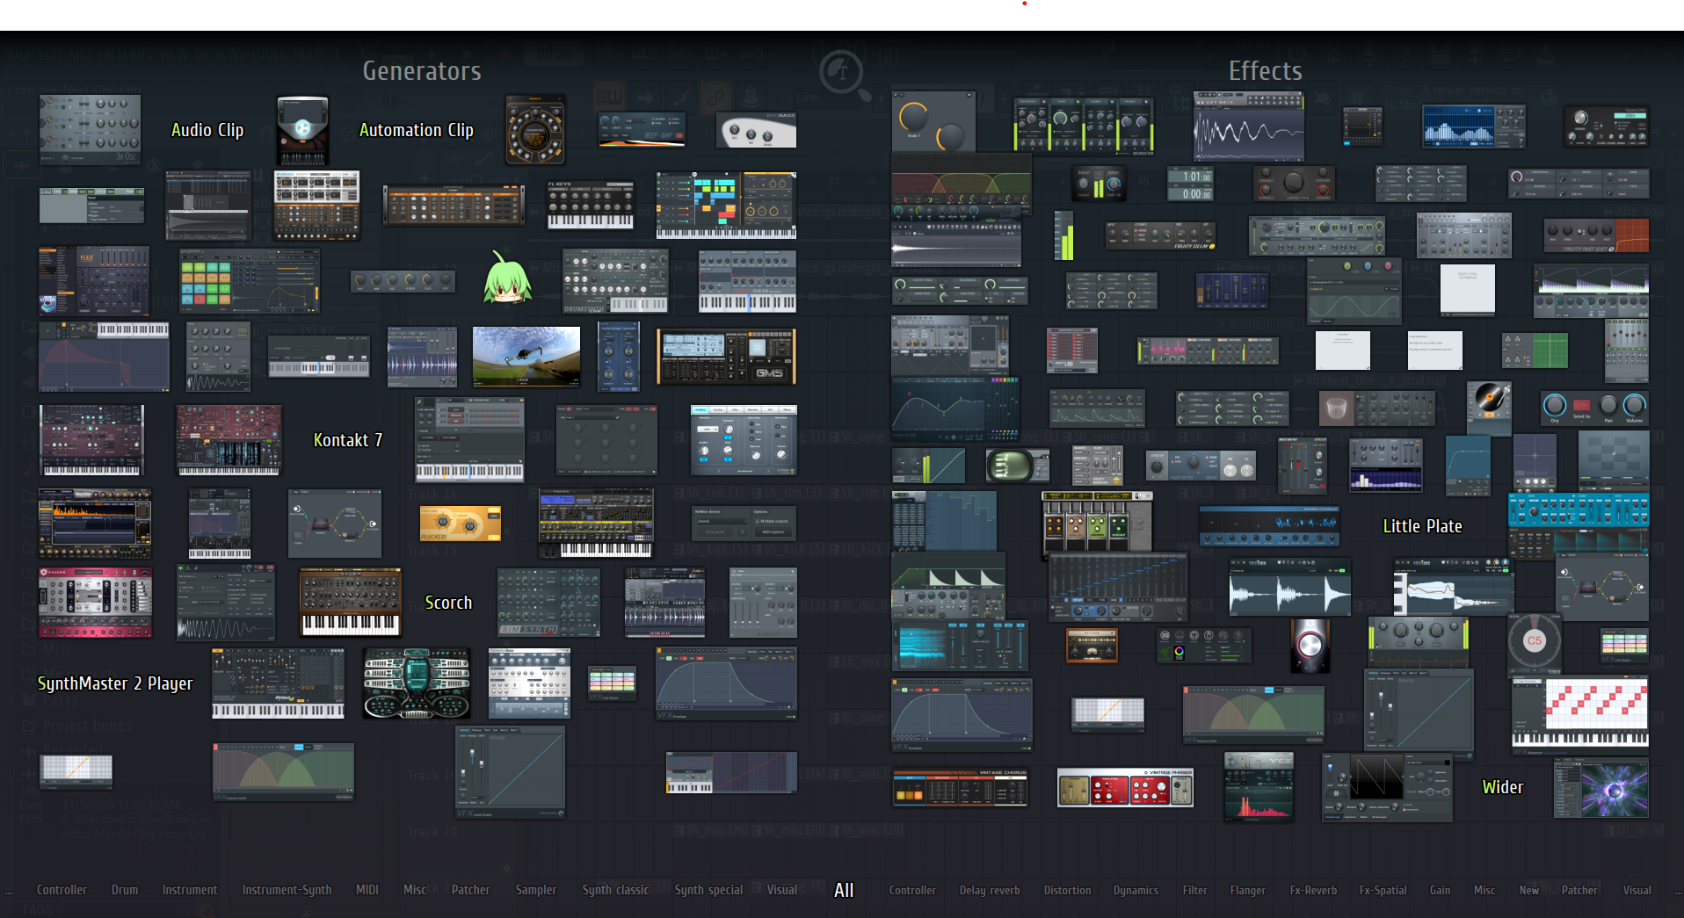
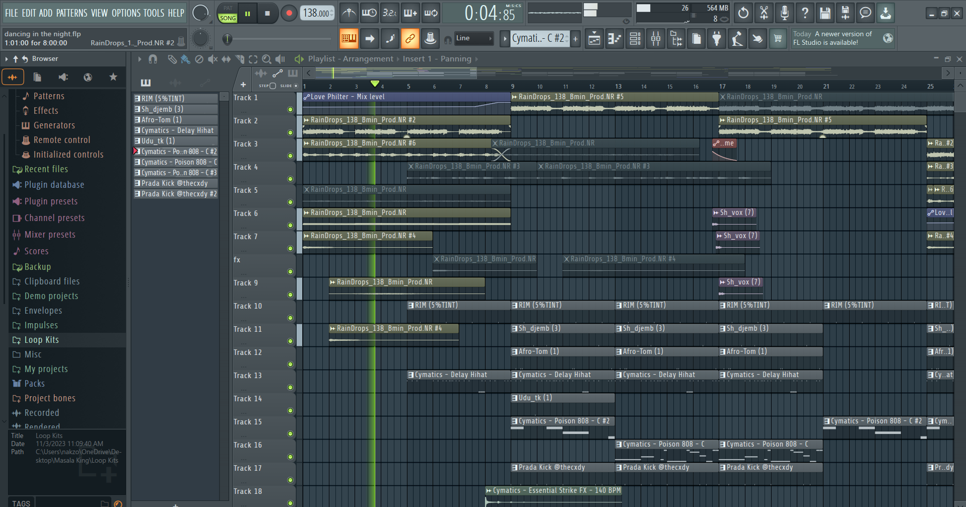
HOW I MAKE MONEY
STEP 1
STEP 2
STEP 3
STEP 4

Slide 21
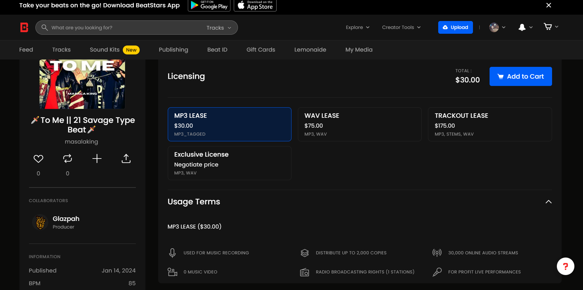




HOW I MAKE MONEY
Unique
First to market
Only product specifically dedicated to this niche market
First beautifully designed product that's both stylish and functional​
BeatStars
Platform for Producers to sell their beats and services
2M producers
Equal playing ground
Ability to see trends
Tested
Authentic
Conducted testing with college students in the area​
Designed with the help and input of experts in the field ​

Slide 22
Products
Exclusive/Unlimited License NEGOTIATED PRICE
MP3 Lease $30
WAV Lease $75
TRACKOUT Lease $175
Basic Lease
2,000 copies
30,000 streams
1 station
For Profit Performances
Upgraded Lease (most common on the platform)
5,000 copies
250,000 streams
2 stations
For Profit Performances
1 Music Video
Access to the STEMS
10,000 copies
650,000 streams
Unlimited Stations
For Profit Performances
2 Music Videos
Unlimited Copies
Unlimited Streams
Unlimited Stations
Unlimited Music Videos

Slide 23
Competitors
Metro Boomin
Soesbeats
BNYX
GLAZPAH

Slide 24

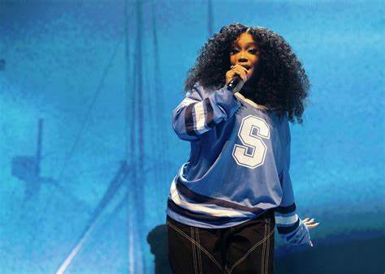
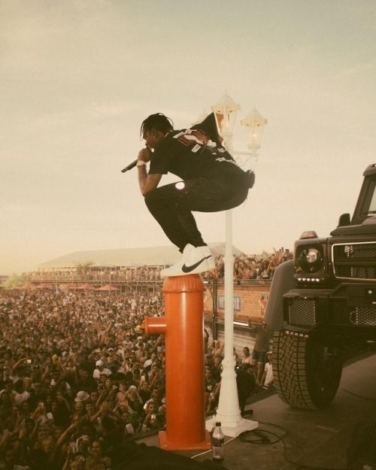
Collaborators and inspirations
Metro Boomin
Soesbeats
BNYX
GLAZPAH
Trades
Melodies
Unique Sound
Made the melody in the beat you heard earlier

Slide 25
THE Future
Reach
Streaming
The album
Consistent posting, streaming, and producing = increase reach
Work with more artists and bigger artists
Create an album that bridges gap between India + US
Connect US artists and artists with Indian descent
Collaborating with producers and artists to create content and show how to make music
Create a community of producers to collaborate

Slide 26
THE Future
Reach
Consistent posting, streaming, and producing = increase reach
Work with more artists and bigger artists
Streaming
Collaborating with producers and artists to create content and show how to make music
Create a community of producers to collaborate
The album
Create an album that bridges gap between India + US
Connect US artists and artists with Indian descent

Slide 27
ASk
Total Ask: $3,400
Software (PLUGINS) $1,052
Copyrights $300
Content $900
Editor $1000
Antares AutoTune Pro (175 yearly)
Fab filter Pro Q3 (167)
Deesser (40)
Omnisphere (480)
Serum (190)
$45-$85 per batch of 10
Labeled as Songwriter (%50 royalty)
Distribution, Sync, Publishing, and ownership
Tripod (100)
Sony ZV 1 ii (800)
2.5x time to edit

Slide 28
Estimated revenue
$850
CURRENT
REVENUE
$6,300
2 beats a week at $75
1 year
$42,000
2 beats a week at $500
1 year
5-15%
Viewers pay streamers
70 viewers $1,820 → $5,460
500 viewers $13,000 → $78,000

Slide 29
Masala King
Thank You
Questions?

Slide 30



Solution
Close the gap
Target audience
Cost savings
Easy to use
Our product makes consumer lives easier, and no other product on the market offers the same features​
Gen Z (18-25 years old)
Reduce expenses for replacement products
Simple design that gives customers the targeted information they need​

Slide 31
Product Benefits
Cool and stylish product​
Areas for community connections
Online store and market swap​

Slide 32
Company Overview

Slide 33



Business Model
Research​
Abstract​
Design​
We based our research on market trends and social media​
We believe people need more products specifically dedicated to this niche market​
Minimalist and easy to use ​

Slide 34
Market opportunity overview
$3b
$1b
$2b
Opportunity to build​
Fully inclusive market​
Total addressable market​
Freedom to invent​
Selectively inclusive market​
Serviceable available market​
Few competitors​
Specifically targeted market​
Serviceable obtainable market​

Slide 35
Market opportunity comparison
$3B
Opportunity to Build
Revenue over 12 months​
$2B
Freedom to Invent
Market share​
$1B
Few Competitors
Obtainable market​

Slide 36
Our competition
CoNTOSO
competitors
Our product is priced below that of other companies on the market​
Design is simple and easy to use, compared to the complex designs of the competitors​
Affordability is the main draw for our consumers to our product​
Company A​
Product is more expensive​
Companies B & C ​
Product is expensive and inconvenient to use​
Companies D & E​
Product is affordable, but inconvenient to use

Slide 37
Growth strategy
How we’ll scale in the future
Feb 20xx
May 20xx
Oct 20xx
Roll out product to high profile or top-level participants to help establish the product​
Release the product to the general public and monitor press release and social media accounts​
Gather feedback and adjust product design as necessary​

Slide 38
Traction
Forecasting for success​
Key metrics
Revenue by year
 | clients | orders | Gross avenue | Net revenue
20XX​ | 10​ | 1100​ | $10,000​ | $7,000​
20XX​ | 20​ | 200​ | $20,000​ | $16,000​
20XX​ | 30​ | 300​ | $30,000​ | $25,000​
20XX​ | 40​ | 400​ | $40,000​ | $30,000​
20XX​ | 50​ | 500​ | $50,000​ | $40,000​
20XX | 10 | 1100 | $10,000 | $7,000

Slide 39
Two-year action plan
Draft blueprints​
Run focus groups​
Gather feedback​
20XX
Jan
Feb
Mar
Apr
May
Jun
Jul
Aug
Sep
Oct
Nov
Dec
Test design​
Launch design​
Deliver to client
20XX
Jan
Feb
Mar
Apr
May
Jun
Jul
Aug
Sep
Oct
Nov
Dec

Slide 40
financials
 | Year 1 | Year 2 | year 3
Detailers​ | 5,000​ | 40,000​ | 160,000​ | ​
Users​ | 50,000​ | 400,000​ | 1,600,000​ | ​
Sales​ | 500,000​ | 4,000,000​ | 16,000,000​ | ​
Average price per sale​ | 75​ | 80​ | 90​ | ​
Revenue @ 15%​ | 5,625,000​ | 48,000,000​ | 216,000,000​ | ​
Gross Profit​ | 5,625,000​ | 48,000,000​ | 216,000,000​ | ​
Expenses​ | ​ | ​ | ​ | ​
Sales & marketing​ | 5,062,500​ | 38,400,000​ | 151,200,000​ | ​
Customer service​ | 1,687,500​ | 9,600,000​ | 21,600,000​ | 70%​
Product development​ | 562,500​ | 2,400,000​ | 10,800,000​ | 10%​
Research​ | 281,250​ | 2,400,000​ | 4,320,000​ | 5%​
Total Expenses​ | 7,593,750​ | 52,800,000​ | 187,920,000​ | 2%​
EBIT | -1,968,750 | -4,800,000 | 28,080,000 | ​

Slide 41




Our team
Takuma Hayashi​​
Mirjam Nilsson​​
Flora Berggren​​
Rajesh Santoshi​​
President
Chief Executive Officer​
Chief Operations Officer​
VP Marketing​

Slide 42








Our team
Takuma Hayashi​​
Mirjam Nilsson​​
Flora Berggren​​
Rajesh Santoshi​​
President
Chief Executive Officer​
Chief Operations Officer​
VP Marketing​
Graham Barnes​
Rowan Murphy​
Elizabeth Moore​
Robin Kline​
VP Product​
SEO Strategist​
Product Designer​
Content Developer​

Slide 43
Funding
12K
14K
32K
82K
Property
Angel Investments
Cash
Shares
Revenue obtained from property rentals​
Amount obtained through other investors​
Liquid cash we have on hand​
Number of shares converted into USD​

Slide 44
Summary
At Contoso, we believe in giving 110%. By using our next-generation data architecture, we help organizations virtually manage agile workflows. We thrive because of our market knowledge and great team behind our product. As our CEO says, "Efficiencies will come from proactively transforming how we do business."​

Slide 45
Thank you
Mirjam Nilsson​​
206-555-0146​
mirjam@contoso.com​
www.contoso.com​

