Slide 1


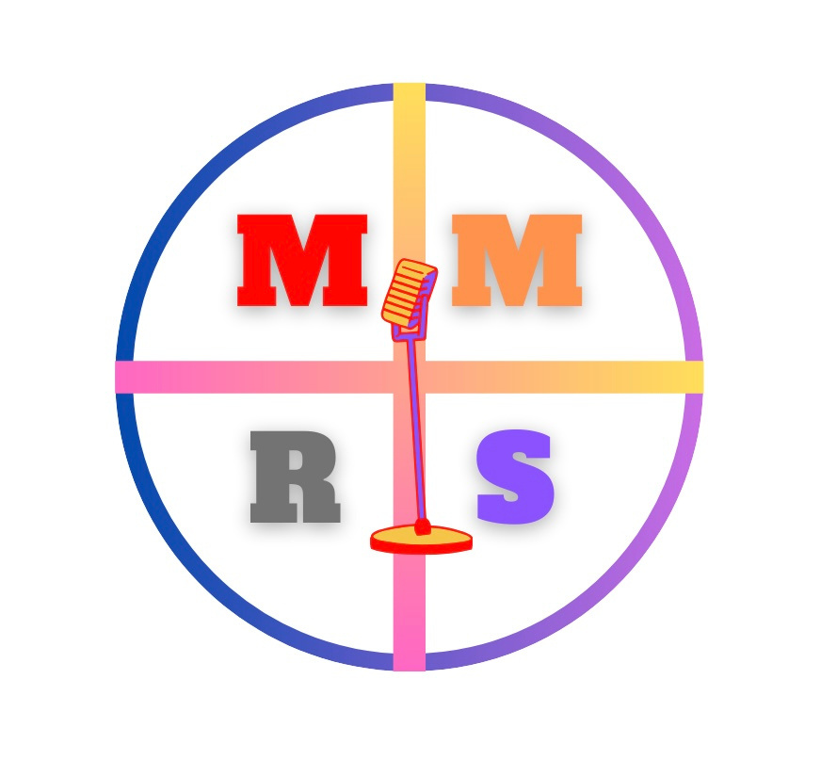


MANNY’S MOBILE
RECORDING
STUDIO
WITH MANNY TORTO
Notes:
“Hello everyone. Sorry for pausing that beautiful music. My name is Manny Torto and my business is Manny’s Mobile Recording Studio, a come-to-you recording service that provides access to equipment and a trained engineer.”

Slide 2
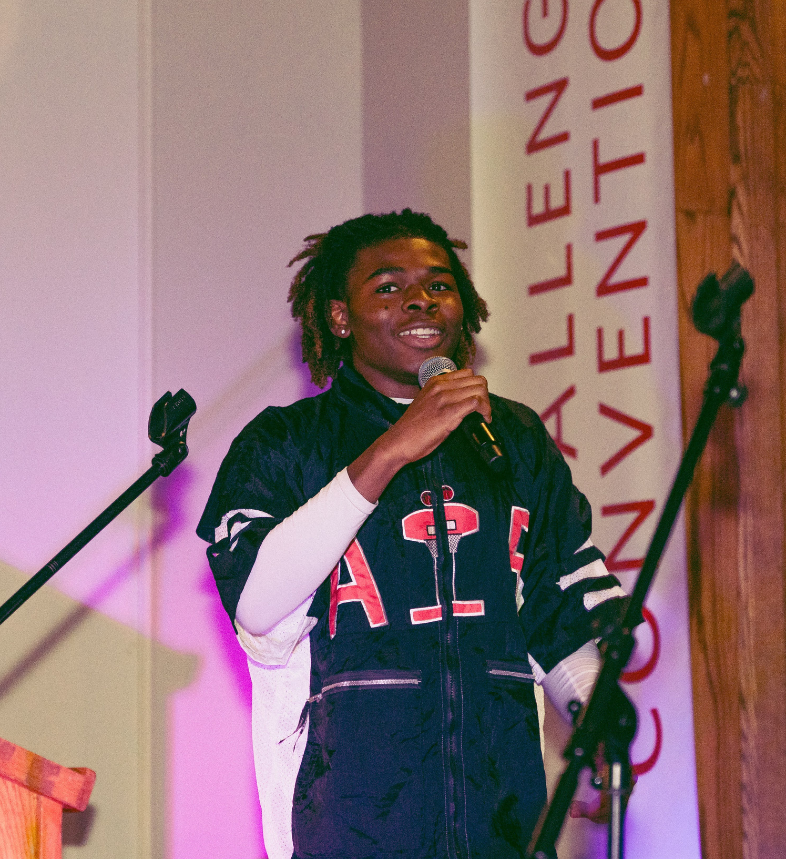
"The best way to know your audience is to become your audience"
  MUSICIAN
  SINGER/SONGWRITER
  RECORDING ENGINEER
  GREW UP IN WORCESTER
  LOVES MUSIC/PRODUCTION
Notes:
“Born and raised in Worcester, I would describe myself as a musician, singer/songwriter, and recording engineer. From a young age, I found a passion for music, sound, and anything that could get people to stop and listen. My biggest inspiration is my mom and some of the best advice she’s given me is to know your audience. And overtime, I realized that the best way to know your audience is to become your audience.”

Slide 3
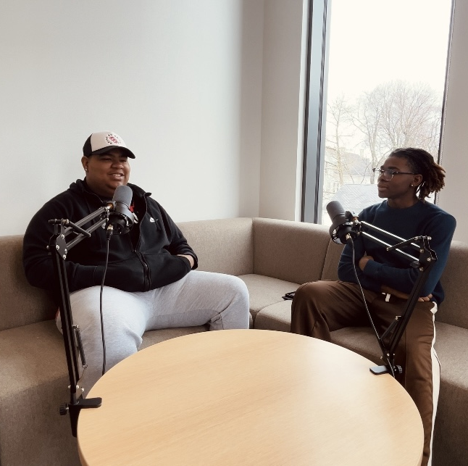
PROBLEM
LOCAL CREATORS CANNOT AFFORD STUDIO ACCESS TO PRODUCE THEIR WORK
THE AVERAGE PRICE FOR STUDIO TIME: $150
MY PRICE: $75
"COME-TO-YOU SERVICE"
Soundwow.com
Notes:
My audience consists of musicians and creators who want to produce their work but don't know where to start, don't have access to studio equipment or can't afford to pay $150 an hour compared to my $75. My audience is clients who'd rather find someone to come to them and guide them through their project at their preferred location, without them having to go out of their way to get to a studio.

Slide 4
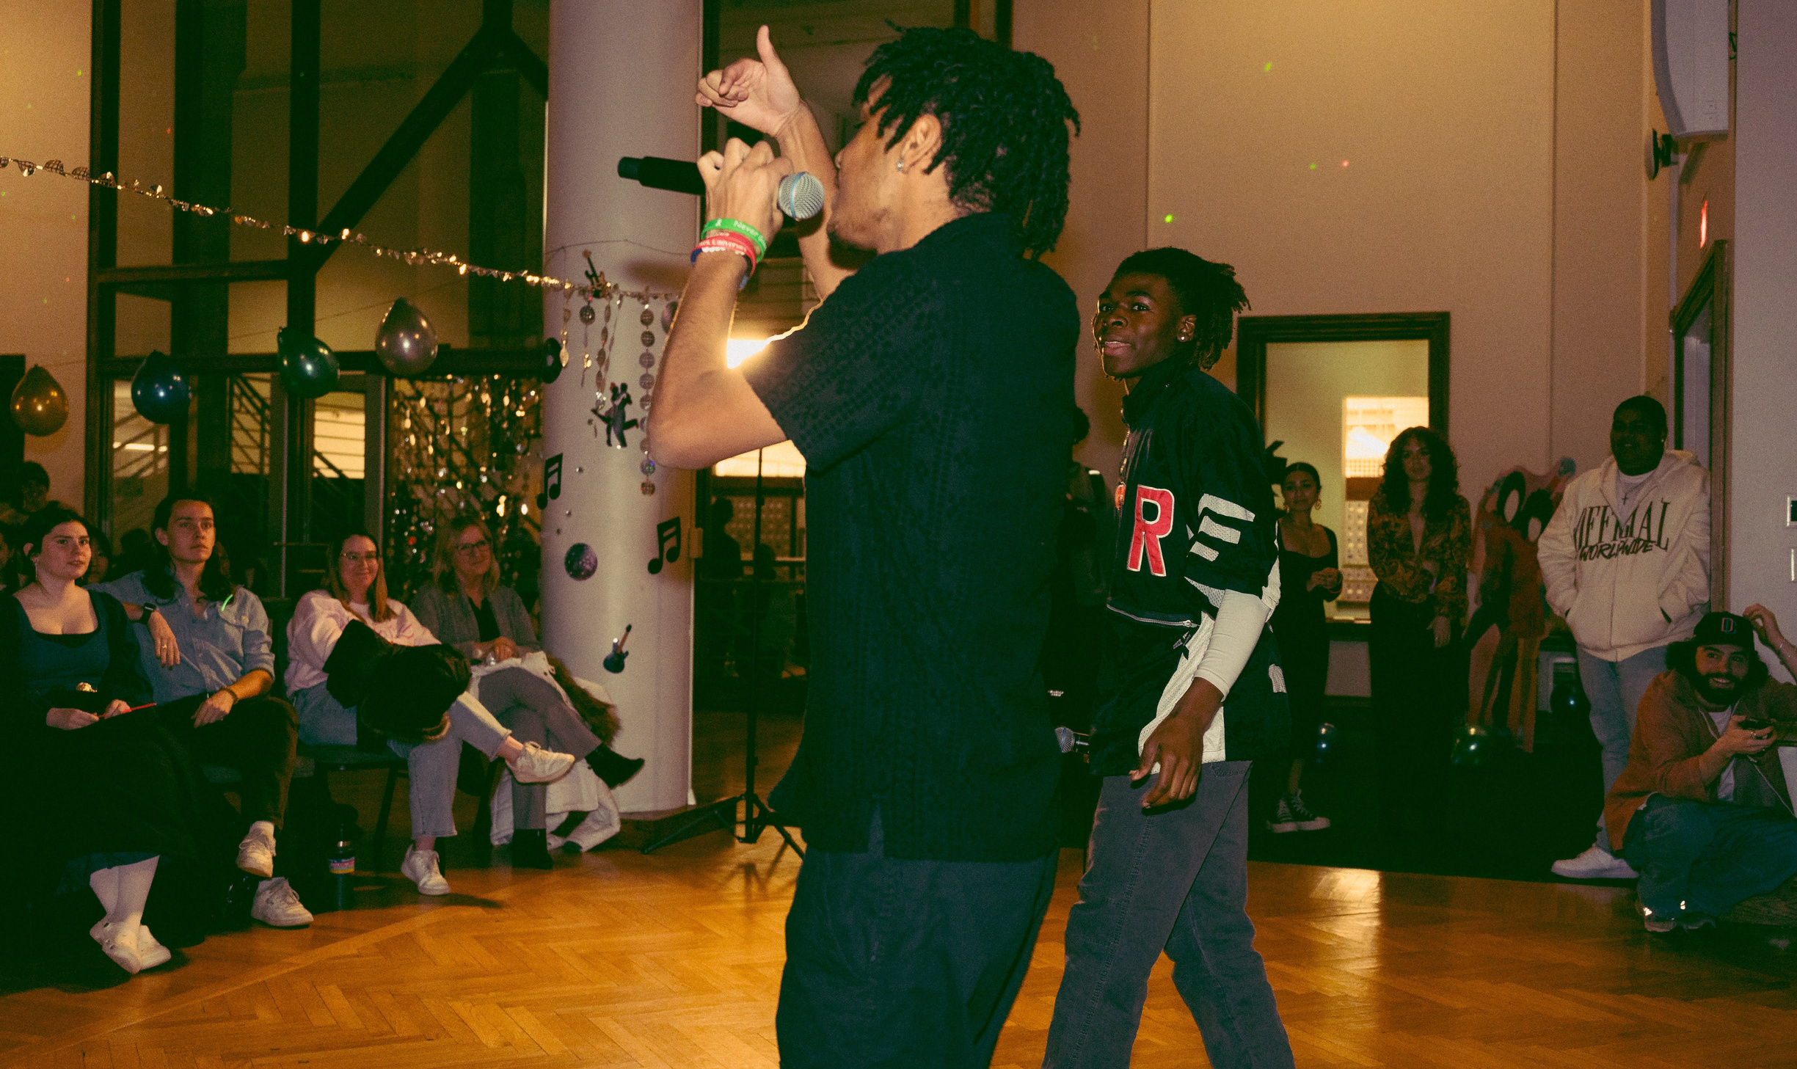
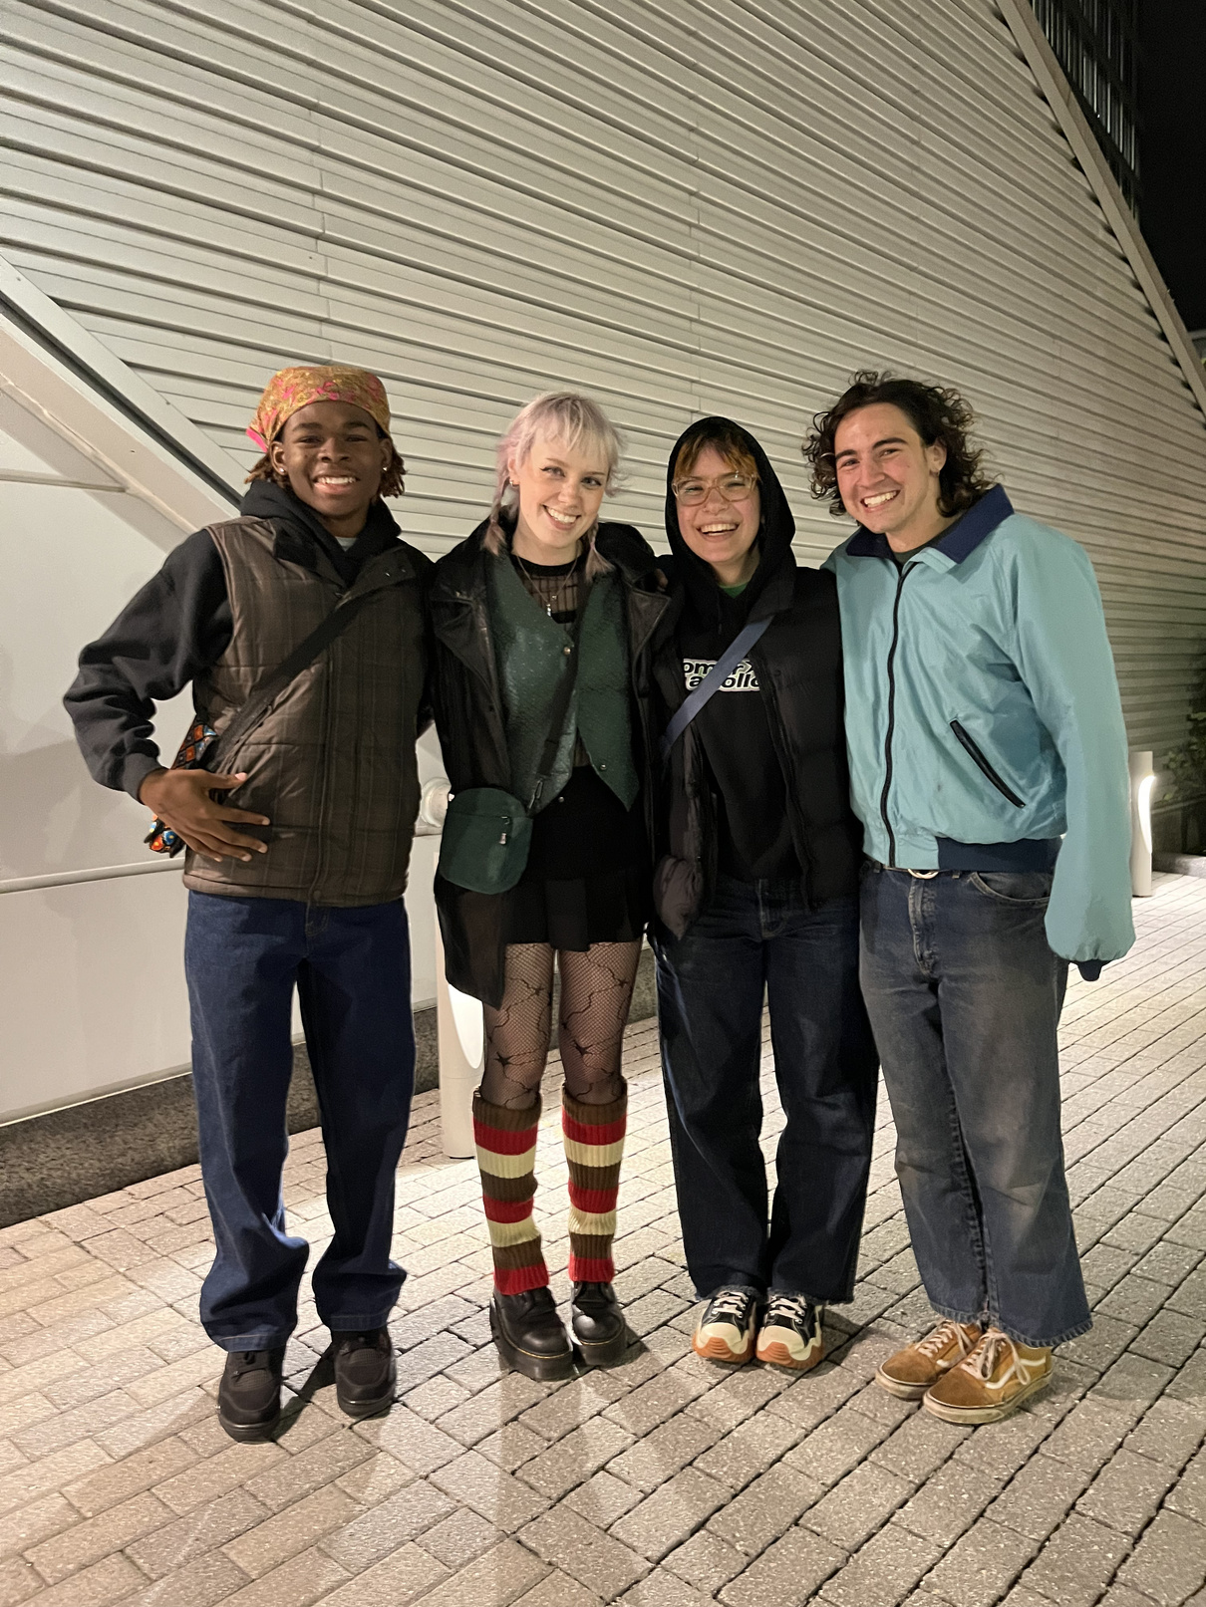
Solution:
Notes:
“Here at Clark University I have noticed that on a smaller scale, in the Worcester community, there is a lack of accessibility to recording components for students who want to get their song, demo, or podcast recorded.”
“My mission is to bring their vision to life with Manny’s Mobile Recording Studio.”

Slide 5
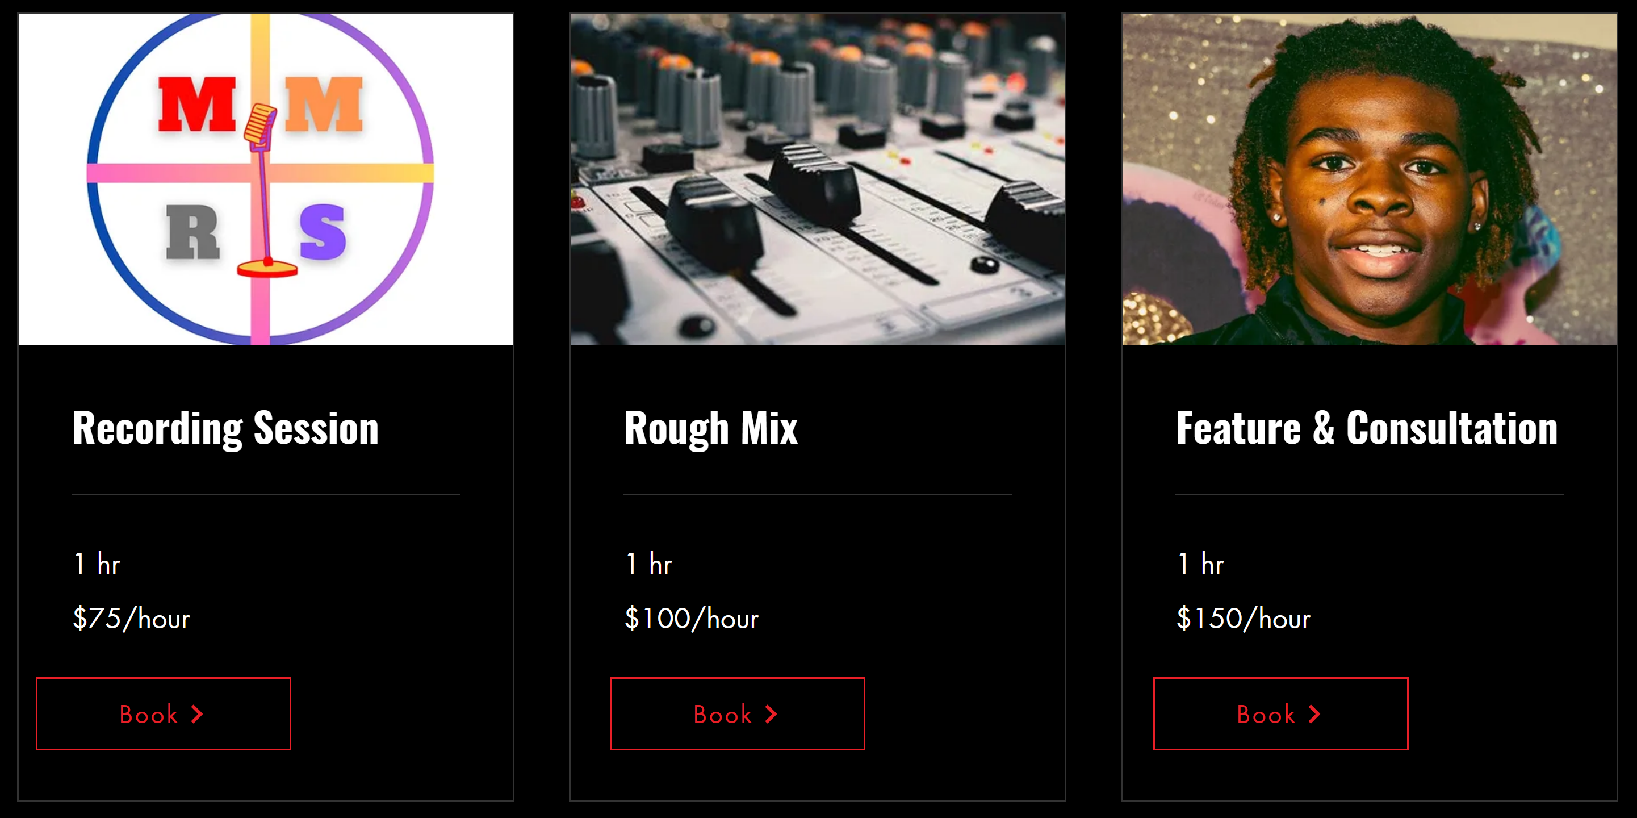
Return on Investment 1
Notes:
“The layout of my business includes a basic recording session, a mixing session putting everything together for the client in terms of production, and a chance to feature me on their project."

Slide 6

Return on Investment 2
CURRENT BASE PRICE: $50
BASE PRICE WITH YOUR INVESTMENT: $75
Notes:
"My current sales for a mix is $50 per session so your investment would help me further diversify my income and increase my value.”

Slide 7
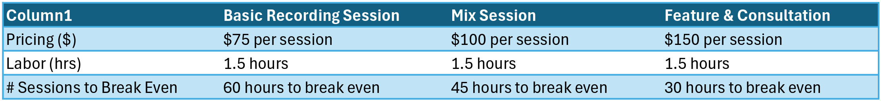
Return on Investment 3
My profit percentage ranges from 312.5% to 625%
I will make a profit of $600-$1200/month
if I record 8 clients per month.
Notes:
"Since my cost of production is my labor, my profit percentage is extremely high, and it would take me an average of 8 full recordings per month to make a profit of between $600 and $1200 per month.”

Slide 8
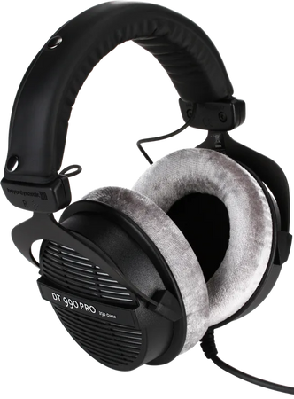
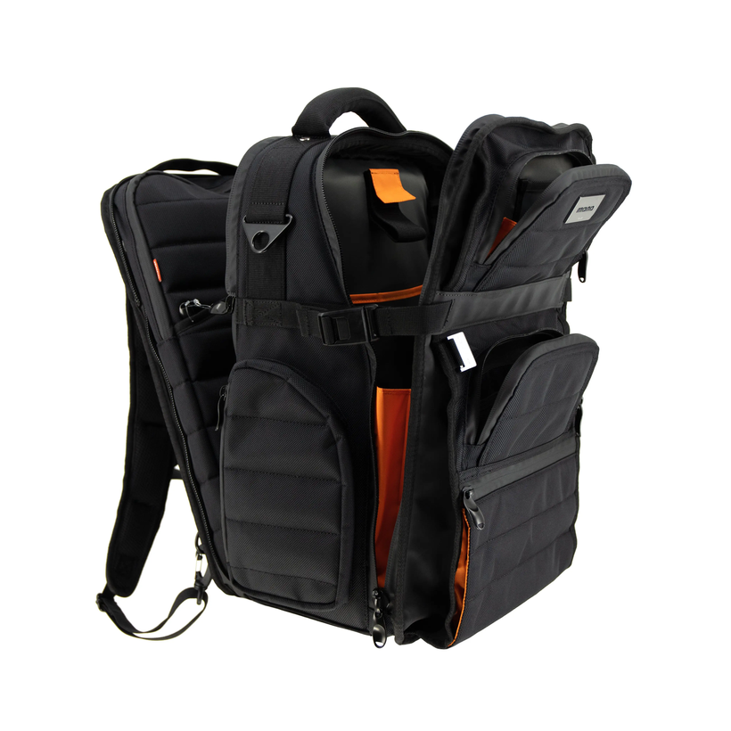
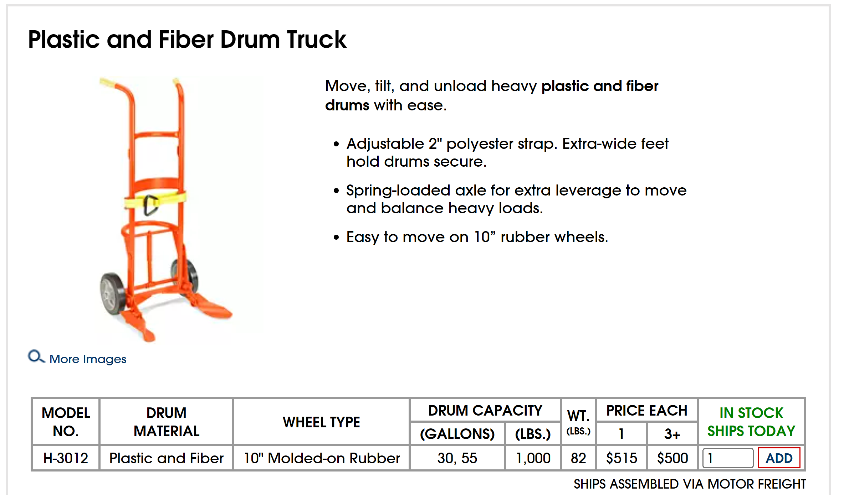
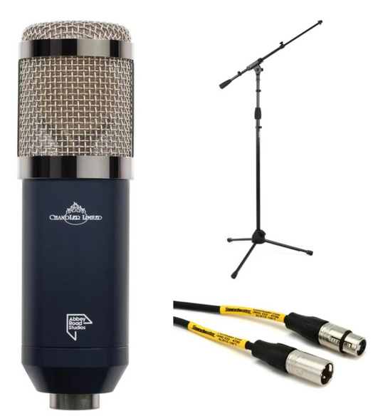
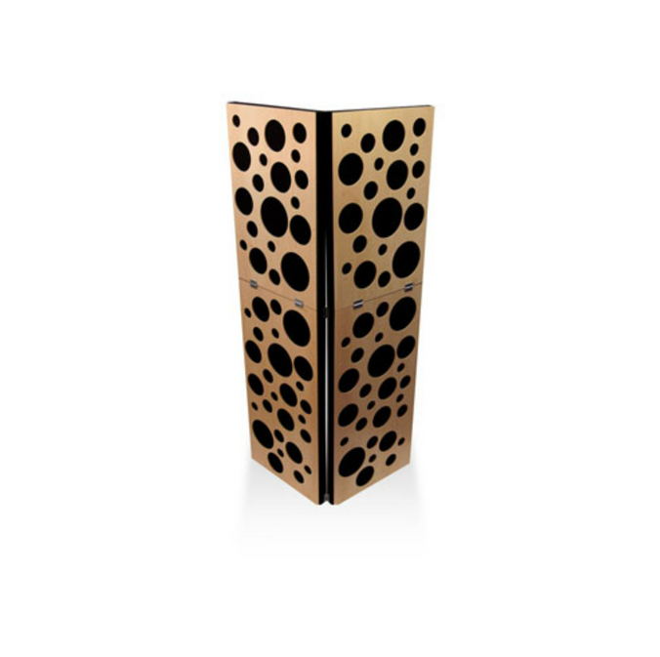
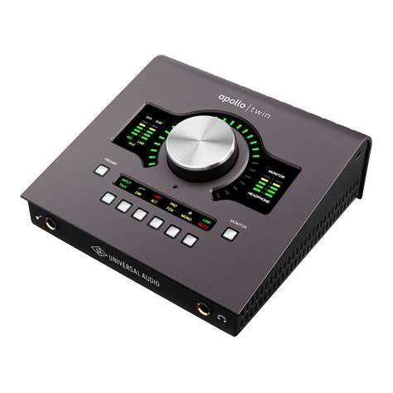
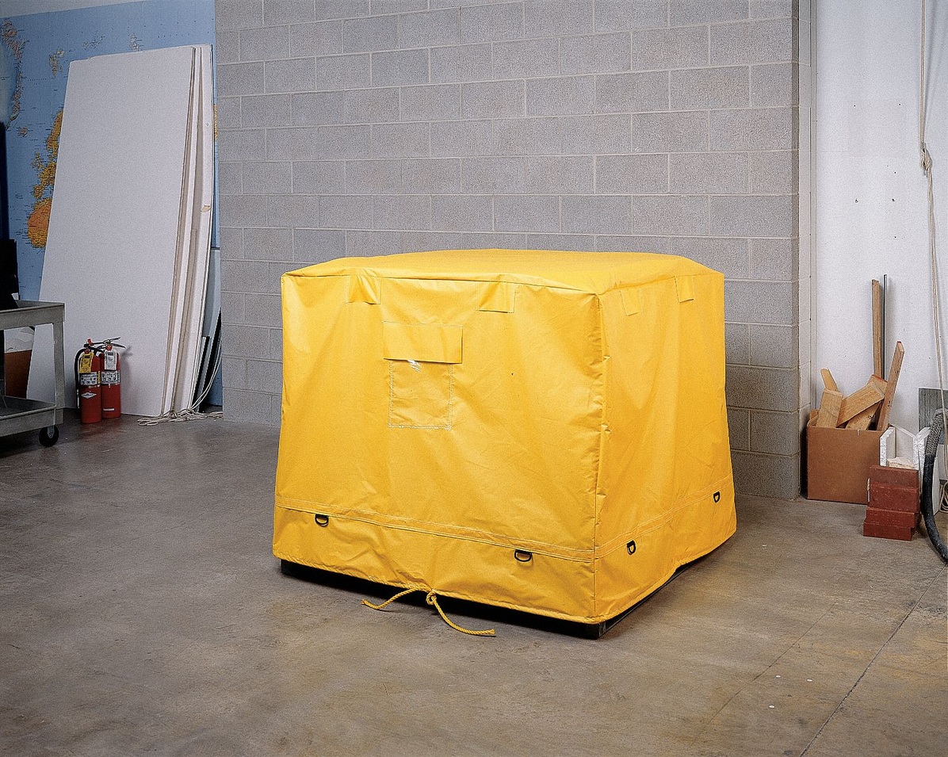
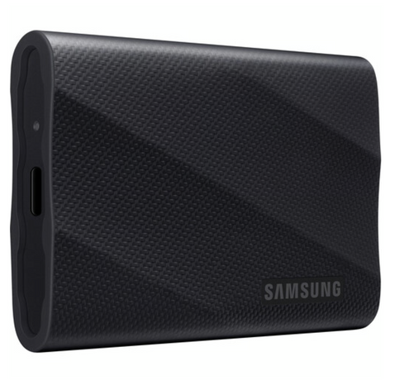
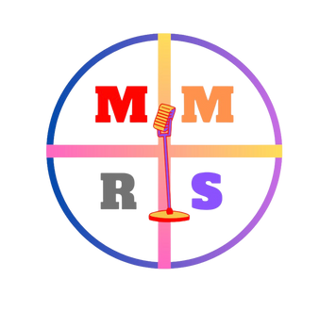
TG MICROHONE BUNDLE: $850
2 BEYERDYNAMIC HEADPHONES:
$340 total
Dolly: $50
ENGINEERING BAG: $100
UNIVERSAL APOLLO
INTERFACE: $1200
3 HARD DRIVES:
$330 total
ACOUSTIC BOARDS: $700
Custom Tarp: $30
Notes:
“Your investment will be allocated to 8 components to the success of my business.”
“The first set includes a TG microphone bundle, which would be used to capture vocals or any sounds the client wants to record, 2 sets of headphones to accurately hear and portray the signals from the microphone, an Apollo Interface to heighten the quality of the audio
transported to my laptop from the microphone, examples of protection and storage, an engineering backpack and 3 hard drives to save the information from my clients’ sessions. And then we have the mobile booth or acoustic treatment to block out exterior noises from the session.
The second set of products combine branding with the mobile aspect of the studio. A dolly big enough to transport the acoustic boards, and a custom tarp with my company logo on top of it to shield the boards from the weather.”
“Now picture me walking around Clark University with my mobile drum truck promoting my brand as I head over to my next client. That’s a bright picture, I’ll tell you that.”

Slide 9
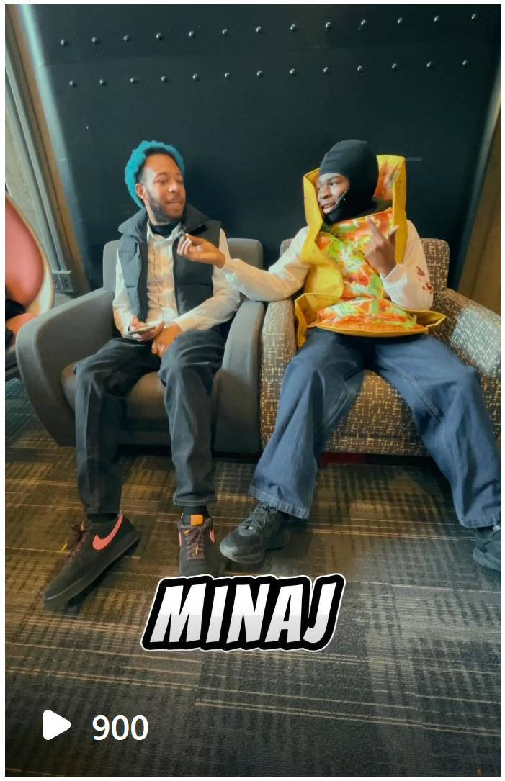

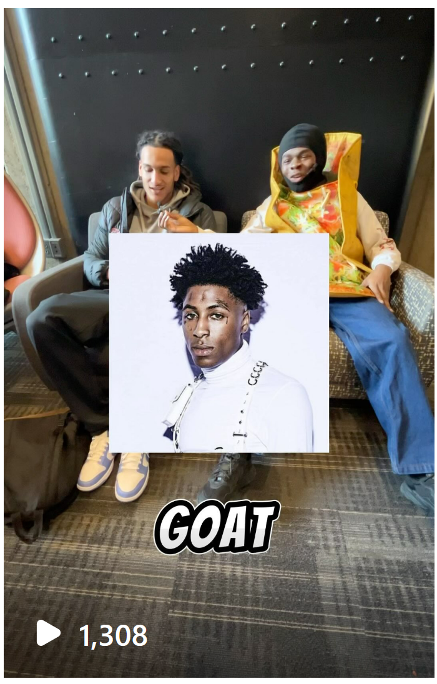
MARKETING
INSTAGRAM: @MANNYSMOBILESTUDIO
Notes:
“On the Mannys Mobile Studio instagram I posted clips talking with a group of students at Clark University about music. Their participation and my vibes attracted a large sum of views. I’ve also attended pop-ups where I gave people the opportunity to hear themselves recorded for the first time. (play video)
As you can see from this video, everyone is smiling and having a great time.”

Slide 10
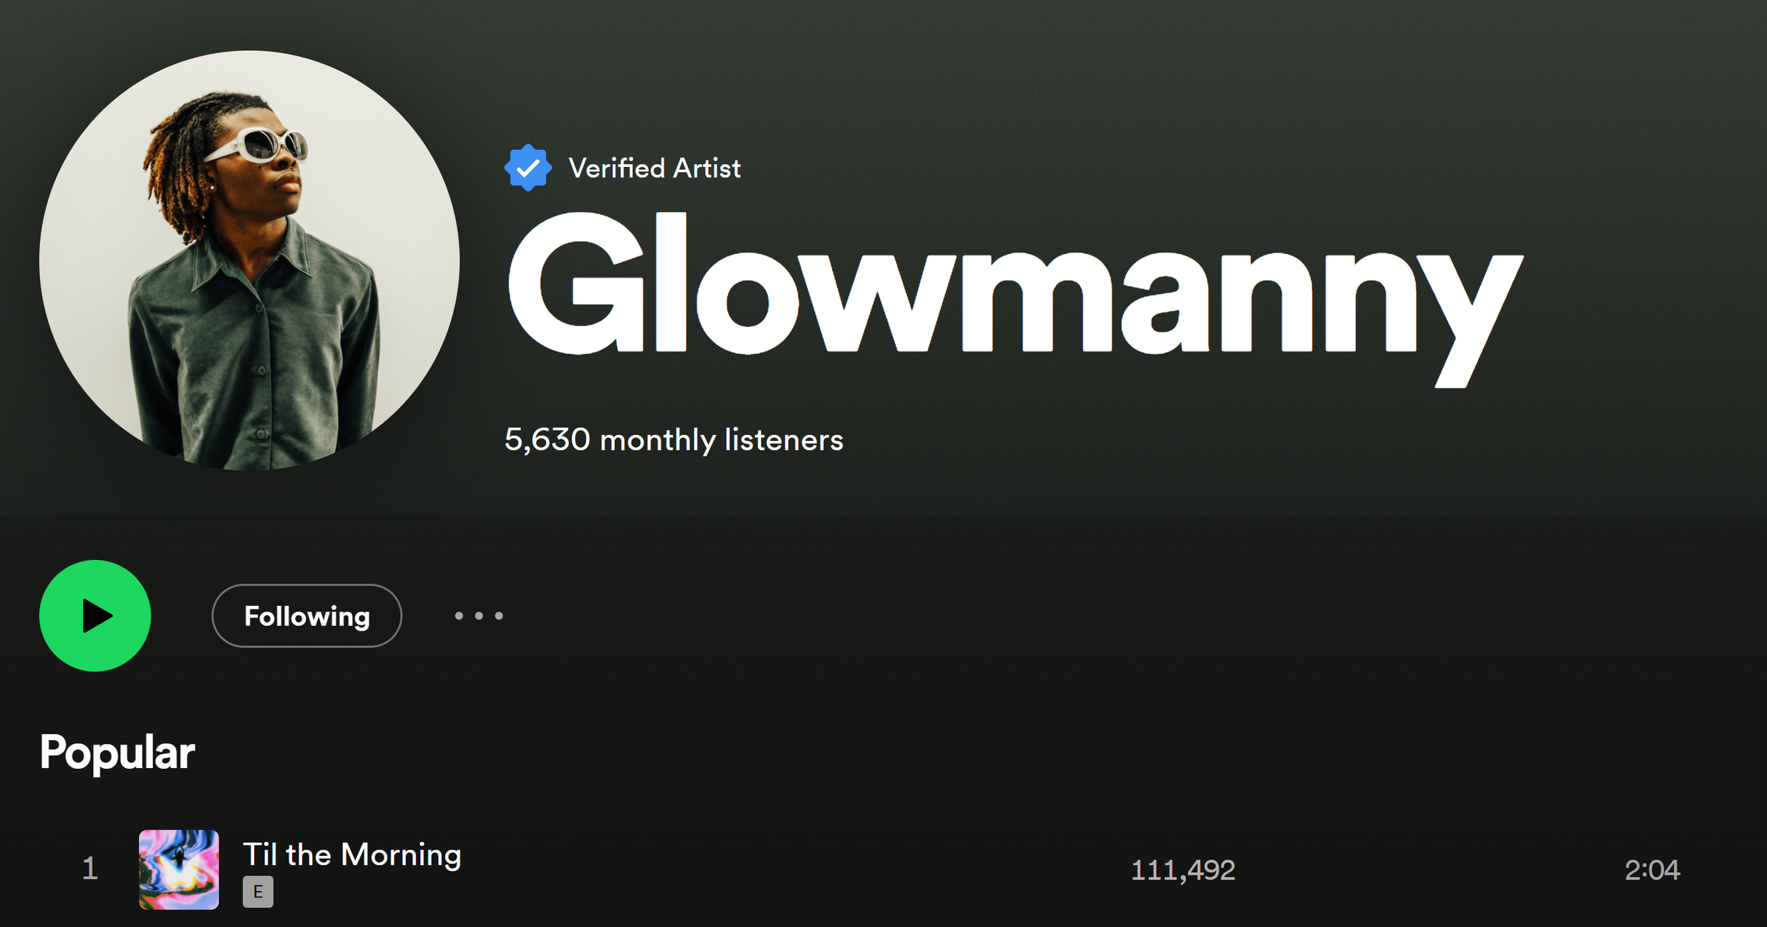
2nd Stream of Revenue
Notes:
“My second stream of revenue comes from making music under the name Glowmanny. My success in music directly translates to my credibility, which can sway my clients to purchase a full package, or at least know they are getting a quality service.

Slide 11
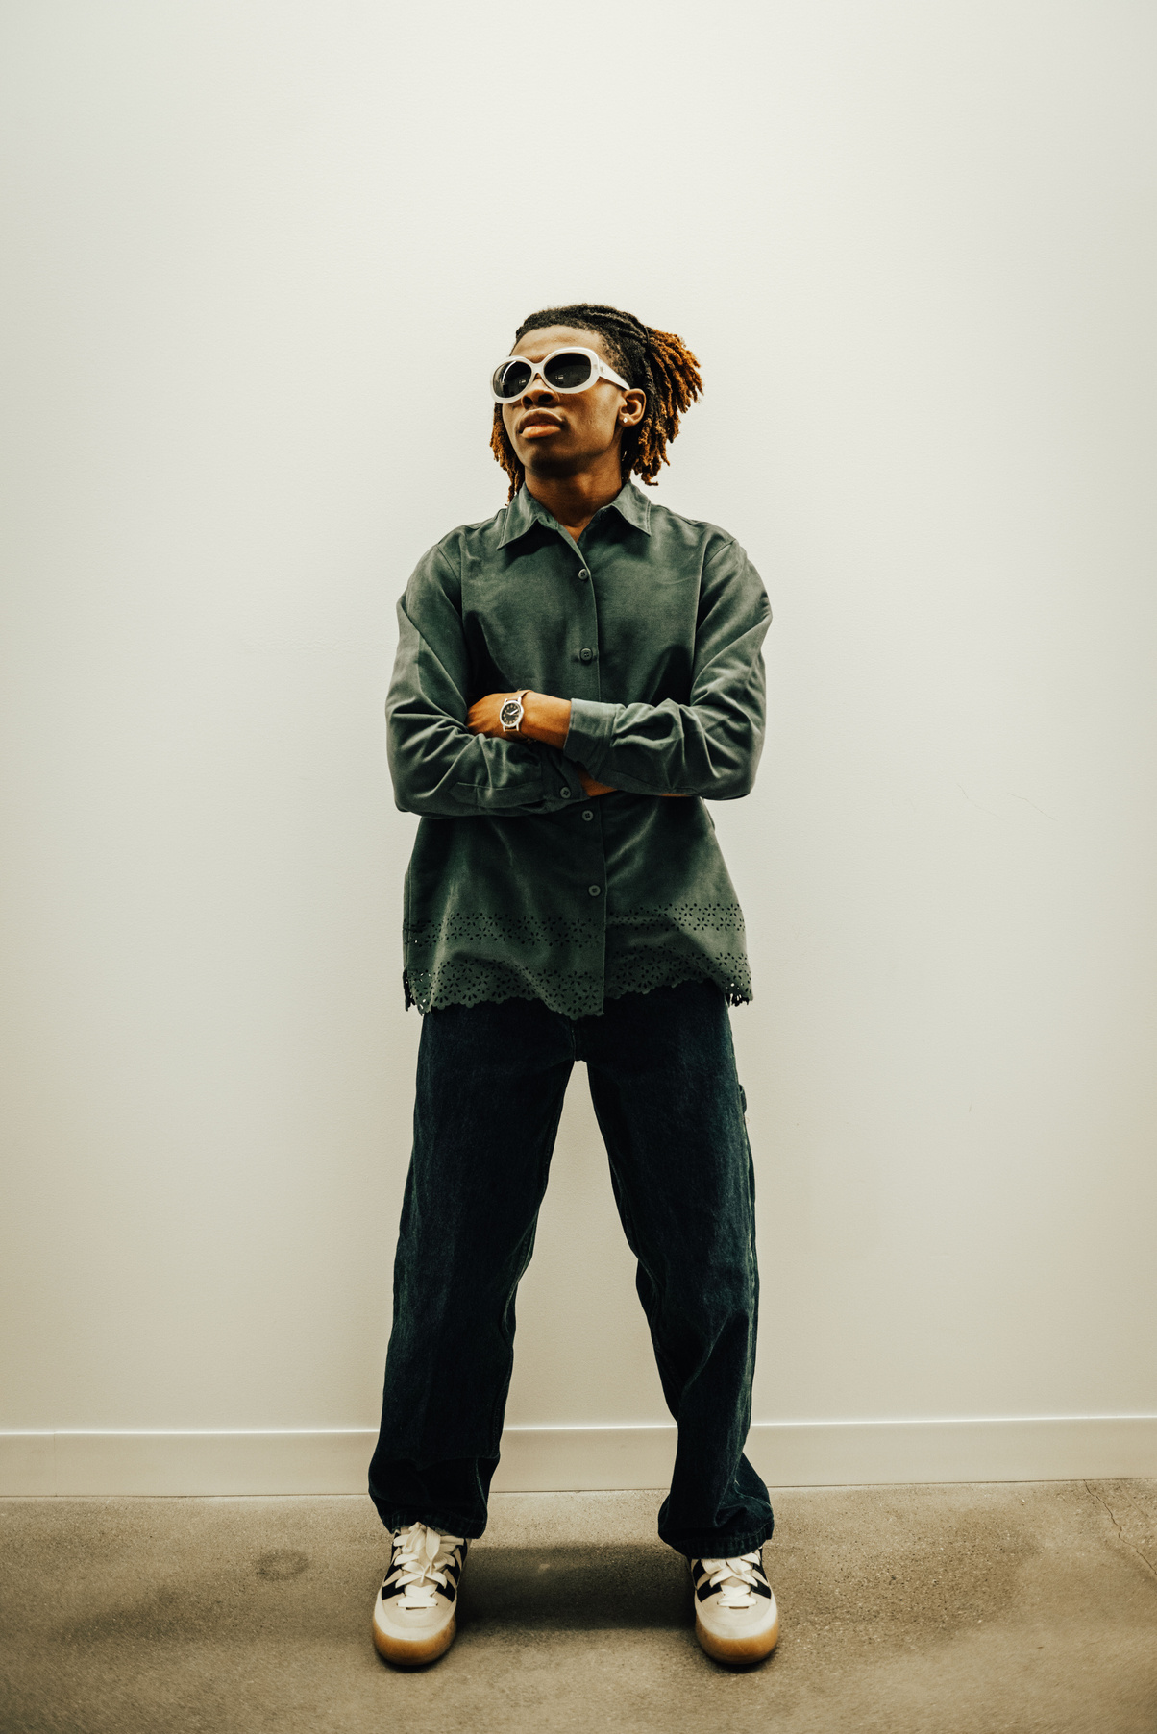
MY ASK: $3600
Notes:
“My ask is $3600. Your investment in my business makes a huge difference in the creative endeavors of the artists of Worcester. With your assistance, I’d be able to record for local creators who have the potential to put out content that people engage with. And in return, during my time as an undergrad, this content will bring more attention to Clark and to Worcester as I promote the business and myself as an artist. More attention means more money, more opportunities, and more creation.”

Slide 12
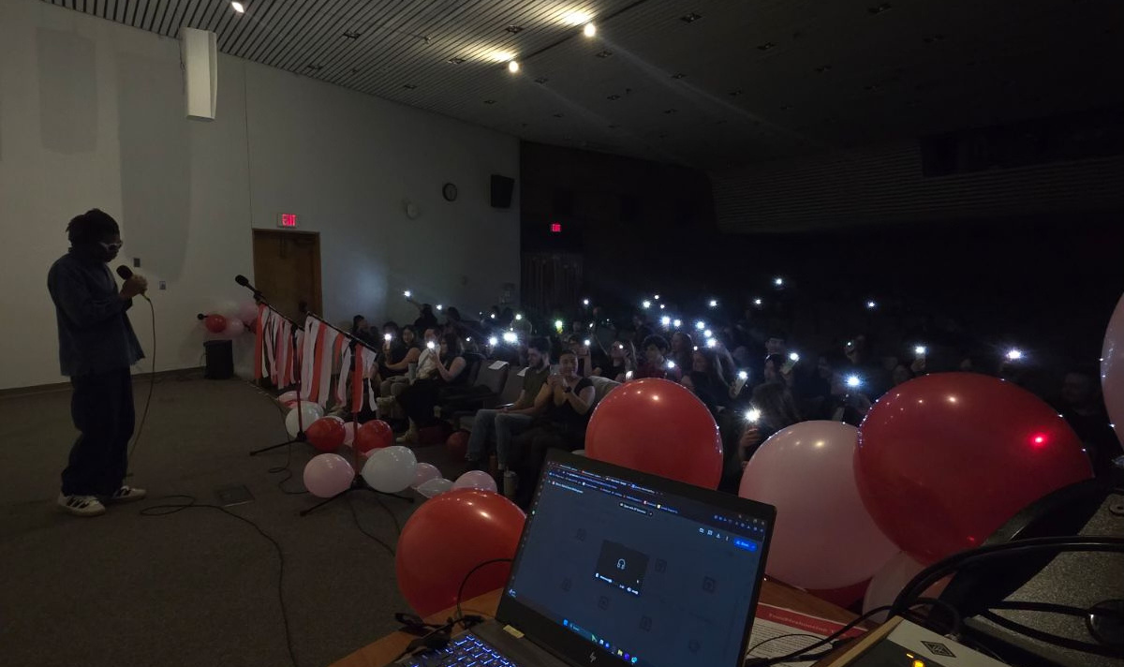
EXPANSION:
WORCESTER COLLEGES
LOCAL MUSIC ORGANIZATIONS
Notes:
“In terms of expansion, I plan to engage in the Clark community for my next four years here, but I will be heavily involved in the Worcester production scene as well, with organizations such as Upward bound and IVOC. Thankfully, this is all possible with time, hard work, and your investment.”

Slide 13
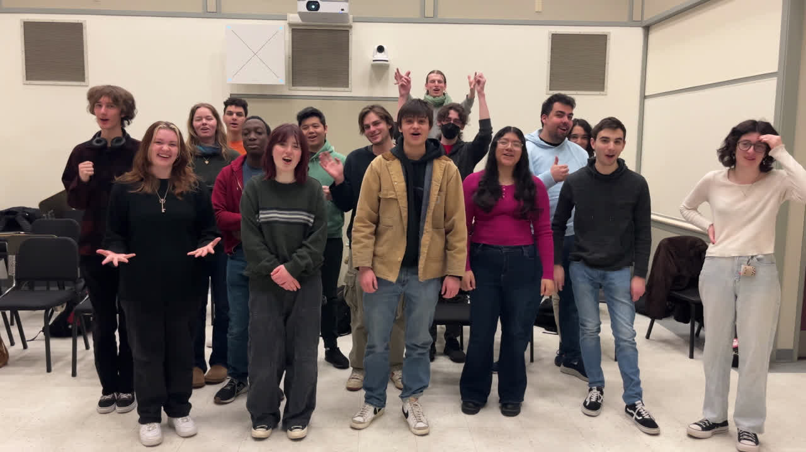

Slide 14
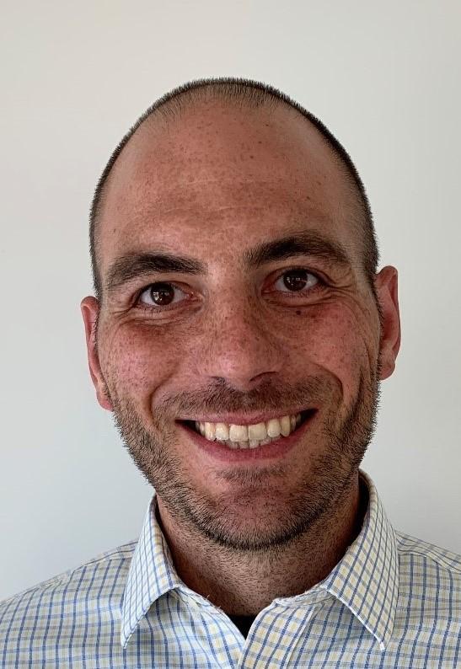
BIG THANK YOU TO MY MENTOR, JOHN FREYERMUTH!!!
Notes:
Big thank you to my mentor, John Freyermuth, for guiding me through my mission and thank you all for your time.”

Slide 15
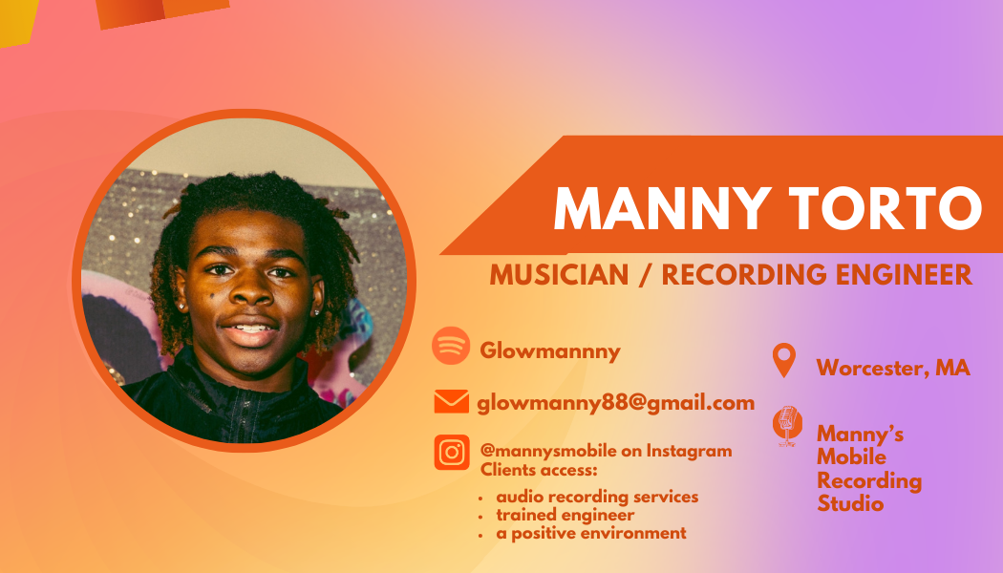
CONTACT ME @

