Slide 1
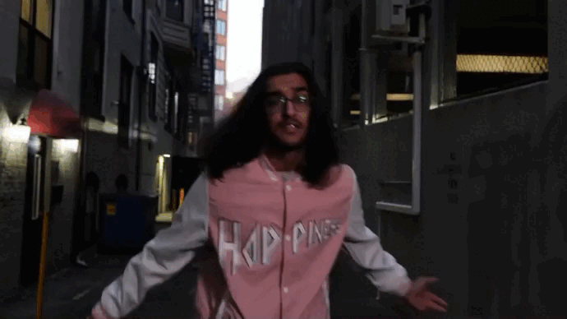
Masala King

Slide 2
mission
Bring cultures together
Share what it’s like being a producer from the ground up
Create a community for collaboration

Slide 3
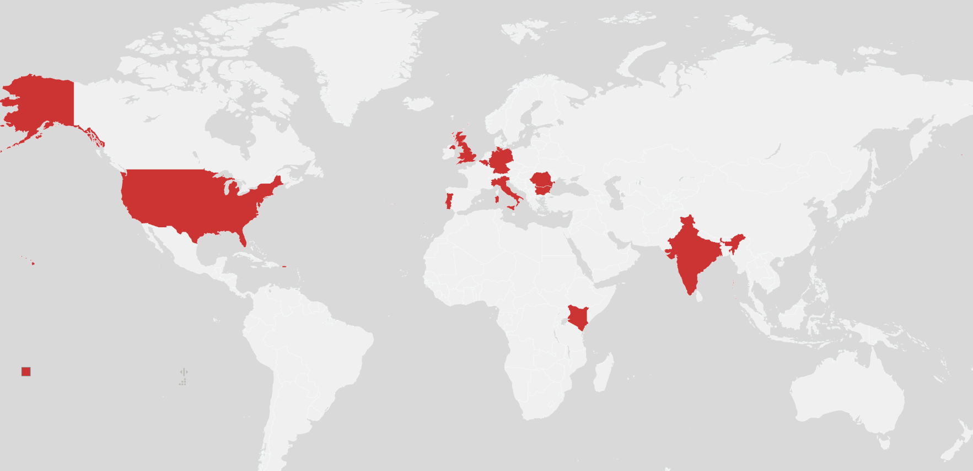
11 Countries

Slide 4
industry
$4.5 BILLION Indie Artists (50% of Spotify payouts)
U.S. Music Revenue $26.2 BILLION
RnB + HipHop 30.7%

Slide 5
industry
According to IFPI
U.S. Music Revenue $26.2 BILLION
RnB + HipHop 30.7%
$4.5 BILLION Indie Artists (50% of Spotify payouts)

Slide 6
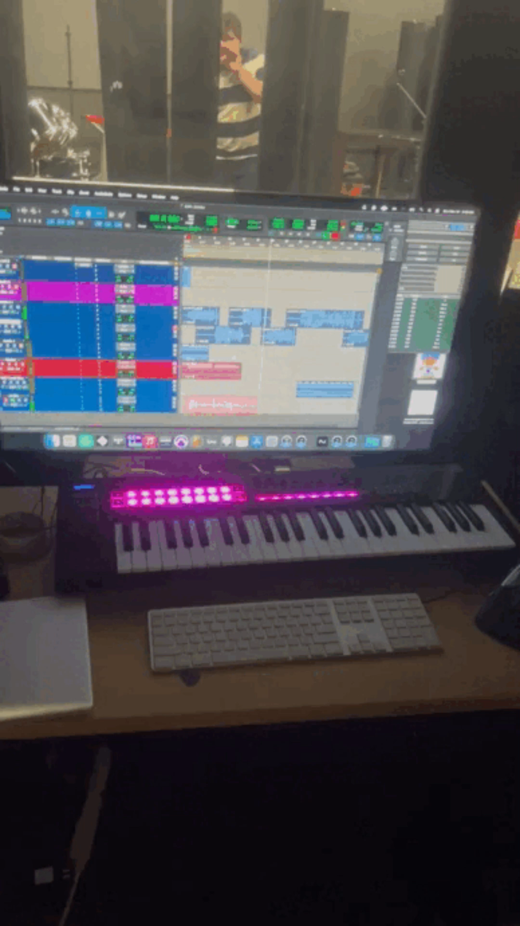
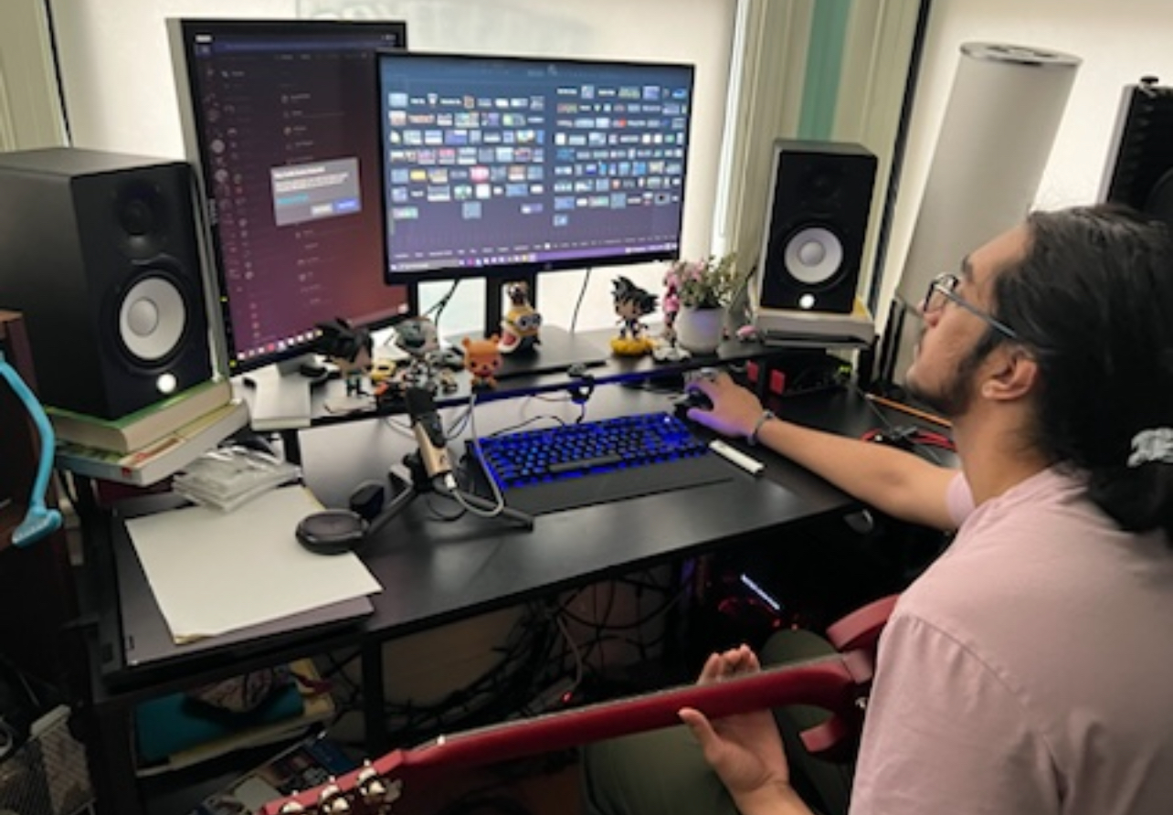
MARKETING PLAN
livestreaming
Content creation
Collaborators
+
their feeds

Slide 7
livestreaming
TikTok
1B active users
TWITCH
140M monthly viewers
30M daily viewers

Slide 8
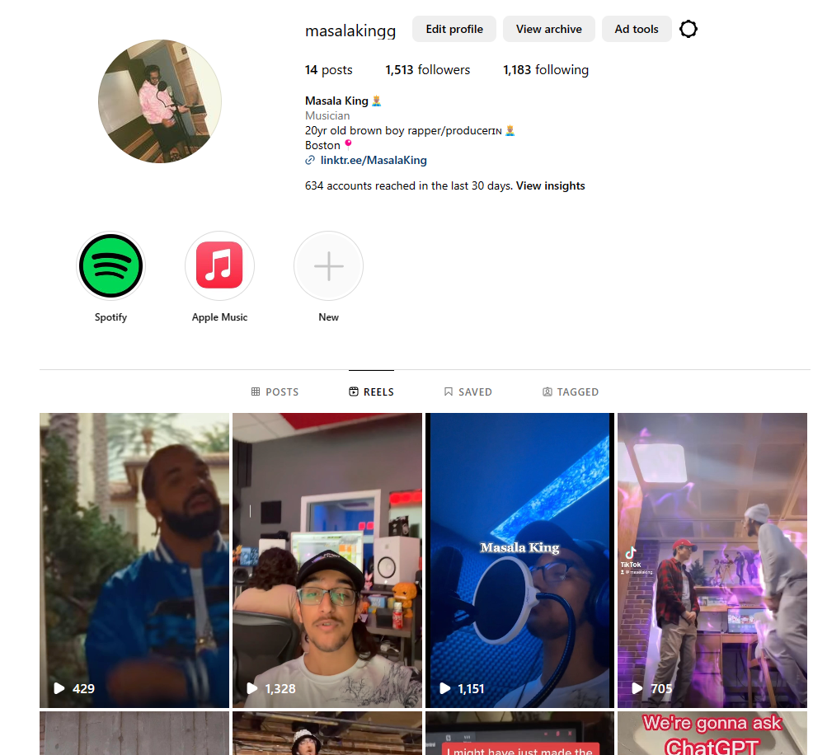
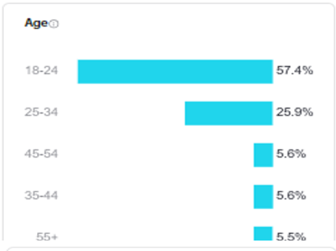
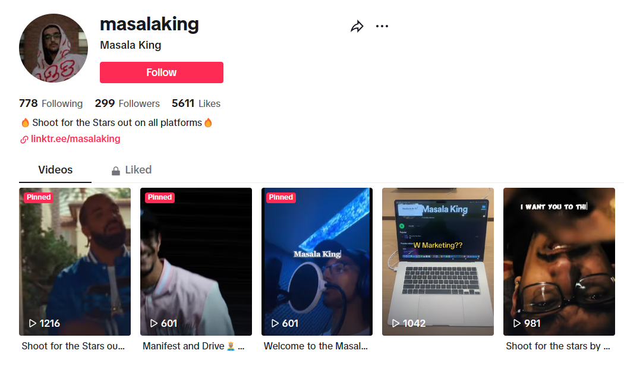
livestreaming
TWITCH
140M monthly viewers
30M daily viewers
Communicate with chat
TikTok
1B active users
Donations make me do things
  Galaxy = Restart beat from scratch
  Rose = Restart layer I am creating
Content creation

Slide 9
Content creation
40,000 views on TikTok
70,000 views on Instagram

Slide 10
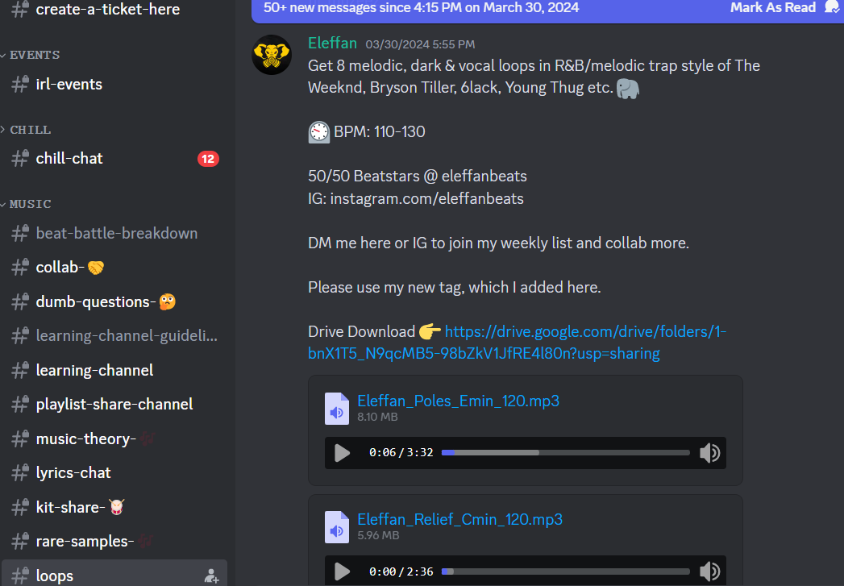
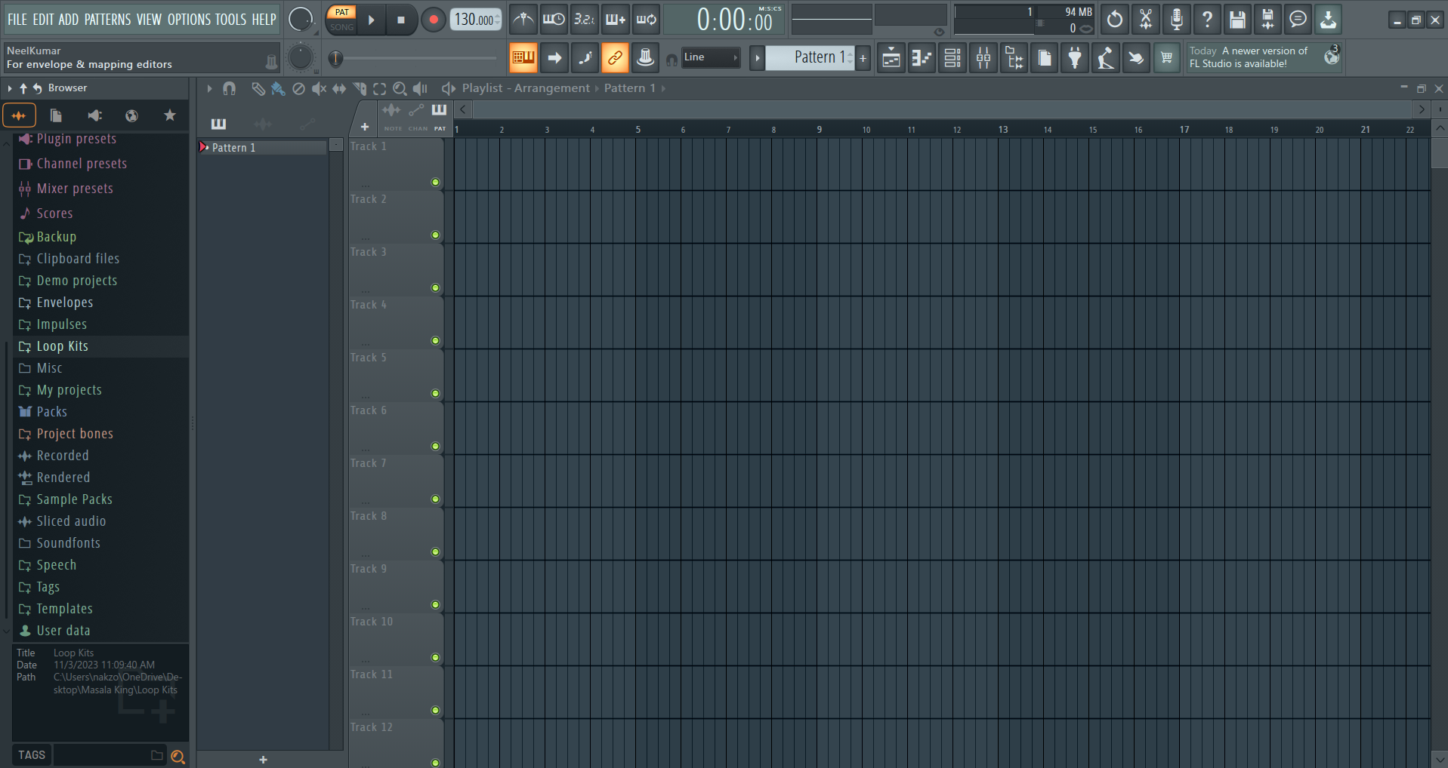
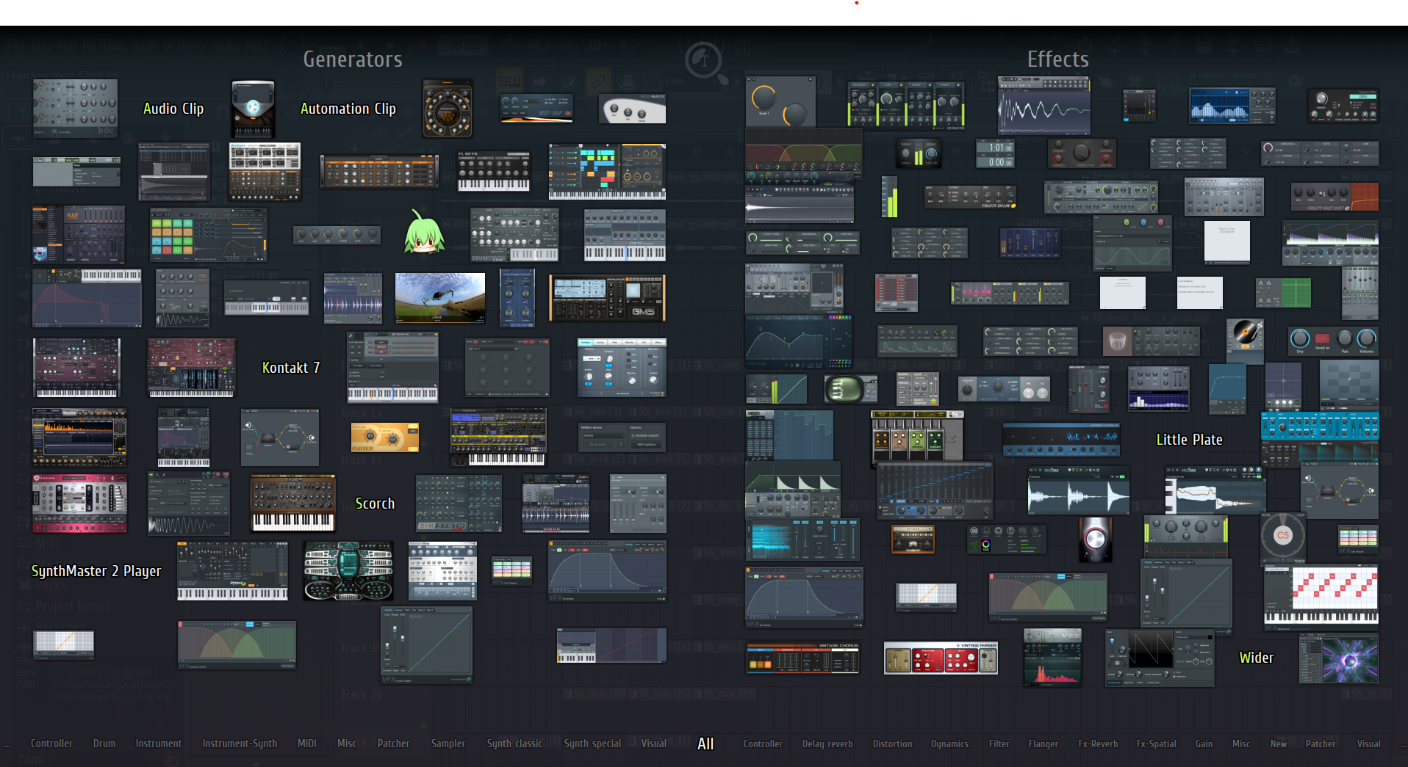

STEP 1
Collaborators
+
their feeds
STEP 2
STEP 3
STEP 4

Slide 11
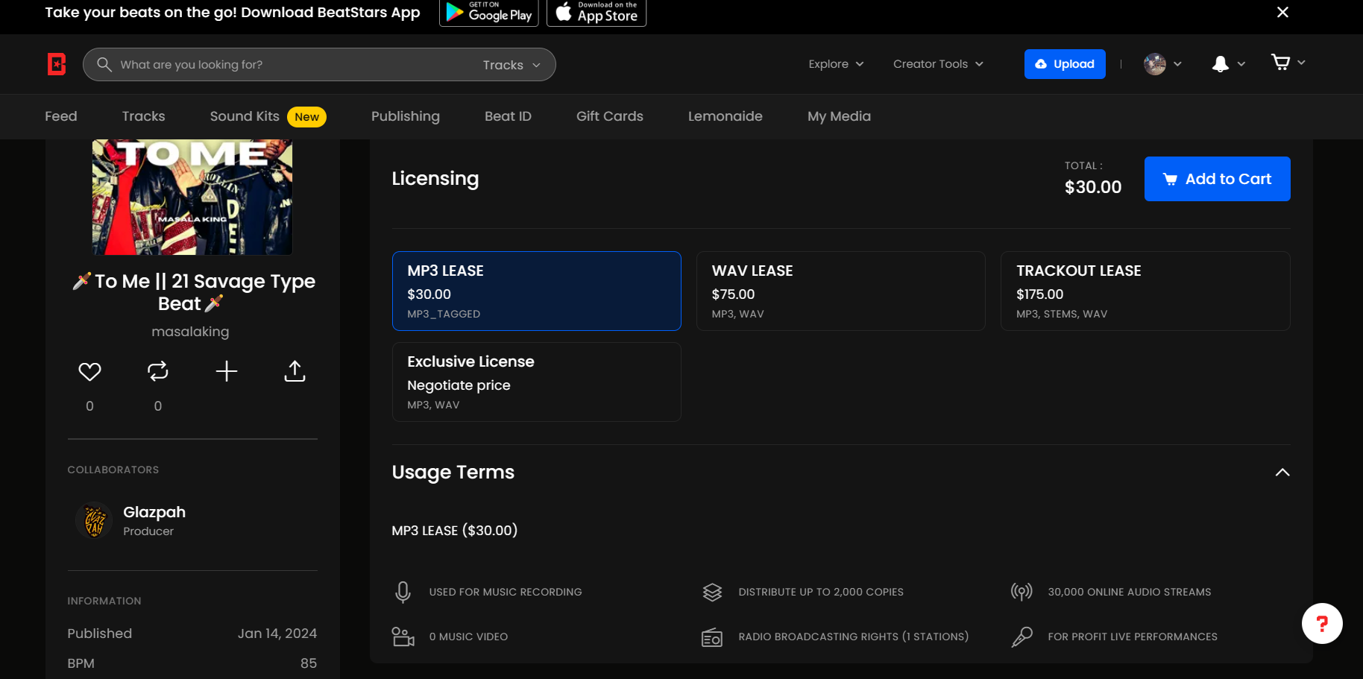




Unique
First to market
Only product specifically dedicated to this niche market
First beautifully designed product that's both stylish and functional​
BeatStars
Platform for Producers to sell their beats and services
2M producers
Equal playing ground
Ability to see trends
Tested
Authentic
Conducted testing with college students in the area​
Designed with the help and input of experts in the field ​

Slide 12
goals
Reach
Streaming
Consistent posting, streaming, and producing = increase reach
Work with more artists and bigger artists
The album
Collaborating with producers and artists to create content and show how to make music
Create a community of producers to collaborate
Create an album that bridges gap between India + US
Connect US artists and artists with Indian descent

Slide 13
goals
Reach
Consistent posting, streaming, and producing = increase reach
Work with more artists and bigger artists
Streaming
Collaborating with producers and artists to create content and show how to make music
Create a community of producers to collaborate
The album
Create an album that bridges gap between India + US
Connect US artists and artists with Indian descent

Slide 14
Estimated revenue
$850
CURRENT
REVENUE
$6,300
2 beats a week at $75
1 year
$42,000
2 beats a week at $500
1 year
5-15%
Viewers pay streamers
70 viewers $1,820 → $5,460
500 viewers $13,000 → $78,000

Slide 15
Masala King
Thank You
Questions?

Slide 16



Solution
Our product makes consumer lives easier, and no other product on the market offers the same features​
Gen Z (18-25 years old)
Reduce expenses for replacement products
Content Creation
Simple design that gives customers the targeted information they need​
Livestream
Cost savings
Easy to use

Slide 17

About Us
At Contoso, we empower organizations to foster collaborative thinking to further drive workplace innovation. By closing the loop and leveraging agile frameworks, we help business grow organically and foster a consumer first mindset.​

Slide 18
Problem
Customers
Market gap
66% of US consumers
spend money on multiple products that only partially resolves their issue
Few, if any, products on the market help customers like we do​
Costs
Financials
Loss of productivity costing consumers thousands of dollars
Millennials account for about a quarter of the $48 billion spent on other products in 2018​

Slide 19
Product Overview
Unique
First to market
Only product specifically dedicated to this niche market
First beautifully designed product that's both stylish and functional​
Tested
Authentic
Conducted testing with college students in the area​
Designed with the help and input of experts in the field ​

Slide 20
Product Benefits
Cool and stylish product​
Areas for community connections
Online store and market swap​

Slide 21
Company Overview

Slide 22



Business Model
Research​
Abstract​
Design​
We based our research on market trends and social media​
We believe people need more products specifically dedicated to this niche market​
Minimalist and easy to use ​

Slide 23
Market opportunity overview
$3b
$1b
$2b
Opportunity to build​
Fully inclusive market​
Total addressable market​
Freedom to invent​
Selectively inclusive market​
Serviceable available market​
Few competitors​
Specifically targeted market​
Serviceable obtainable market​

Slide 24
Market opportunity comparison
$3B
Opportunity to Build
Revenue over 12 months​
$2B
Freedom to Invent
Market share​
$1B
Few Competitors
Obtainable market​

Slide 25
Our competition
CoNTOSO
competitors
Our product is priced below that of other companies on the market​
Design is simple and easy to use, compared to the complex designs of the competitors​
Affordability is the main draw for our consumers to our product​
Company A​
Product is more expensive​
Companies B & C ​
Product is expensive and inconvenient to use​
Companies D & E​
Product is affordable, but inconvenient to use

Slide 26
Our competition graphic
convenient
Contoso
A
expensive
affordable
D
B
C
E
Inconvenient​

Slide 27
Growth strategy
How we’ll scale in the future
Feb 20xx
May 20xx
Oct 20xx
Roll out product to high profile or top-level participants to help establish the product​
Release the product to the general public and monitor press release and social media accounts​
Gather feedback and adjust product design as necessary​

Slide 28
Traction
Forecasting for success​
Key metrics
Revenue by year
 | clients | orders | Gross avenue | Net revenue
20XX​ | 10​ | 1100​ | $10,000​ | $7,000​
20XX​ | 20​ | 200​ | $20,000​ | $16,000​
20XX​ | 30​ | 300​ | $30,000​ | $25,000​
20XX​ | 40​ | 400​ | $40,000​ | $30,000​
20XX​ | 50​ | 500​ | $50,000​ | $40,000​
20XX | 10 | 1100 | $10,000 | $7,000

Slide 29
Two-year action plan
Draft blueprints​
Run focus groups​
Gather feedback​
20XX
Jan
Feb
Mar
Apr
May
Jun
Jul
Aug
Sep
Oct
Nov
Dec
Test design​
Launch design​
Deliver to client
20XX
Jan
Feb
Mar
Apr
May
Jun
Jul
Aug
Sep
Oct
Nov
Dec

Slide 30
financials
 | Year 1 | Year 2 | year 3
Detailers​ | 5,000​ | 40,000​ | 160,000​ | ​
Users​ | 50,000​ | 400,000​ | 1,600,000​ | ​
Sales​ | 500,000​ | 4,000,000​ | 16,000,000​ | ​
Average price per sale​ | 75​ | 80​ | 90​ | ​
Revenue @ 15%​ | 5,625,000​ | 48,000,000​ | 216,000,000​ | ​
Gross Profit​ | 5,625,000​ | 48,000,000​ | 216,000,000​ | ​
Expenses​ | ​ | ​ | ​ | ​
Sales & marketing​ | 5,062,500​ | 38,400,000​ | 151,200,000​ | ​
Customer service​ | 1,687,500​ | 9,600,000​ | 21,600,000​ | 70%​
Product development​ | 562,500​ | 2,400,000​ | 10,800,000​ | 10%​
Research​ | 281,250​ | 2,400,000​ | 4,320,000​ | 5%​
Total Expenses​ | 7,593,750​ | 52,800,000​ | 187,920,000​ | 2%​
EBIT | -1,968,750 | -4,800,000 | 28,080,000 | ​

Slide 31




Our team
Takuma Hayashi​​
Mirjam Nilsson​​
Flora Berggren​​
Rajesh Santoshi​​
President
Chief Executive Officer​
Chief Operations Officer​
VP Marketing​

Slide 32








Our team
Takuma Hayashi​​
Mirjam Nilsson​​
Flora Berggren​​
Rajesh Santoshi​​
President
Chief Executive Officer​
Chief Operations Officer​
VP Marketing​
Graham Barnes​
Rowan Murphy​
Elizabeth Moore​
Robin Kline​
VP Product​
SEO Strategist​
Product Designer​
Content Developer​

Slide 33
Funding
12K
14K
32K
82K
Property
Angel Investments
Cash
Shares
Revenue obtained from property rentals​
Amount obtained through other investors​
Liquid cash we have on hand​
Number of shares converted into USD​

Slide 34
Summary
At Contoso, we believe in giving 110%. By using our next-generation data architecture, we help organizations virtually manage agile workflows. We thrive because of our market knowledge and great team behind our product. As our CEO says, "Efficiencies will come from proactively transforming how we do business."​

Slide 35
Thank you
Mirjam Nilsson​​
206-555-0146​
mirjam@contoso.com​
www.contoso.com​

