Slide 1

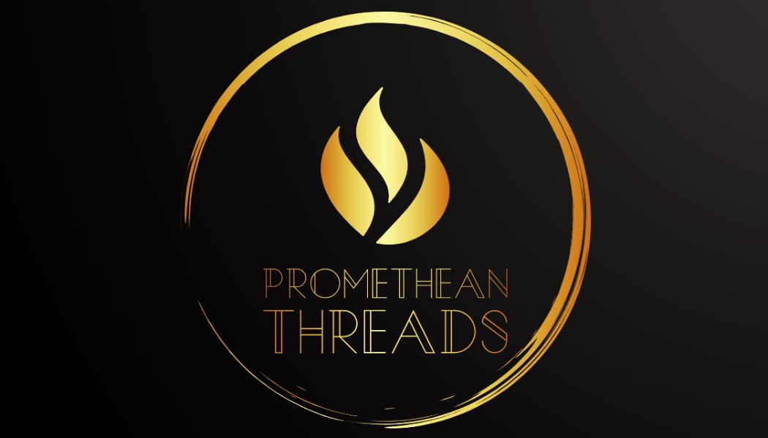
Promethean Threads
By Kai Cecil
Notes:
Hello everyone, my name is Kai Cecil and I’m presenting Promethean Threads, a clothing company that like its namesake that was inspired by the greek myth of Prometheus, bring a warm, guiding light to those with alzheimer’s and their family.
Use more icons to make it look more professional

Slide 2
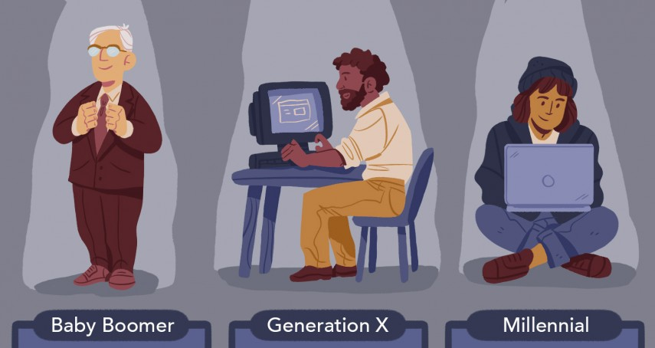
Target Market

Slide 3



Marketing Plan
Website Blog
Email Newsletter
Social Media

Slide 4

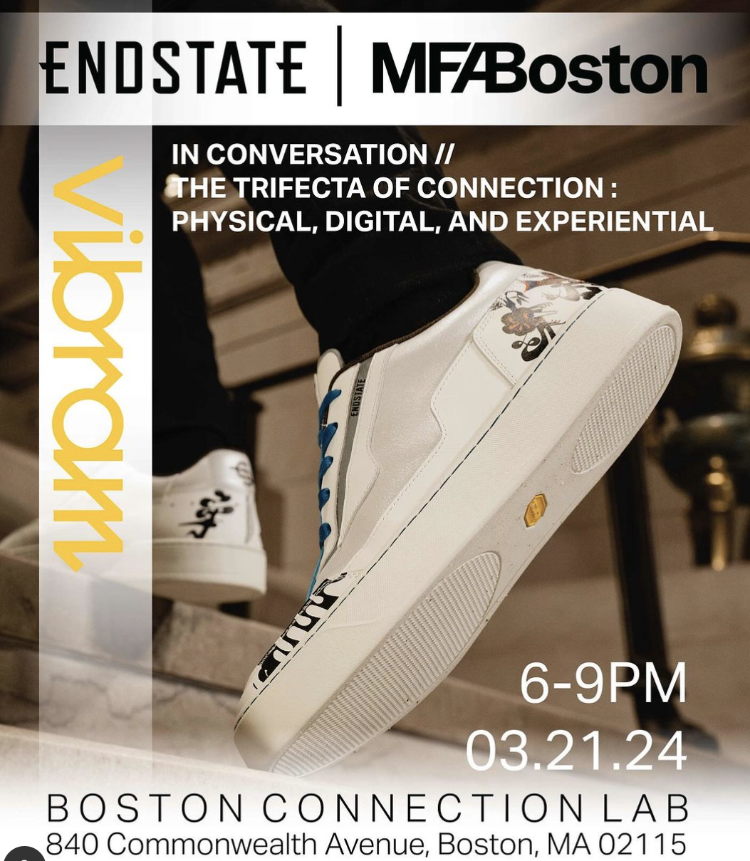
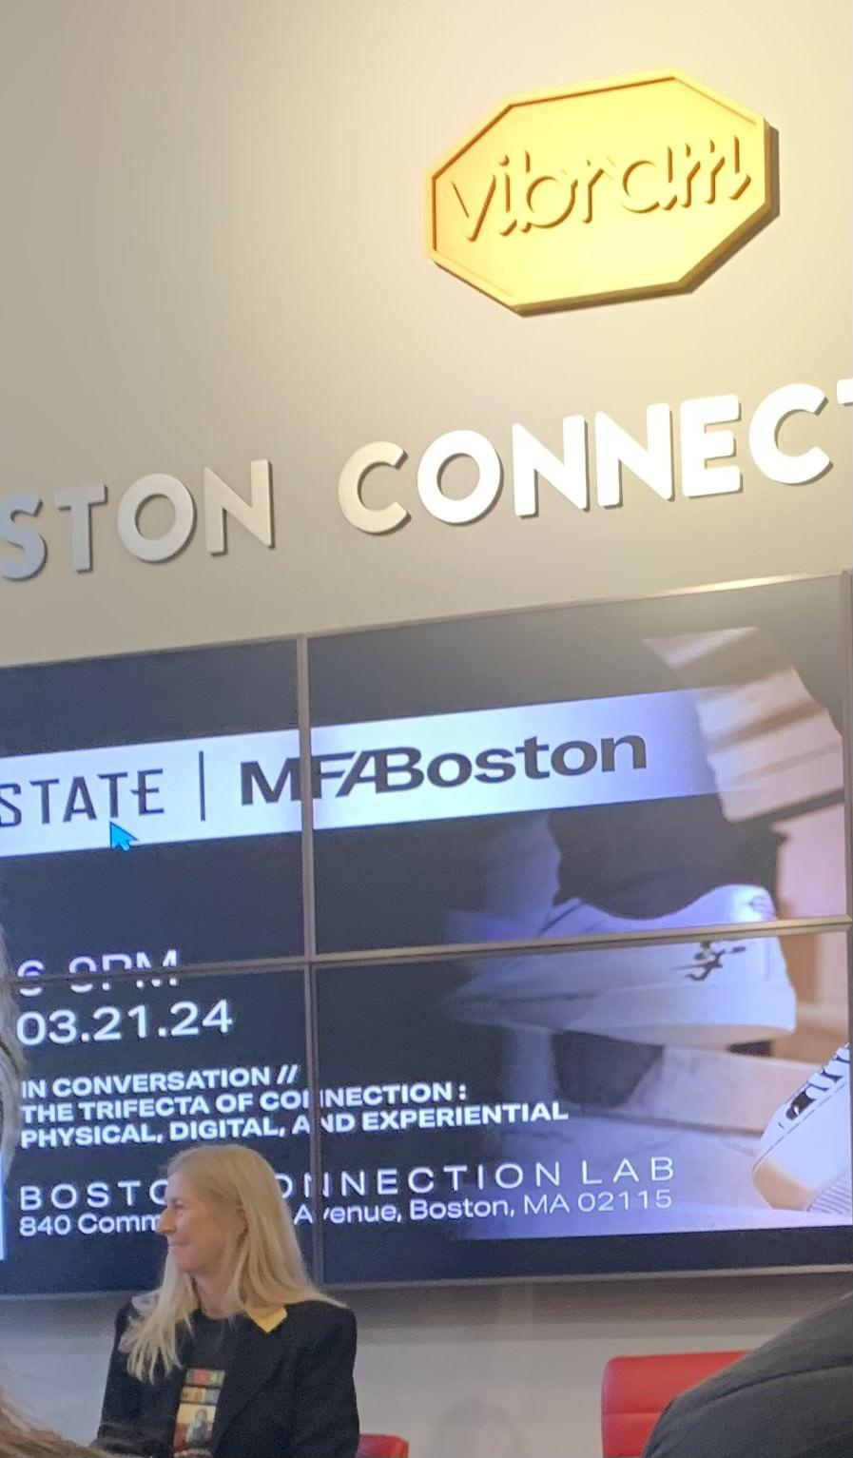
Marketing Strategy
Public Relations
Events
Branding
Notes:
As a website based business, website traffic is essential for converting sales so by using a blog on my website I can increase backlinks and reliability, increasing my SEO, and thus making my website easier to find. Then by implementing an email collection list and newsletter I can provide information and resources and releases. I will also use social media, more so Facebook so I can show what events I’ll be at, validate designs, engage with Alzheimer’s awareness and organizations, have information, etc to make a community for my consumers who are likely late 20s-Older who have some extra cash and are affected by alzheimer’s in some way or those who see it as a cause they want to donate to. Events are one of the ways I can build this community and build awareness of my brand, for example this fashion event I went to and got some interest in what I was making. I also plan to go to events related to Alzheimer’s such as the “name run” in “month” .

Slide 5
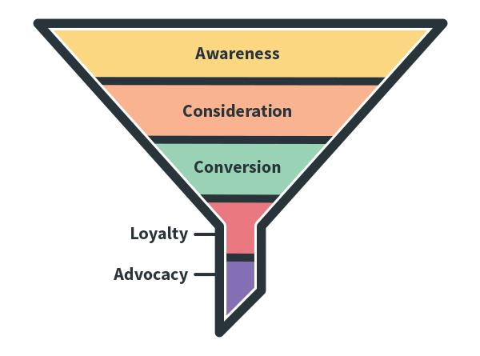
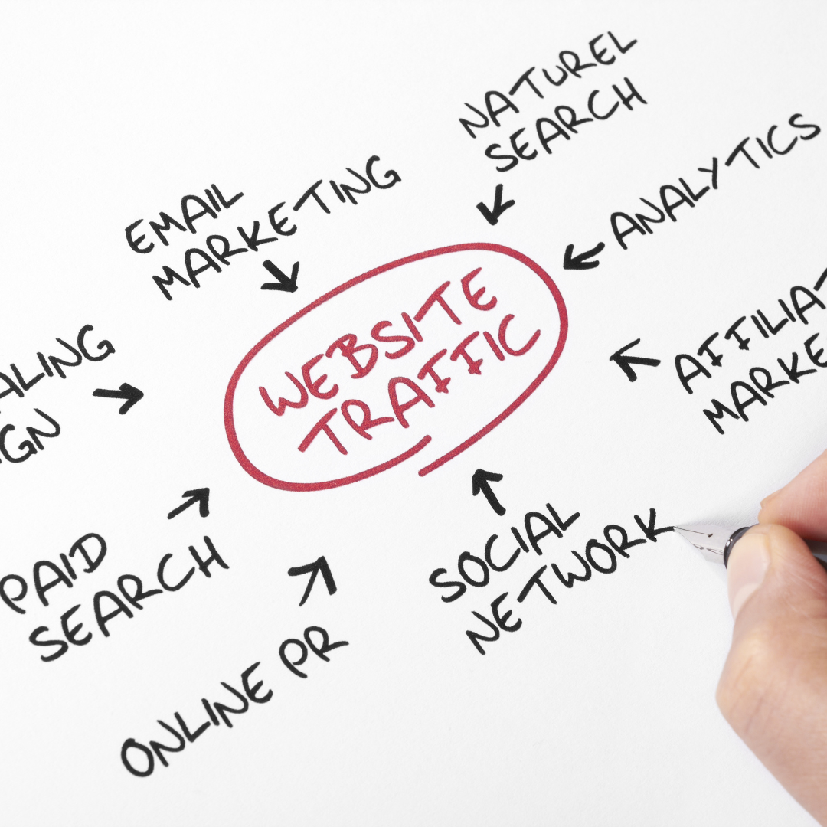
Outcome
Notes:
As a website based business, website traffic is essential for converting sales so by using a blog on my website I can increase backlinks and reliability, increasing my SEO, and thus making my website easier to find. Then by implementing an email collection list and newsletter I can provide information and resources and releases. I will also use social media, more so Facebook so I can show what events I’ll be at, validate designs, engage with Alzheimer’s awareness and organizations, have information, etc to make a community for my consumers who are likely late 20s-Older who have some extra cash and are affected by alzheimer’s in some way or those who see it as a cause they want to donate to. Events are one of the ways I can build this community and build awareness of my brand, for example this fashion event I went to and got some interest in what I was making. I also plan to go to events related to Alzheimer’s such as the “name run” in “month” .

Slide 6

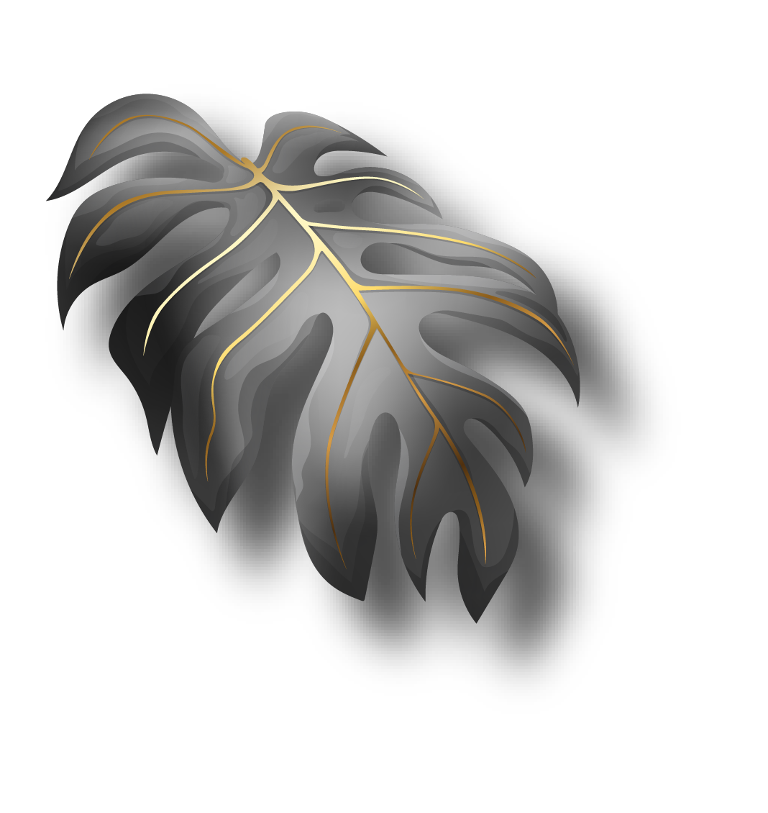
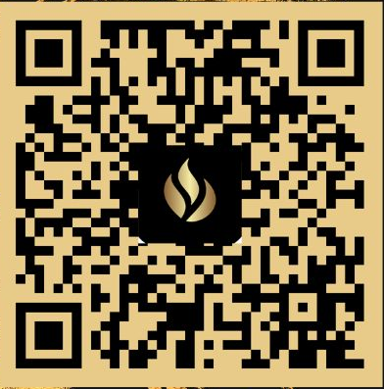


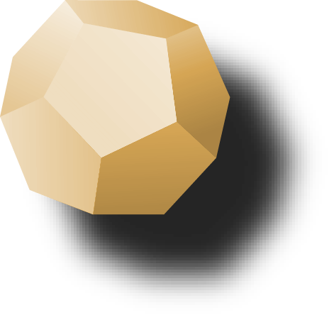
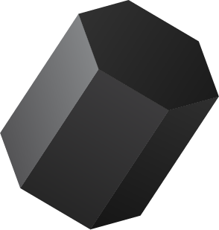
Thank You
Website
Instagram: @ Promethean Threads
Facebook: Promethean Threads
TikTok: @prometheanthreads

