Slide 1

Clark Tank Marketing Pitch Competition

Slide 2

Introduction
Overview: WanderWise is a groundbreaking travel app redefining the travel experience.
Mission: Empower travelers with personalized journey planning.
Key Features:
  Traveler community building
  Customized itineraries
  Comprehensive travel assistance
  Safety and well-being features

Slide 3

Traveler Community Building
Connectivity: Form traveler groups, fostering connections with nearby adventurers.
Enhanced Experiences: Elevate hiking experiences through group interactions.

Slide 4
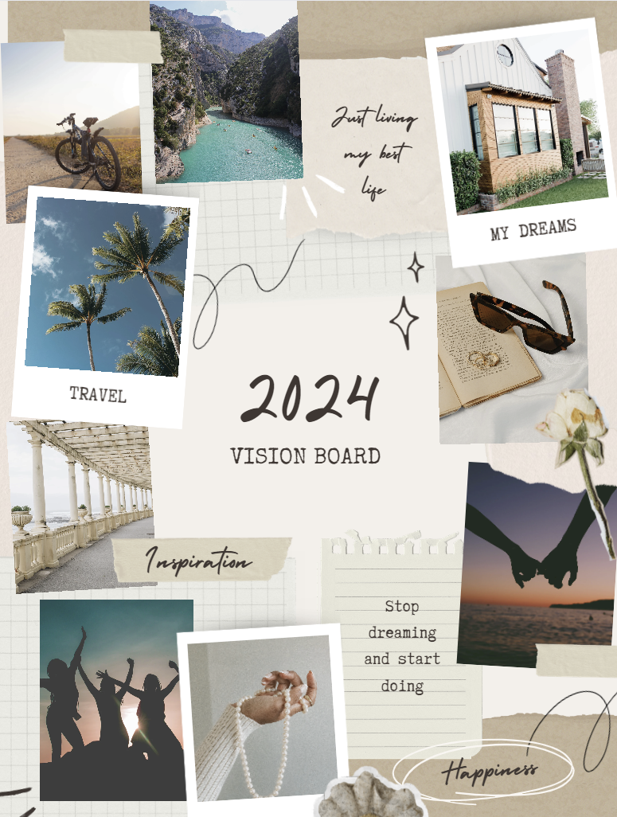
Customized Itineraries
Empowerment: Tailor journeys based on preferences and interests.
Flexibility: Plan unique itineraries for individual needs.

Slide 5

Comprehensive Travel Assistance
Seamless Booking: Book tickets and accommodations effortlessly within the app.
Event Discovery: Stay updated on local events and cultural happenings.

Slide 6

Safety and Well-being
Emergency Support: Access SOS features and locate emergency services online and offline.

Slide 7

Content Creation and Inspiration
User Showcase: Share travel adventures through videos, and inspiring exploration.
Discovery: Explore user-generated content for hidden gems and recommendations.

Slide 8
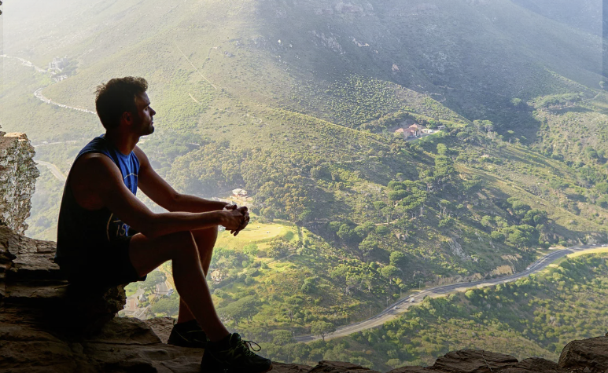
Personalization and Recommendations
Organization: Save favorite places and receive personalized recommendations.
Tailored Suggestions: Get suggestions based on travel preferences.

Slide 9

Collaboration with Leading Platforms
Integration: Book flights and accommodations seamlessly through partnerships with Booking.com and Airbnb.

Slide 10
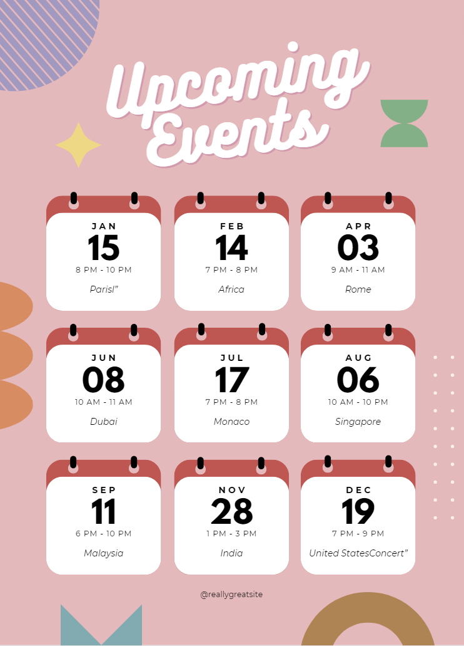
Keeping Travelers Informed
Real-time Updates: Stay informed about local events and attractions.
Destination Insights: Gain insights into the unique offerings of each destination.

Slide 11

Solution Slide: Stand Out from Other Travel Apps
Differentiation: WanderWise offers a holistic travel solution with community building, personalized recommendations, and comprehensive assistance.
Unique Selling Proposition: Emphasize innovative features and seamless integration.

Slide 12

Process Slide: Bringing WanderWise to Life
Development Stages: From conceptualization to launch.
Key Milestones: Highlight development, design, testing, and marketing strategies.

Slide 13

Marketing Plan
Target Audiences: Age, categories, limited audience.
Channels: Websites, blogs, public relations, social media, digital marketing, branding, and events.
Content Calendar: Marketing schedule.

Slide 14

Expected Outcome
KPIs: Track engagement metrics.
Projected Research: Budget allocation for marketing strategies.
Adjustments:
  Emphasize sales, themed advertising, and social media.
  Simplify and streamline information for clarity and impact.
  Incorporate team members and marketing strategies effectively.

Slide 15
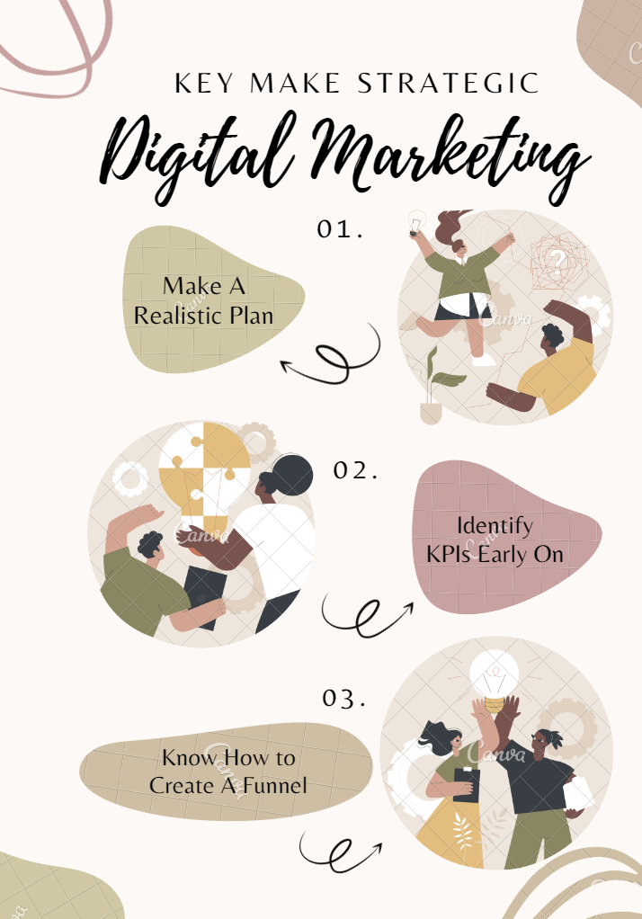
Adjustments
KPIs: Track engagement metrics.
Projected Research: Budget allocation for marketing strategies.

Slide 16

Questions

