Slide 1


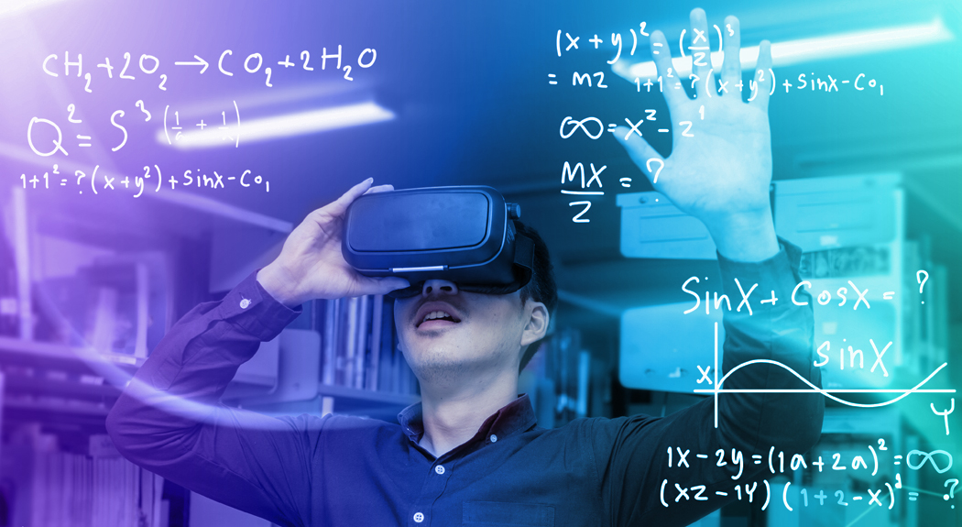
Connect.ai
Redefining reality using AI in the Metaverse for Endless Virtual Collaborations
Presented by Chandraditya Ghosh

Slide 2
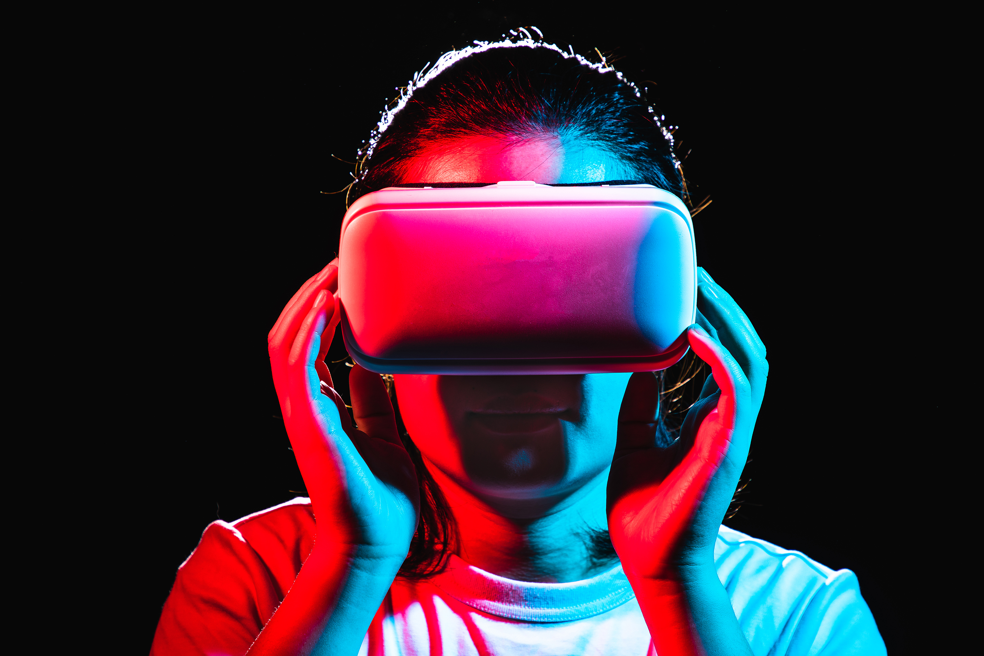
RE - IMAGINE
IMAGINE
a realm where virtual meeting feels as tangible as face to face encounters

Slide 3
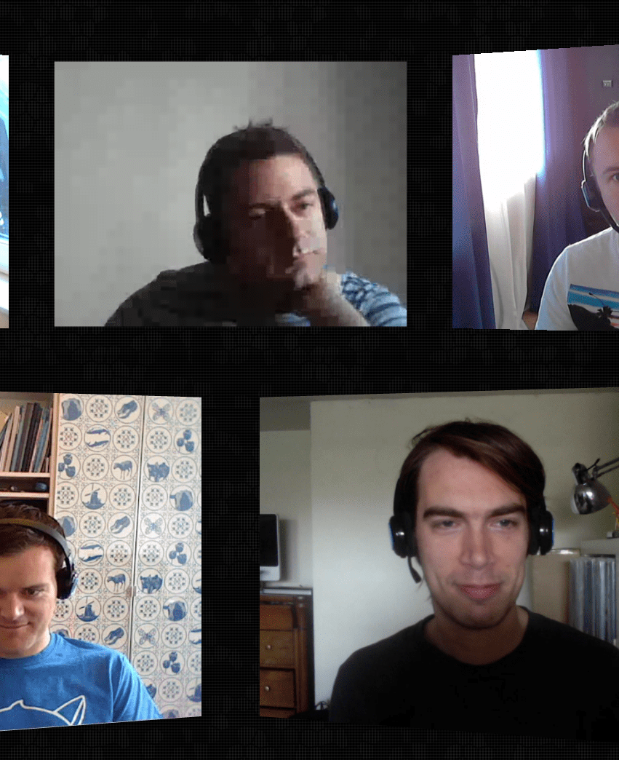
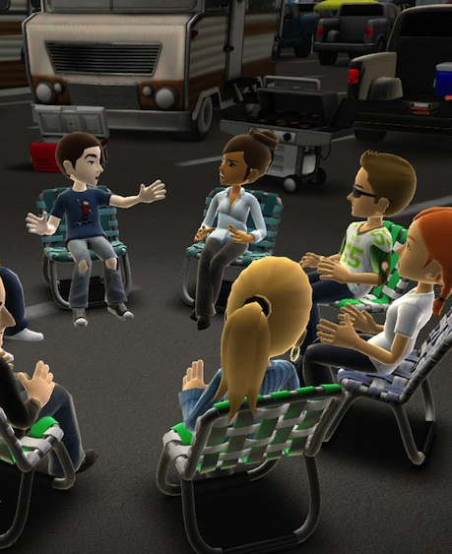

RE-IMAGINE

Slide 4
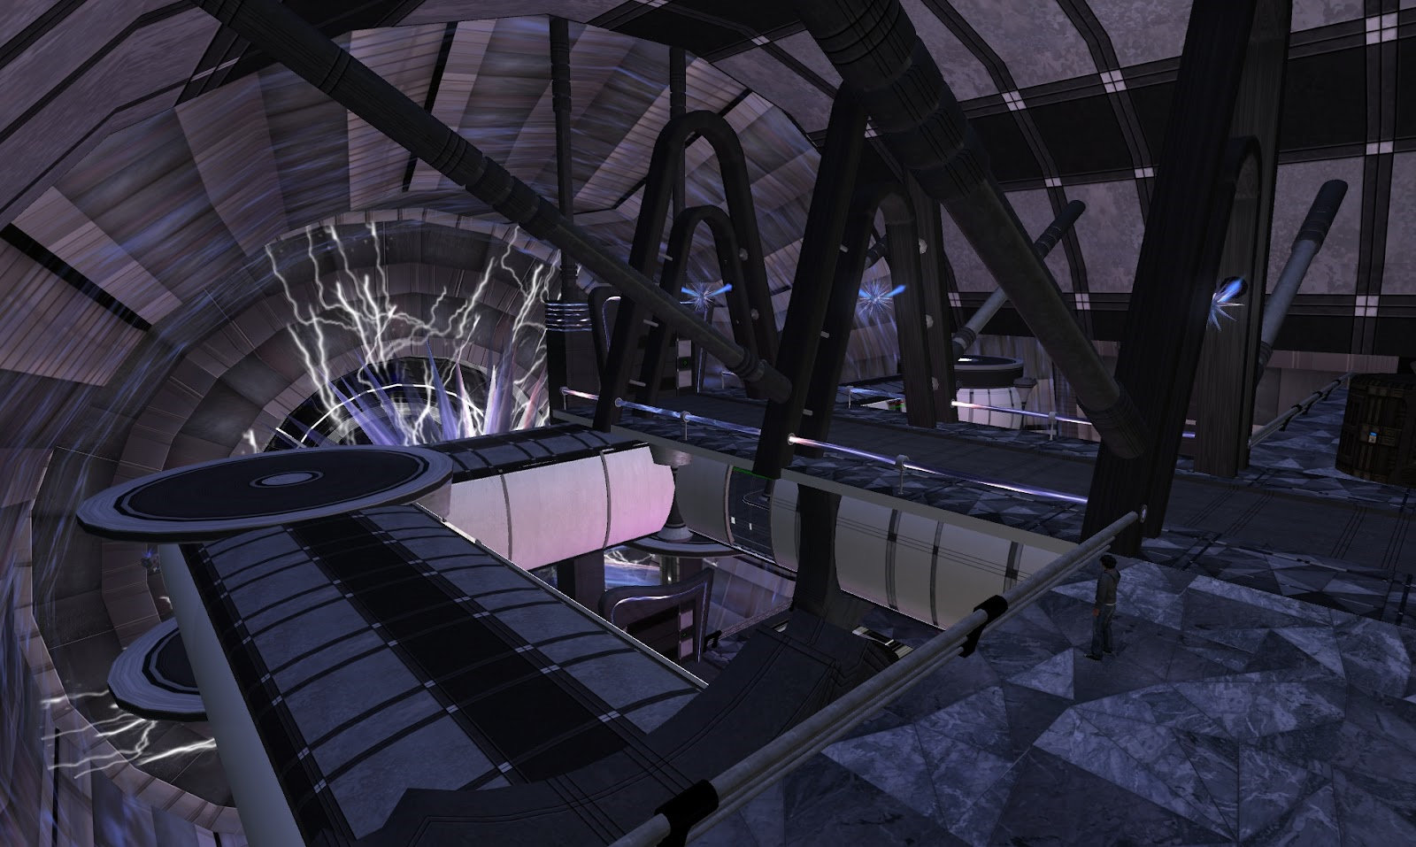

MISSION :
Reimagining human connection through immersive experiences, Connect.ai leverages cutting-edge technology to unite people across distances, fostering genuine connections in a digital world.

Slide 5

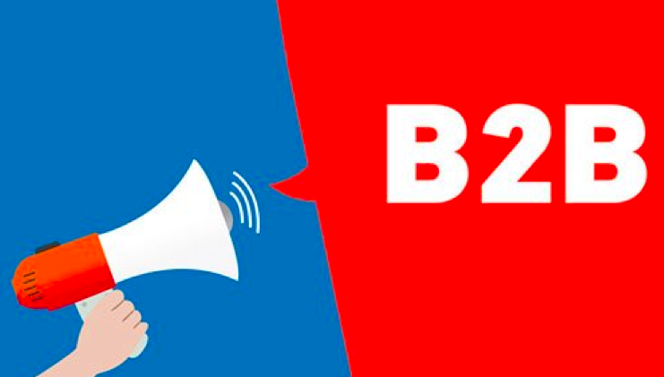
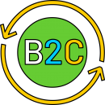
TARGET SEGMENT
Multi National Companies
Startup Organizations
Banks, Global Businesses, Universities
Decision Makers and Executives
Early Technology Adapters
Professionals and Students aged 18 and above

Slide 6
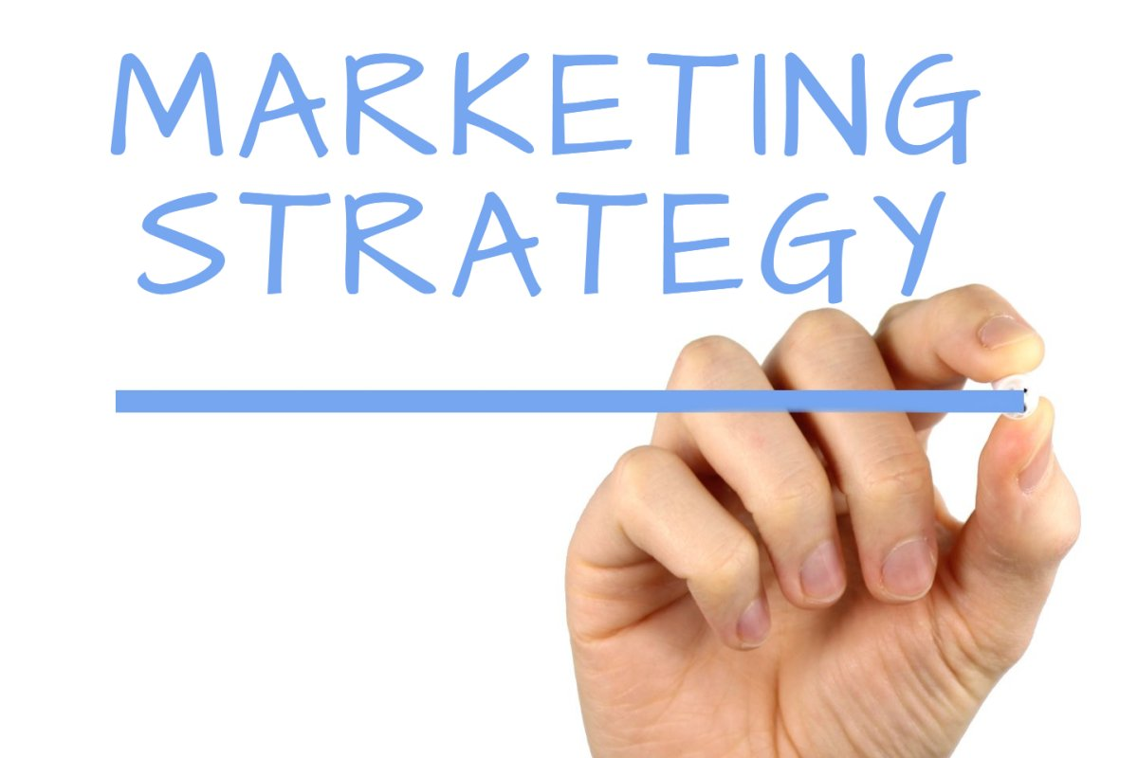
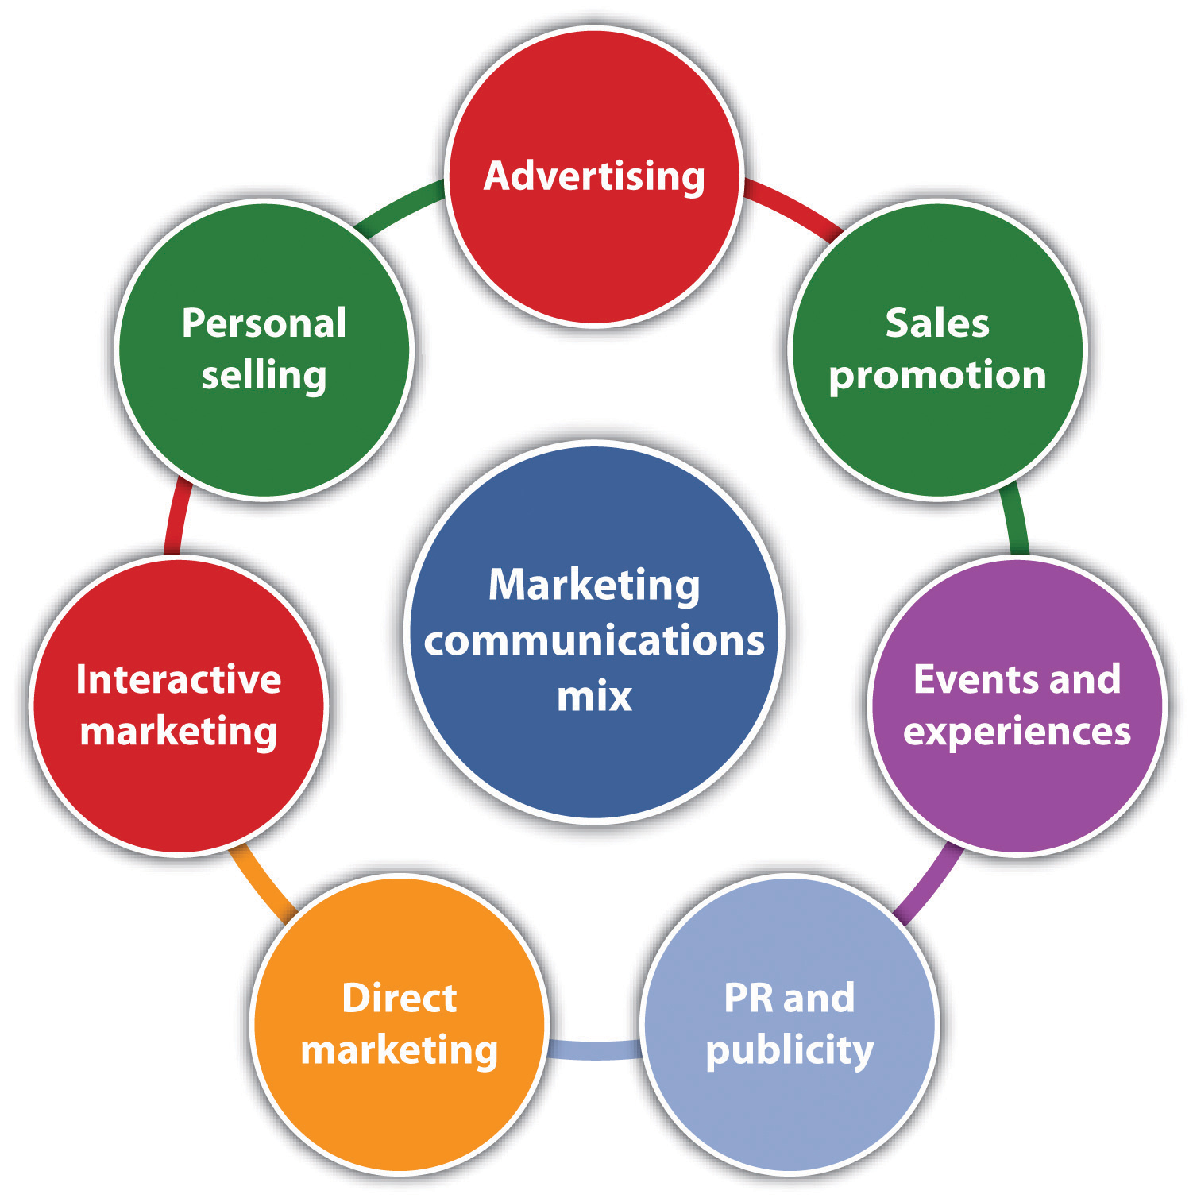
This Photo by Unknown author is licensed under CC BY-SA.

Slide 7
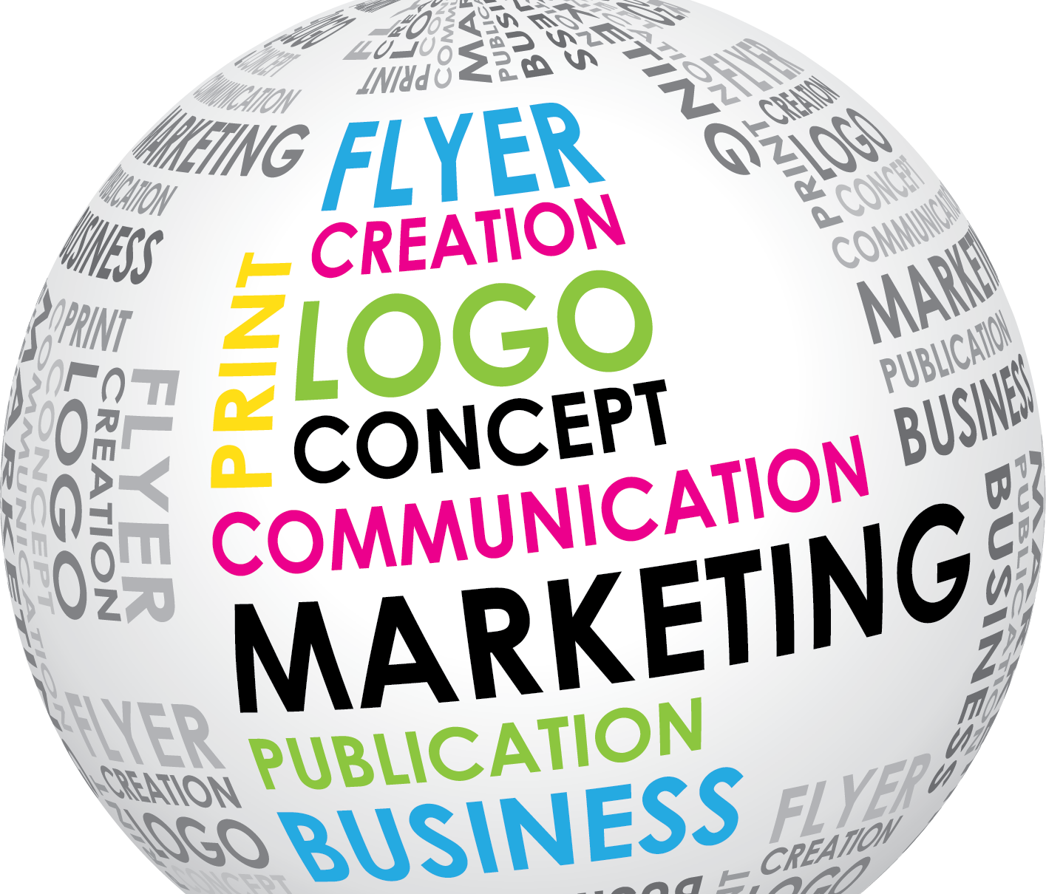
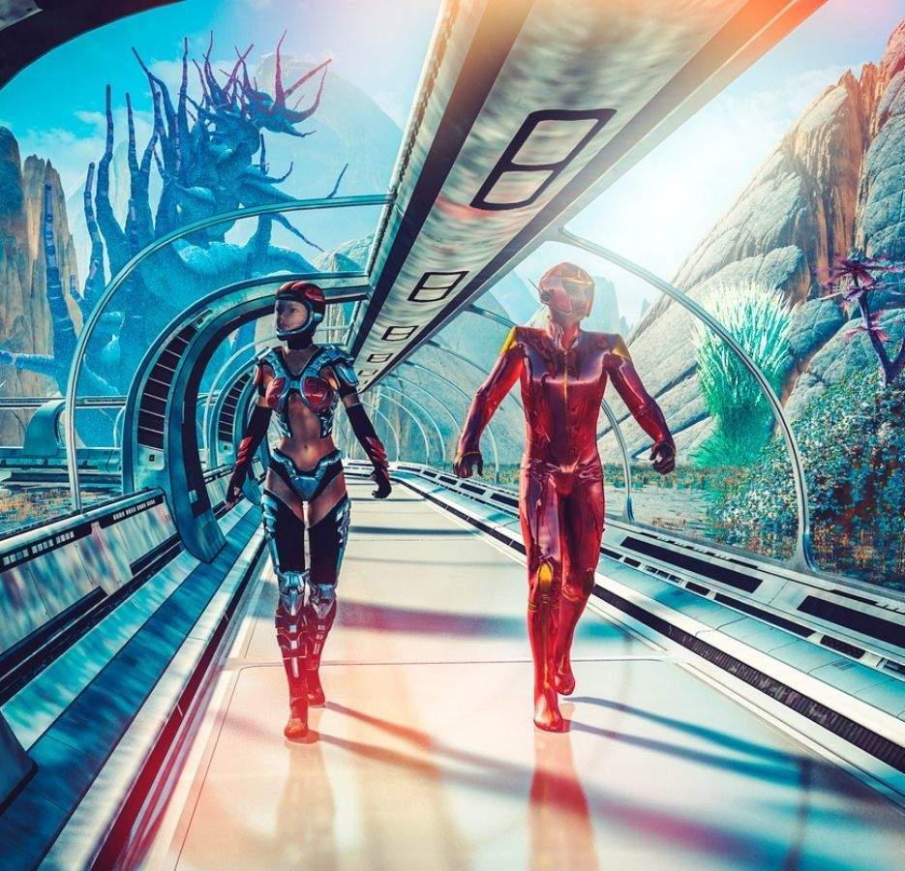
MARKETING OBJECTIVE
Increase Brand Awareness
Drive Customer Engagement
Generate Leads and Conversions
Support Sales Growth
Build Brand Loyalty
Maximize ROI

Slide 8
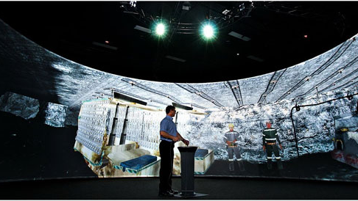
Connect.ai
MARKETING STRATEGY
Immersive Demo Experiences
Host virtual reality (VR) demo experiences at technology conferences, trade shows, and online events.
Allow potential users to immerse themselves in a simulated Connect.ai meeting environment.
Drive website traffic through social media
www.connect.ai

Slide 9
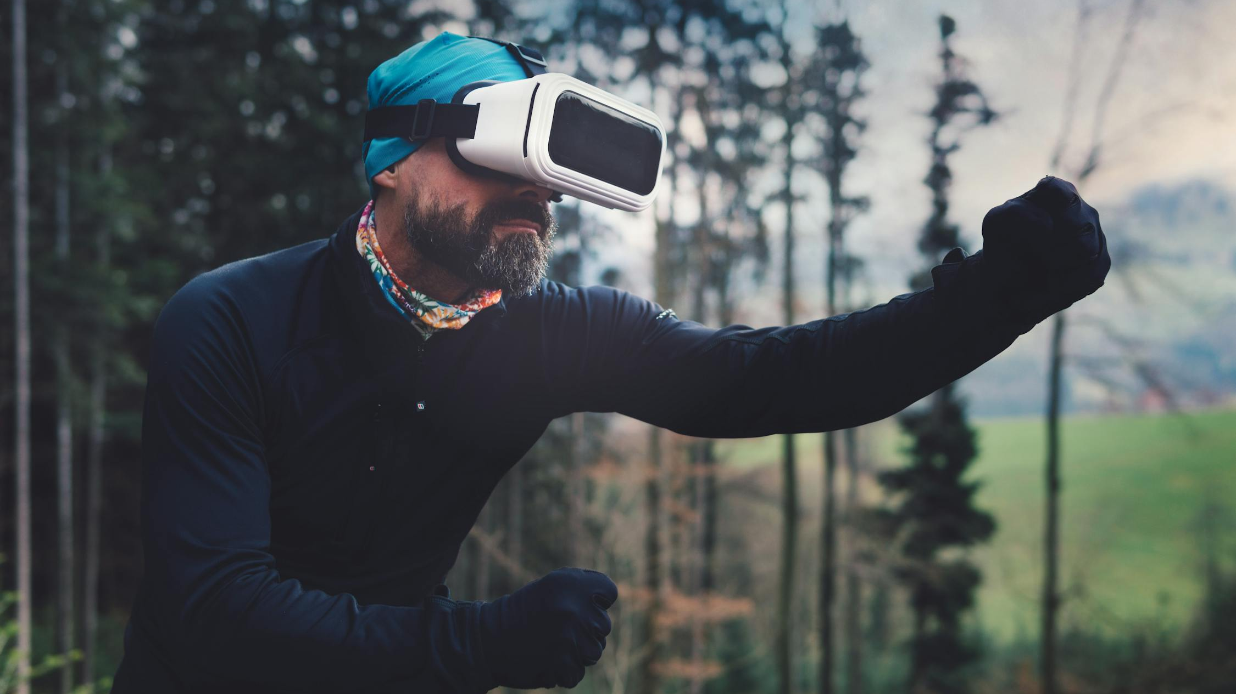
User-Generated Content Campaigns
Encourage users to create and share their experiences with Connect.ai
Leverage user-generated content to amplify brand visibility and showcase diverse use cases.
Utilize social media platforms and hashtags to engage with the target market.
Connect.ai
MARKETING STRATEGY

Slide 10
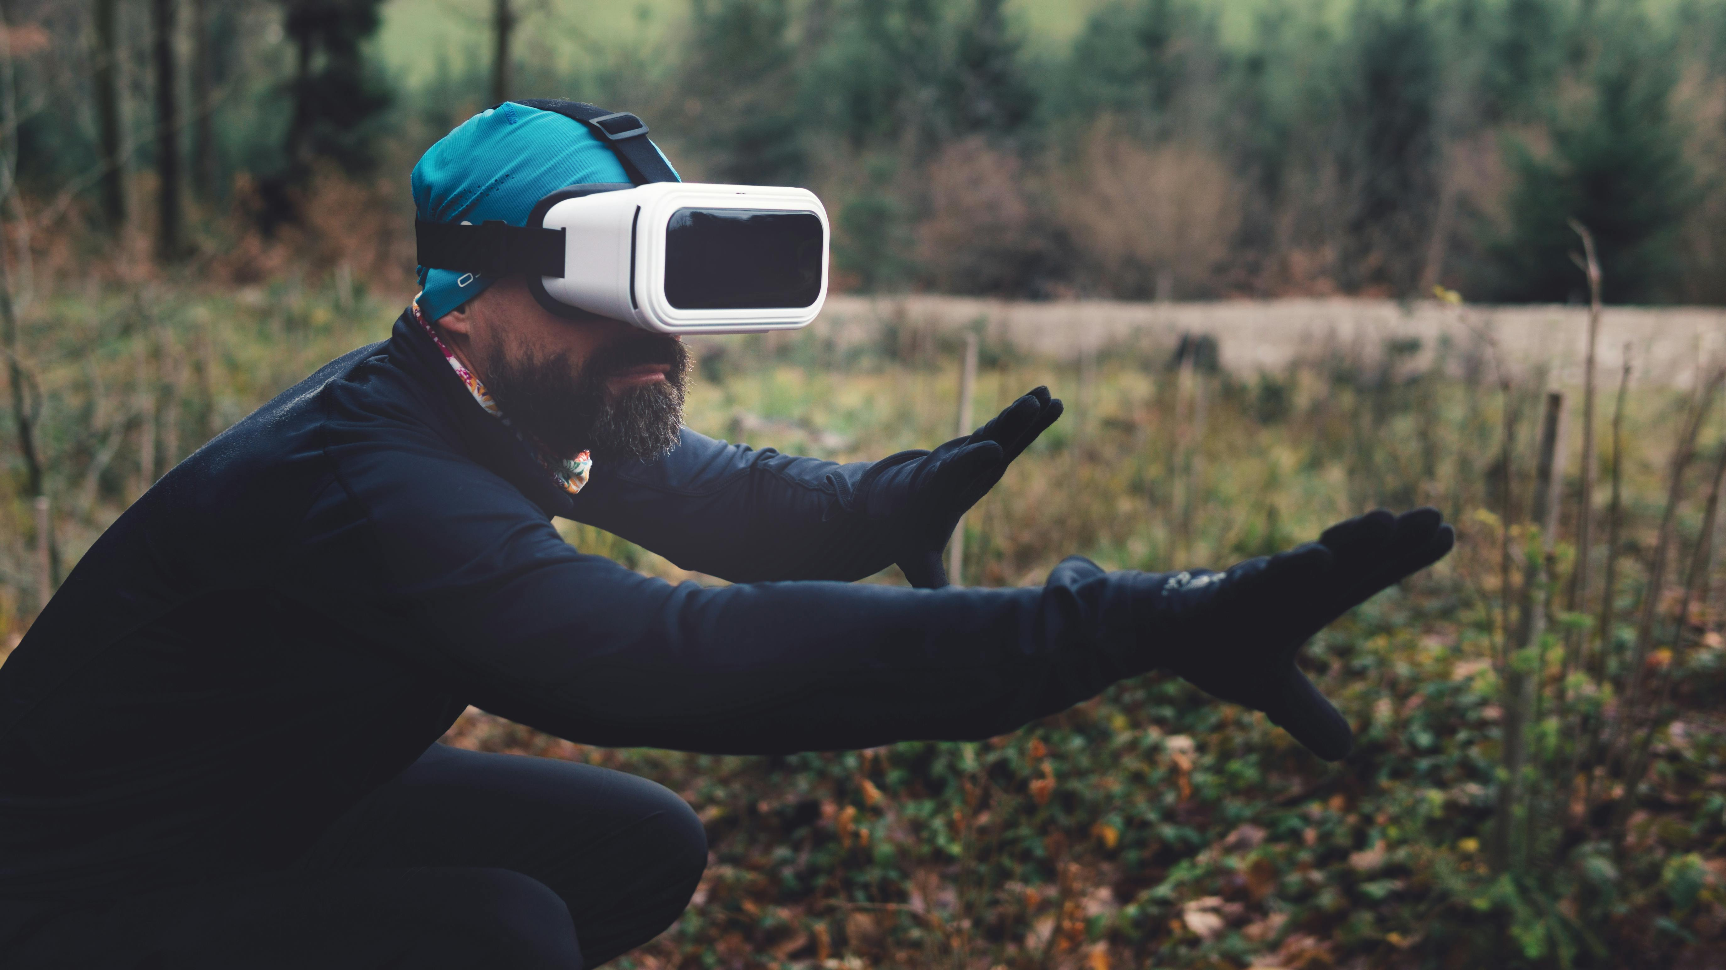
Strategic Partnerships with Influencers
Collaborate with influencers within the technology, remote work, and collaboration space and industry experts.
Endorse and promote Connect.ai to increase brand credibility and reach.
Connect.ai
MARKETING STRATEGY

Slide 11

Virtual Events and Webinars
Host virtual events, webinars, and workshops showcasing Connect.ai capabilities.
Provide educational content on remote collaboration best practices.
Attract professionals, students, and businesses interested in improving virtual meeting experiences.
Connect.ai
MARKETING STRATEGY

Slide 12
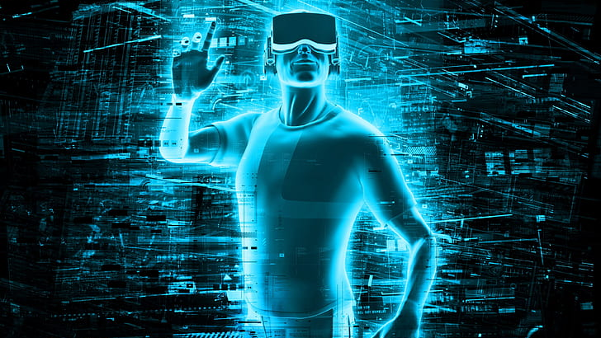
MARKETING IMPLEMENTATION
Conduct market research and analysis.
Analyze key value propositions.
Host VR demo experiences at tech events and educational webinars.
Launch campaigns across social media.
Curate and amplify user-generated content.
Collaborate on content creation and promotions.
Gather feedback for refining strategies.
Analyze performance and adjust strategies.

Slide 13
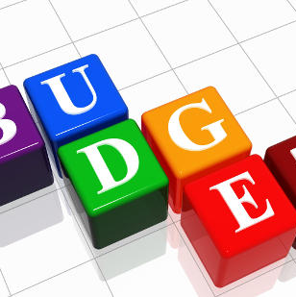
BUDGET
ALLOCATION
Financial Investments: $400,000
  Influencer Partnerships
  Digital Advertising Campaigns
  Event Sponsorships
  Research and Development (R&D)
Human Capital: $230,000
  Marketing Manager
  Content Creator
  Graphic Designer
  Social Media Manager
  Training and Development
Technological Tools: $60,000
  Marketing Automation Software
  Analytics Tools
  CRM Platform

Slide 14

ANALYSIS OF MARKETING EFFECTIVENESS
User Acquisition: Analyze the number of new users acquired through marketing channels, tracking the effectiveness of different acquisition channels and campaigns.
Engagement Metrics: Evaluate user engagement metrics such as time spent on the platform, frequency of interactions, and participation in key activities to gauge the level of user involvement.
Conversion Rates: Assess conversion rates at various stages of the user journey, from initial sign-ups to paid subscriptions or purchases, to measure the effectiveness of marketing efforts in driving conversions.
Brand Perception: Monitor brand sentiment, mentions, and sentiment analysis on social media and other channels to understand how the brand is perceived by its target audience.
Return on Investment (ROI): Calculate the ROI of marketing campaigns by comparing the cost of marketing activities to the revenue generated or value created, ensuring that marketing efforts are cost-effective and contribute positively to the business.

Slide 15

EXPECTED
OUTCOME
Short term benefits
Long term benefits

Slide 16
SHORT TERM BENEFITS
Increased Sales
Improved customer engagement

Slide 17
LONG TERM BENEFITS
Enhanced Brand awareness
First mover advantage
Sustainable Growth

Slide 18
PROJECTED COST BENEFIT ANALYSIS
Financial Investments
Benefits:
  Increased brand visibility and awareness.
  Potential revenue growth from increased sales.
Costs:
  Initial financial outlay.
  Risk of not achieving desired ROI.
Influencer Partnerships
Benefits:
  Authentic promotion to engaged audiences.
  Enhanced brand credibility and trust.
Costs:
  Partnership fees.
  Monitoring and management expenses.
Digital Advertising Campaigns
Benefits:
  Targeted reach to specific demographics.
  Measurable performance metrics.
Costs:
  Ad spend.
  Creative development and management costs.
Event Sponsorships
Benefits:
  Brand exposure to targeted audiences.
  Networking opportunities.
Costs:
  Sponsorship fees.
  Travel and accommodation expenses.
Research and Development (R&D)
Benefits:
  Innovative marketing strategies.
  Competitive advantage.
Costs:
  Investment in new technologies and methodologies.
  Time and resource allocation.
Technological Tools
Benefits:
  Efficiency gains from automation.
  Enhanced data analysis capabilities.
Costs:
  Software subscription fees.
  Implementation and integration costs.

Slide 19
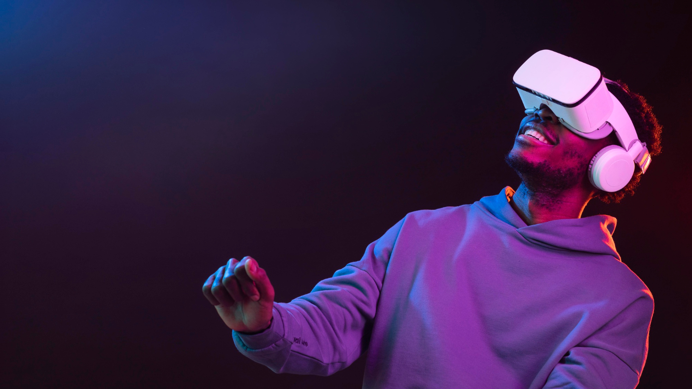
Thank You
This Photo by Unknown author is licensed under CC BY-SA-NC.

