Slide 1
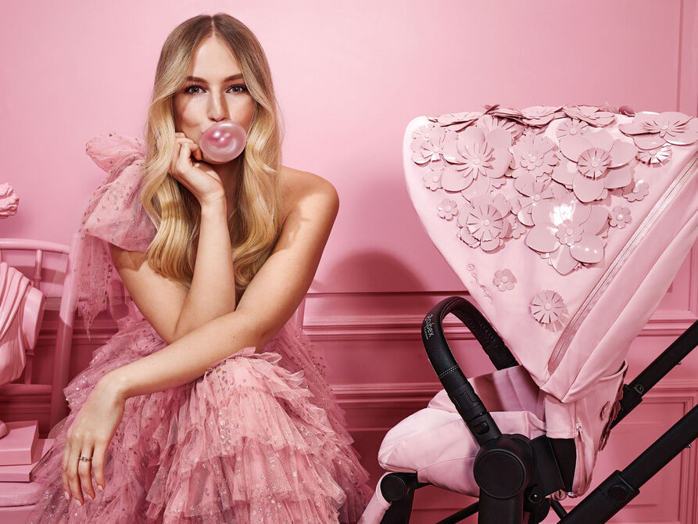
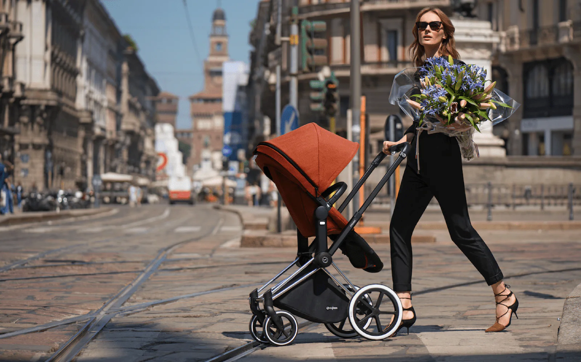

Kumar Gaurav
MARKETING PITCH

Slide 2
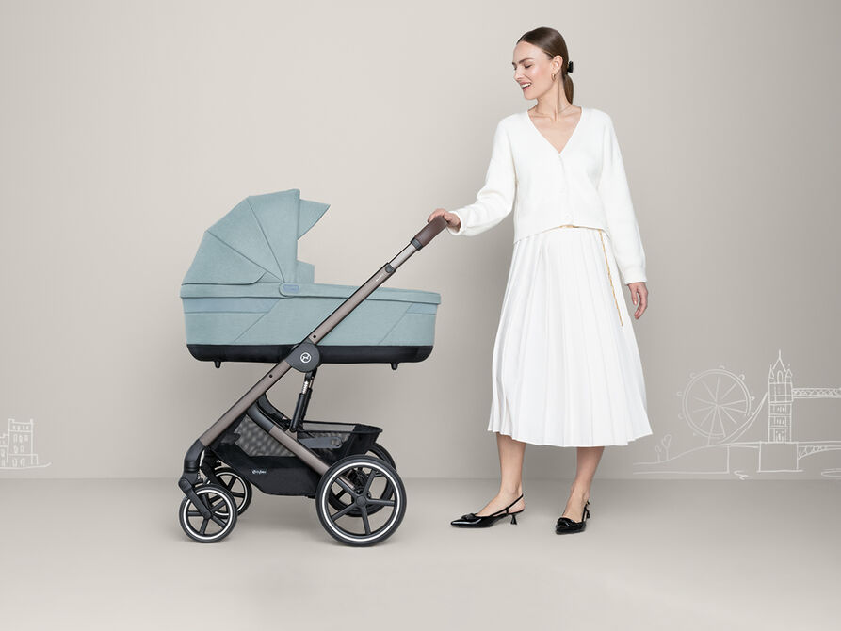
CYBEX OVERVIEW
Notes:
Disclaimer – The data, facts, and numbers provided in this document are sourced from various internet sources for illustrative purposes only. They are presented here for informational use and should not be construed as accurate or verified information. Readers are advised to independently verify any information presented herein before relying on it for decision-making purposes. The authenticity and reliability of the data cannot be guaranteed, and the author assumes no responsibility for any inaccuracies or errors in the information provided.

Slide 3
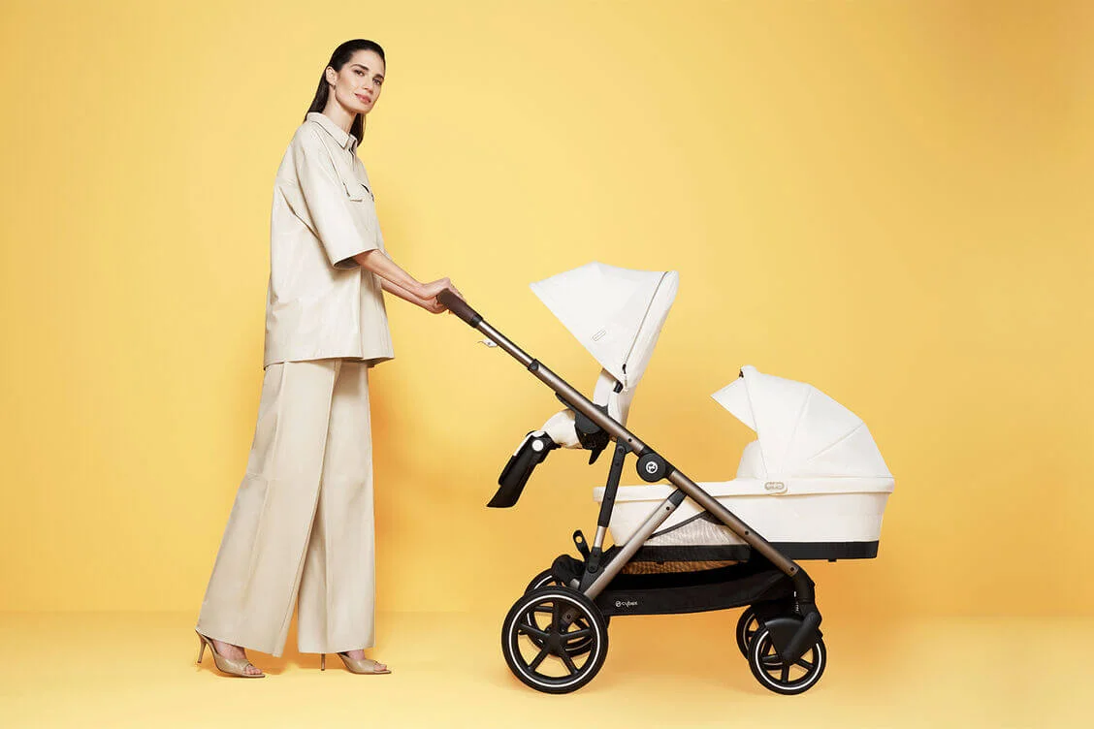
HOW IT IS DIFFERENT FROM OTHERS (USP)
Design Safety Functionality

Slide 4

WHAT PROBLEM IT SOLVES
Urban lifestyles
Makes parenting delightful journey

Slide 5
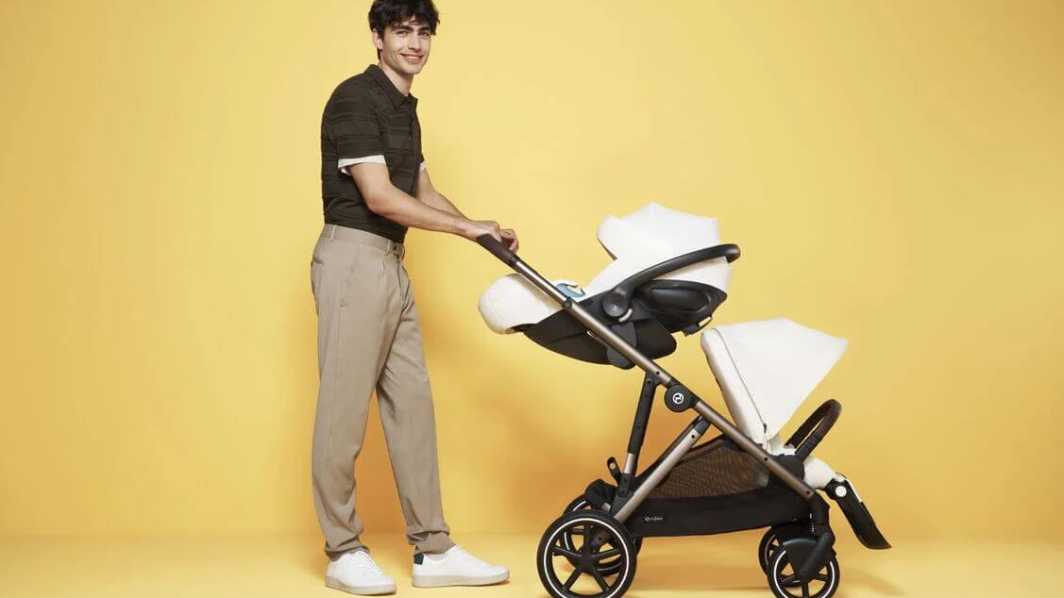
TOP 2 in Europe
https://www.riverbabygroup.com/best-4-european-stroller-brands/

Slide 6
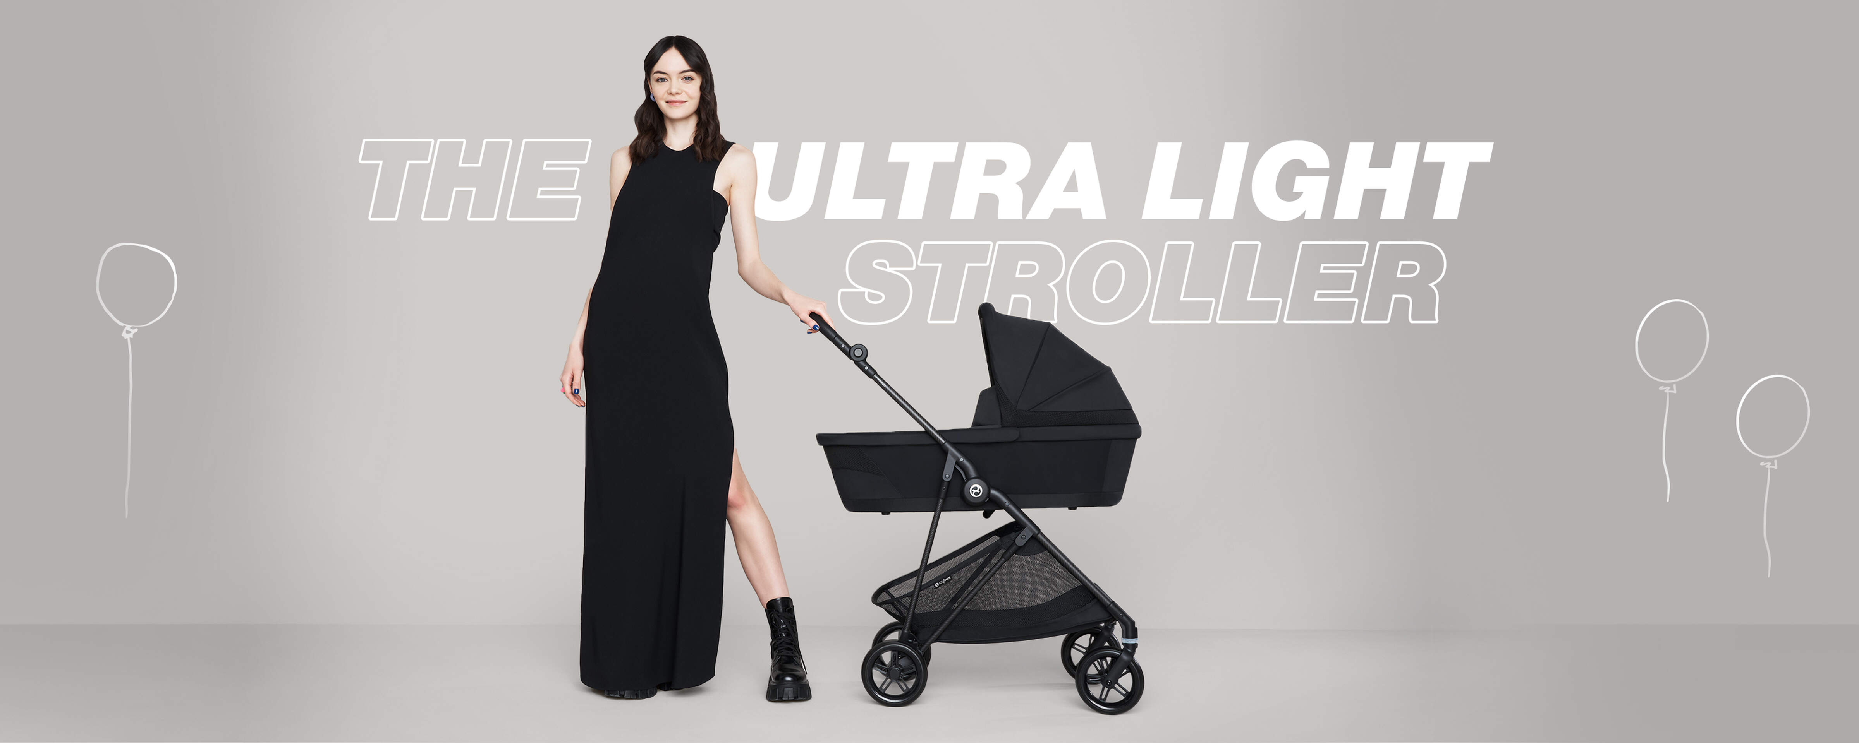
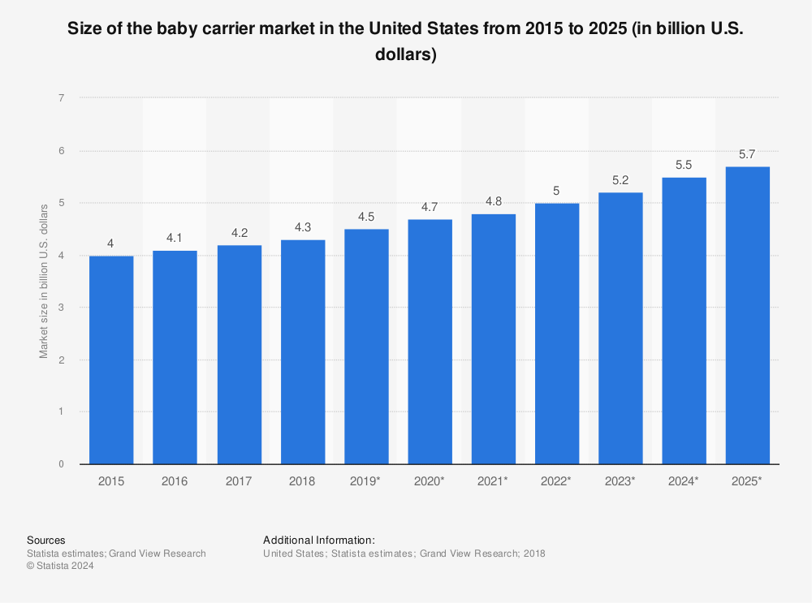
USA MARKET SIZE

Slide 7
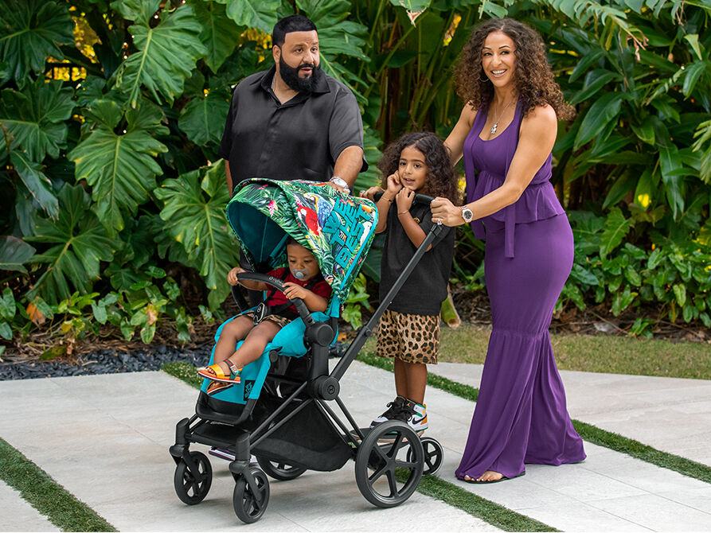
BRAND COLLABORATION
DJ KHALED
Grammy award-winner

Slide 8
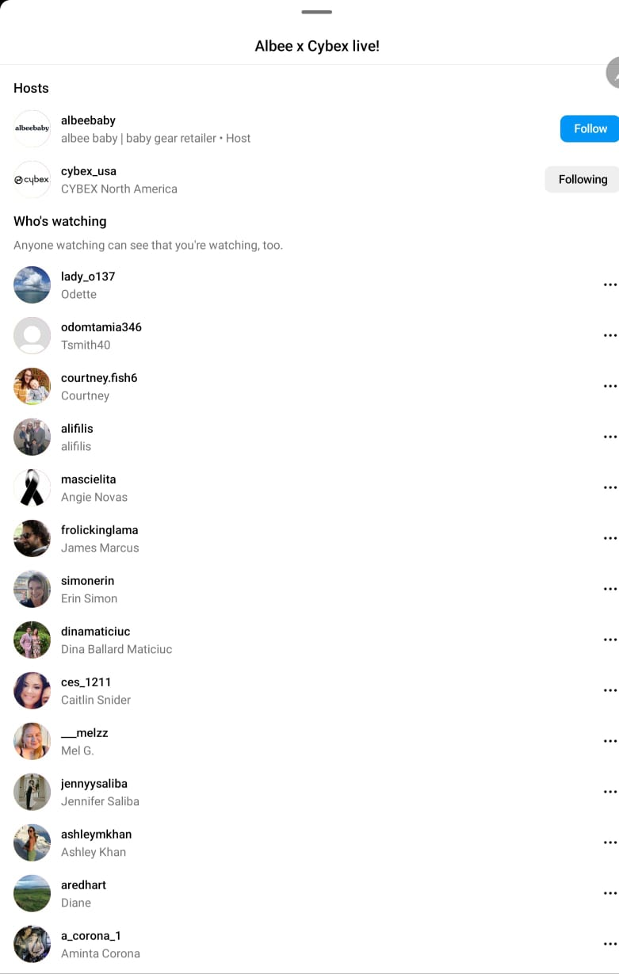
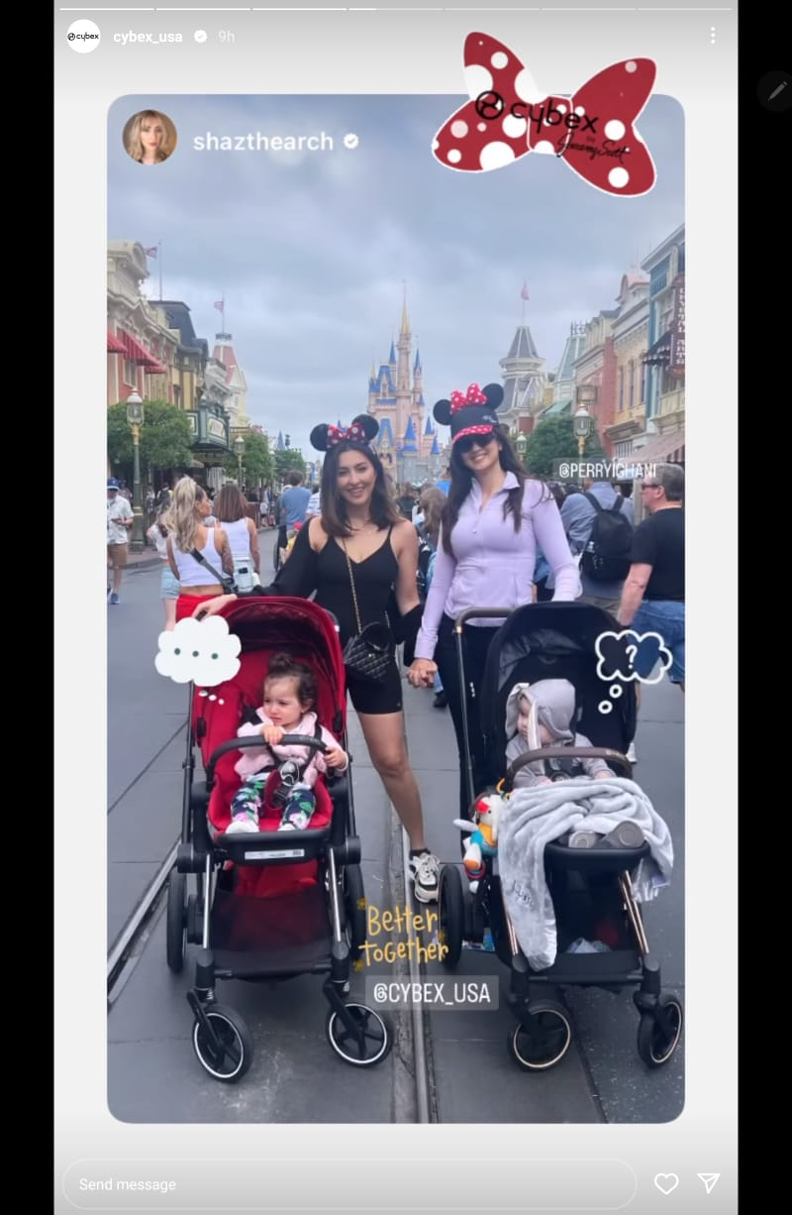
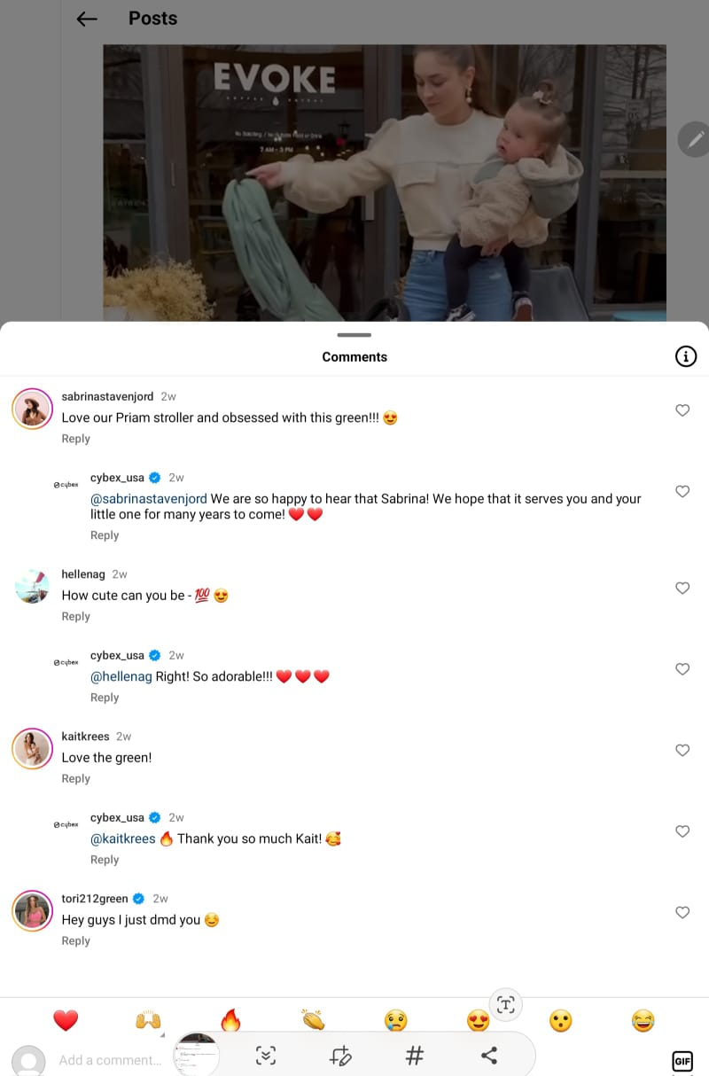
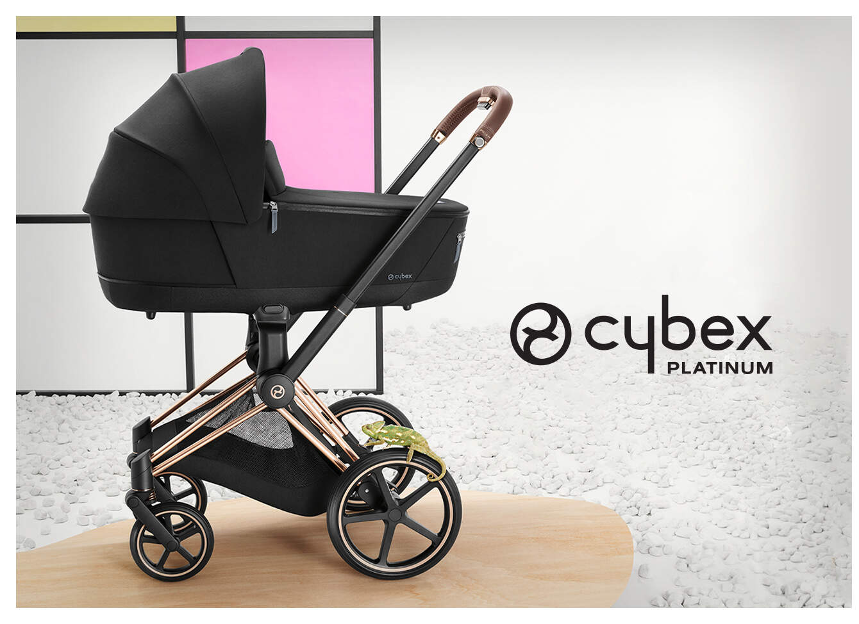
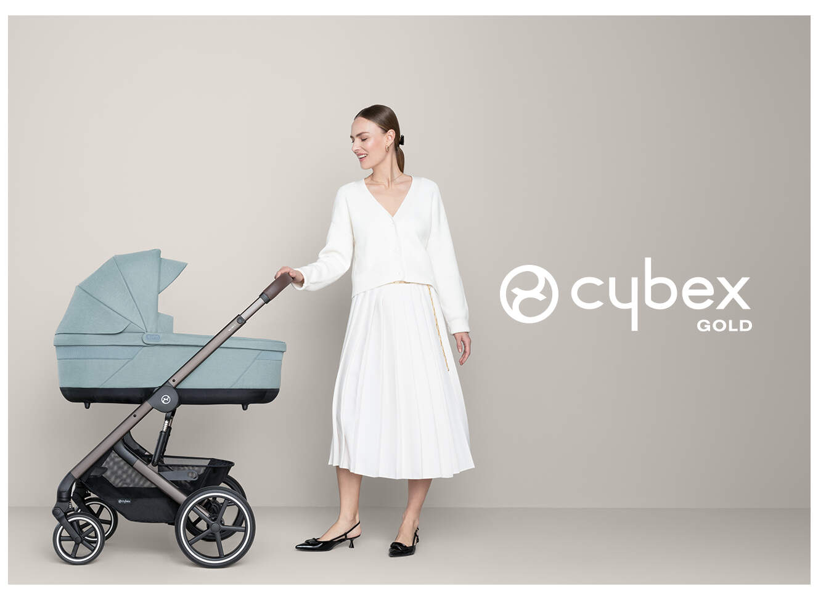
Female

Slide 9
Target Audience
Urban parents seeking practical, stylish strollers.
Safety-conscious consumers.
Design enthusiasts

Slide 10
Market Segmentation
Consumers aged 24 and younger, including young parents, contribute the least revenue to the durable baby goods industry.
They often have limited disposable income, leading them to opt for more affordable or second-hand products.
Revenue from this demographic has declined over recent decades, partly due to the rising age of first-time mothers.
Consumers aged 25 to 44 are the primary drivers of demand for baby goods.
The average age of first-time mothers in the US is around 27, aligning with this demographic.
Despite rising living costs, they typically have steady incomes and moderate disposable income, fueling demand.
Online shopping convenience has led to a significant portion of purchases within this age group being made online.
Consumers aged 45 and older, often grandparents, contribute through gifting baby goods.
This group typically enjoys higher disposable incomes and may splurge on higher-quality items.
Grandparents, in particular, are inclined to purchase gifts for their grandchildren, benefiting the industry.

Slide 11
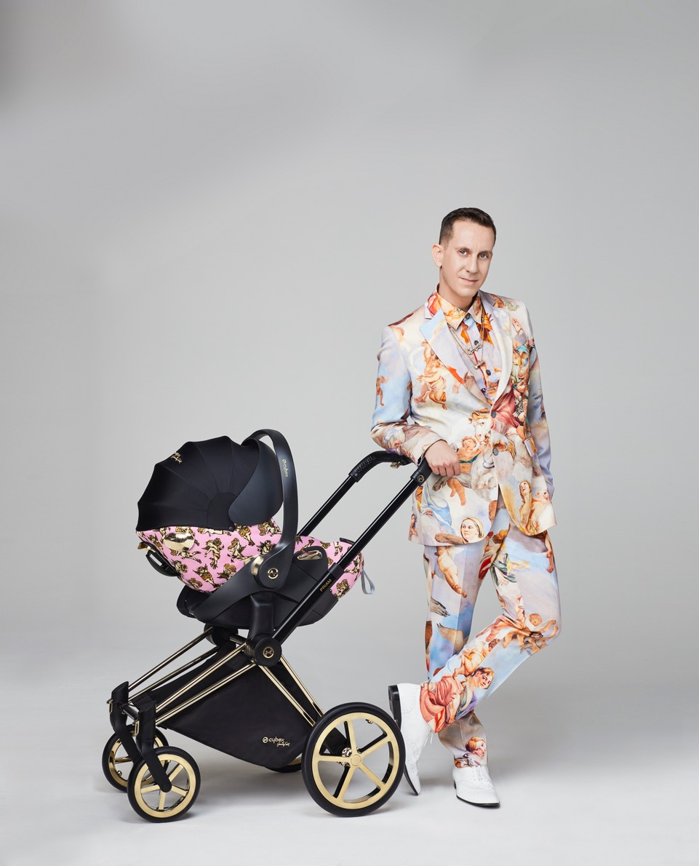
Social Media:
Instagram: Share lifestyle photos, user-generated content, and safety tips, Monthly photo contests, hashtags.
Facebook: Run targeted ads to reach parents

Slide 12
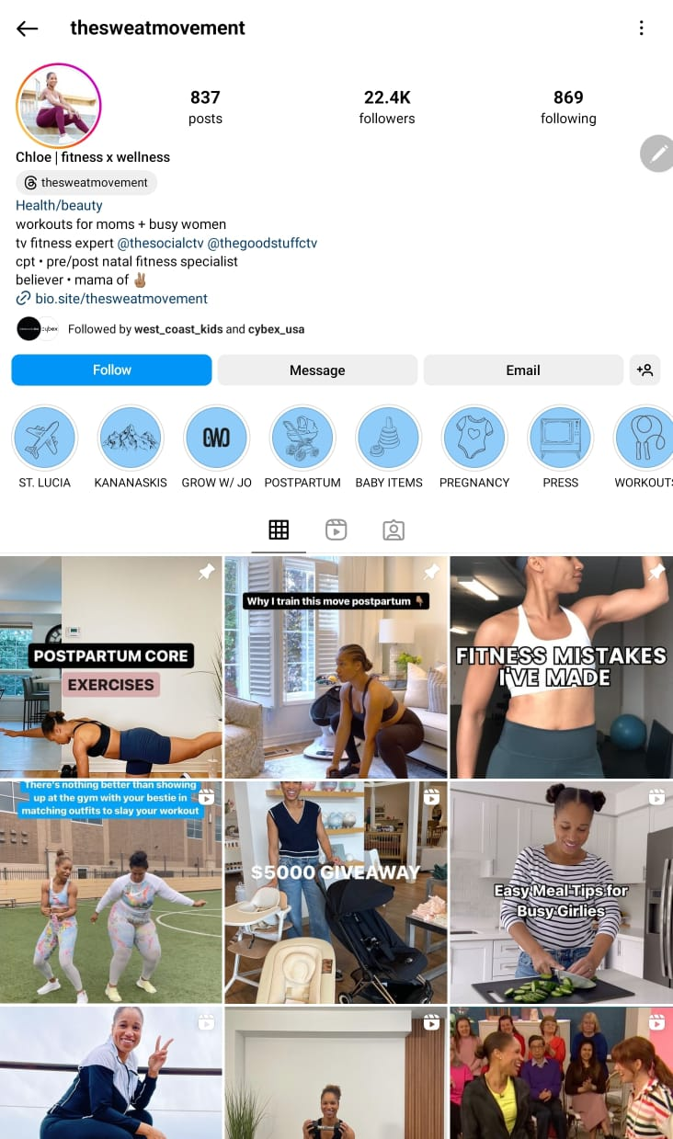
Influencer Collaborations:
Partner with parenting influencers for authentic endorsements

Slide 13
Parenting Blogs and Magazines :
Publish articles on stroller trends, safety, and design
Video Tutorials
User Stories Testimonials

Slide 14
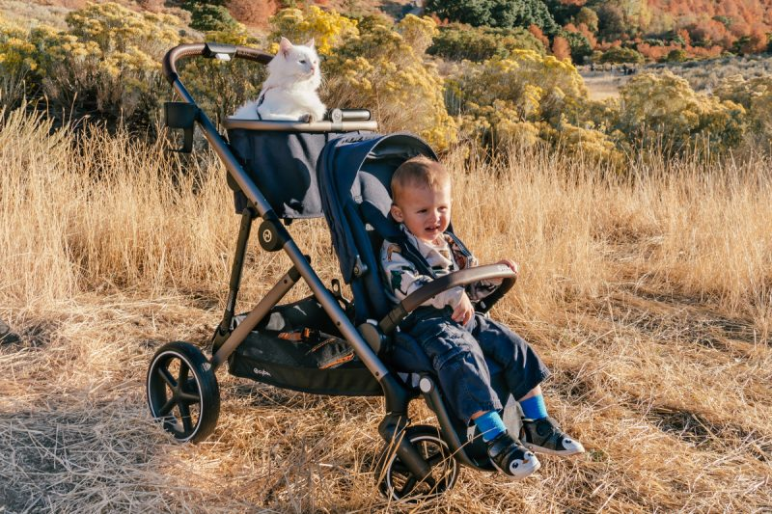
Partnerships
Collaborate with like-minded brands:
Fashion Brands
Health and Wellness Brands
Lifestyle Influencers:
Unboxings, reviews, and styling tips.
Show strollers in real-world settings (cafes, parks, public transport

Slide 15
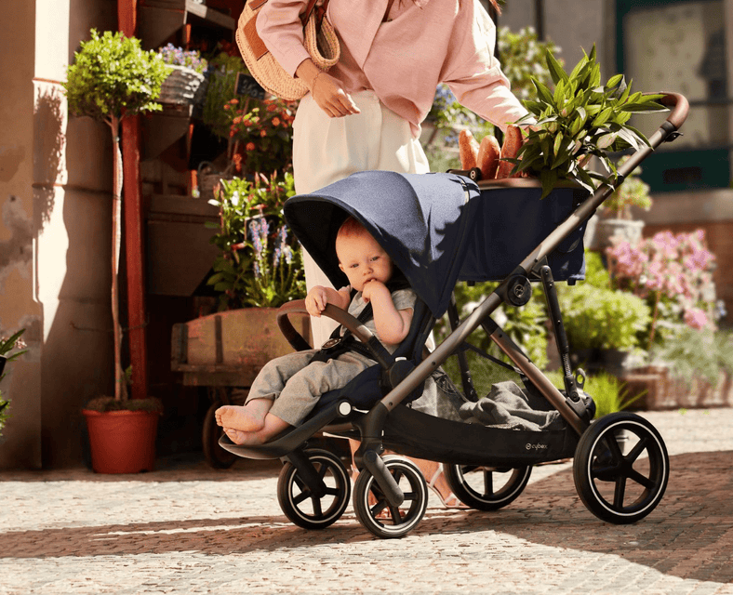

Events
Pop-Up Shops
Parenting Expos

Slide 16


Data Collection Tools
Facebook Conversion API Pinterest Conversion Tag
Google Analytics

Slide 17
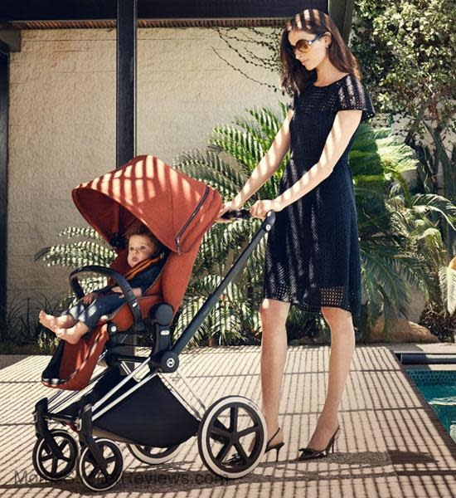
KPI
20% increase in website traffic
10,000 unique visitors per month
5% conversion rate on the CYBEX website
Instagram : 500 likes per post and 50 comments per post
Facebook: Aim for 200 shares per month
15% growth in CYBEX stroller sales revenue
minimum ROAS of 300% or more
NPS – 85+

Slide 18

THANK YOU
KUMAR GAURAV
kgaurav@clarku.edu

