Slide 1
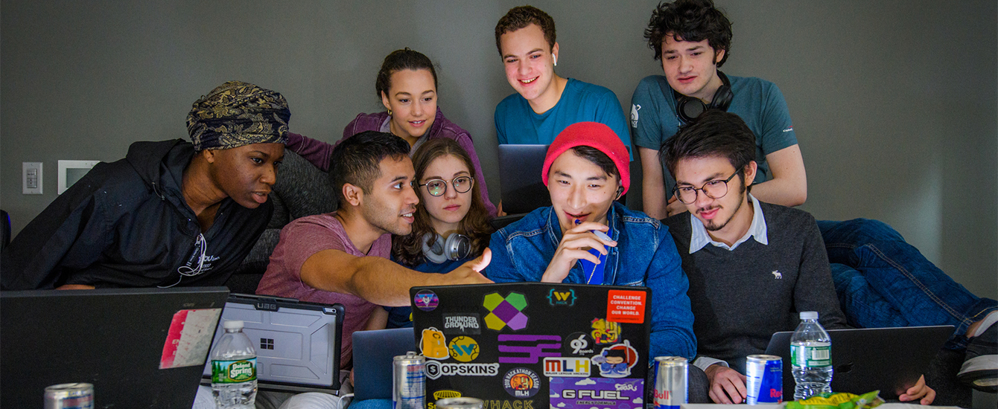
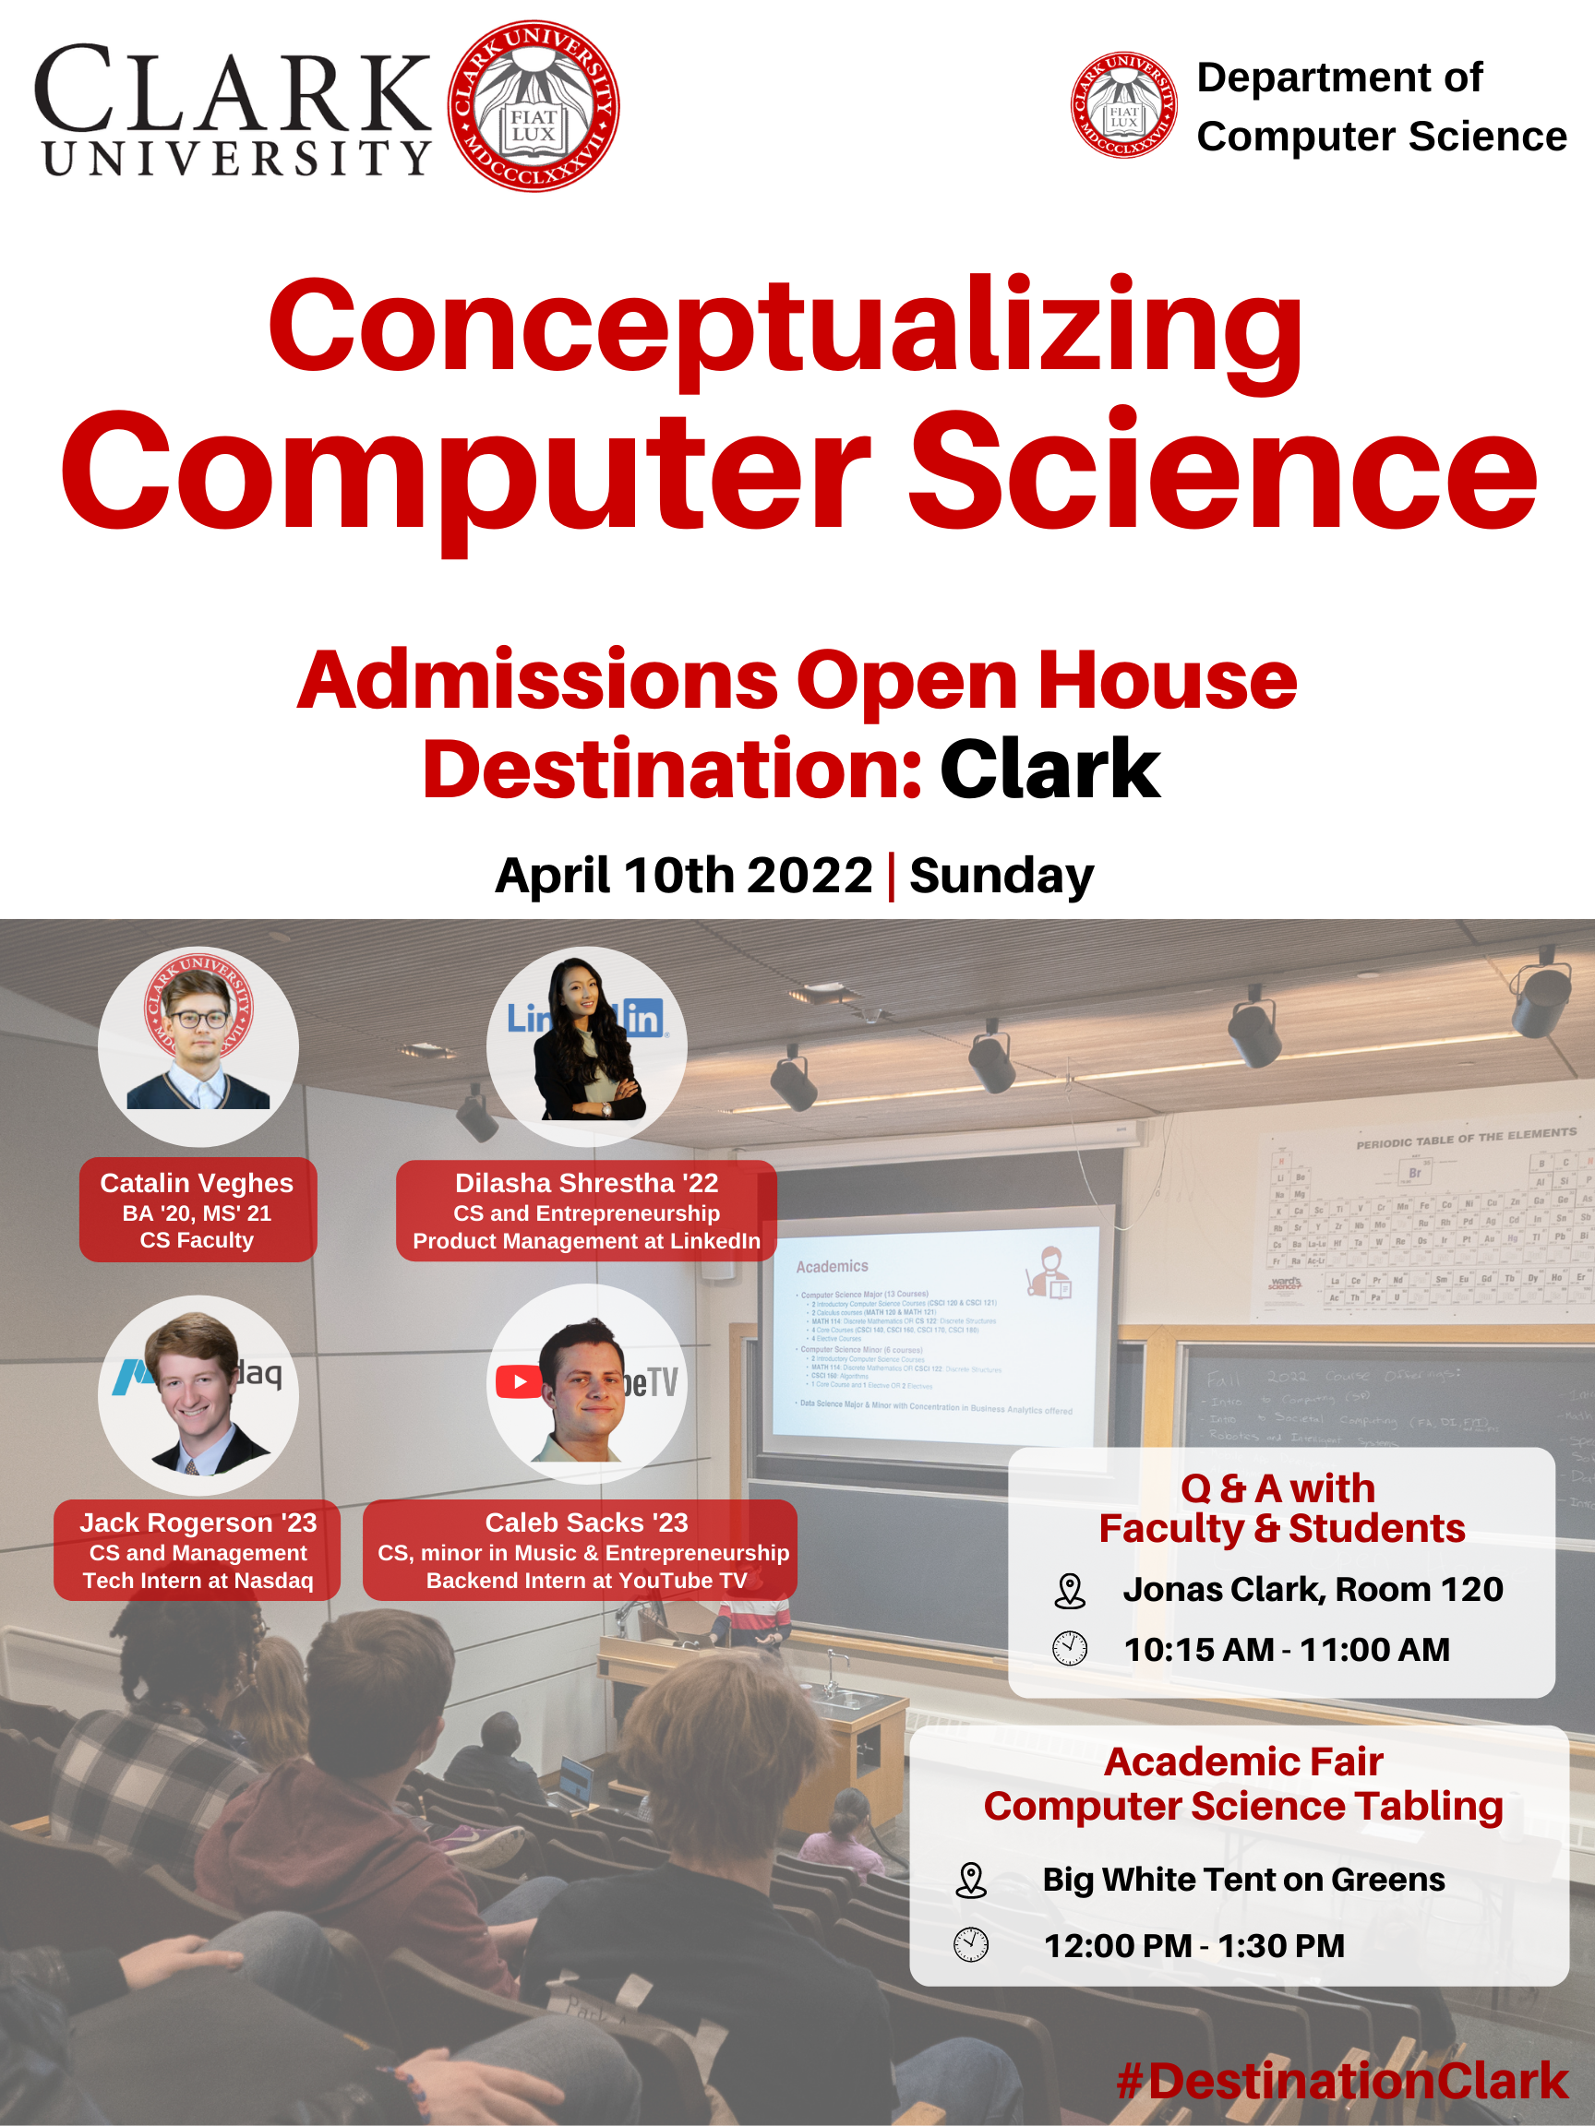

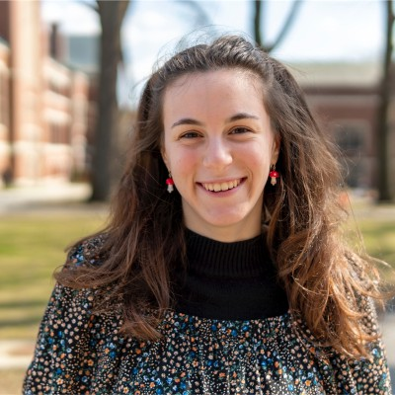
DESTINATION CLARK: COMPUTER SCIENCE
Department of
Computer Science
Nina Carlson ’24
Intern @ Microsoft

Slide 2
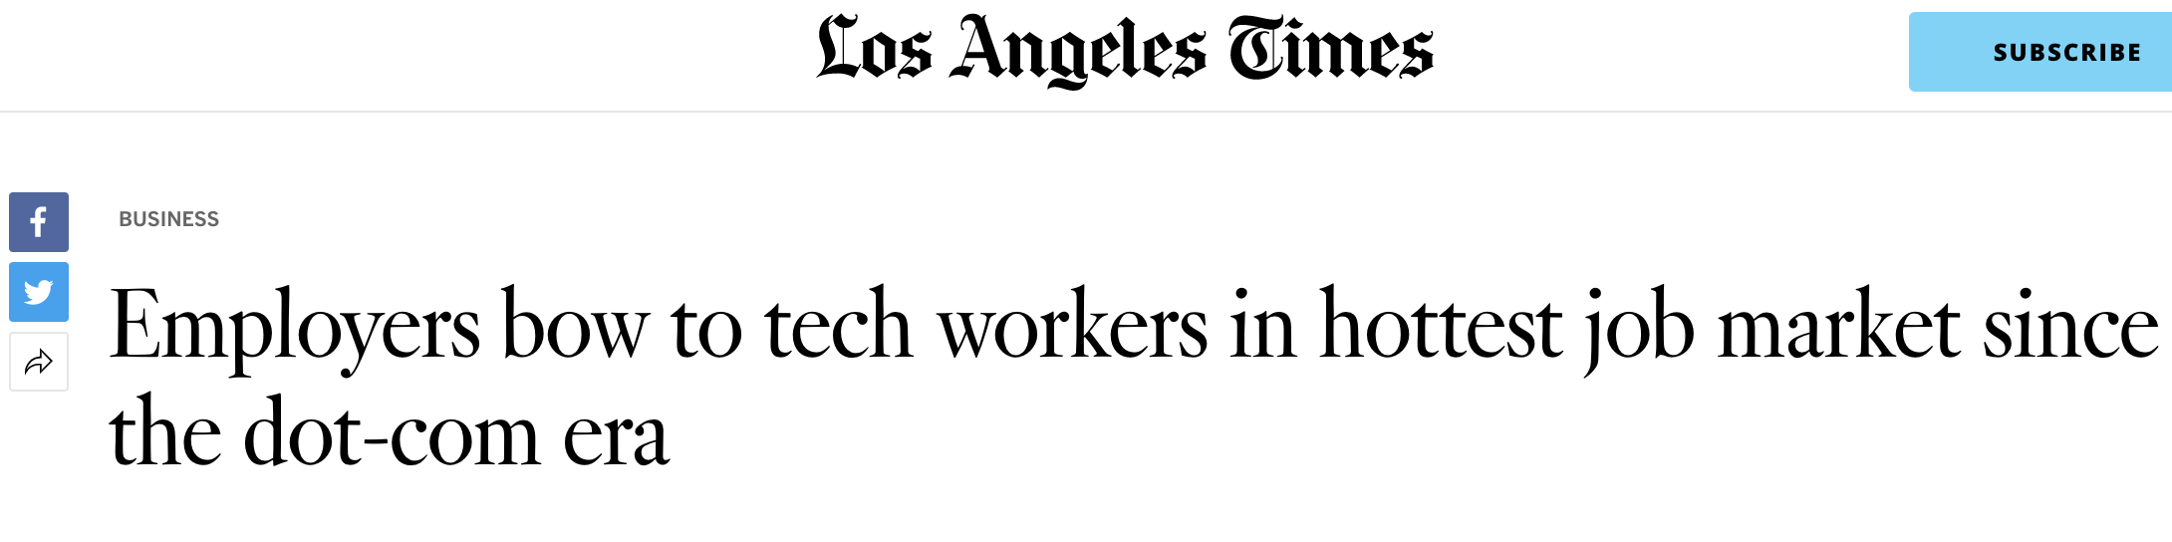

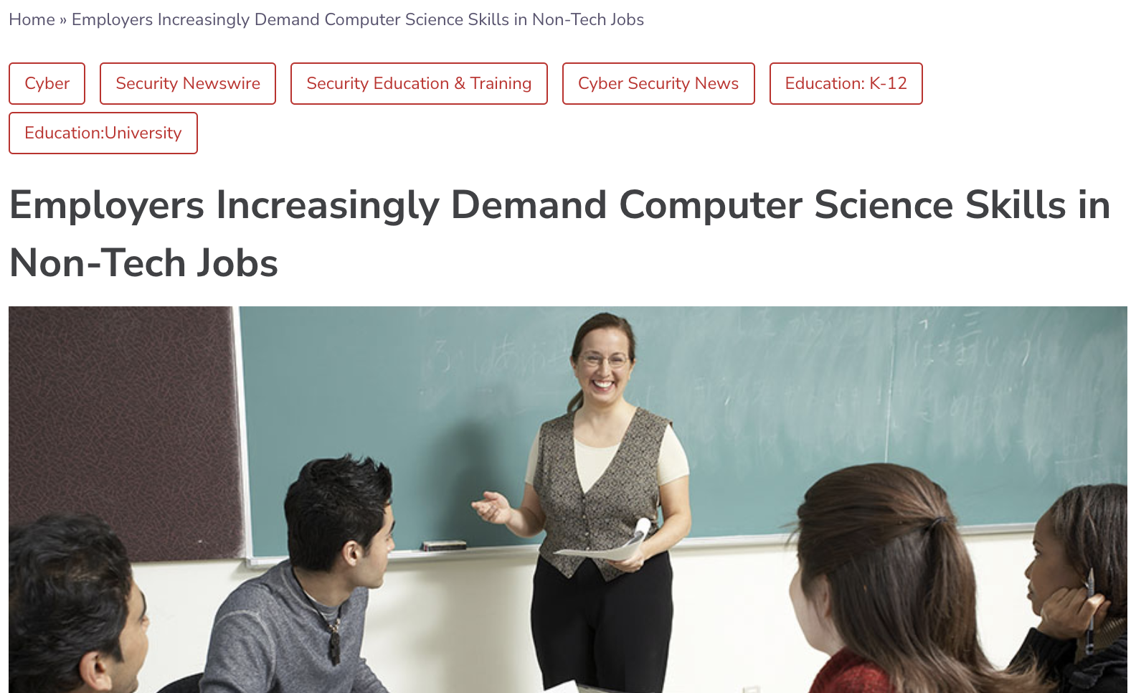
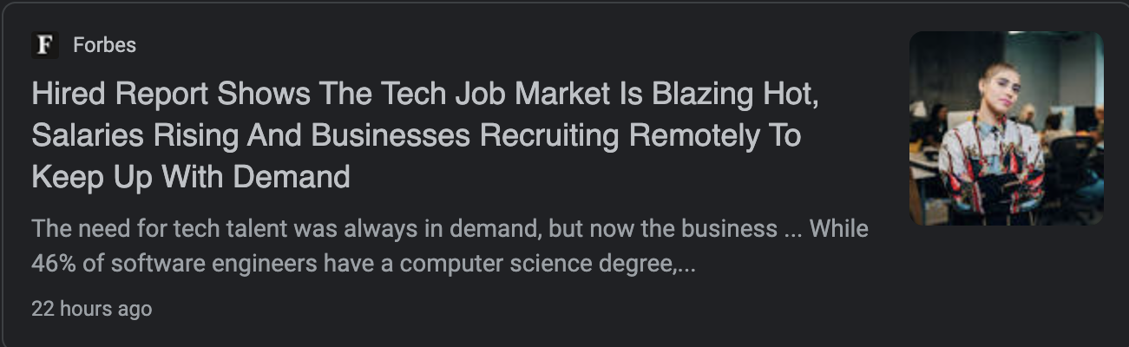
Computer Science
Prospects

Slide 3
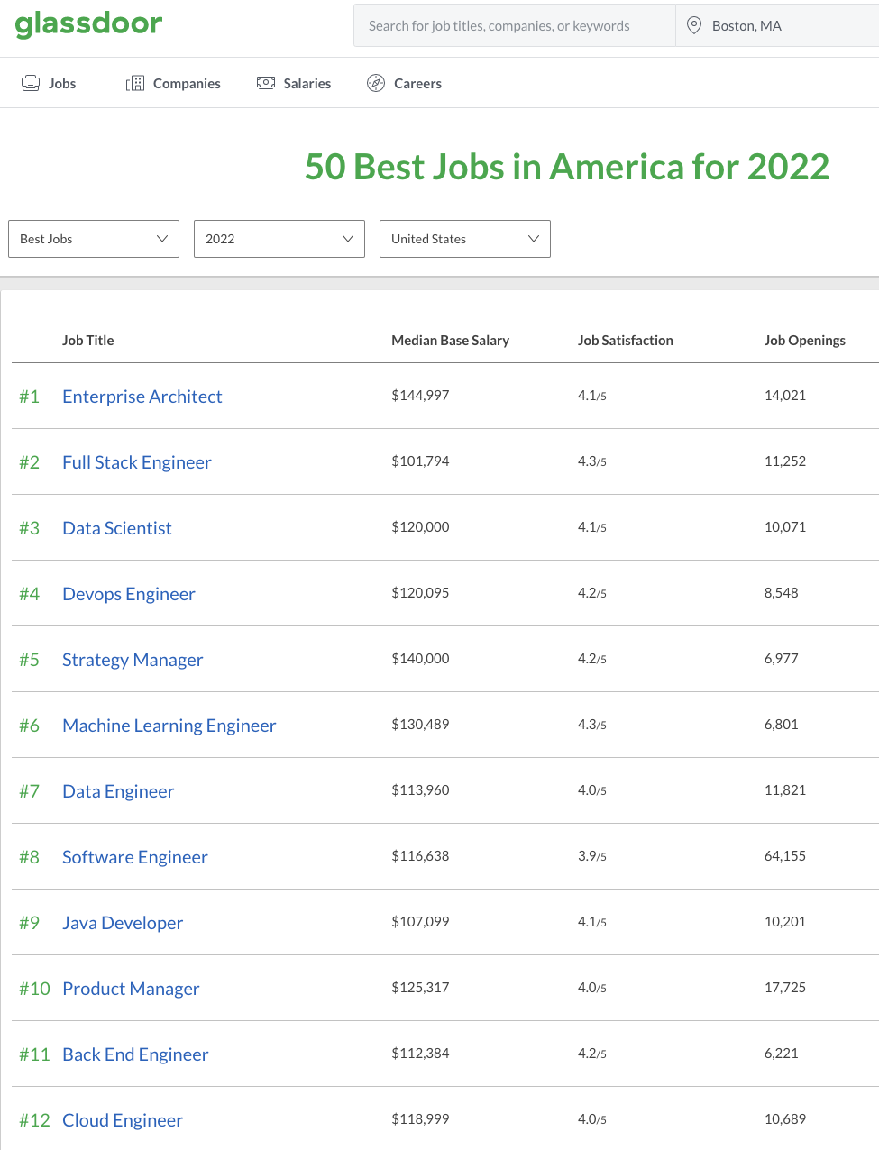
Some of the best jobs in the industry
Jobs in the Computer Science industry are known to be one of the most rewarding ones, having one of the highest opening position numbers, starting salaries and work satisfactions.

Slide 4
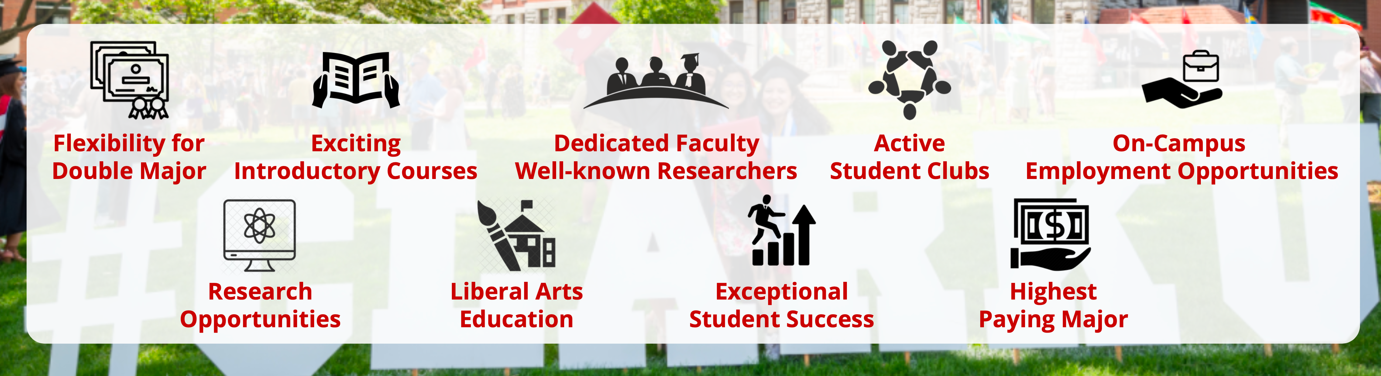
Why CS @ Clark?

Slide 5
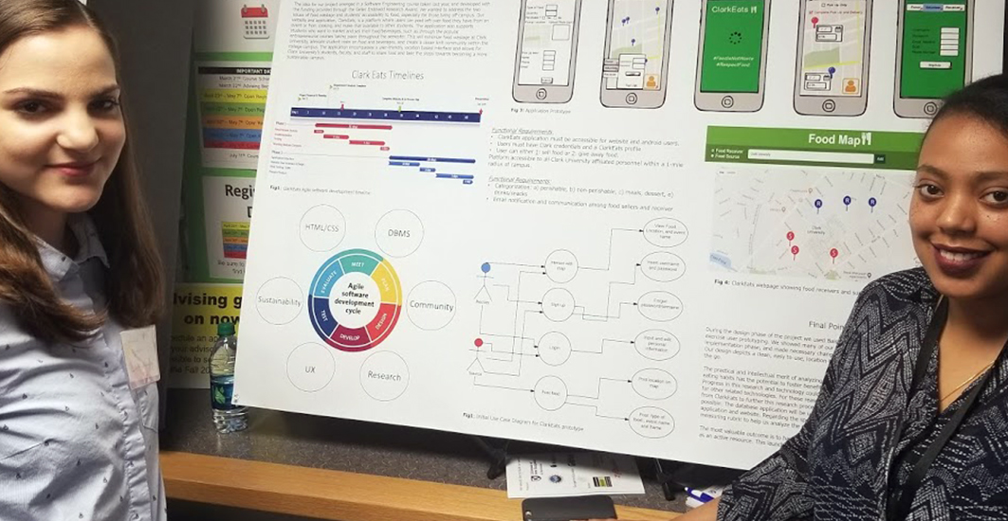
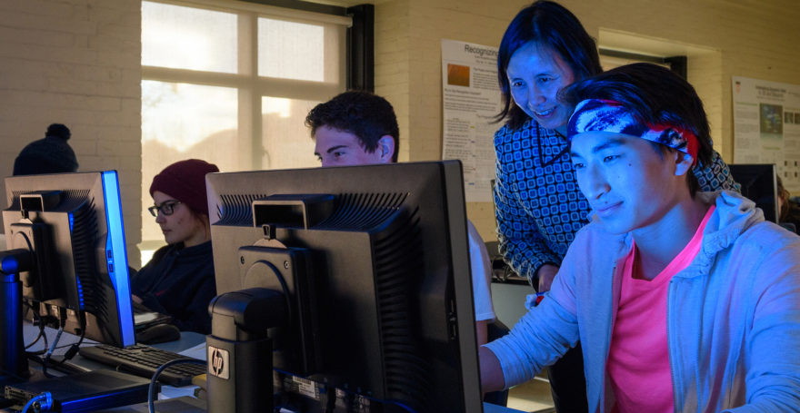

Opportunities on Campus
Teaching Assistants
Research Assistants
ITS Help Desk
Academic Technology Services
System Administrator
Media Services
LEEP Grant
Hackathons
Conferences
Notes:
Opportunity!!!
A great number of our students have the opportunity to be involved with the department and relevant industry fields at Clark.
Clark is able to offer many unique opportunities such as serving as Teaching Assistants during undergrad study.
A number of student fulfill a variety of roles within the Clark ITS department.
Students can fulfill roles such as general troubleshooting and helpdesk assistance, to more technical positions such as DevOps for our campus learning management system or system administrations for our High-Performance Computing infrastructure.
Research and

Slide 6
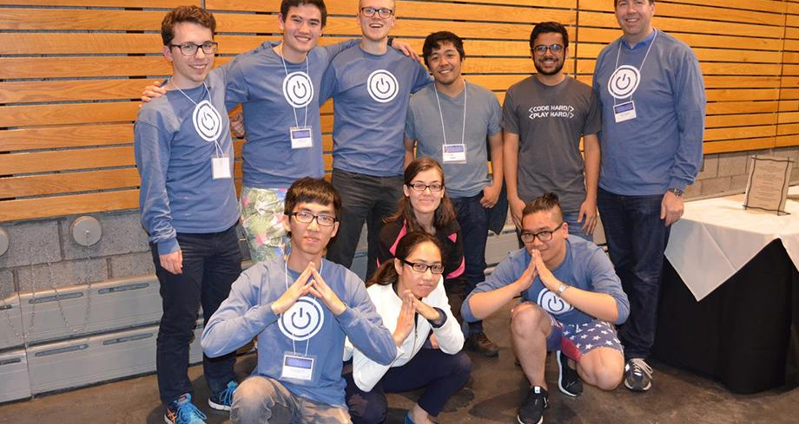
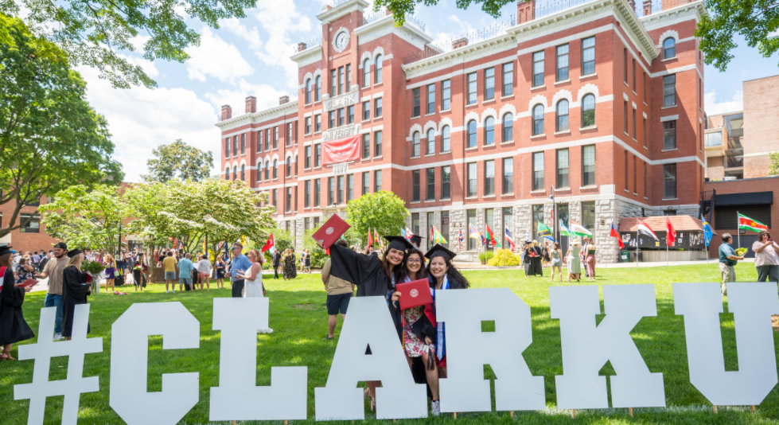
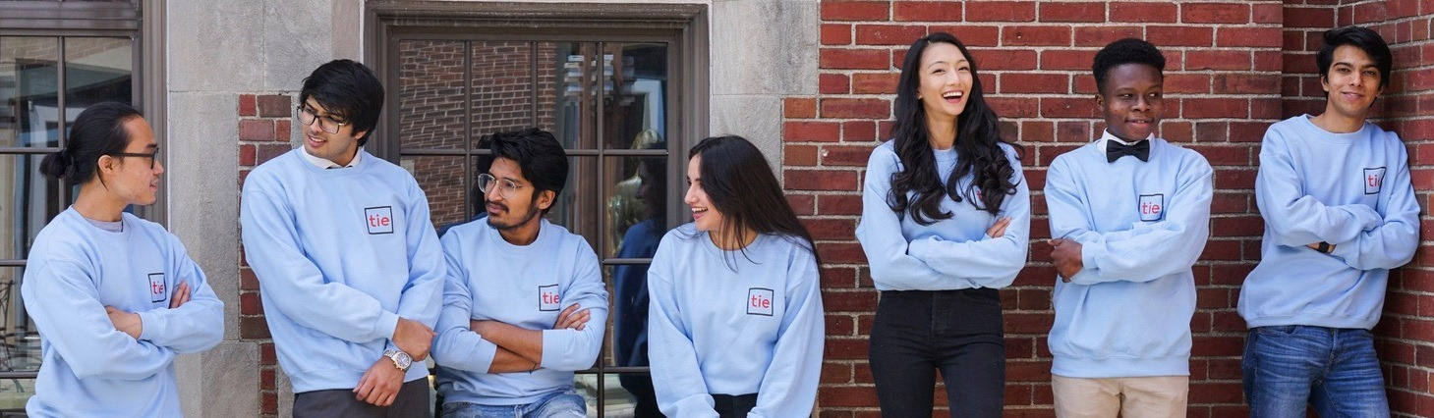
Computer Science
Community @ Clark
Supportive Community
Helpful Alumni
Proactive Faculty
Student Clubs
Clark TIE (Clark Center for Technology Innovation & Entrepreneurship)
CCCC (Clark Competitive Computing Club)
ACM Chapter at Clark
Notes:
Clark CSCI is a supportive community that presents great opportunity
Students can peruse high levels of involvement inside and outside of the classroom setting.
Students are supportive of each other
A network of Alumni that supports students in a variety of ways:
Volunteer to host enrichment session such as coding/problem solving practices.
Happy to refer Clark students within their companies and organizations.
Faculty:
Faculty look to support students whenever possible.
You are a name, not an ID number at the Clark CS department.
Highly responsive outside of class.
Are happy to support career development by recommending programs, internships, and career support by reviewing resumes.
Student clubs:
Allow students to be involved outside of the classroom while using relevant industry knowledge.
Host and support on average one week event open to all students

Slide 7
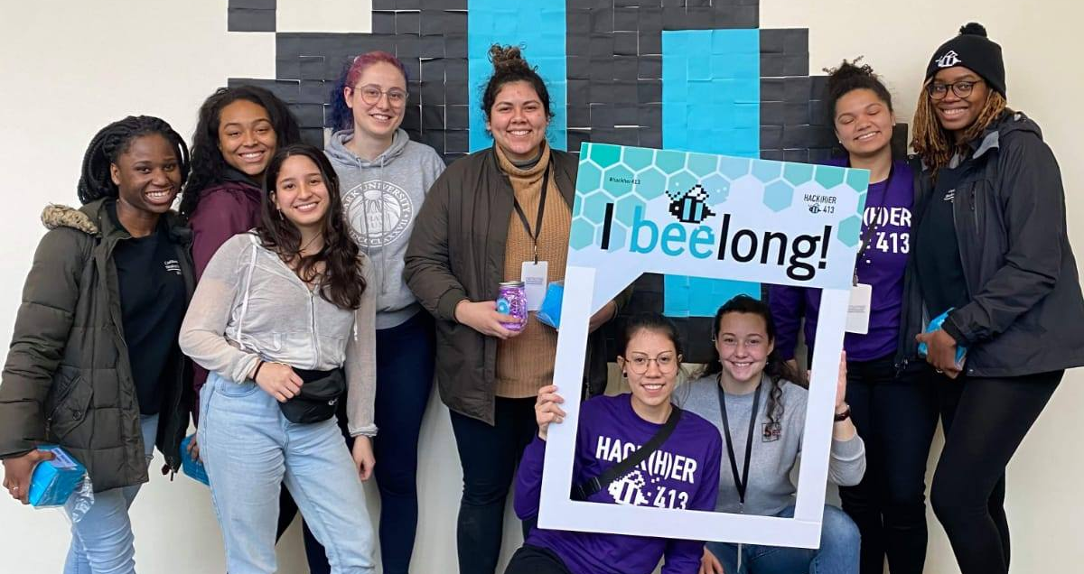
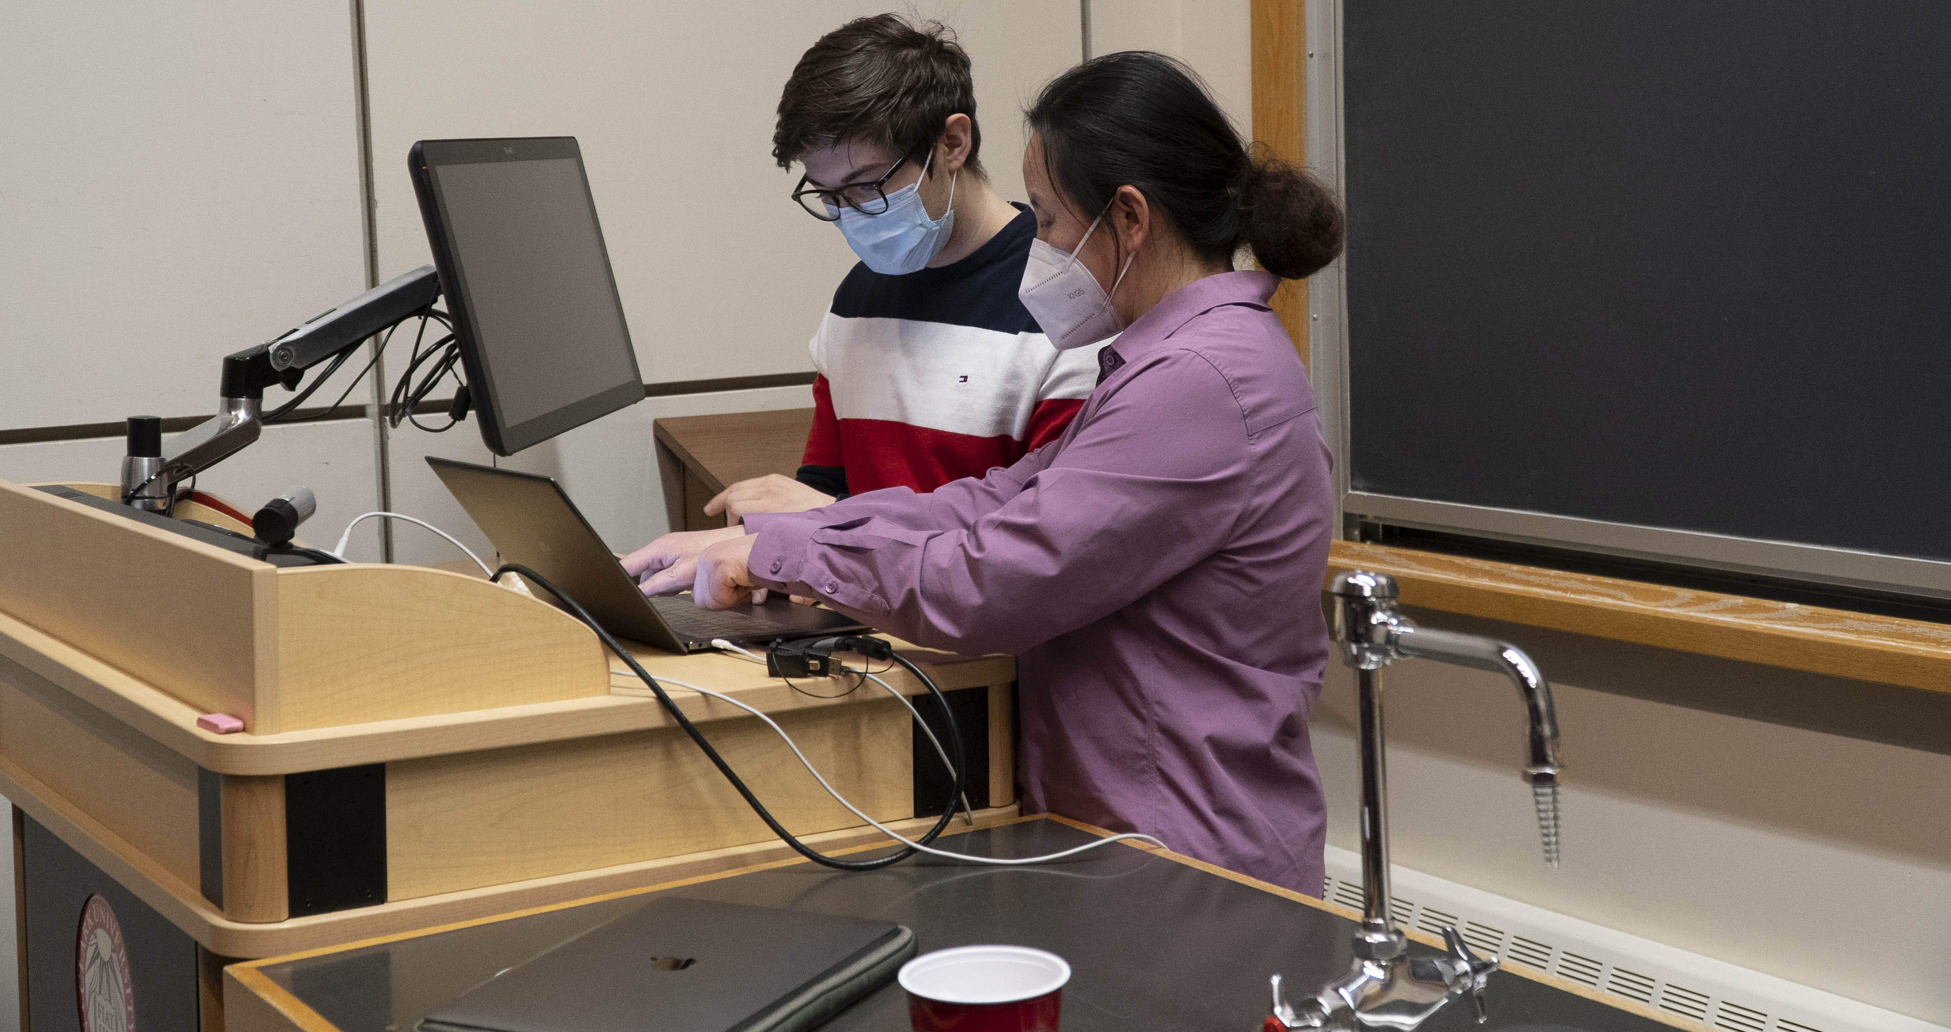
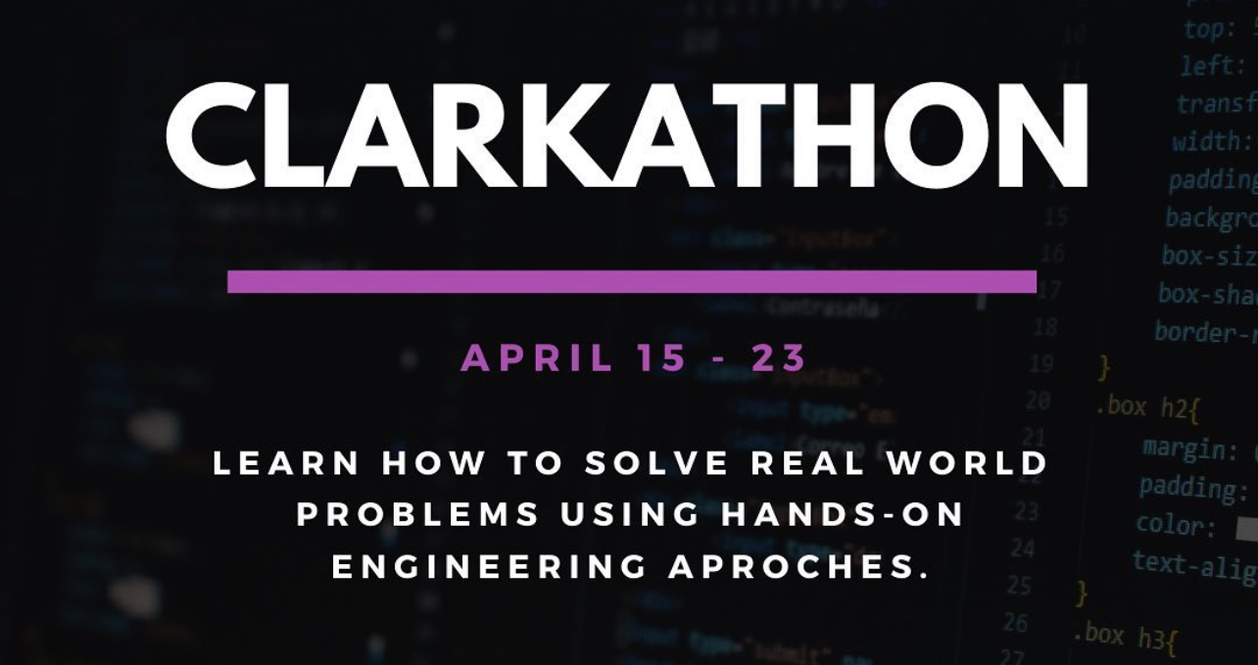
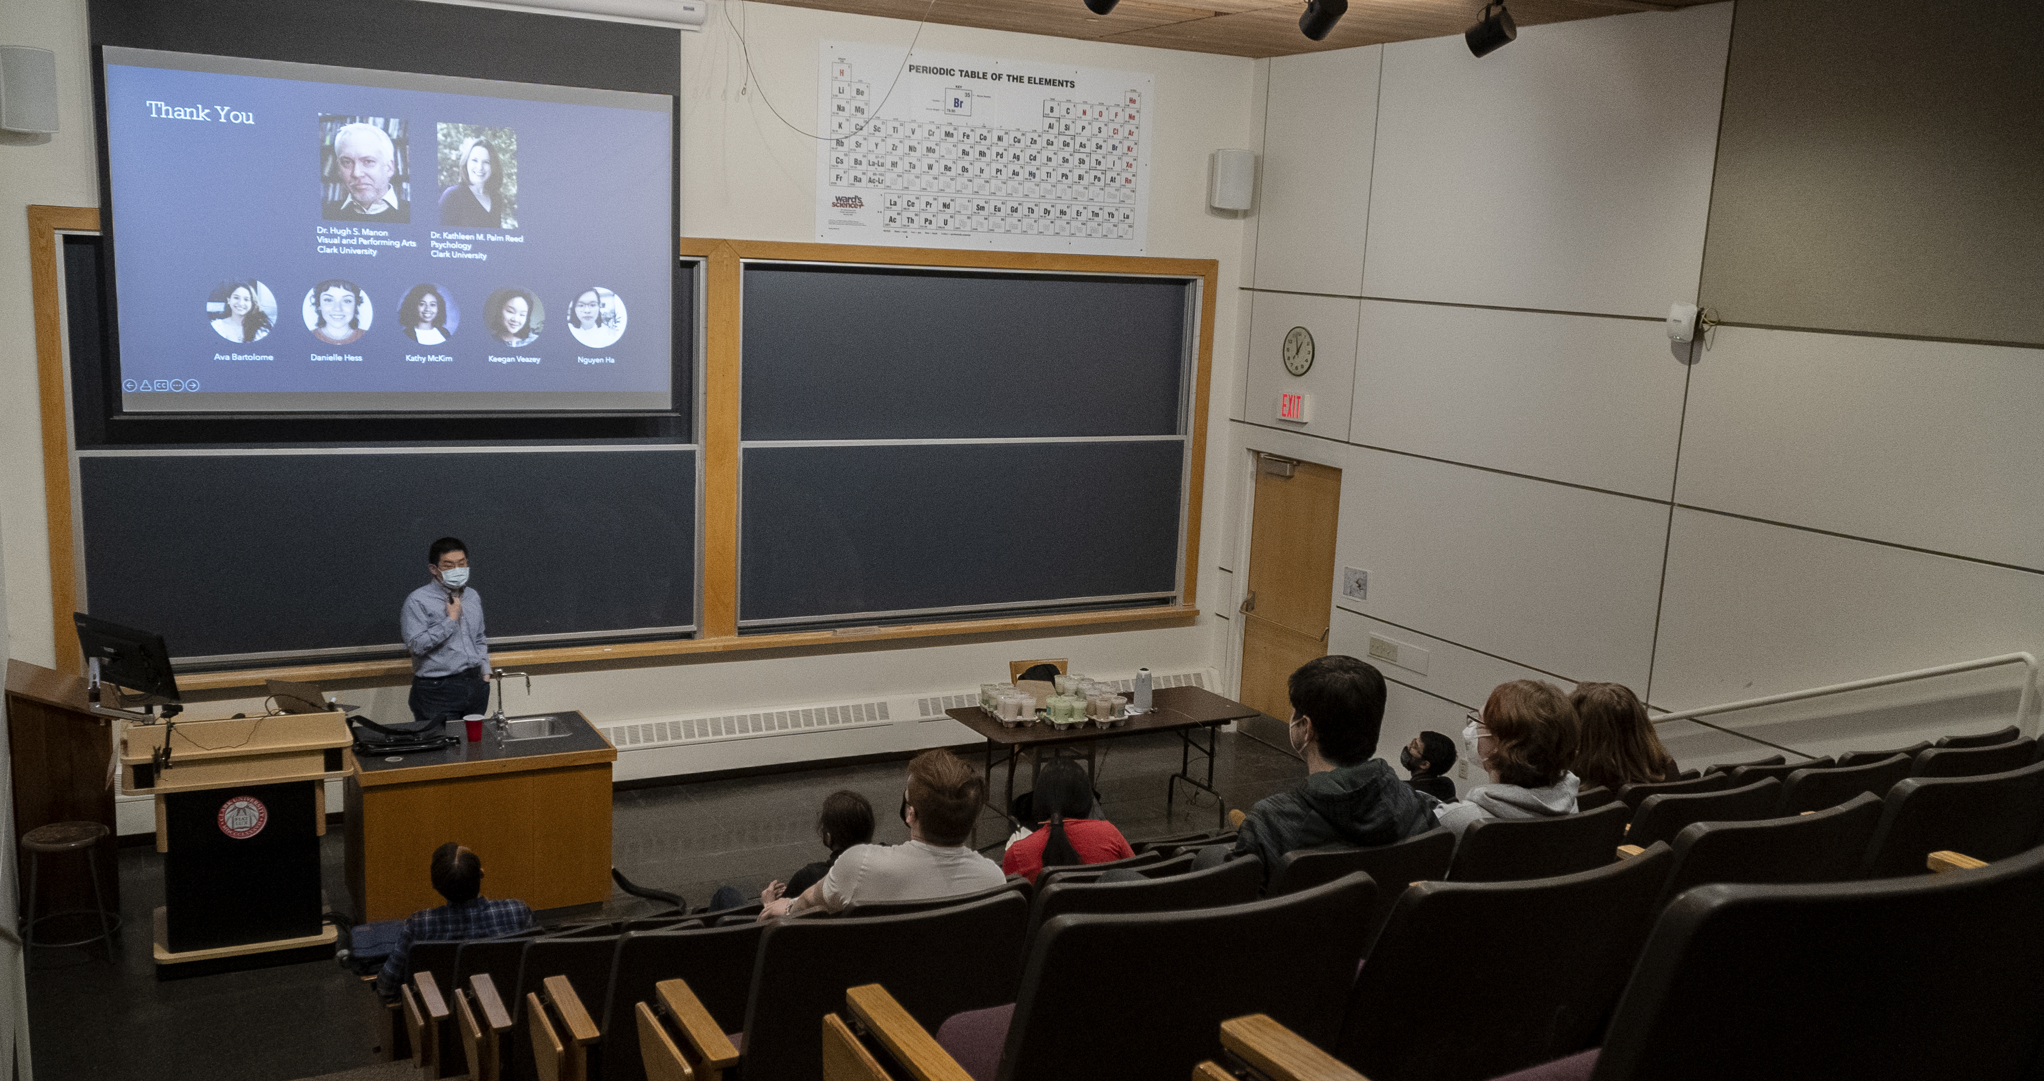
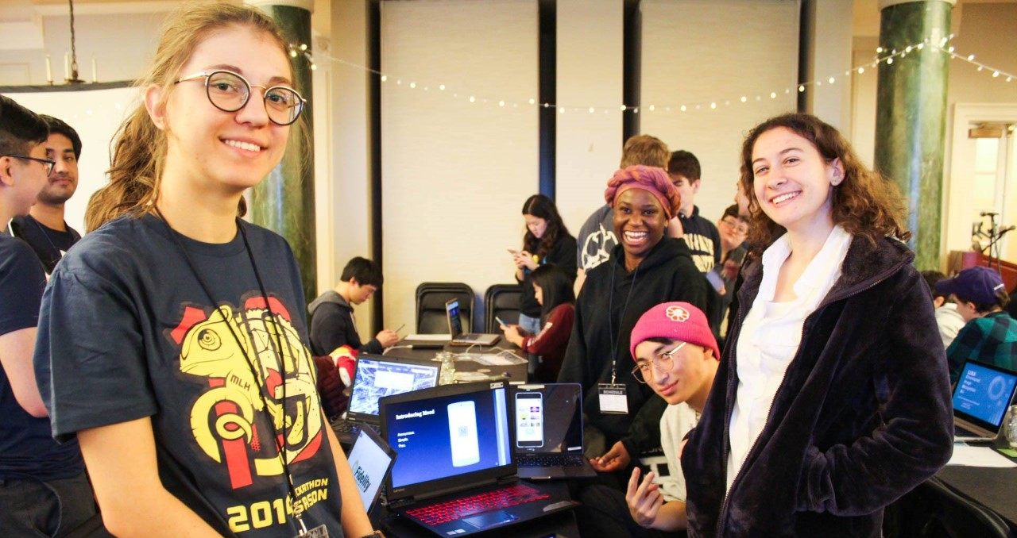
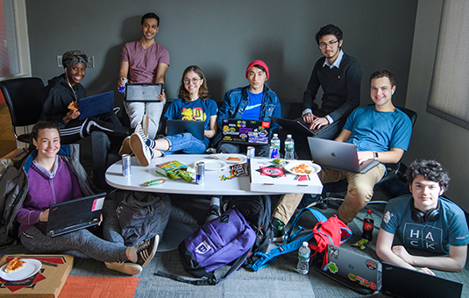
Clubs & Activities
Notes:
Some recent events.
Such as the first ever Clark Hackathon opening this Friday.

Slide 8

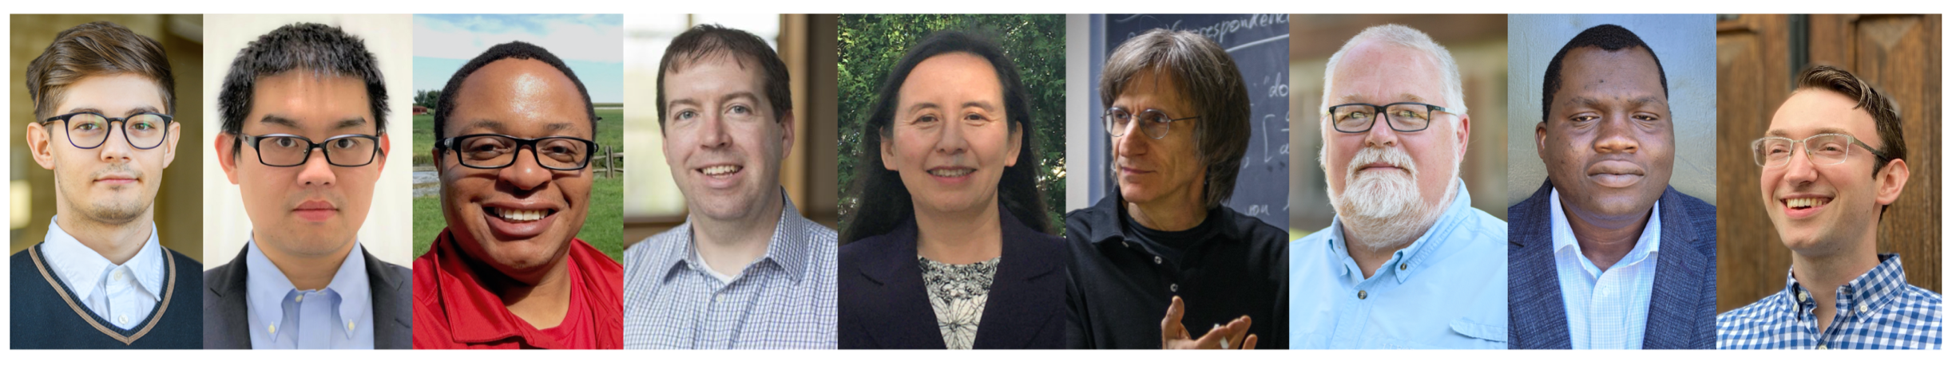
Faces of Computer Science

Slide 9
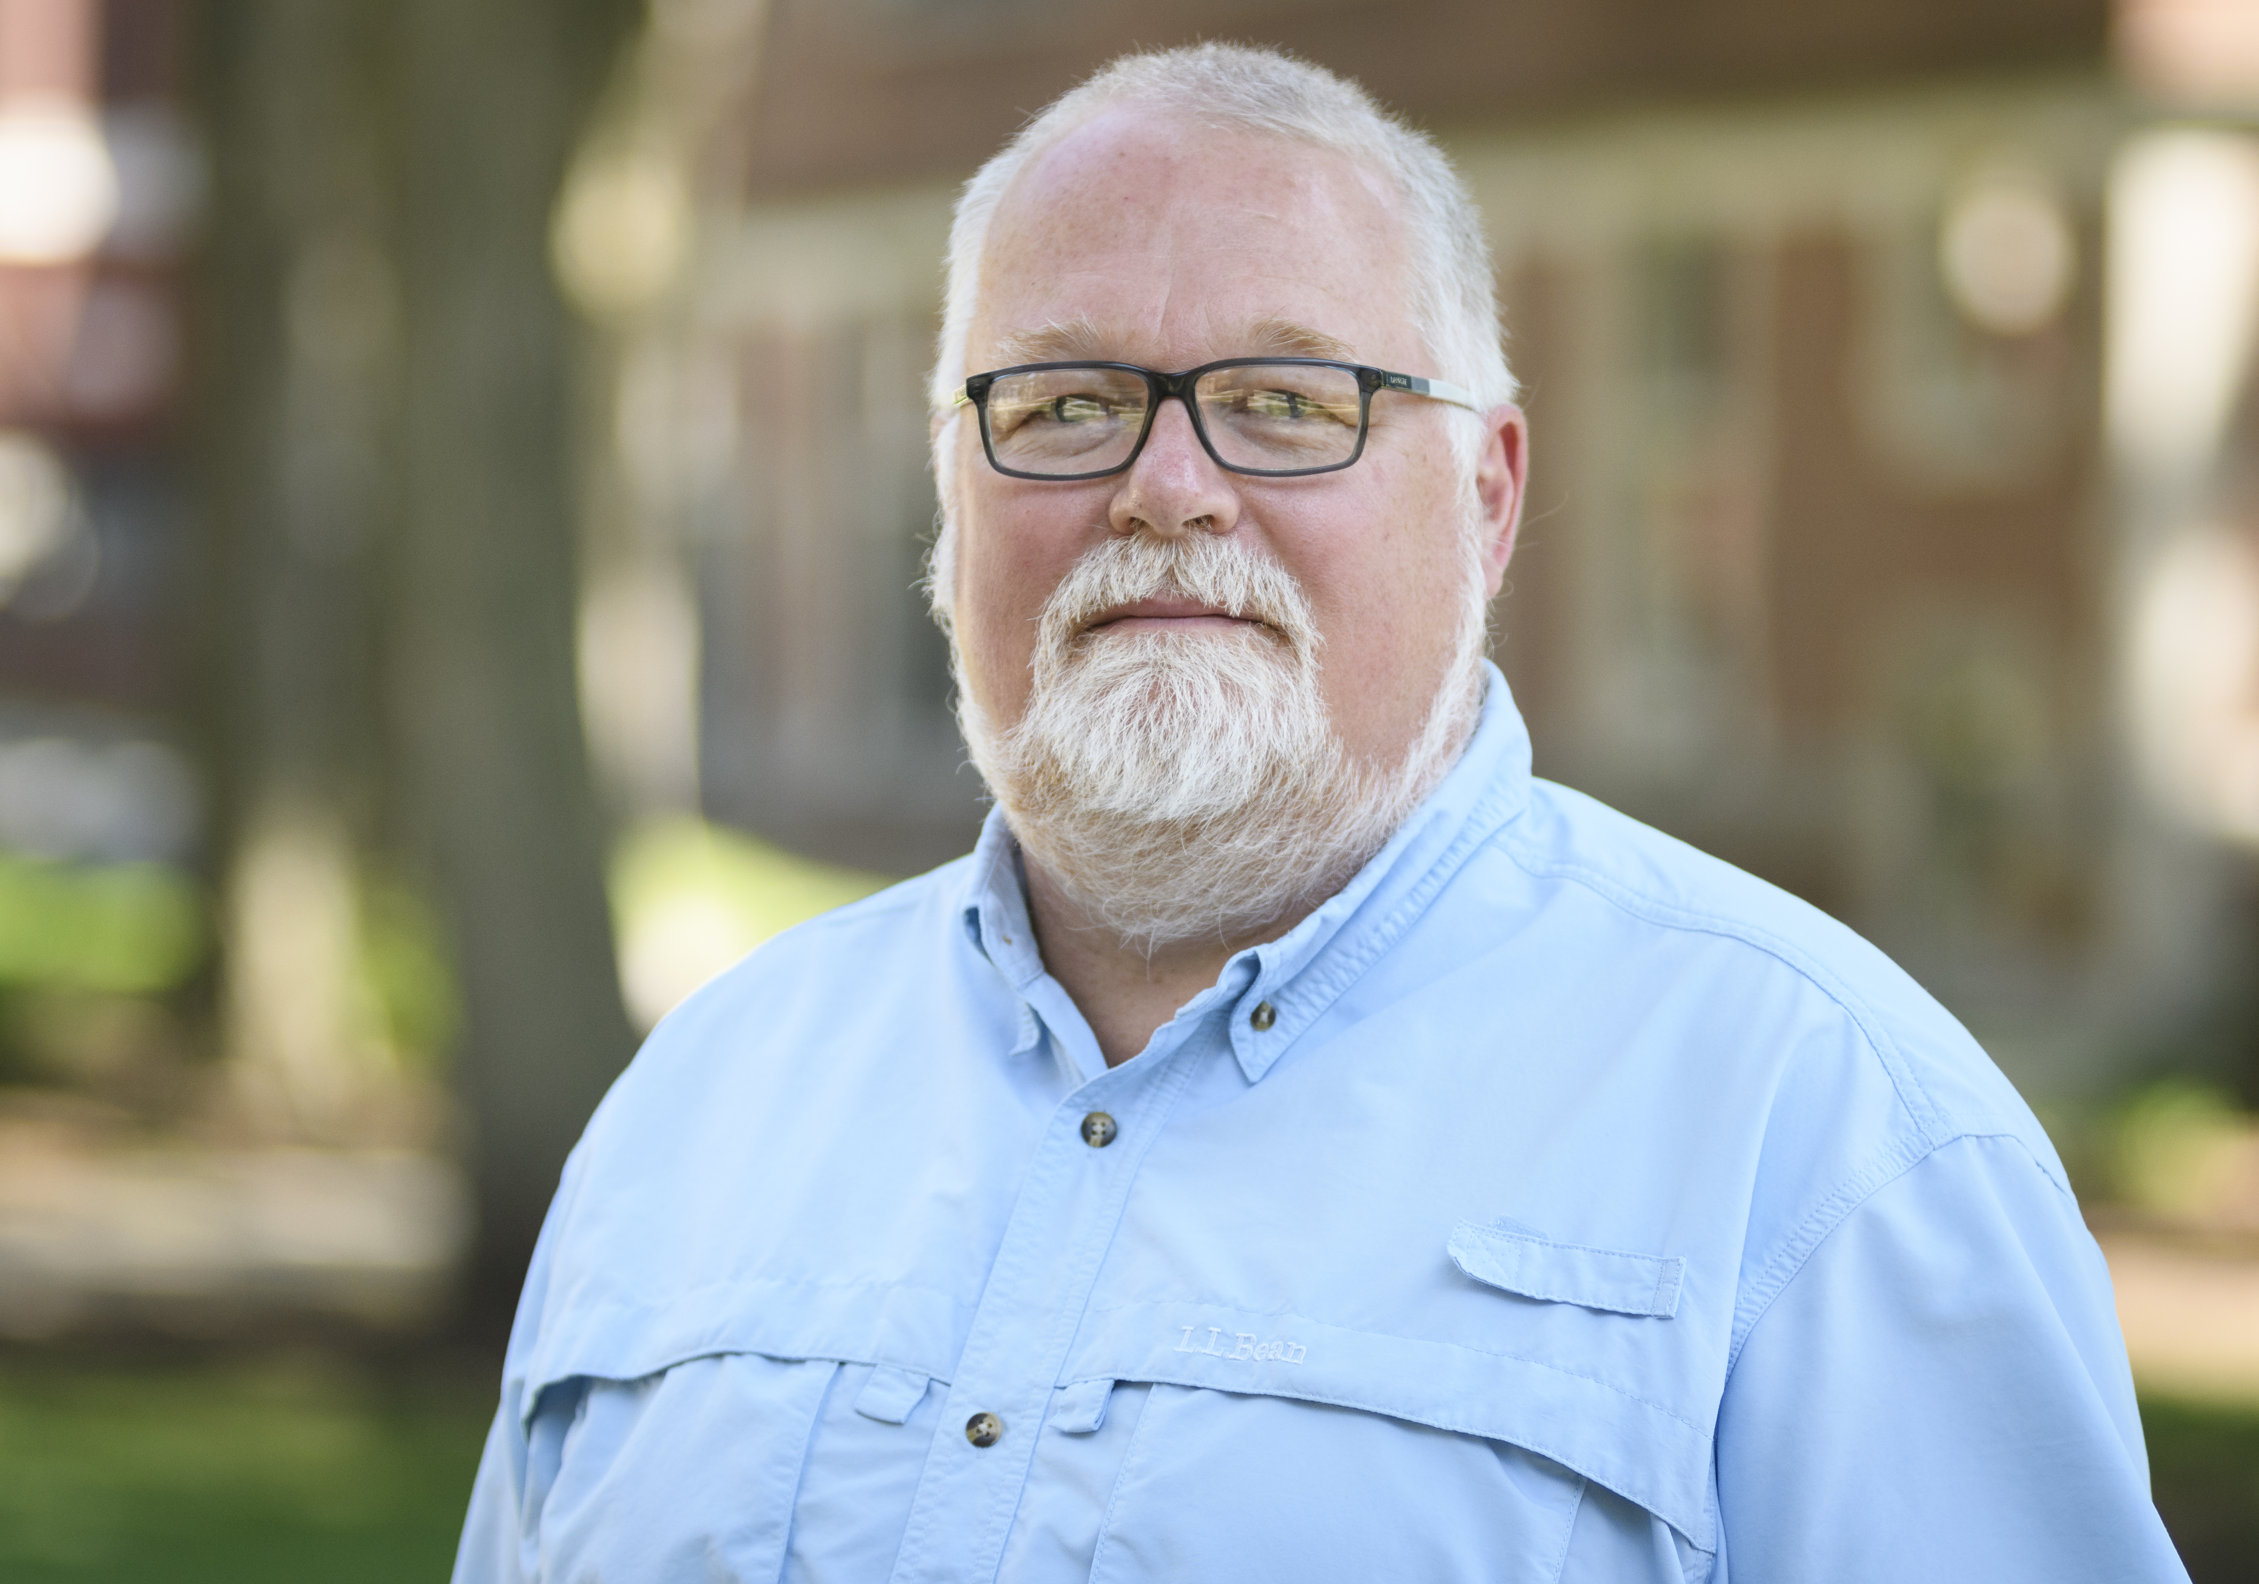
Ken Basye
Professor of Practice
Speech Recognition,
Natural Language Processing,
Machine Learning
Notes:
Speech Recognition

Slide 10
Fred Green
Professor
Theory of Computation, Circuit Complexity, Quantum Computation
Notes:
Theory of Computation

Slide 11
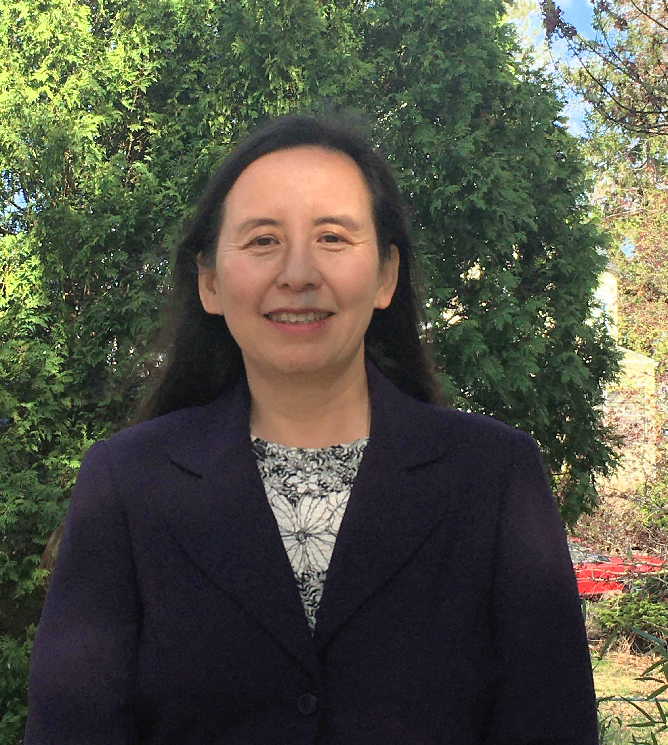
Li Han
Professor
Data Science,
Computational Science,
Robotics
Notes:
Data Science

Slide 12
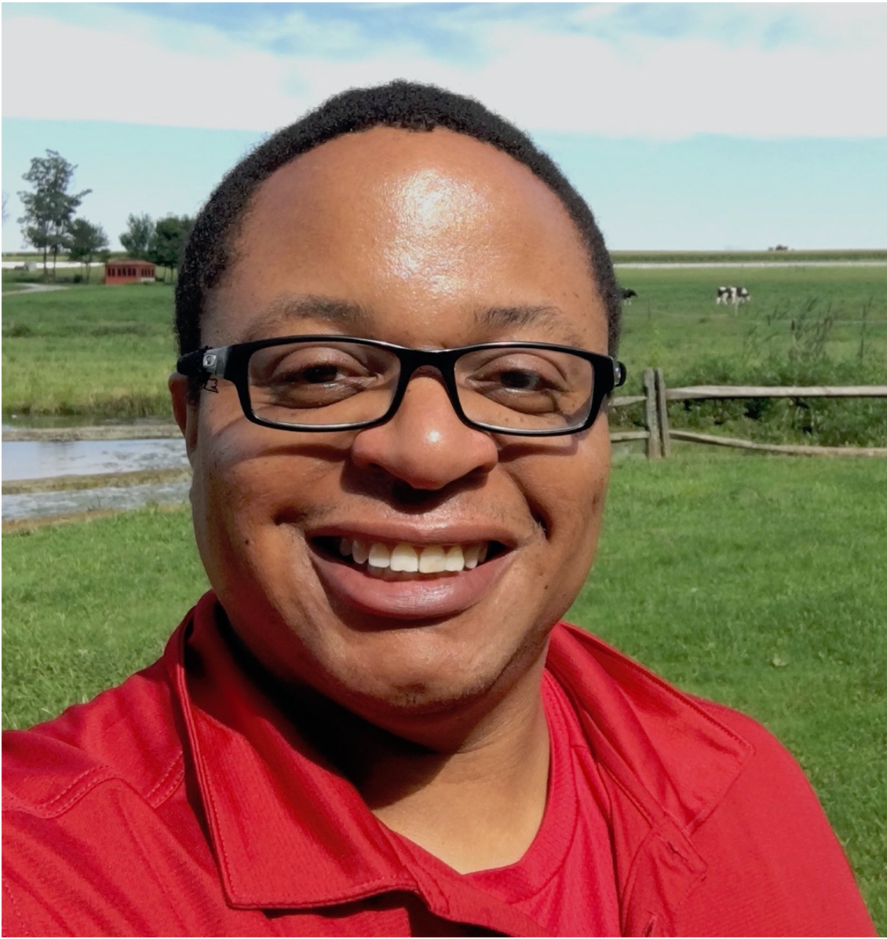
Gary Holness
Associate Professor
Distributed Systems,
Intelligent Sensing,
Interdisciplinary Applications of Machine Learning
Notes:
Distributed Systems

Slide 13
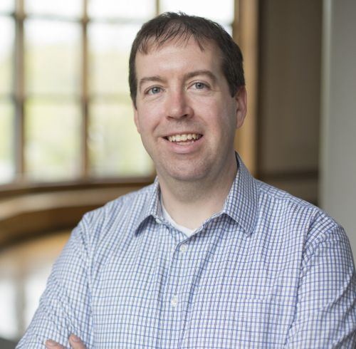
John Magee
Associate Professor, Department Chair
Computer Vision,
Accessible Computing,
Human-Computer Interaction (HCI)
Notes:
Computer Vision

Slide 14
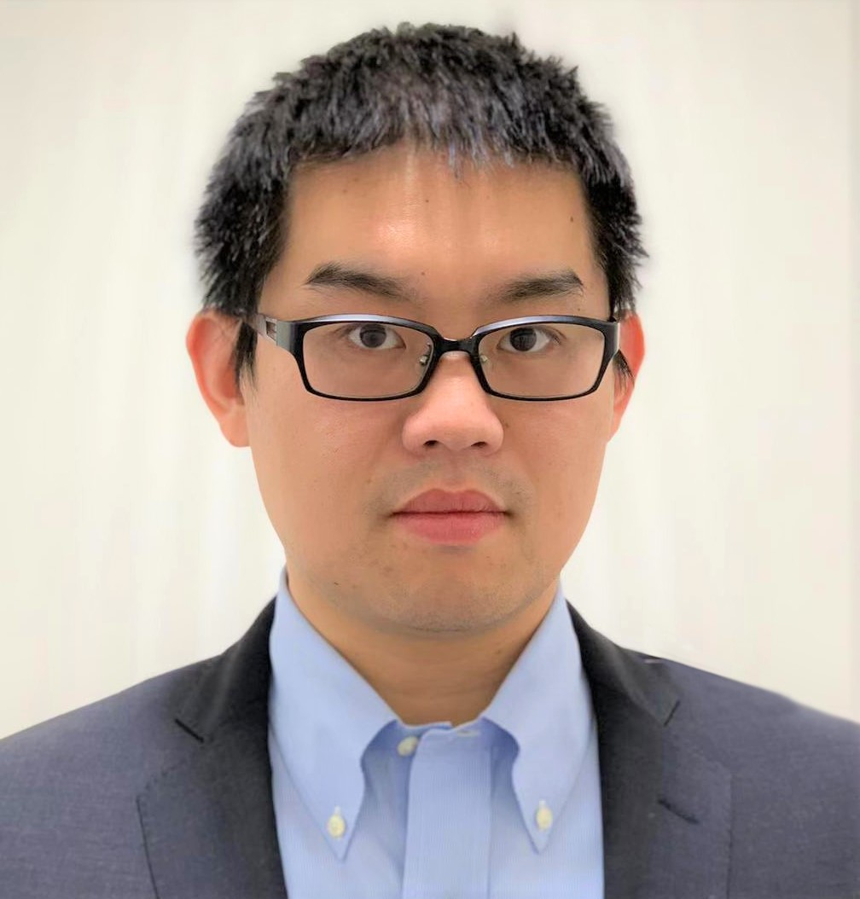
Shuo Niu
Assistant Professor
Social Computing,
Machine Learning,
Natural Language Processing
Notes:
Social Computing

Slide 15
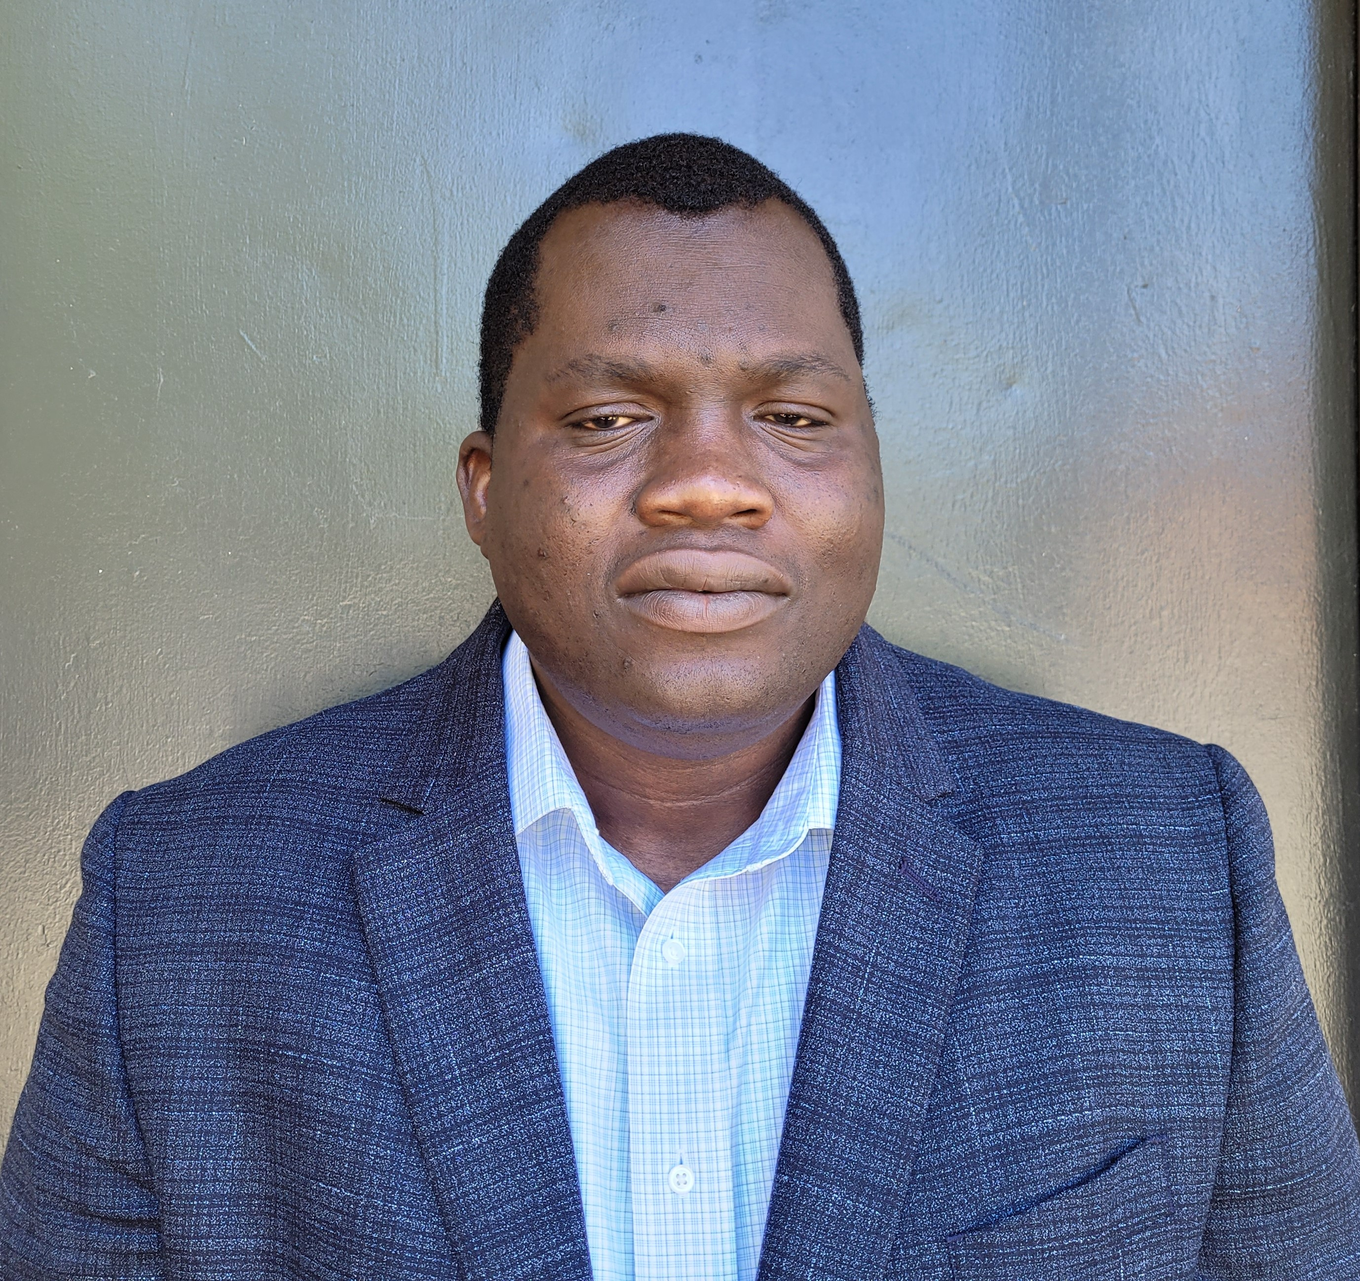
Olufemi Odegbile
Assistant Professor
Network Security,
Traffic Measurement,
Edge Computing
Notes:
Network Security

Slide 16
Peter Story
Assistant Professor
Full Stack Development,
Nudging, Technology Adoption,
Natural Language Processing
Notes:
Full Stack Development

Slide 17
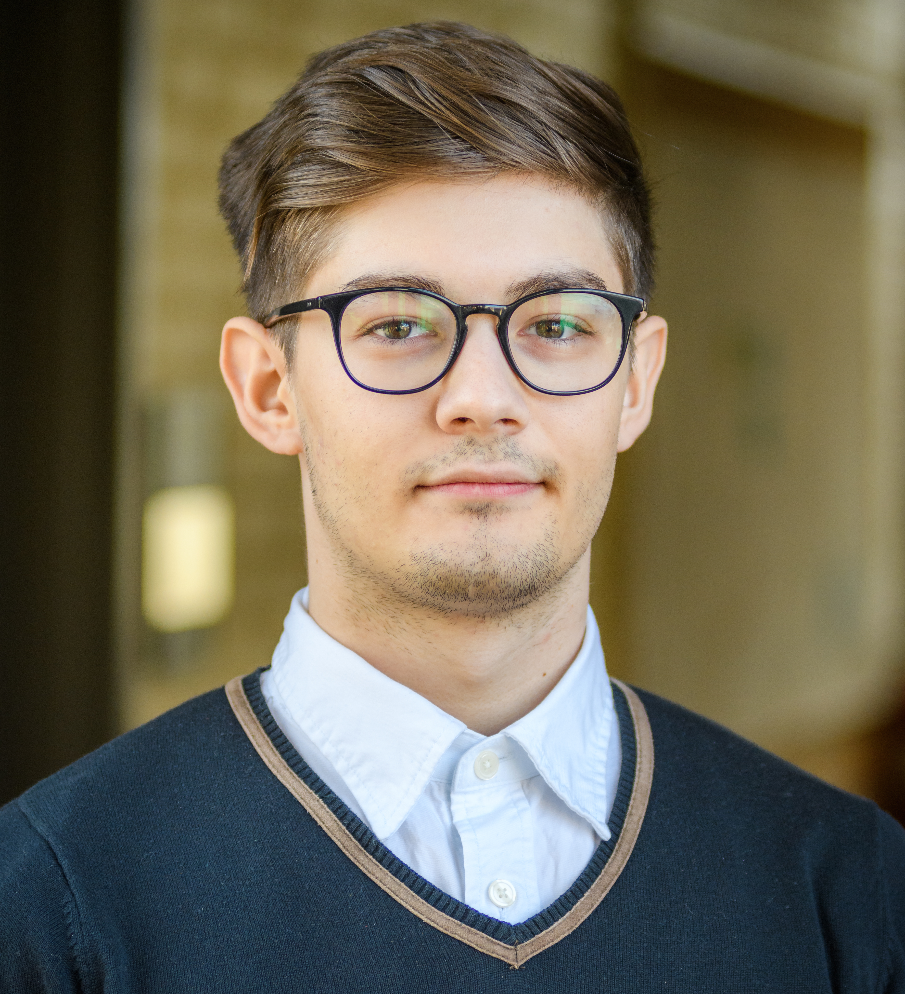
Catalin Veghes
Assistant Professor
Software Engineering,
Web Development,
Cloud Computing
Notes:
Software Engineering

Slide 18

Academics
Computer Science Major (13 Courses)
  2 Introductory Computer Science Courses (CSCI 120 & CSCI 121)
  2 Calculus courses (MATH 120 & MATH 121)
  1 Math Foundations of Computer Science Course, CSCI 122 or MATH 114
  4 Core Courses
  4 Elective Courses
Computer Science Minor (6 courses)
  2 Introductory Computer Science Courses
  1 + Core Course
  1 + 200 - Level
Data Science Major & Minor
Concentration in Business Analytics offered
Notes:
What does the CS Major and Minor at Clark look like?
--INFO
DSCI SESSION AFTER
Student also can opt to pursue double majors across disciplines.

Slide 19
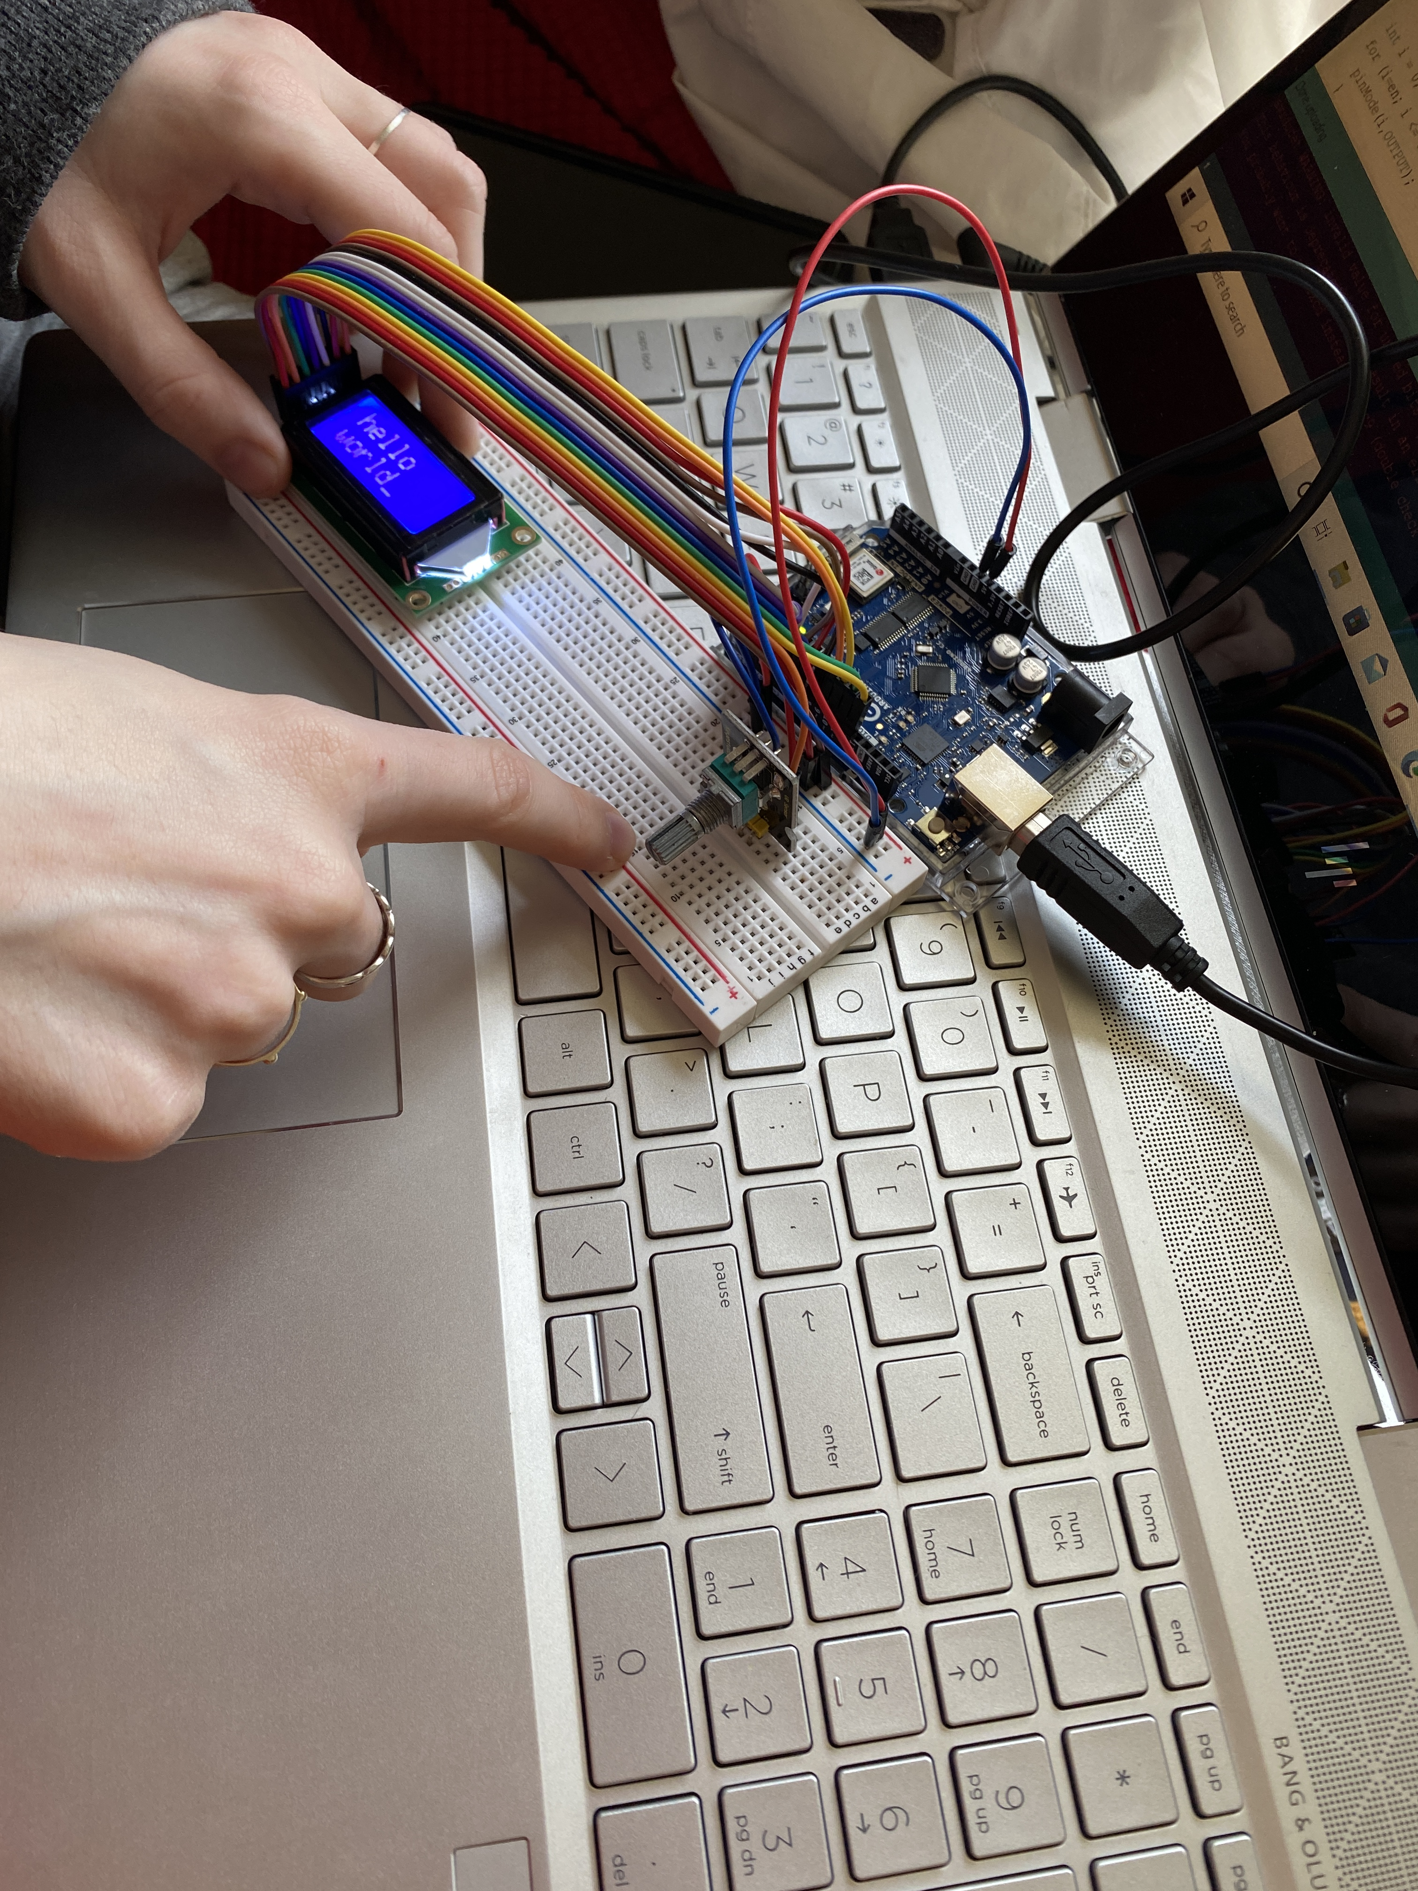
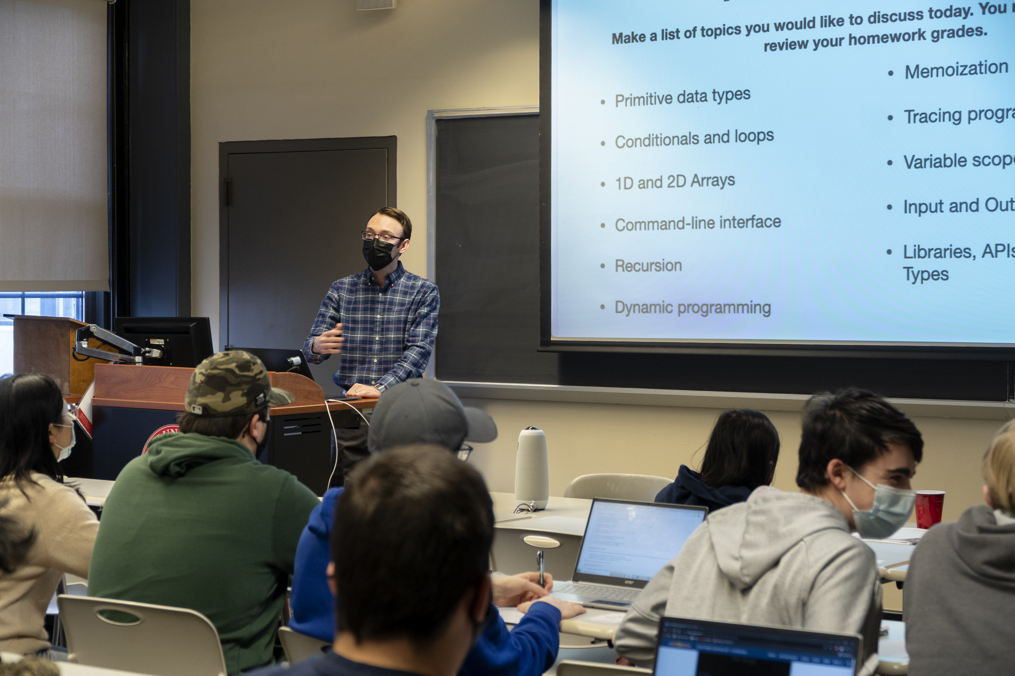
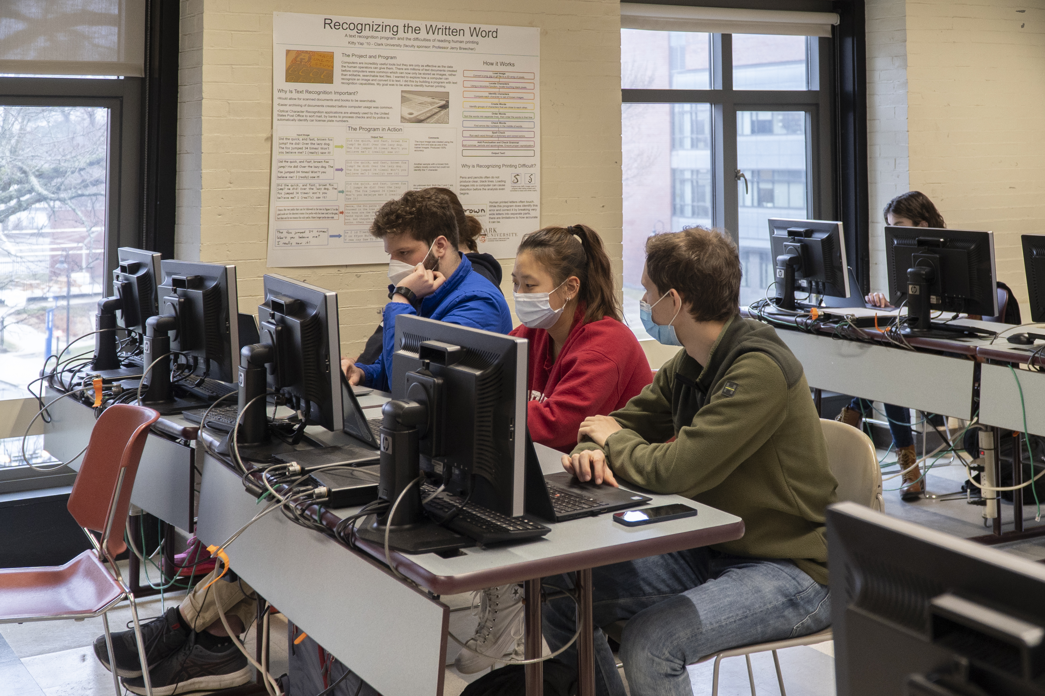
A Selection of Course Offerings
Introduction to Societal Computing
Introduction to Computing
Data Structures
Algorithms
Mobile App Development
Artificial Intelligence
Software Engineering
Database Management
Internet of Things
Computer Networks
Robotics & Intelligent Systems
Operating Systems
Notes:
A variety of courses that range from the roots of Computer Science theory, to hands on practice with application of CS including:

Slide 20
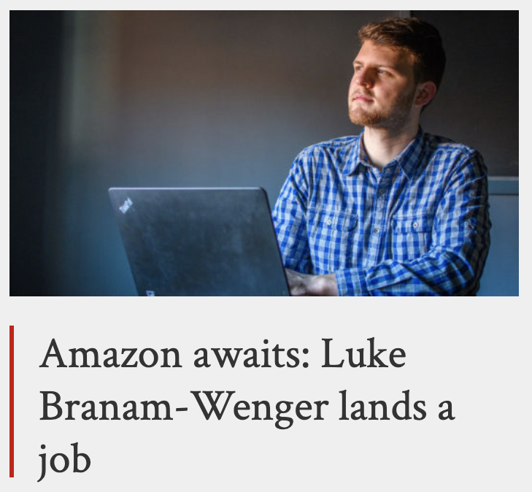
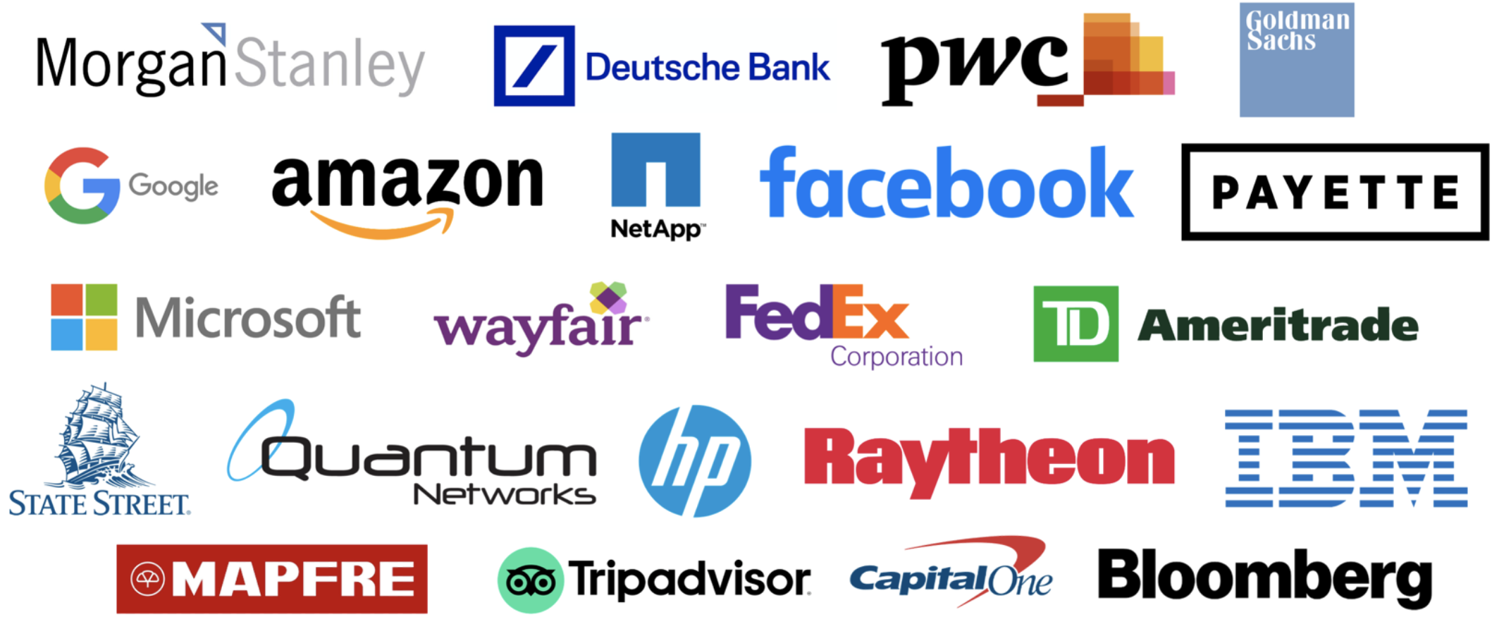


Outcomes
Some of our students go on to work for top-tier companies in the industry while some go on to pursue the path of higher education in graduate schools

Slide 21

Selected Courses Offered Next Semester
Here are the courses being offered next semester with the inclusion of two new exciting courses:
*CSCI 103: Intro to Societal Computing
  Peter Story
CSCI 120: Intro to Computing
  Catalin Veghes | Li Han
CSCI 121: Data Structures
  Catalin Veghes
CSCI 122: Discrete Data Structures
  Olufemi Odegbile
CSCI 160: Algorithms
  Li Han
CSCI 180: Automata Theory
  Kenneth Basye
CSCI 245: Mobile Software Development
  Shuo Niu
*CSCI 265: Robotics & Intelligent Systems
  Gary Holness

Slide 22
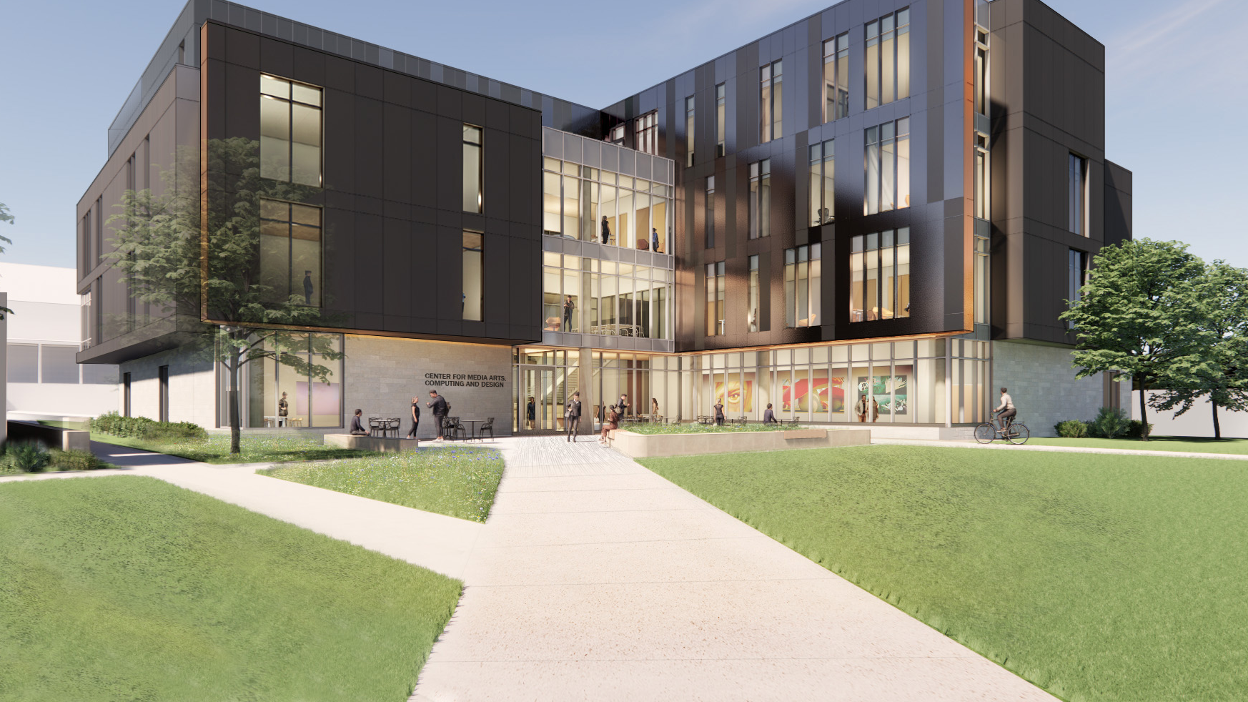
Our Future Home:
Center for Media Arts, Computing, and Design
Opening: Fall 2023

Slide 23

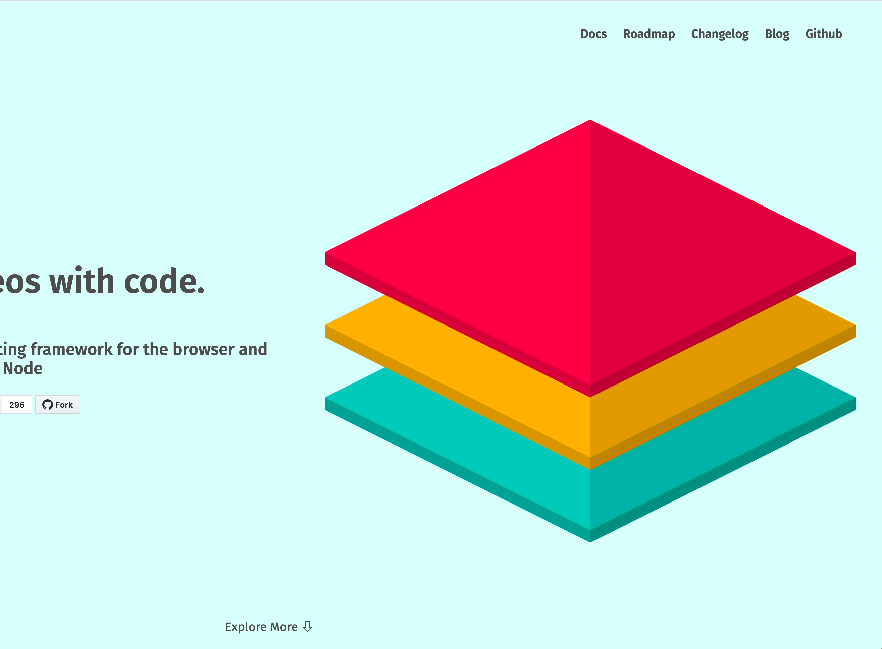
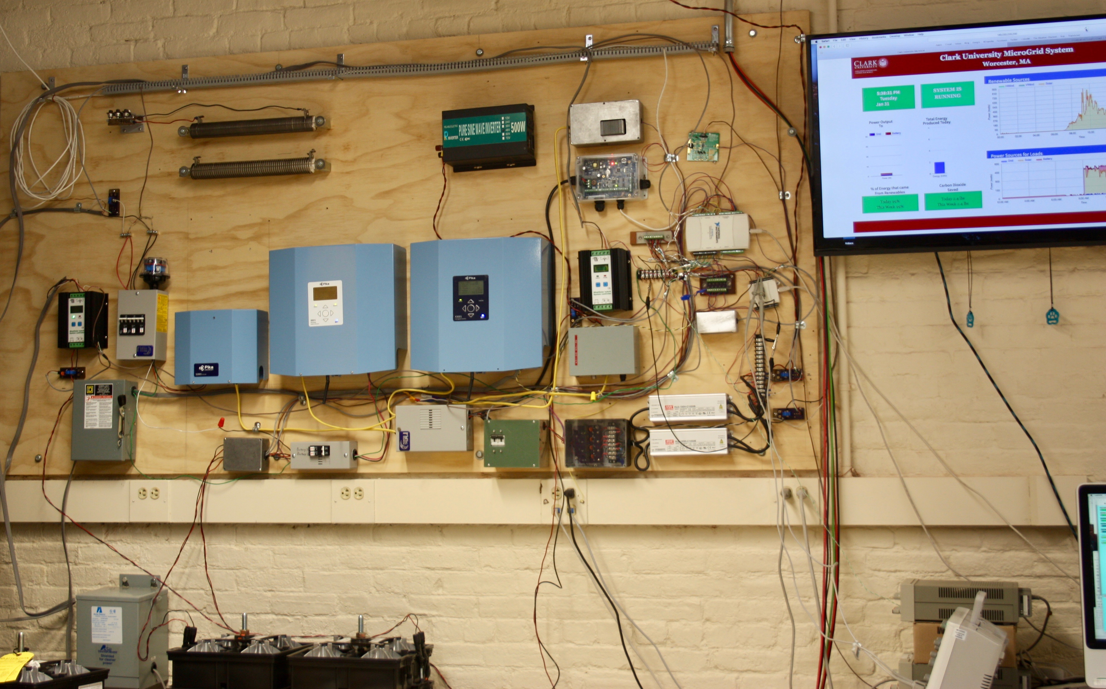
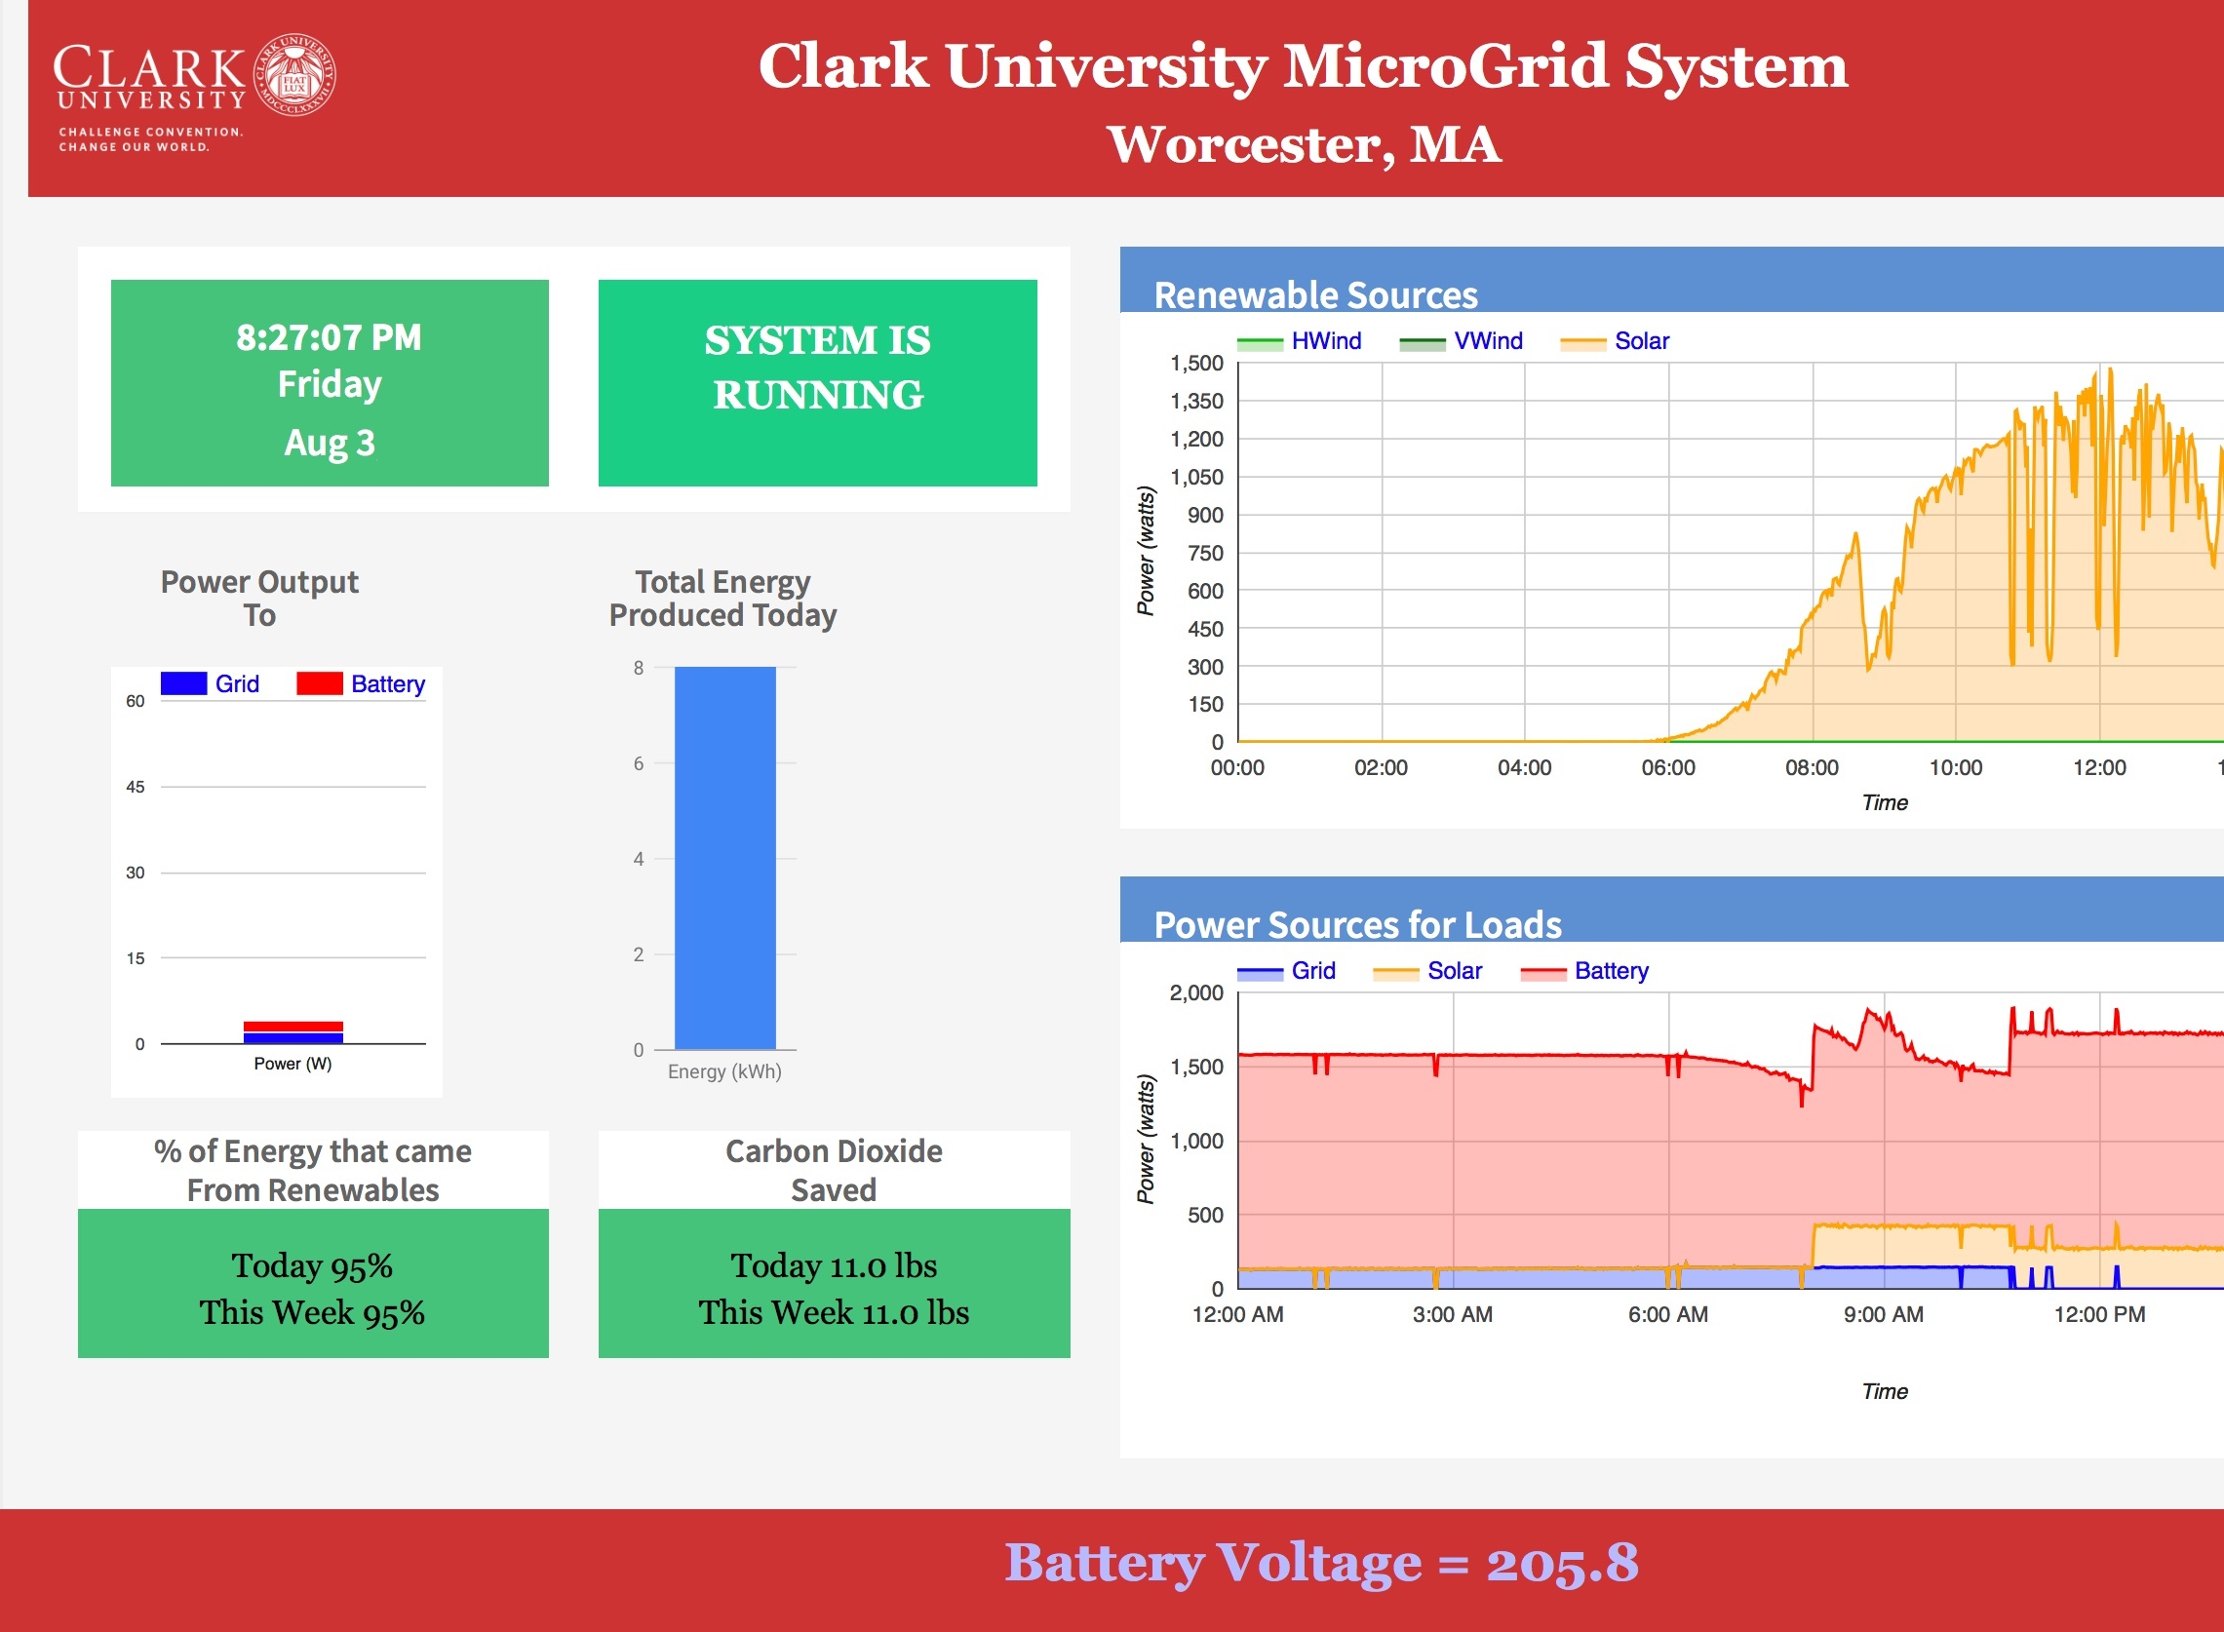
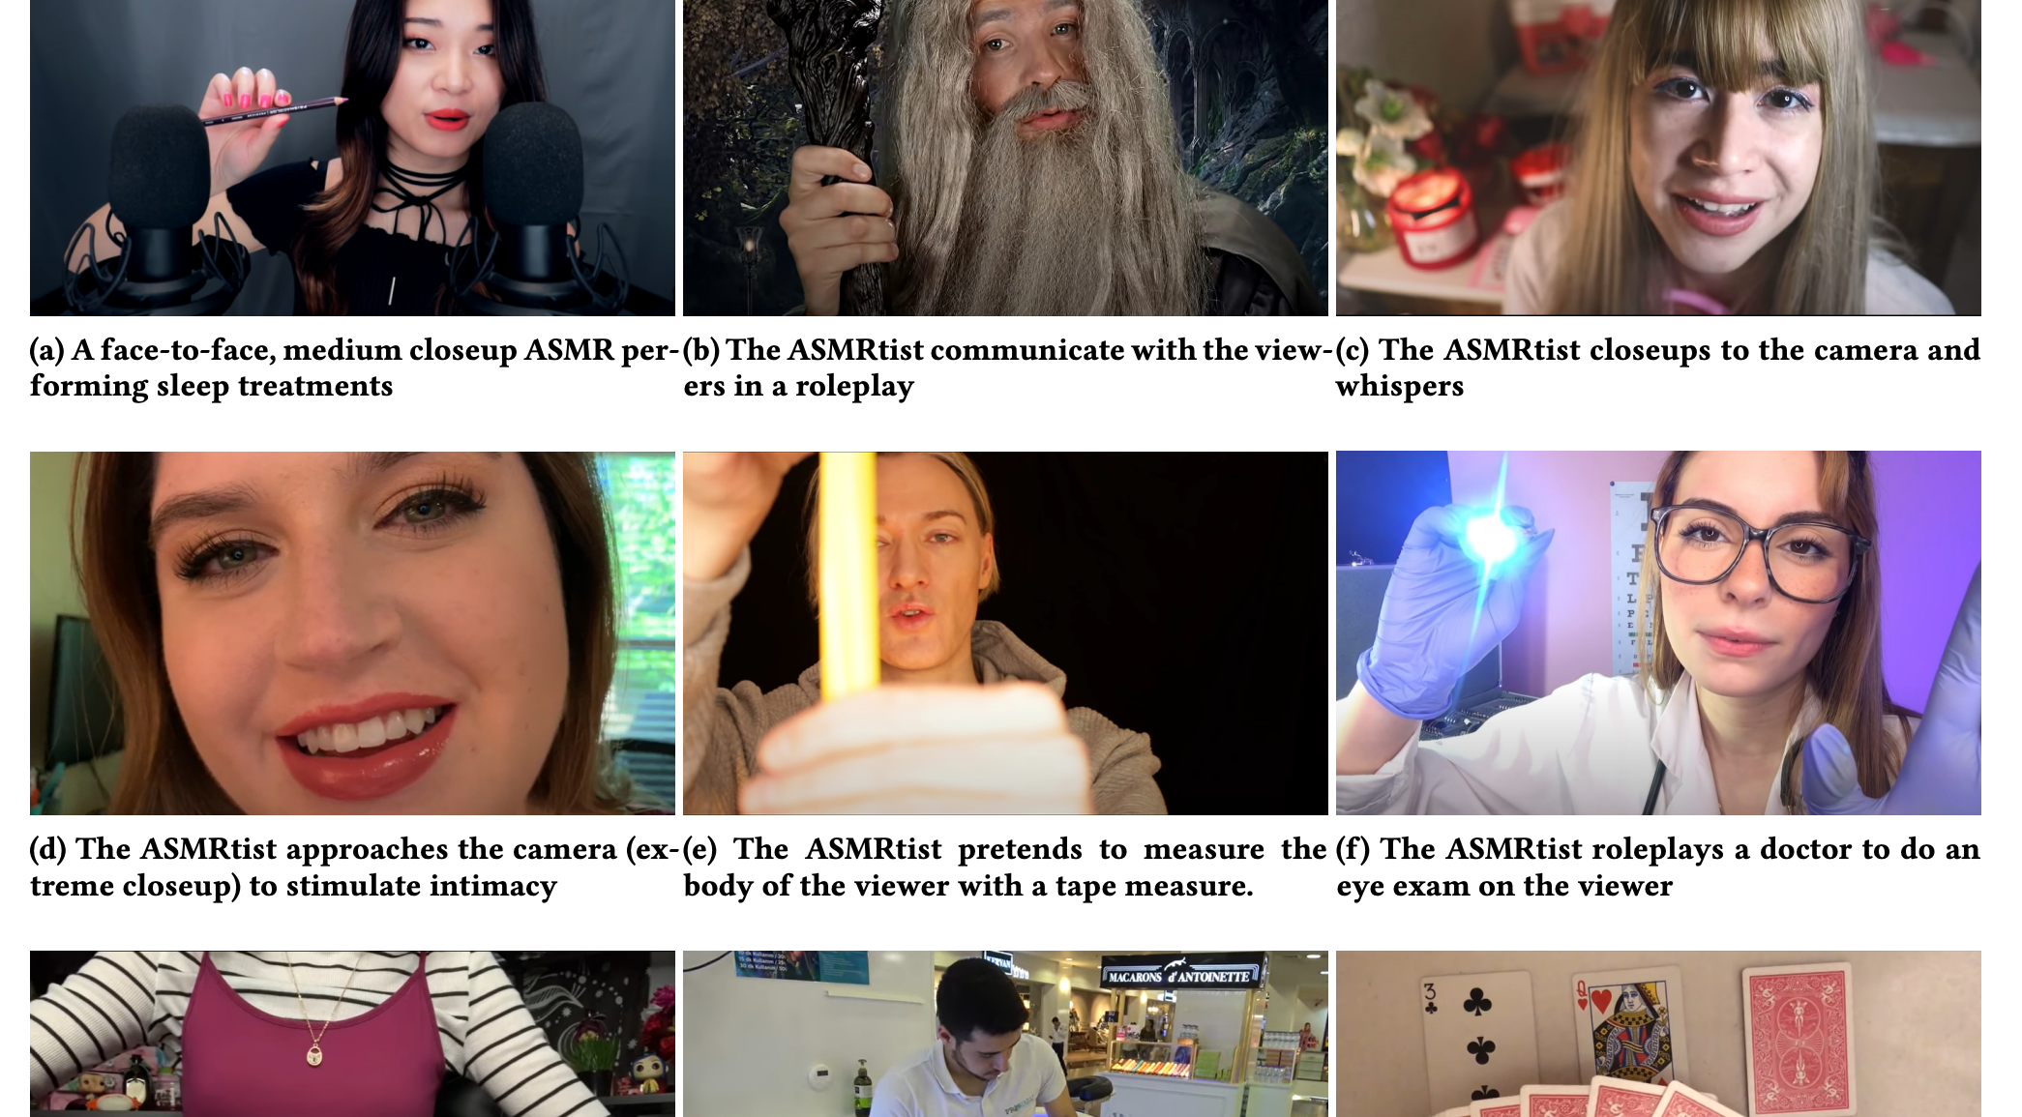
Student Projects
Opportunity for Research, Interdisciplinary Work, and Personal Projects.
Academic Research:
YouTube & COVID-19
Data Collection & Presentation:
Interdisciplinary - Clark Microgrid
Open Source Projects:
Etro-JS
ITS & Department Administrators:
User & Application Support

Slide 24
Nina Carlson ’24
Intern @ Microsoft

Slide 25
Questions?
Department of
Computer Science

