Slide 2
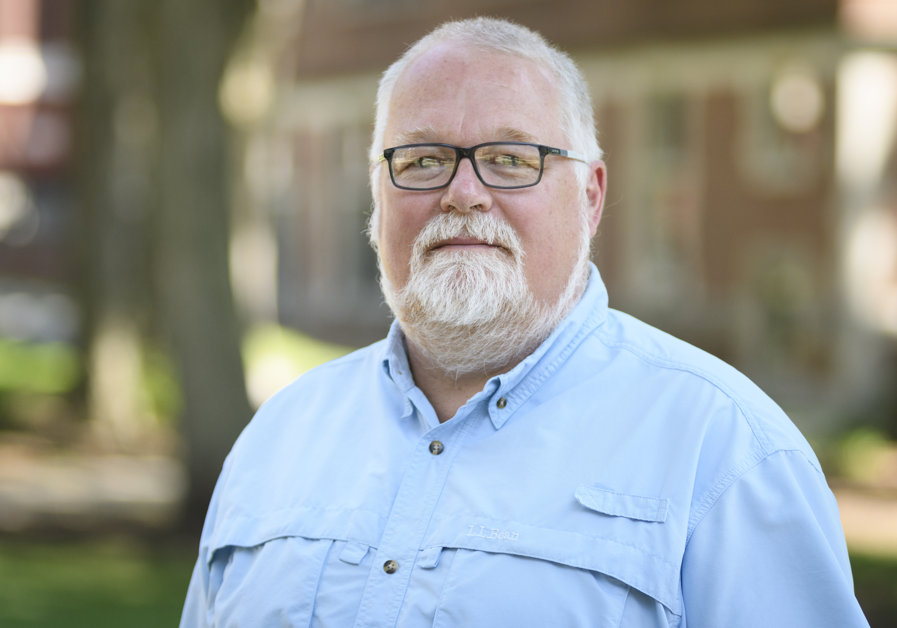
Ken Basye
Professor of Practice
Fields of Interest:
Speech Recognition, Natural Language Processing,
Machine Learning

Slide 3
Fred Green
Professor
Fields of Interest:
Theory of Computation, Circuit Complexity, Computational Complexity, Quantum Computation, Theoretical and Computational Physics
Personal Website

Slide 4
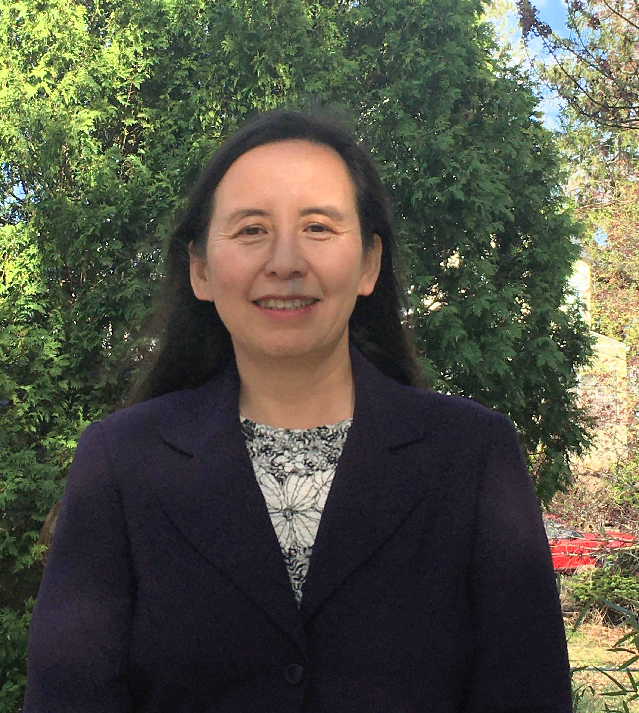
Li Han
Professor
Fields of Interest:
Data Science, Computational Science, Robotics
Personal Website

Slide 5
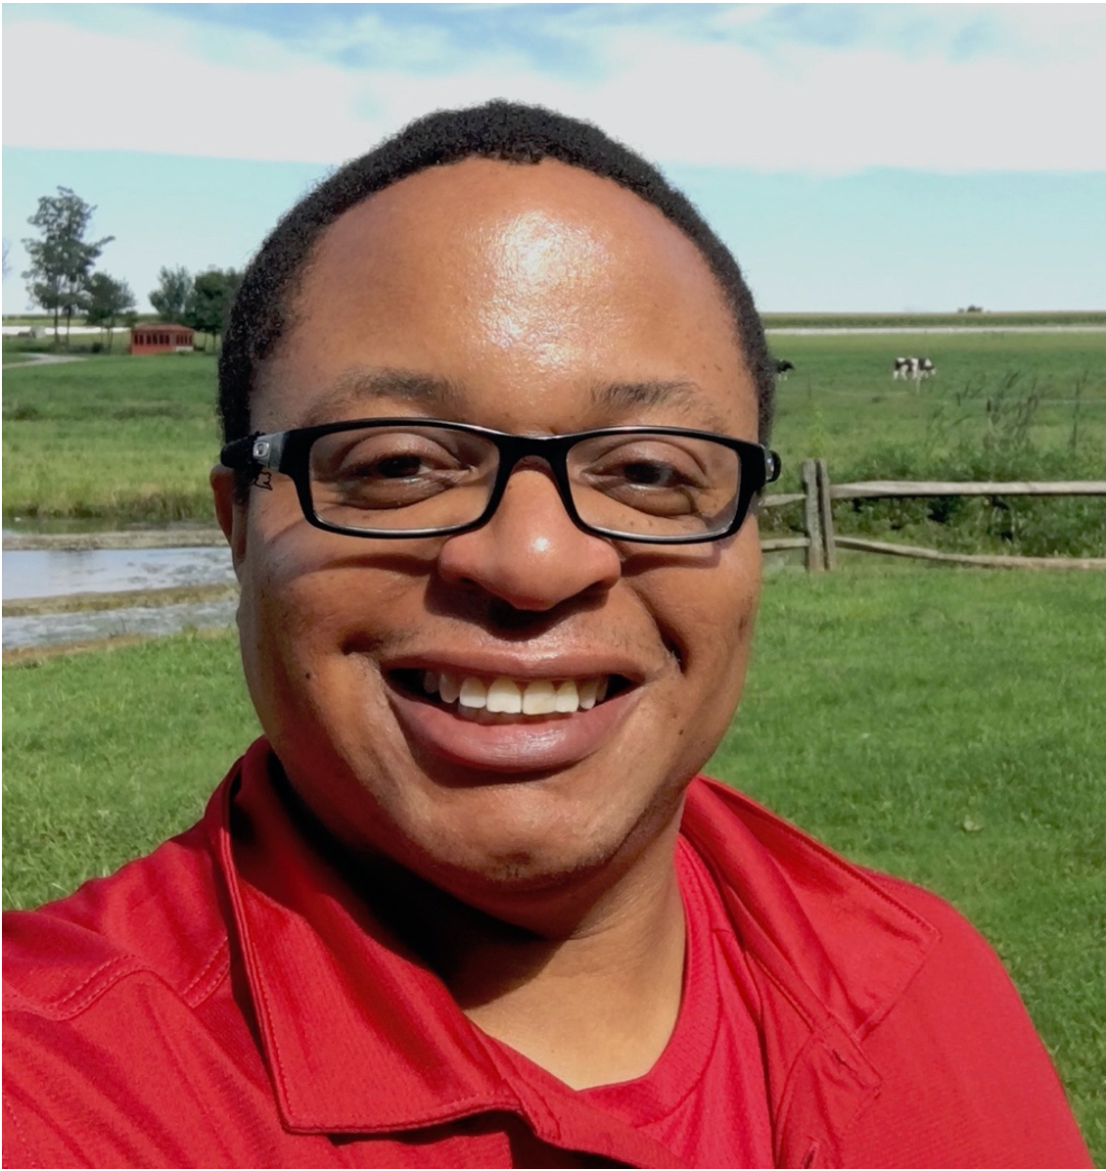
Gary Holness
Associate Professor
Fields of Interest:
Machine Learning, Machine Perception, Distributed Systems, Robotics, Statistics, Intelligent Sensing, and Interdisciplinary Applications of Machine Learning, Integration and Prototyping of Architectures and Systems in support of Machine Intelligence
Personal Website

Slide 6
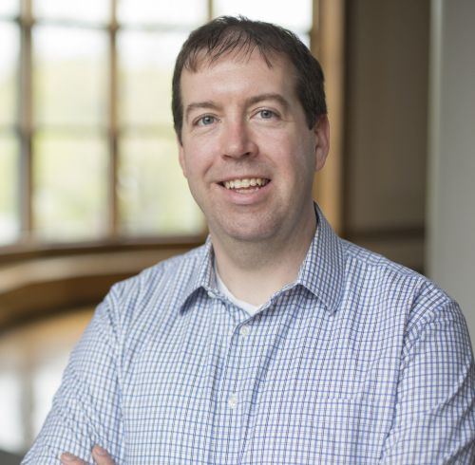
John Magee
Associate Professor, Department Chair
Fields of Interest:
Accessible Computing, Human-Computer Interaction (HCI), Computer Vision
Personal Website

Slide 7
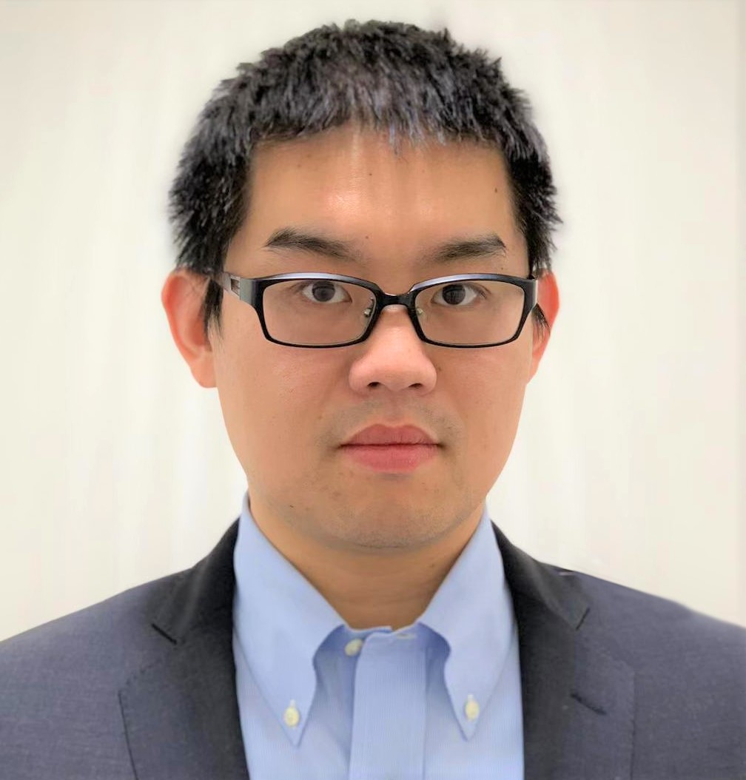
Shuo Niu
Assistant Professor
Fields of Interest:
Human Computer Interaction, Human-Centered Data Science,
Social Computing, Machine Learning, Natural Language Processing
Personal Website

Slide 8
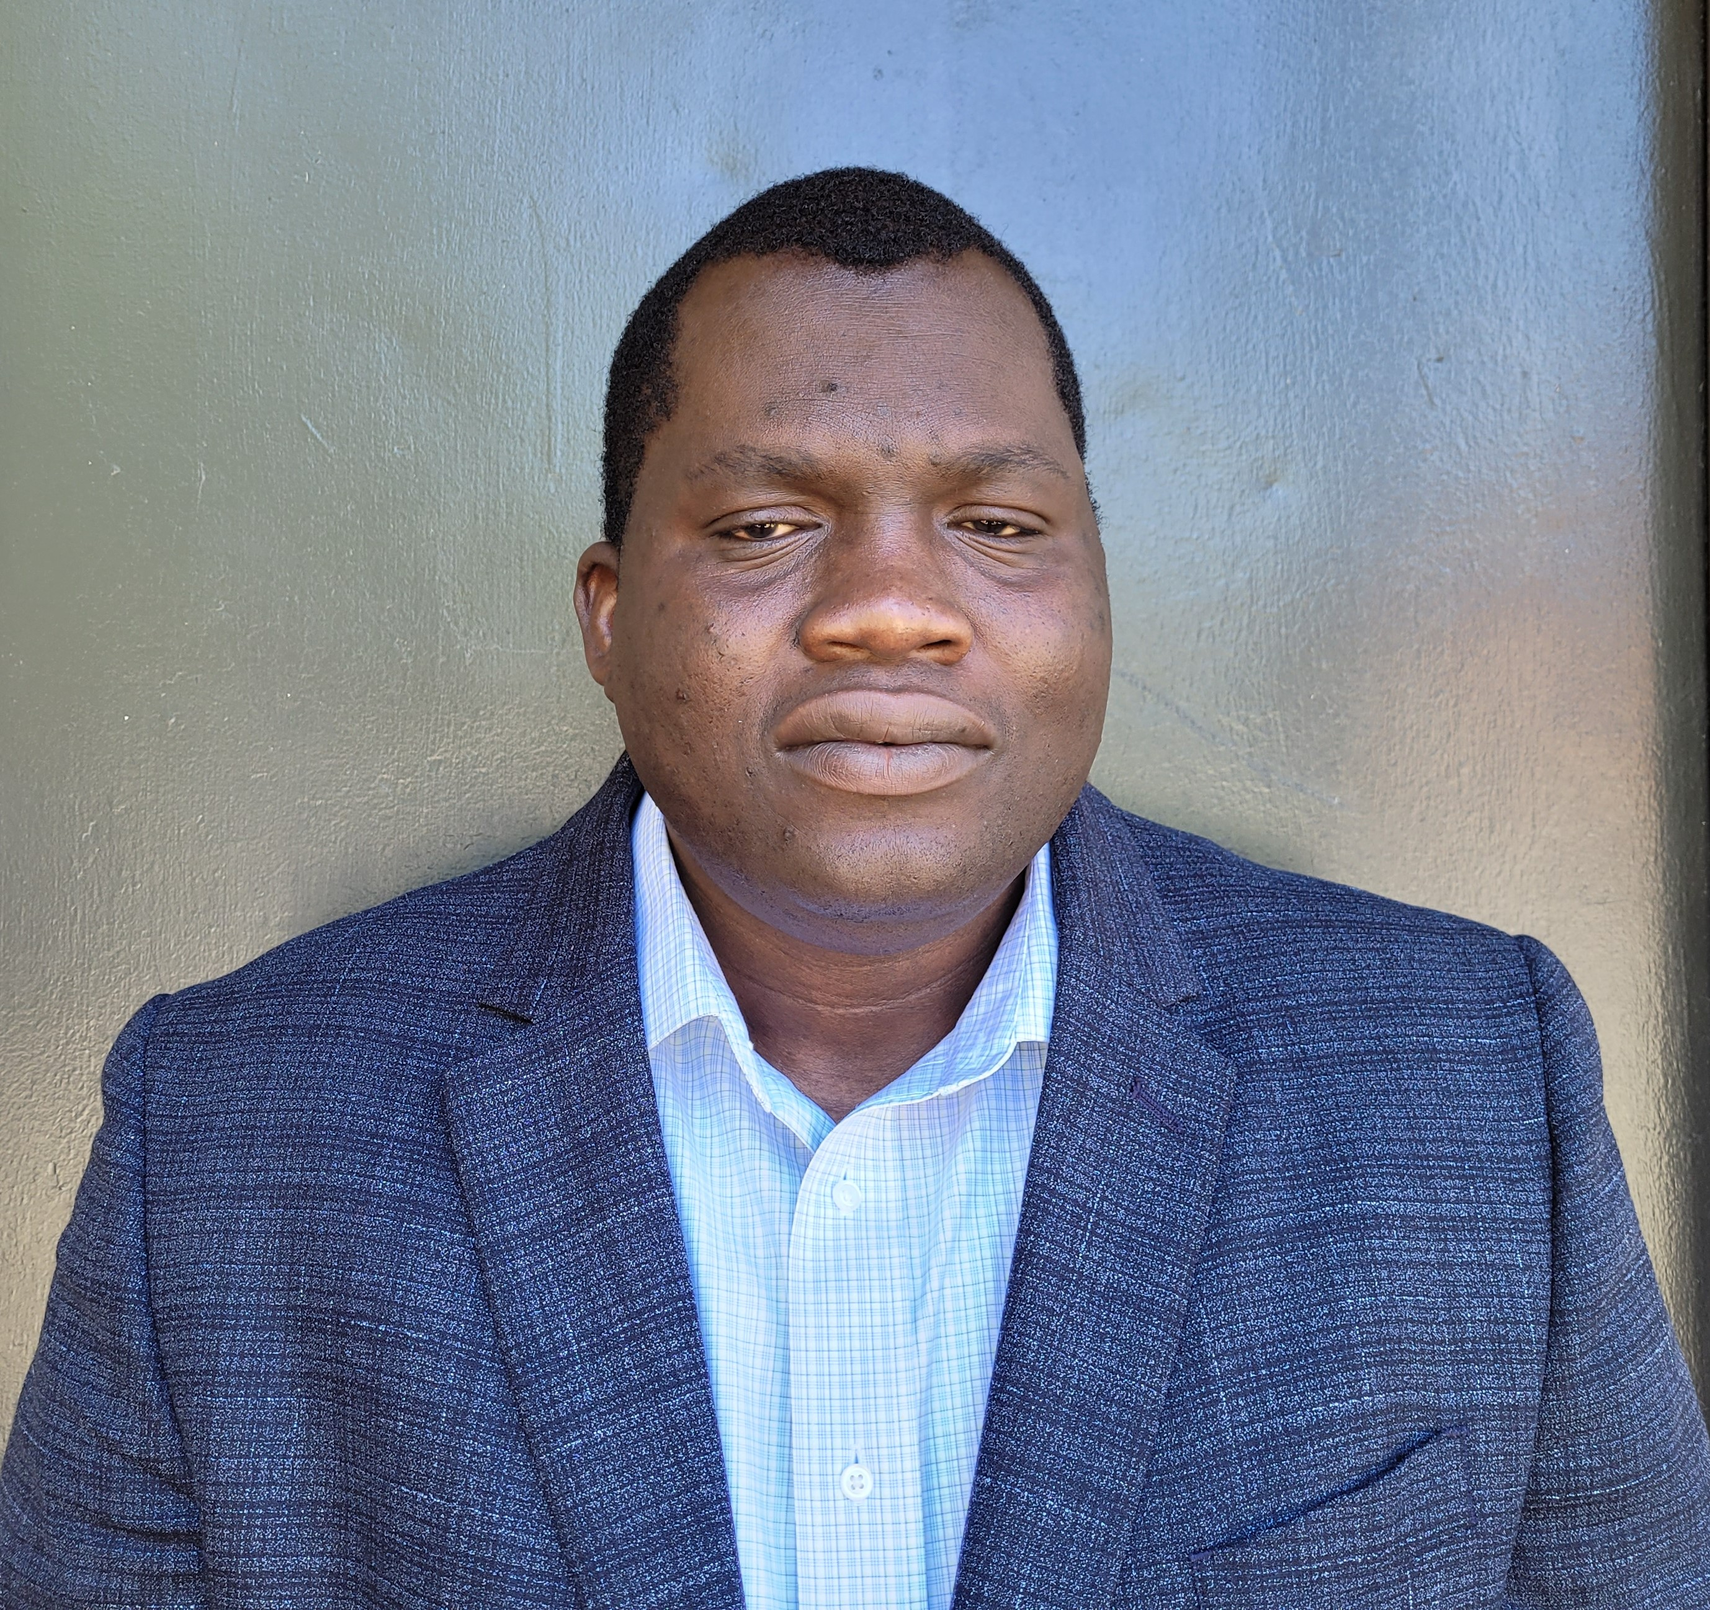
Olufemi Odegbile
Assistant Professor
Fields of Interest:
Network Security, Big Data, Network Traffic Measurement,
Edge Computing, Internet of Things, and Machine Learning

Slide 9
Peter Story
Assistant Professor
Fields of Interest:
Privacy, Security, Nudging, Technology Adoption,
Full Stack Development, Natural Language Processing
Personal Website

Slide 10
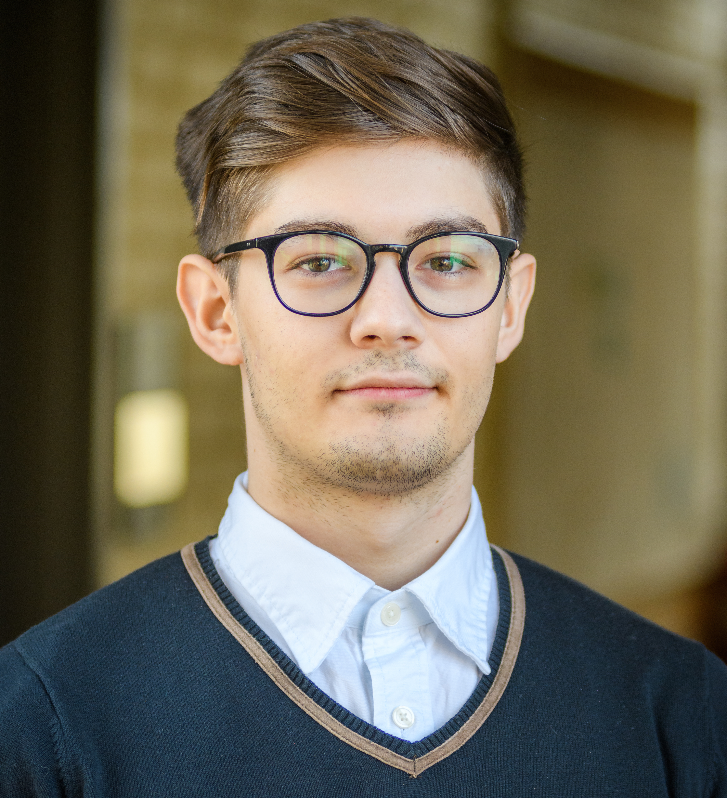
Catalin Veghes
Visiting Lecturer
Fields of Interest:
Software Engineering, Web Development, Machine Learning,
Data Mining, Computer Networking, Cloud Computing,
Network Security
Personal Website

