Slide 1
CS 220: Database Management and Systems Design
Introduction to Databases, part 1

Slide 2
About the course – Administrivia
Instructor:
  Peter Story
  Happy to answer emails, meet before/after class, etc.
  Office hours: 1pm-3pm on Fridays, location TBD
Website:
    - Check frequently!
    - Syllabus, schedule, assignments, readings, …
    - Lecture slides
Course design was adapted from material by Zhenguang Gao and George Kollios
(and John and Tricia Magee)
Notes:
Briefly review the syllabus

Slide 3
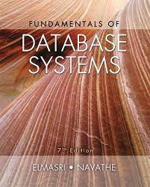
Textbook
Fundamentals of Database Systems (7th Edition)
By Ramez Elmasri and Shamkant Navathe

Slide 4
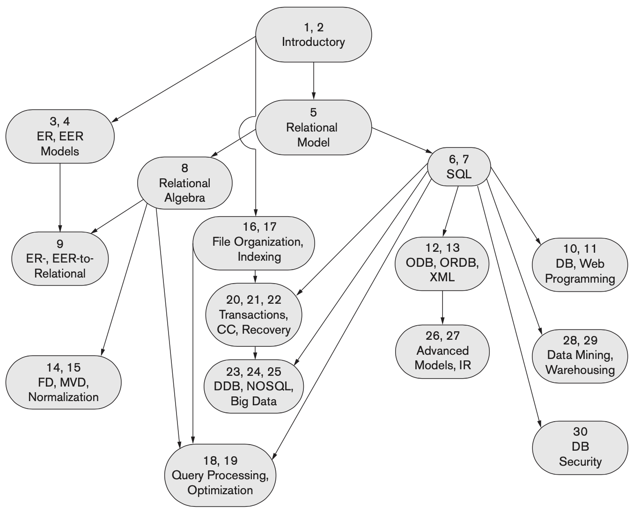
Notes:
TODO Highlight the chapters we will cover

Slide 5
Grading
Attendance, participation, professionalism: 10%
Homework / Programming assignments: 30%
Quizzes (~6): 30%
Final Project and Presentation: 30%
2 minute quizzes at start of class will count towards participation.

Slide 6
Who are you?
Introduce yourself to me and the class:
  Why are you taking this course?
  Full time student? Work?
  What programming/web experience do you have?
  Anything else?

Slide 7
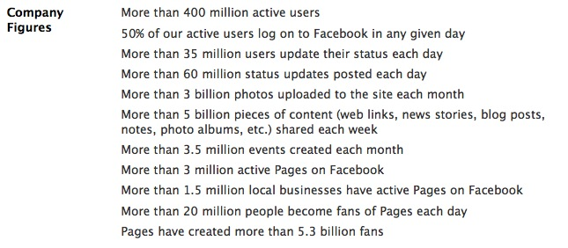

Facebook: Usage Statistics
  http://www.facebook.com/about#!/press/info.php?statistics
  March 2010
Notes:
These statistics are outdated. Now, Facebook has nearly 3 billion active users (monthly).

Slide 8
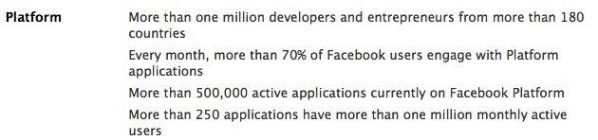
What is Facebook, anyway?
Core Applications
  Profile, friends, social network, inbox, photos, groups, events, …
Platform
  Enables developers to write their own Facebook applications.

Slide 9
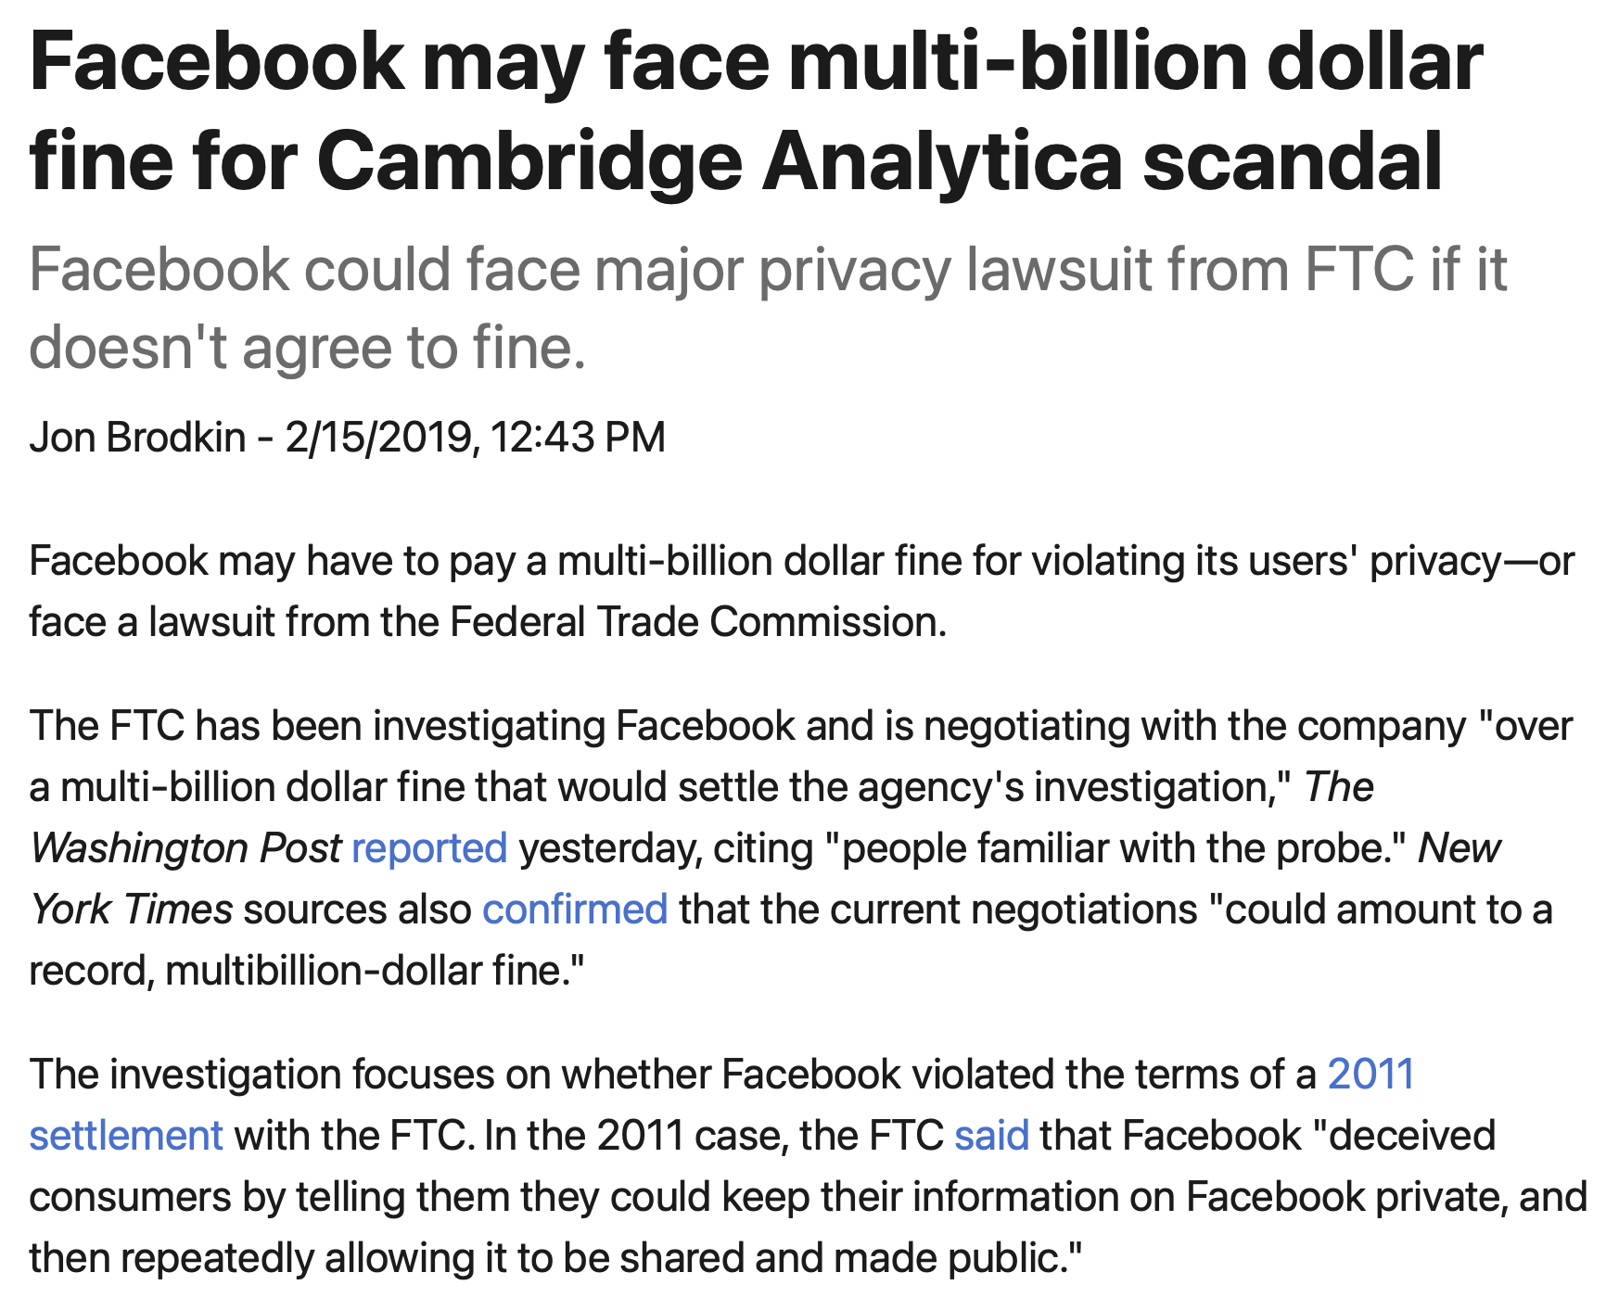
Notes:
An aside: that platform is got them into trouble in the Cambridge Analytica scandal. CA’s app integrated w/ Facebook, and collected data from friends of users.

Slide 10
How does Facebook generate your page?
Facebook is a data-driven application.
What kind of data?
  Profiles, Status, Friends, Groups, Friends, Events, Photos, etc.
All of this data is stored in a database.
What’s a database?

Slide 11
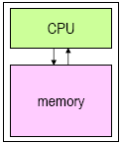
Storing Data: Memory
Memory is used to store programs and other data that are currently in use.
  LOAD, STOR operations
Advantage of memory: short access times
  Read/write times in nanoseconds (10⁻⁹ sec)
Disadvantages of memory:
  relatively expensive ($/byte)
  “volatile”
Notes:
Memory is used to store programs and other data that are currently in use.
Values stored in memory are read into the CPU to be operated on.
The results of operations performed by the CPU can be written back to memory.
Advantage of memory: short access times
can be read from or written to in times that are measured in nanoseconds (10⁻⁹ sec)
Disadvantages of memory:
relatively expensive
its contents are lost when the power is turned off!

Slide 12
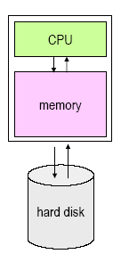
Storing Data: Secondary Storage
Secondary storage is used to store data for later use (examples: disks, CD, DVD).
  Data is written from memory to disk.
  When needed, data is read back into memory.

Slide 13
Secondary Storage
Advantages of secondary storage:
  relatively inexpensive ($/byte)
  not “volatile”
Disadvantage of secondary storage: long access times
  Read times in milliseconds (10⁻³ sec).
  in 10 ms, a modern CPU can perform millions of operations!
Thus, it's important to minimize the number of times that the disk is accessed.

Slide 14
Example: Facebook Profile
What info is on a Facebook profile page?
No matter which page you view, it has these same elements…
These data are stored in a database table.
First Name
Last Name
Email
Password
Birthday
About me
Activities
Favorite Books
Favorite Movies
Favorite Music
Favorite Quotes
Favorite TV shows

Slide 15
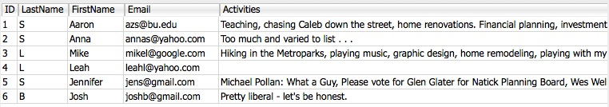
What’s a Table?
Each table (sub-collection) is a collection of records, and each record contains fields. Example: a profiles table
The primary key is a field which uniquely identifies one record within a table.
Consider this URL:
http://www.facebook.com/profile.php?id=125490994

Slide 16
Primary Key
The Primary Key:
  uniquely identifies a record within a table
  is an ideal search key
  is a way to create relationships between different tables
Consider this URL again... http://www.facebook.com/profile.php?id=125490994

Slide 17

Example: Status Updates
Not all data fits neatly into the profile table. Consider status updates…
A separate Status table tracks all status updates for all users.
What fields does it need?
  timestamp, userid, status

Slide 18
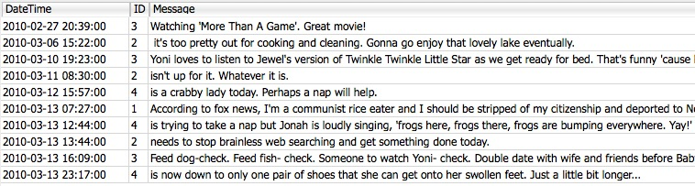
Example: Status Table
Each status message is related to exactly one profile by the foreign key (the field called ‘id’).
These ids are called a foreign key, because they are primary keys in another table.

Slide 19

Example: Friends
The Facebook “friend” relationship is created by an entry in a friend table.
Each record has two user ids:
These ids are called a foreign keys, because they are primary keys in another table.

Slide 20
Databases
A database is:
  a collection of data stored in a way to enable quick access
  organized into related sub-collections called tables.
Example: a mini facebook database:
    A profiles table has records of each user
    A status table has records of status messages
    A friends table has records friend relationships
Each table (sub-collection) is organized by records, and each record contains fields.

Slide 21
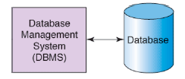
Database Management Systems
A database is a collection of data (not software).
A database management system (DBMS) is the software which manages a database.
Functions of a DBMS:
  Efficient storage and access
  Providing a logical view of data (tables, records)
  Query processing
  Transaction management

Slide 22
Function: Efficient Storage and Access
Indexing enables efficiently locating a record based on some unique attribute, called a key.
  Example: looking up stocks by their symbol.
  Example: update the record for symbol=‘FB’
A hash index can make these operations O(n)
A b-tree index can make these operations O(log n)
Notes:
DBMS organize data to make finding it efficient. Indexing makes it possible to find a record based on some unique attribute, called a key.
Example: looking up stocks by their symbol.
DBMS allows the user to interact with a logical representation of the data, without needing to know the details of the physical storage on disk.
Example: update the record for symbol=‘FB’.

Slide 23
Function: Logical View
Abstraction – Representing the data as tables and rows, so programmers (usually) don’t need to think about how the data is physically stored on disk (e.g., in which files?)
Notes:
DBMS organize data to make finding it efficient. Indexing makes it possible to find a record based on some unique attribute, called a key.
Example: looking up stocks by their symbol.
DBMS allows the user to interact with a logical representation of the data, without needing to know the details of the physical storage on disk.
Example: update the record for symbol=‘FB’.

Slide 24
Function: Query Processing
A query language is used to access and modify the data.
SQL (Structured Query Language) is the standard for relational databases.
Many different database vendors support SQL:
  Oracle, Sybase, IBM DB2, MS SQL Server, MS Access
  PostgreSQL, MySQL, SQLite (free/open-source)

Slide 25
Function: Transaction Management
“ACID” properties:
  Atomicity
    All of a transaction must be completed, or none of it
  Consistency (Correctness)
    Don’t allow the database to enter a corrupted state
  Isolation
    Concurrently executed transactions must have the same effects as sequentially executed transactions (since databases usually have multiple users)
  Durability
    After a transaction completes, it should persist even if the power fails, etc.

Slide 26
What is a Database System?
Database:
A very large collection of related data
Models a real world enterprise:
  Entities (e.g., teams, games / students, courses)
  Relationships (e.g., The Celtics are playing in the Final!)
  Even active components (e.g. “business logic”)
DBMS: A software package/system that can be used to store, manage and retrieve data form databases
Database System: DBMS+data (+ applications)

Slide 27
Why Study Databases?
Shift from computation to information
  Always true for corporate computing
  More and more true in the scientific world
  and of course, Web
  New trend: social media generate ever increasing amount of data
DBMS encompasses much of CS in a practical discipline
  OS, languages, theory, AI, logic

Slide 28
Advanced Topics
Data Analytics is an important domain
  Given large amount of data in the database, how can you use them to help you take business decisions?
Cluster based data analytics:
  Map-Reduce, shared nothing DBs
Main memory databases (NVRAM)
Notes:
Removed: OLAP and Data Cube

Slide 29
Outline
Application-oriented
  How to develop database applications: User + DBA
  For learning, we will do things the hard way (i.e., using lightweight frameworks). In the real world, I recommend a featureful framework like Django, but doing things the hard way will show the value of more featureful frameworks.
System-oriented
  Learn the internals of a relational DBMS

